Slide 1

My future profession-Interpreter

Slide 2

I would like to be an interpreter in future.
At the present time it is very popular profession in the world because it gives the opportunity to meet a lot of people from different countries and to be well-to-do that is important.
It is not easy to be a good interpreter. You have to know not only Phonetics and Grammar rules. You have to know the culture perfectly because you will not only translate or interpret speech. Sometimes you will help people to communicate by giving advice how to behave in certain cases.
You have to read a lot of English books in origin to make phrases right and to be able to translate jokes, something specific and so on. Also you have to be creative, imaginative, communicative, understand human psychology.

Slide 3

Interpreter
An interpreter is a person who converts a thought or expression in a source language into an expression with a comparable meaning in a target language either simultaneously in "real time" or consecutively after one party has finished speaking. The interpreter's function is to convey every semantic element (tone and register) and every intention and feeling of the message that the soue-language speaker is directing to target-language recipients.

Slide 4
There are two ways of interpreting known as consecutive and simultaneous.
Simultaneous interpreting involves interpreting in 'real time'. Many would have seen an interpreter sitting in a booth wearing a pair of headphones and speaking into a microphone at a conference or large diplomatic meeting such as the EU or UN. A simultaneous interpreter has the unenviable task of quickly digesting what one person is saying before immediately translating it to others. One of the key skills simultaneous interpreters must demonstrate is decisiveness. They must think quickly and on their feet.
Consecutive interpreting is carried out in face to face meetings, speeches or court cases. A speaker will usually stop at regular junctures, say every few sentences, and have the interpreter translate, before proceeding. A key skill involved in consecutive interpreting is the ability to remember what has been said.

Slide 5
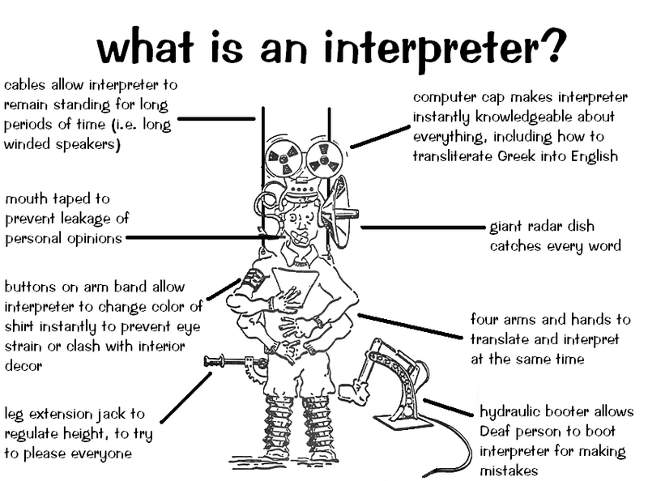

Slide 6
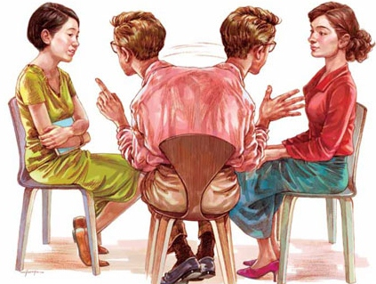
Pros and Cons of the profession
Pros
The possibility of self-realization in all areas : translation, interpreter , interpreting and consecutive interpreting , translating movies, books , magazines ;
A person who holds a foreign language , willing to take in journalism , travel agencies , pr- company management;
Is able to communicate with different people and learn cultures of other countries;
From professional translators often depends on a favorable outcome of negotiations.
Work can be found in various types of settings (schools, hospitals, conferences, and courtrooms)
Excellent job growth predicted (42% from 2010 to 2020)
Cons
Unstable loading in different months , the amount of translation varies several times ;
Fees often are not in fact putting the material, and when it comes to payment from the customer;
Sometimes such professionals are like people of second-class : interpreters accompanying delegation of shops and bars , and sometimes perform courier assignment.
Irregular and long hours may be common for freelancers.
Interpreting can be stressful at times

Slide 7

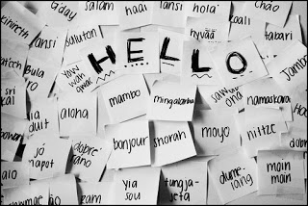
Place of work:
travel agencies
bureaus
international companies and organizations
hotels and restaurants
presentations, negotiations, business meetings
museums and galleries
exhibitions, educational institutions

Slide 8
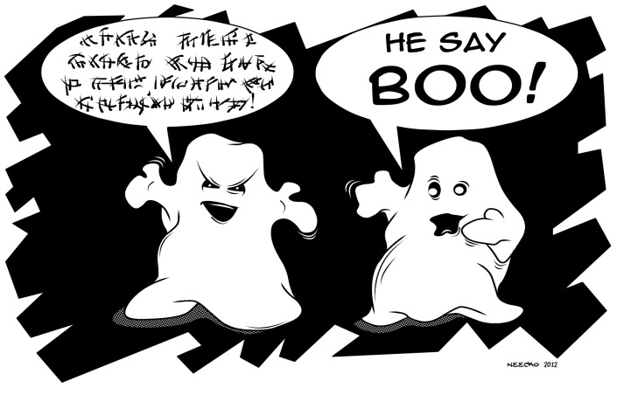

The dominant activities:
Organizing and conducting tours of cultural and historical places for foreigners;
Support for foreign students during their visits to the country ;
Assist in the placement and residence of foreign nationals ;
Translation of presentations , meetings, negotiations
Providing written translations ( specialized scientific, technical, artistic, journalistic literature) ;
Support groups for trips abroad;
Translation of foreign television and radio programs, motion pictures ;
Teaching activities .

Slide 9

Professional qualities:
Strong analytical thinking , flexible thinking processes ;
good long term structured memory , memory for auditory images ;
concentration and attention span ;
advanced verbal reasoning;
communication and organizational skills, ability to hear and to listen ;
verbal ability , well put it , a rich vocabulary ;
a high level of distribution of attention ;
emotional stability, patience, diligence , punctuality , curiosity investigator;
physical and mental endurance.

Slide 10

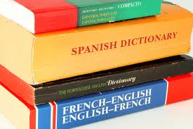


Slide 11
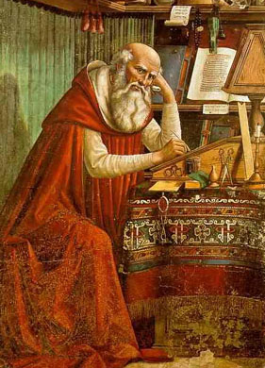
Quote of the translation
Non verbum e verbo, sed sensum exprimere de sensu.
St. Jerome

