Slide 1
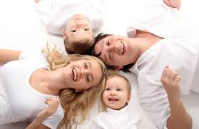
My happy family

Slide 2
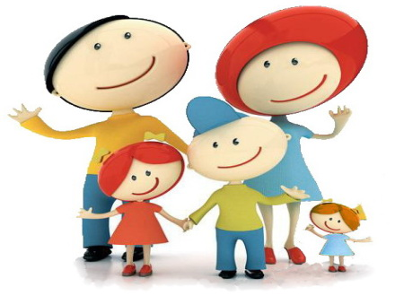
Заголовок слайда
Everyone wants to grow well children. what do you need to do for this? here are some rules that are executed in my family:
Текст слайда
Child begin to require clever or "include fool." Such behavior is annoying parents and conflict begins, entailing punishment of a child. In fact, children do not have enough attention from his parents, and therefore their love. And such an extreme way they get attention.
Such behavior of the child, parents need to show our love somehow informally.
Obstinate child and any price he wants to get his win , to convince , to prove who is the boss . This elemental power struggle . Parents easily get involved in this fight , because it is a joyous process , nice goal - to prove that you're in the family chief . For this fight child hides its lack of significance. The strategy of an adult in this situation - to realize that the essence of the conflict between two people fighting for power, take time out and switch to something else , and then carry on with the child peace talks . A further show the child its significance in your family to him and you do not have to fight over trifles . Learn and understand their children in a crisis situation to understand the true motives of their child. Behave correctly , achieving positive results in educating children without punishment.

Slide 3
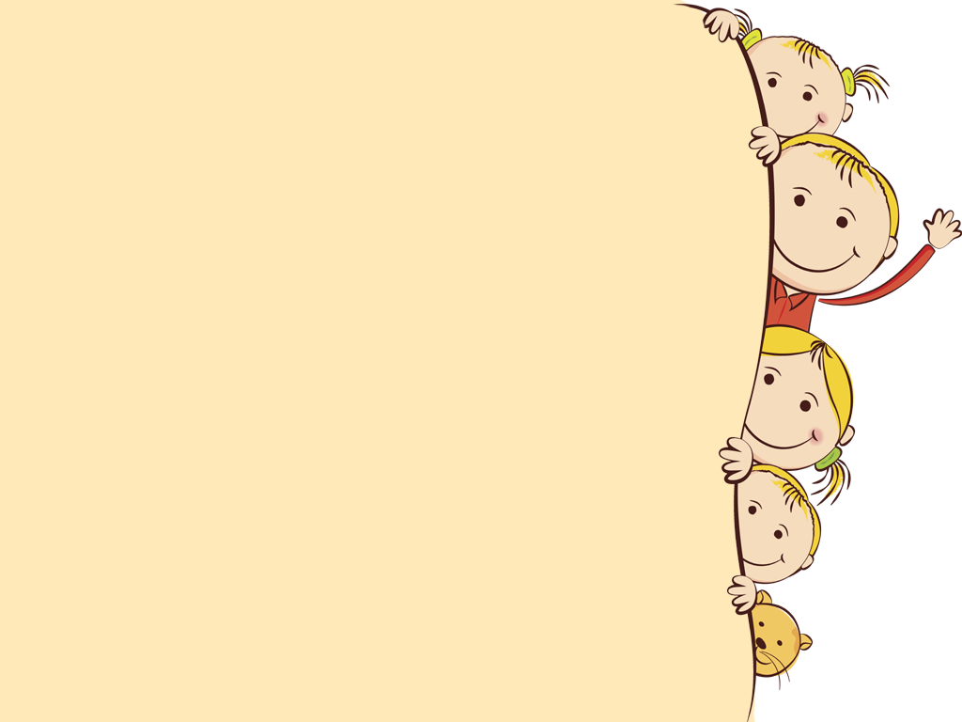
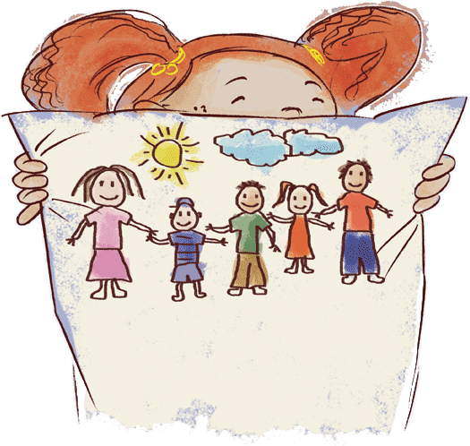
The family is one of nature's masterpieces.
A baby is God's opinion that the world should go on.
Other things may change us, but we start and end with family.

Slide 4
Our family is not large. We are a family of 3: my father, my mother and I.My name is Viktoriya. I am seventeen. I am a school leaver. Our family is very united. We like to spend time together. In the evenings we watch TV, read books and newspapers, listen to music or just talk about the events of the day. Our parents don’t always agree with what we say, but they listen to our opinion.
Our family is very united, close-knit and happy. I spend a lot of time with my family. We go for a walk together, visit friends and relatives, watch films or just talk. I love my family very much.

