Slide 1
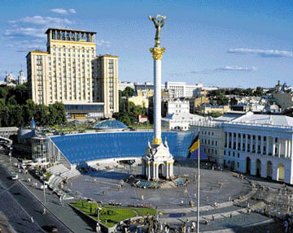
The traditions of Ukrainians
Student made ​​7-a-class
Pysarenko Yulia
Shebalkova Elizabeth
Oleinikova Helena

Slide 2
The traditions and customs of Ukrainians
The whole life of Ukrainians, as humdrum and festive, imbued vault interesting customs that have passed through the centuries. Ukrainian youth are generally happy to take over this tradition, maintaining the spiritual continuity with their ancestors. In this case, all customs is heavily intertwining pagan and Christian beliefs, which adds colorful ceremonies.
Guests of the country often have a unique opportunity to plunge into the world of the Ukrainian culture, participated in the celebration of Christmas, Oil, Easter or Midsummer, admire the mysterious wedding ceremony, listen to Christmas carols and gaivki, taste delicious ritual food such as kutya, Pasco, and even to join the exciting process of coloring Easter eggs.

Slide 3
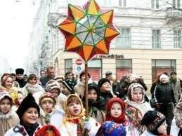
Ukrainian holidays:
Christmas
New Year
Easter
green day
Harvest
Day Saint. Nicholas
On some of which we will now tell

Slide 4
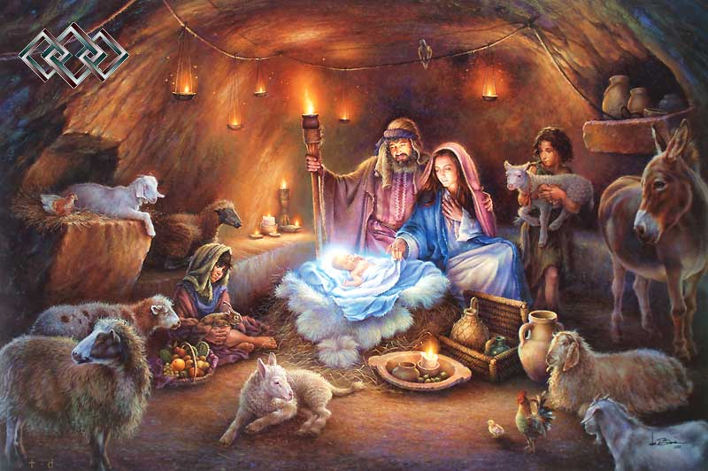
Christmas
During the Christmas holidays in Ukraine popular tradition of caroling, when children go from house to house singing Christmas songs and the owners want peace and prosperity, "sowing" floor grains of wheat or barley, which is home to the well-being and happiness. In gratitude to the hosts endows children sweets and coins, which bring good luck for the whole year. On Christmas Eve (Holy Night) in the run up to Christmas is strictly adhered to tradition filing sing Christmas songs, remember all the good things that were in the past year, and wish each other happiness Health.

Slide 5
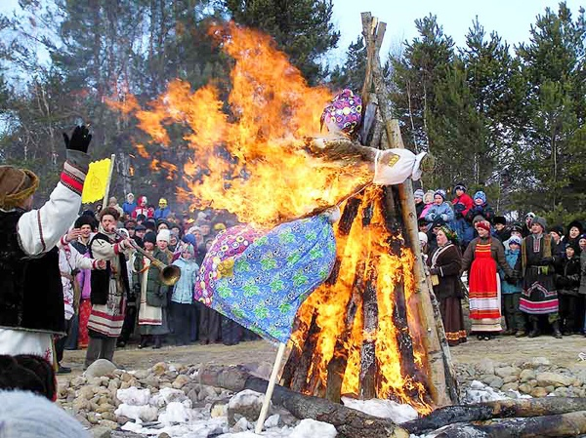
Carnival
Week preceding Lent coincided with a pagan holiday to winter and welcome spring, so the celebration of Carnival is always distinguished by a special joy because, seven weeks ahead of the severe food restrictions, thoughts and actions. Pancakes, an indispensable attribute of Maslenitsa had ritual significance: round, ruddy, hot - they are a symbol of the sun, which is brighter flares, lengthening days. In addition, in this day to apologize to all the relatives and neighbors, to be cleansed of all bad thoughts.

Slide 6
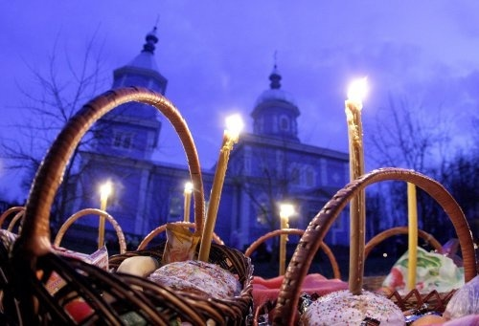
Easter
Easter - the main Orthodox holiday. On this day the souls of believers crowded bright joy, and this contributes to nature, which threw off the shackles of winter sleep and in harmony with the universal joy greeted the resurrection of Christ. On the night of Easter is not taken to bed the night before everyone goes to church for vespers service. The beautiful baskets are a variety of dishes for the consecration, but returned and begin to break the fast. Whatever the culinary diversity of the table, to start a dinner party with the Easter bread Pasco. On this day, every Orthodox Christian welcomes other words, "Christ is risen!" And receives in return a confirmation of the words "He is risen indeed!".

Slide 7
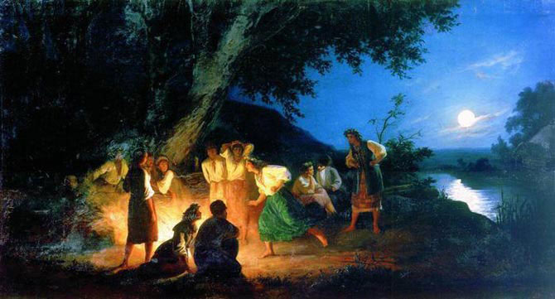
Ivana Kupala
Ancient Slavic holiday of Ivan Kupala in honor of the sun to celebrate midsummer sun standing. It is filled with rituals associated with water, fire and herbs. On this day daredevils jump over the fire, and at midnight looking fern flower to get the ability to see the future and find untold riches. Bereguinyas kind family and hearth weave wreaths. Single girls let their wreaths on the water: What side will beat it - there she married and go

Slide 8
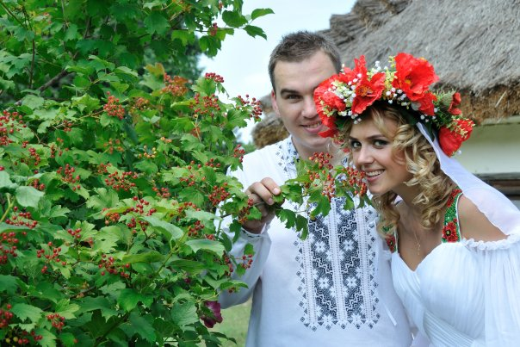
Wedding traditions
Family for the Ukrainians is very important, which is why wedding traditions, wedding and christening ceremonies are observed with great care. Wedding ceremony begins with the ritual Brokage bridegroom sending in elders, respected the elderly, who are asking the bride's hands. If you accept a girl makes an embroidered towel, and "Garbuz" - in case of failure. A few days before the wedding ritual baked traditional bread - a loaf. On the day of the wedding the young leaves for the young, where in the yard with his demand ransom. After the church wedding ceremony, to celebrate, as usual, go to the house of the young, and after the dinner party young unwinds her hair and tied a scarf as a sign that she was a married woman. Carnivals, games and songs, often going the next day.

Slide 9
Traditional symbols of Ukraine: the plants and animals
To plant symbols of Ukraine are viburnum, willow, oak, poplar, periwinkle, marigold. They represent a long time the beauty of Ukraine, the spiritual strength of the people, love to certify the home land.
On the national symbols composed many legends of sing the songs. They are used in rituals, customs, embroidered on their shirts, towels. People's characters - is our sanctuary.

Slide 10
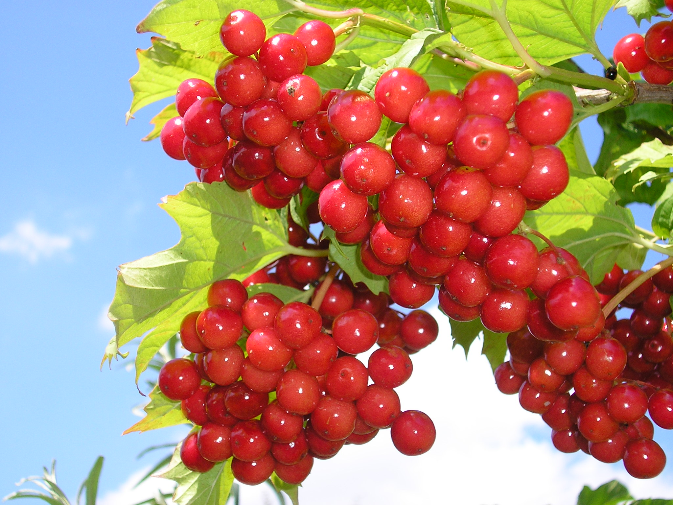

Slide 11
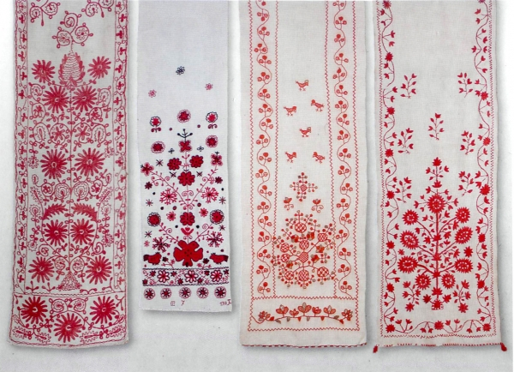
Ukrainian characters also have: a towel.

Slide 12
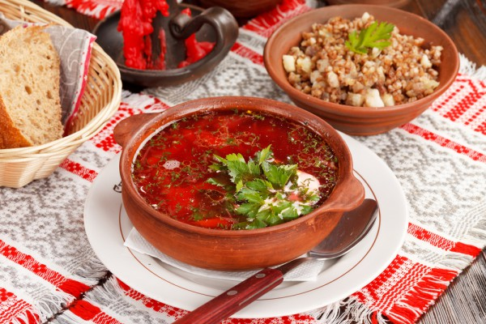
Ukraine has formed its own kitchen with original dissimilar to the neighborhood, a variety of dishes, drinks and their unique ways of cooking. Table are based on Ukrainian borsch, potatoes, dumplings and porridge. These meals are balanced and are very rich in minerals.

Slide 13
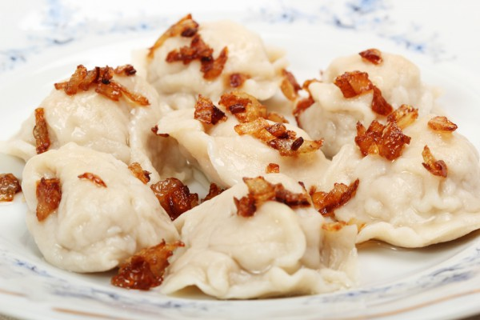
Vareniki
Traditional Ukrainian dish which sang in his works himself Nikolai Gogol. Many Slavic peoples assign dumplings recipe itself.
Many housewives can boast its own recipe for preparing this dish. Although no real difficulty in the recipe no.

Slide 14
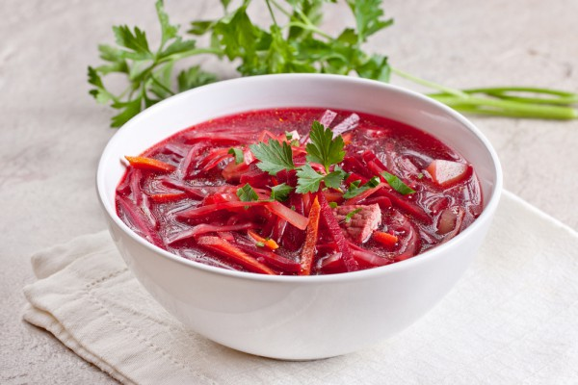
Ukrainian borsch
In our latitudes, he appeared in pre-Christian times, so this dish is considered the birthplace of the Ukrainian land. Thanks ethnographers, who managed to find a written memo, the first known mention of borscht,. Many Ukrainian and international linguists believe that the name of this dish comes from the plant borschovnik, sheet plant used in place of cabbage borscht.

Slide 15
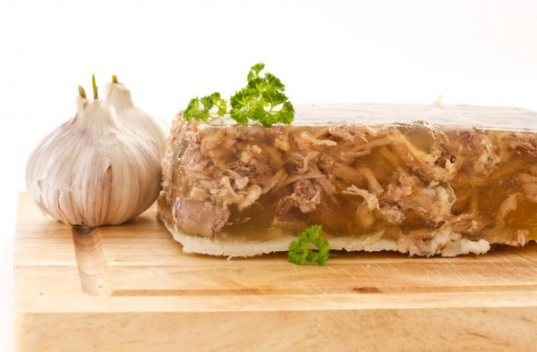
Holodets
It is a popular antique dish, without which no cost, no feast. Preparation correct brawn - not an easy task. And if simple housewife preparing a dish of meat residues, in the homes of aristocrats over brawn preparation worked any hour, lightening the stock and making aspic look more attractive. In Ukraine, jelly made ​​from pork and beef feet or lower legs. To the table brawn always served with horseradish or mustard.

Slide 16
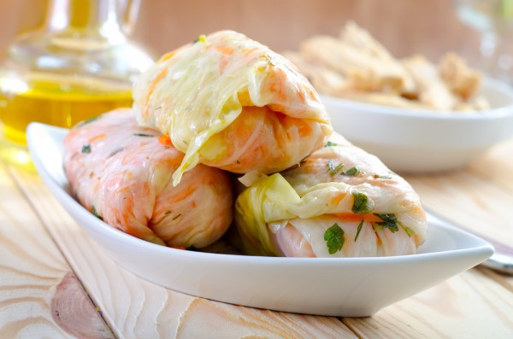
Cabbage rolls
This dish of Middle Eastern and European cuisine is very fond of Ukrainians. The hit they have a dish of grilled pigeon slightly conjured chefs and got another no less tasty dish - cabbage leaves stuffed with minced meat that is stuffed.

Slide 17
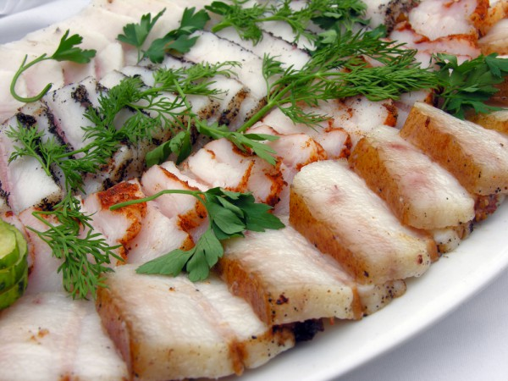
Lard
Ukrainian lard - a real delicacy for many foreign visitors. It is used as food in several forms: fresh, salted, stewed, boiled, smoked or fried. If the fat layer of meat, there are numerous - it salted lard - known to all the bacon and fried without fat in a frying pan - greaves, it is difficult even to imagine Ukrainian dinner.

Slide 18
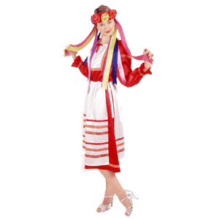
Ukrainians

