Slide 1
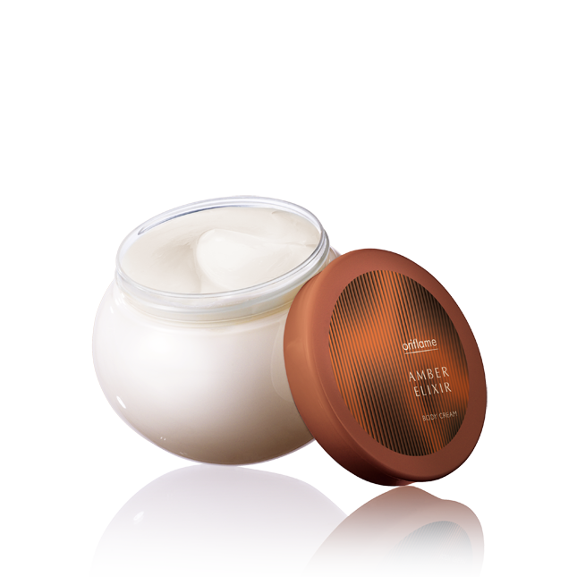
Крем

Slide 2
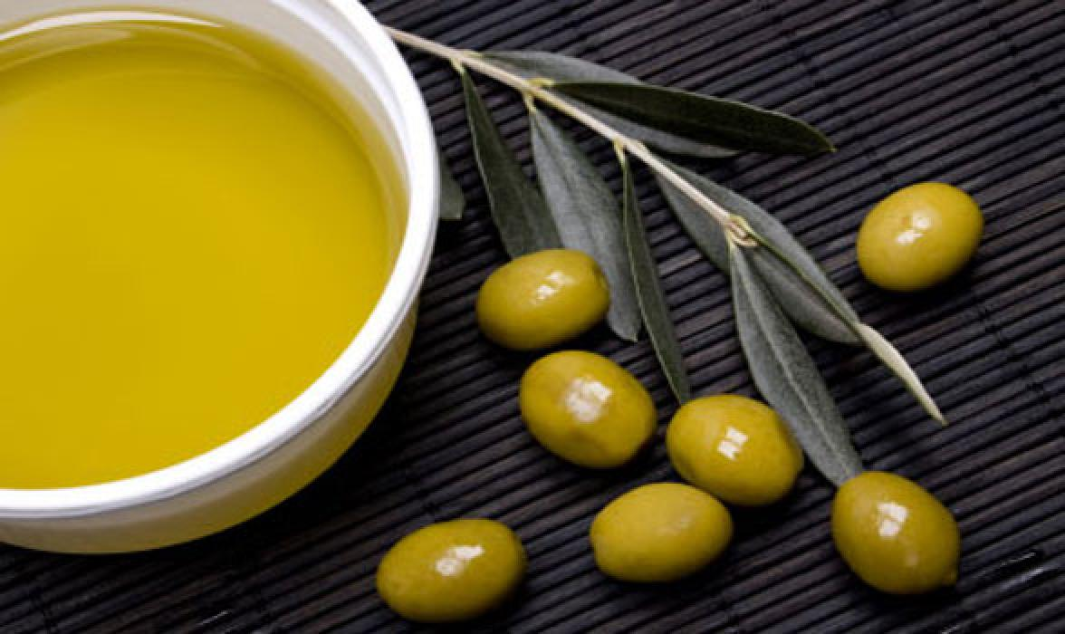
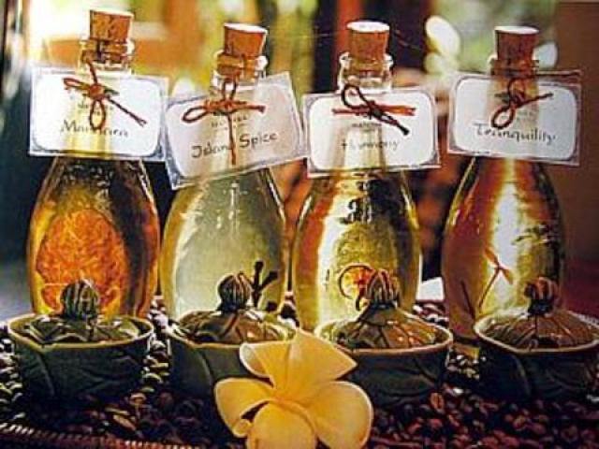
История

Slide 3
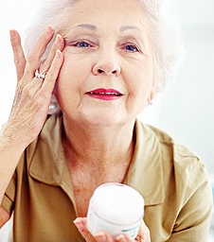
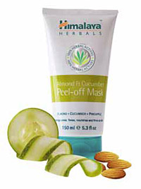
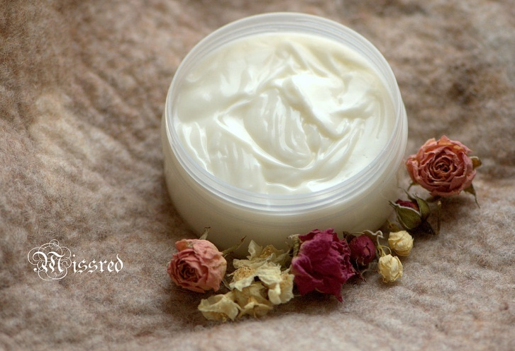
Виды кремов

Slide 4
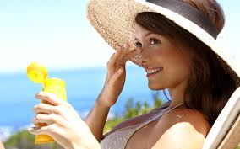
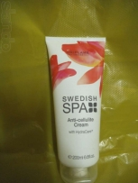
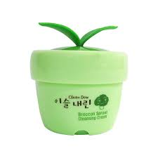
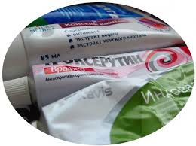
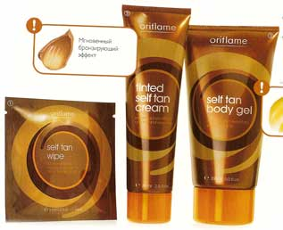
ВИДЫ КРЕМОВ

Slide 5
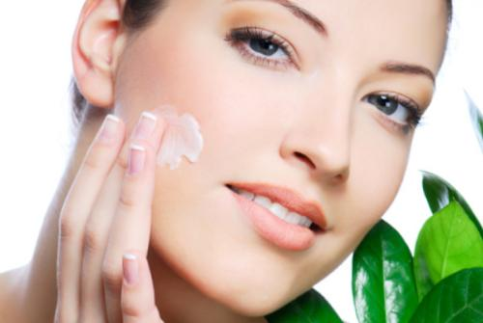
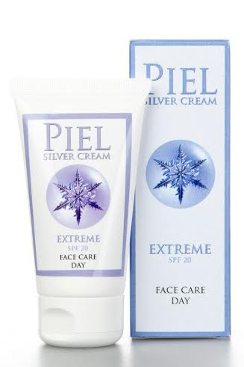
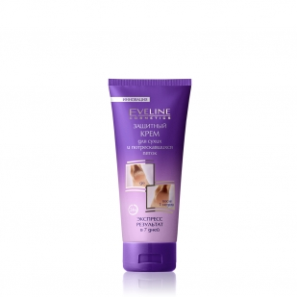
Защитный крем

Slide 6
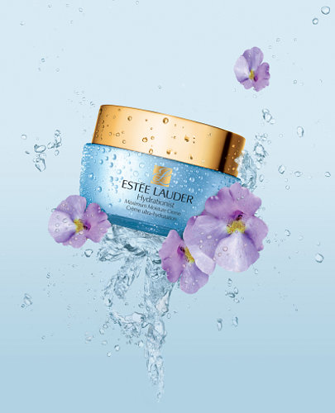
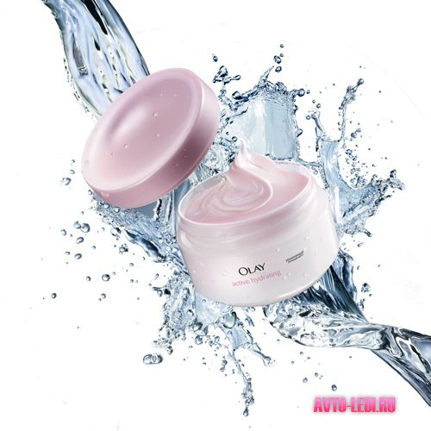
Отличие от традиционных увлажняющих кремов

Slide 7
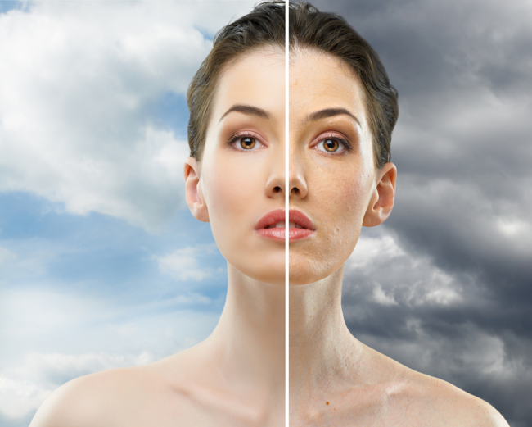
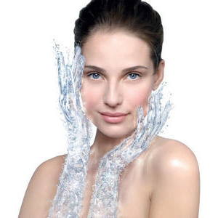
Увлажнение и лечение сухой кожи

Slide 8
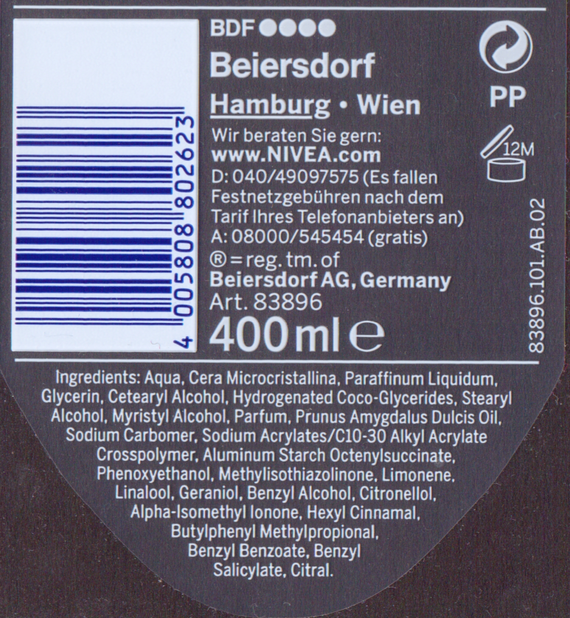
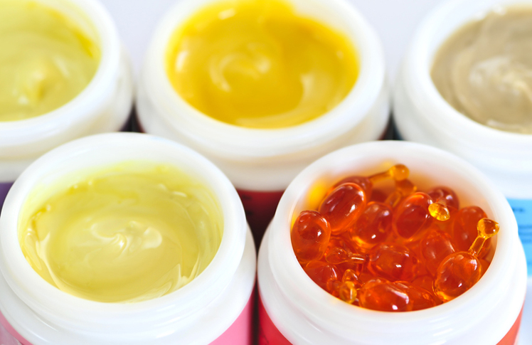
Фактор безопасности косметики

Slide 9
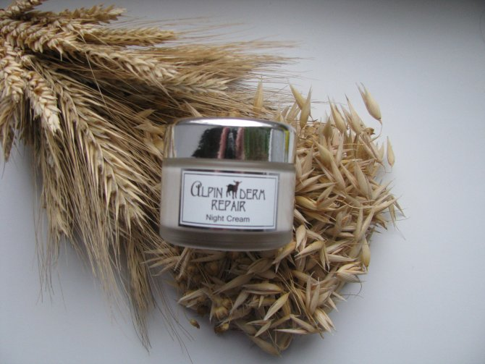
Крем от STYX
Состав(INCI): Aqua (Water), Caprae Butyrum (Goat Butter), Glycerin, Isopropyl Myristate, Cetearyl Glucoside, Cetearyl Alcohol, MAcadamia Ternifolia Seed (MAcadamia Nut) Oil, Calendula Officinalis (Marigold Flower) Oil, Stearyl Alcohol, Benzyl Alcohol, Aloe Barbadensis (Aloe Vera Extract) Leaf Juice, Simmondsia Chinensis (Jojoba) Oil, Tocopheryl Acetate (Vitamin E), Chamomilla Recutita (Camomile) Extract, Calendula Officinalis (Marigold Flower) Extract, Achillea Millefolium (Yarrow) Extract, Gentiana Lutea (Gentian) Extract, Melilotus Officinalis (Melilot) Extract, Gramineae (Grass-Hay Flower) Extract, Parfum, Dehydroacetic Acid, Butylphenyl Methylpropional, Potassium Sorbate, Sodium Benzoate, Limonene

