Slide 1
The most successful partnership
in the world

Slide 2
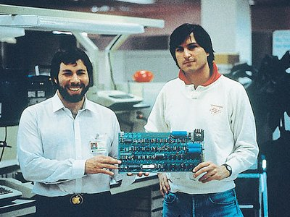
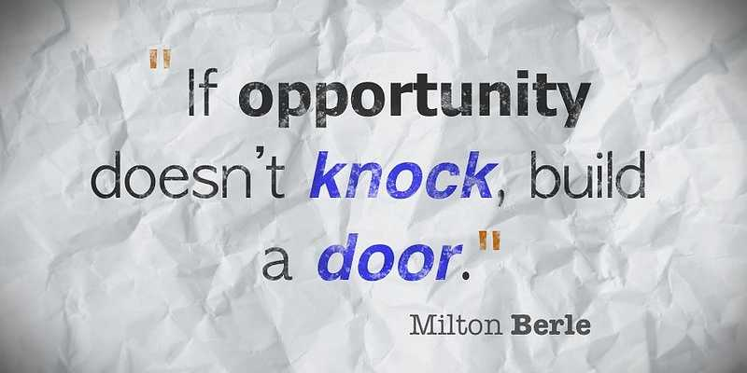

Usually, all well-known companies such as twitter and eBay were built by multiple leaders with productive relationships. Not surprisingly, many partners were long-time friends, classmates, or relatives. Some partners do not get along at all. I always thinking how two or three people can work together because partners sometimes argue about something and it can «kill» business.
But I think the most important thing in a partnership one goal in life, not a relationship

Slide 3

Pierre Omidyar and Jeffrey Skoll
Company: eBay
Year Founded: 1995
How their partnership was formed: Skoll and Omidyar were casual acquaintances when Omidyar built the code for eBay.
They share common democratic values and a common goal which is why theirs Partnership working

Slide 4
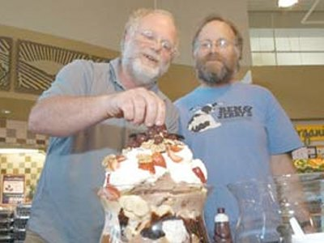
Ben Cohen and Jerry Greenfield
Company: Ben & Jerry's
Year Founded: 1978
How their partnership was formed: Ben Cohen and Jerry Greenfield were childhood friends. They met during high school gym class in 1963 and quickly became inseparable.
Ben and Jerry were able to turn their friendship into a successful business thanks to a joint passion for food and a desire to do more than just profit.

Slide 5
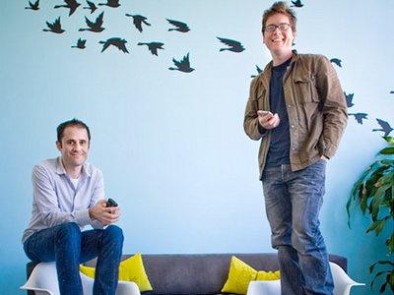
Evan Williams and Biz Stone
Company: Twitter
Year Founded: 2006
How their partnership was formed: They met at work. Williams hired Biz Stone to new work.
They have worked very hard in blogs and have common interests.

Slide 6

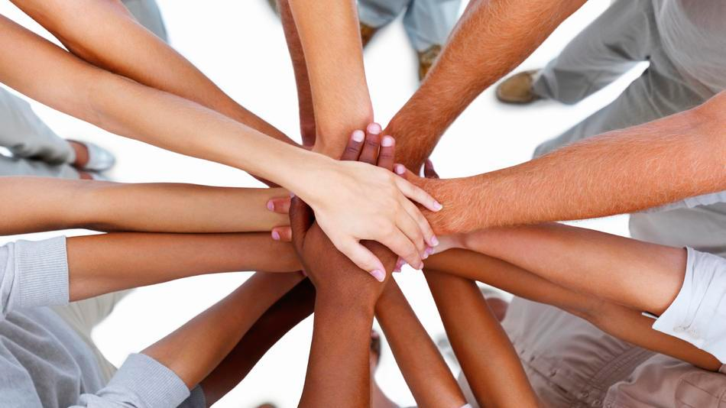
Two heads are better than one
I think partners should have a new idea, a common goal and will work hard then the world will see new sites, firms, achievements and etc.
Made by Bonk Veronika 11-A

