Slide 1
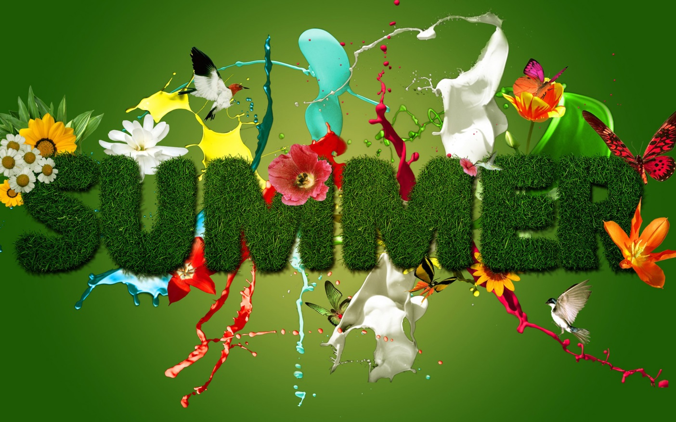
Summer holiday
Prepare
pupil 8 class
Pavlukovska Oksana

Slide 2
Let me start with summer holidays. Pupils have summer holidays that are three months long. Children don't have to get up early. There is no homework to do and lessons to learn. That's why they like summer holidays.

Slide 3
My summer holiday
I like summer holidays because I have a lot of free time. In summer my friends and I often go swimming and boating there. There is a lot of fish in the lake, so I sometimes go fishing. When it is very hot I usually go to the forest. The air is cool there. I like to walk in the shade1 of trees and pick mushrooms and berries. I like to go to the beach2 in the morning when it is not too hot. I swim, sunbathe, and play with my friends on the bank of the river. I always help my grandmother to work in the kitchen garden or to look after chickens.

Slide 4
10 cause why I love summer holiday

Slide 5
1. Warm weather

Slide 6
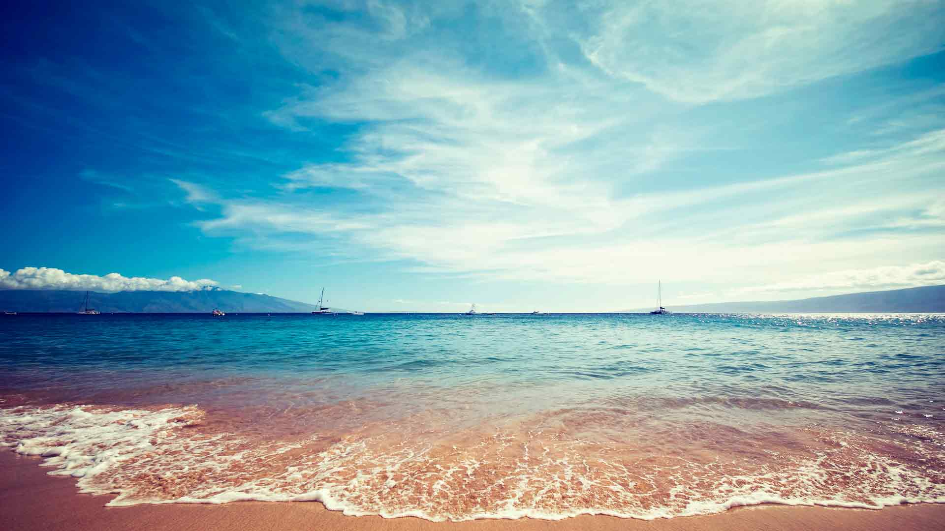
2. Bathing season

Slide 7
3. Holiday Ivana Kupayla

Slide 8
4. Transparent river

Slide 9
5. Fair sun

Slide 10
6. Walk forest

Slide 11
7. Endless sky

Slide 12
8. Short and mild night

Slide 13
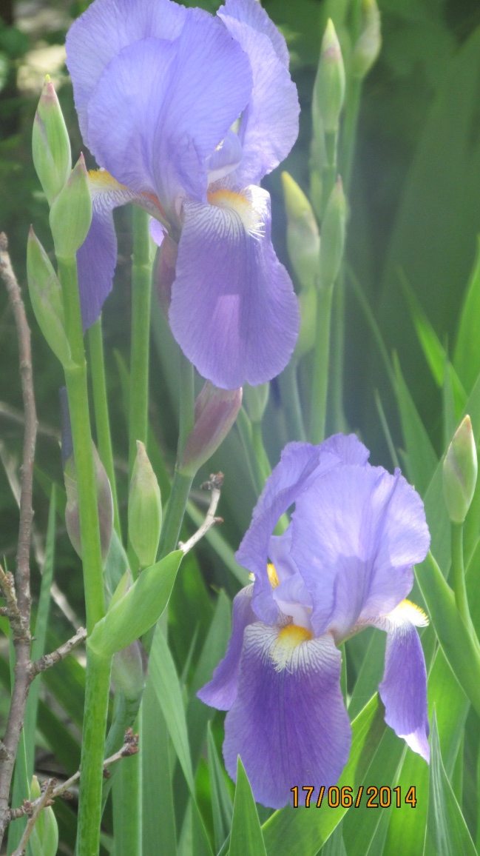
9. Beautiful flowers

Slide 14
10. Gathering berry

Slide 15
But unfortunately time flies quickly on holidays and soon it's time to go to school again.

Slide 16
The end

