Slide 1
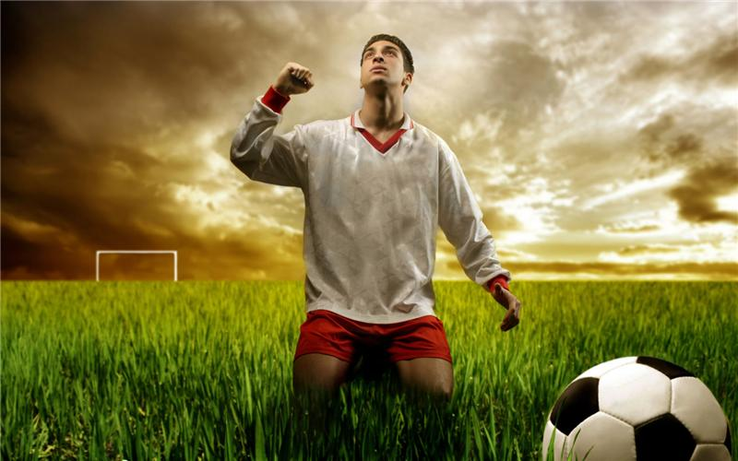
Football

Slide 2
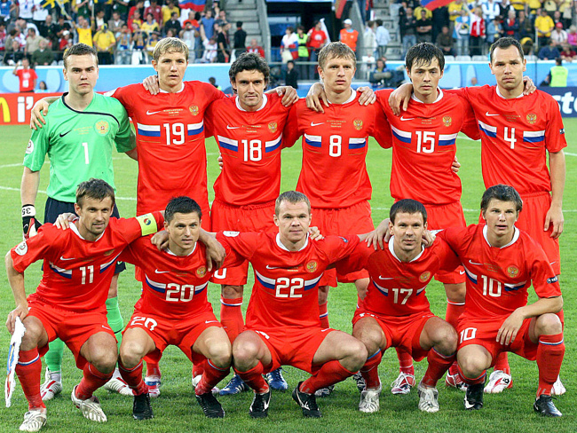
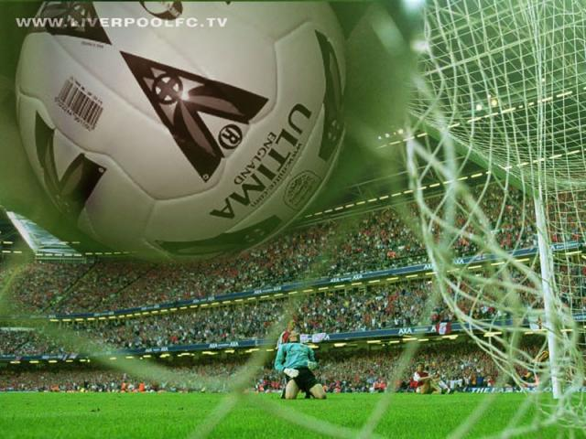
Football is an outdoor game for two teams of eleven players

Slide 3
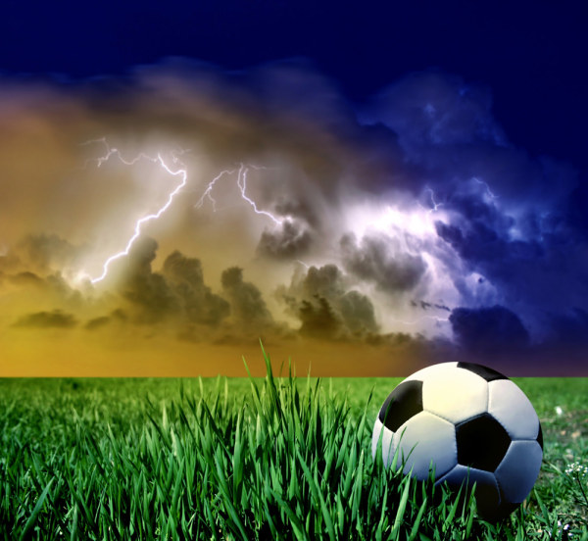
.
But the goalkeeper is the only person who can touch the ball with his hands. The other players can only kick or roll the ball. The winner is the team with most goals at end of the game.

Slide 4
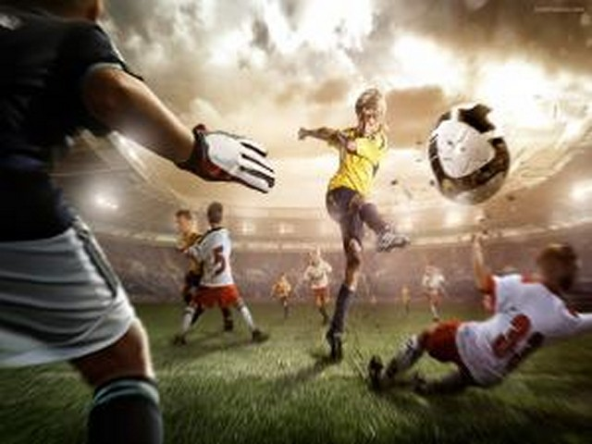
Football is spread all over the world.

Slide 5
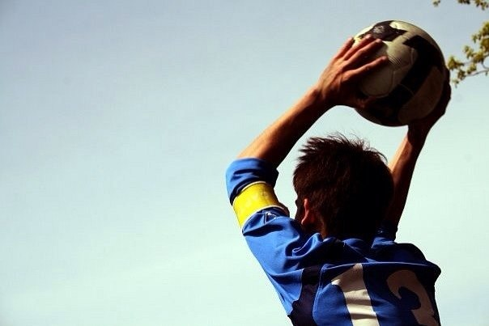
There are several national football teams in Britain, which compete with each other every year.

Slide 6


The two best teams play in the cup final at wembley stadium in London. It is the most important football match of the year.

Slide 7
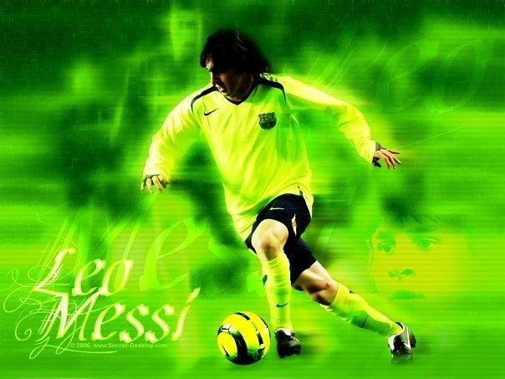
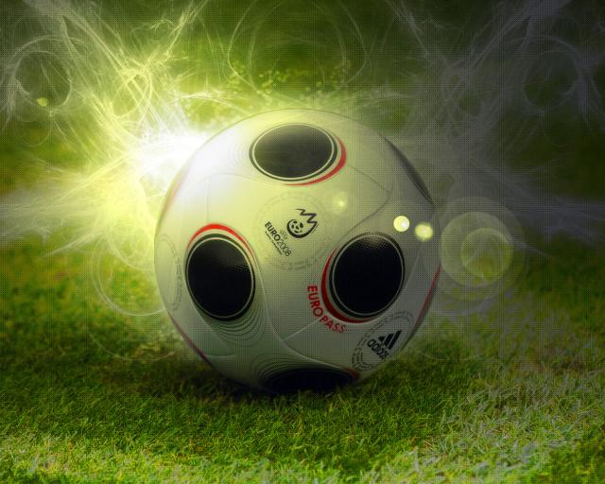
National football teams take part in European competitions and other international matches.

Slide 8
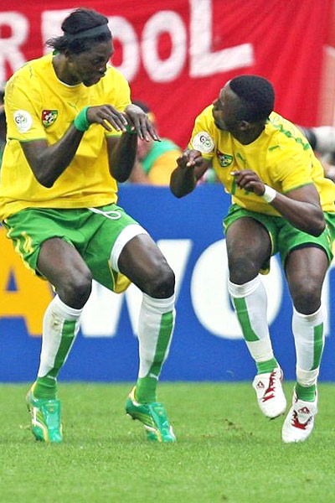
The end

