Slide 1
Fast food
Mikheyeva Nastya
11-P
2013

Slide 2
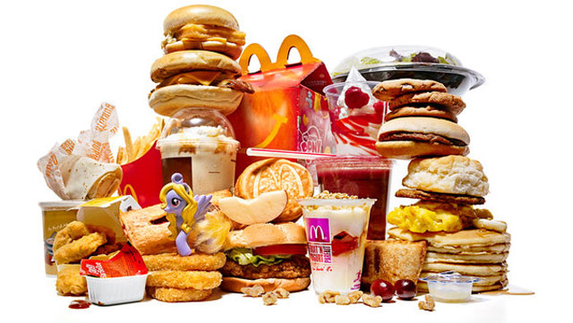
First popularized in the 1950s in the United States
Fast food is the term given to food that can be prepared and served very quickly

Slide 3
The Pros

Slide 4
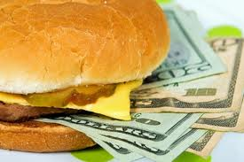

pretty cheap

Slide 5
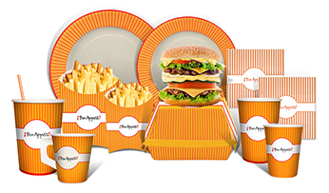
ready to go

Slide 6
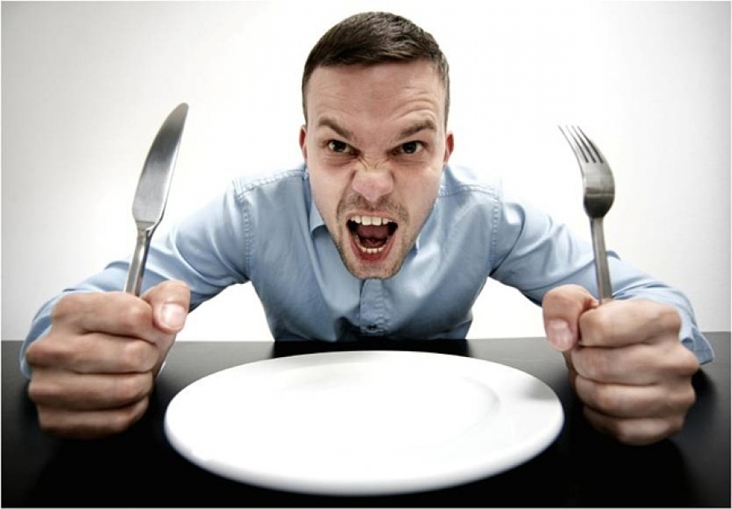
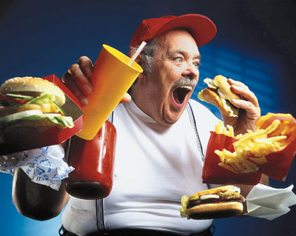
perfect for when you are really hungry

Slide 7
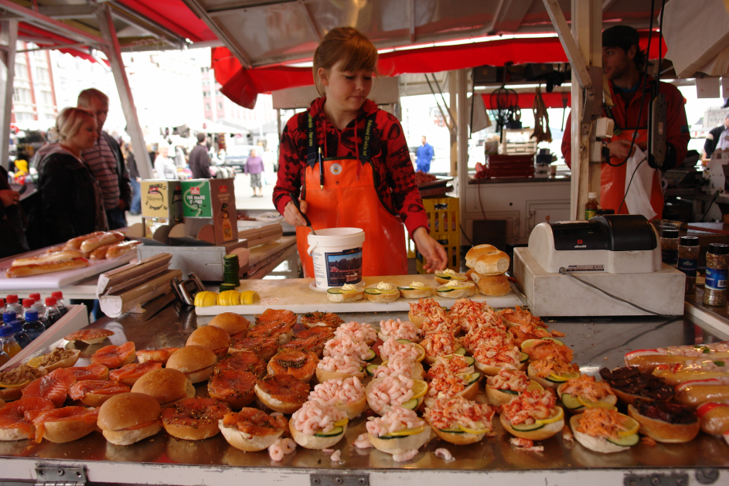
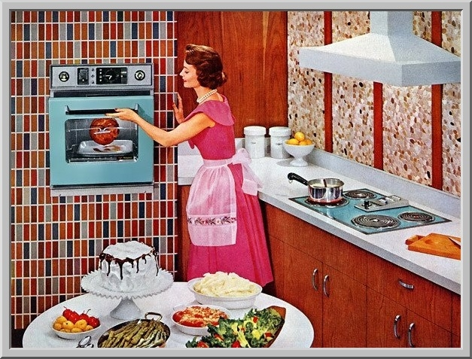
an easy solution for those who don't feel like cooking or preparing a home made meal

Slide 8

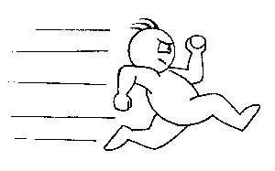
you don't have to wait

Slide 9
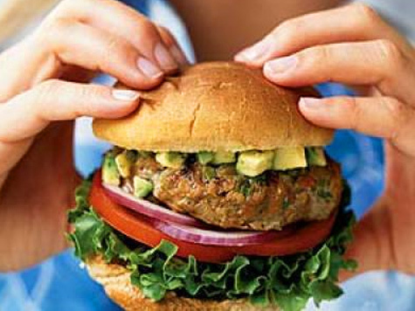
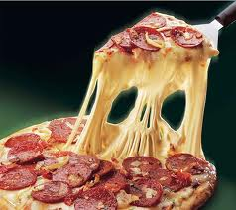
a very tasty food

Slide 10
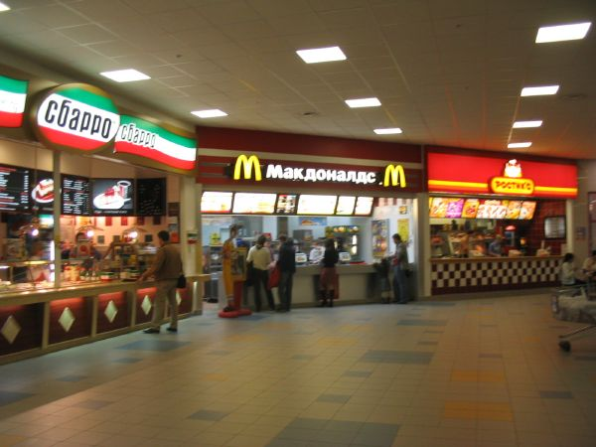

it's almost impossible not to find a fast food restaurant in your way to work or to school

Slide 11
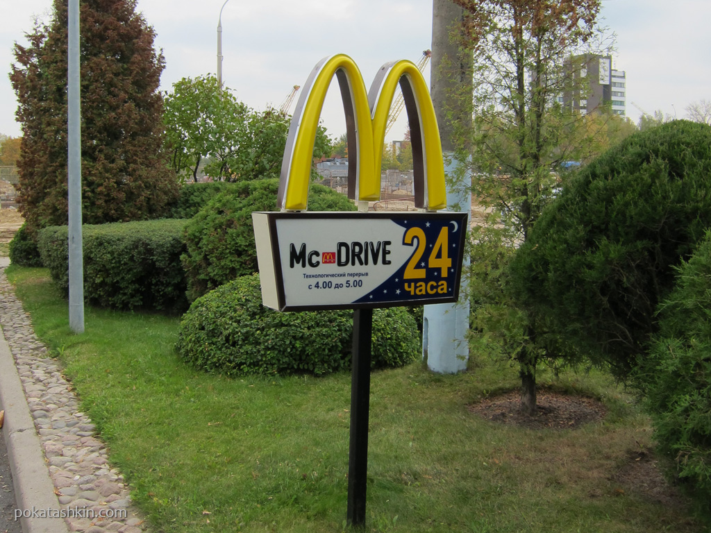
it's easier to eat from a drive in fast food than to look for a parking place in a crowded area

Slide 12
The cons

Slide 13
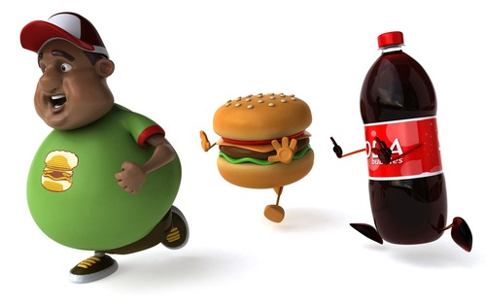
it's pretty catchy... it's tasty, it's good, it solves the hunger problem and it becomes the solution for every day lunch. High-fat, high-sugar foods are widely available, taste good and cost less than healthier foods

Slide 14
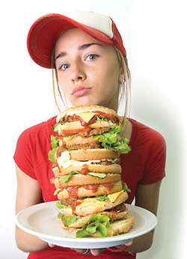
the sizes keep increasing, making us more and more dependent on this type of food; in addition, because it is tasty, you'll try to eat the entire "super-size" meal, even if your body doesn't need that much

Slide 15
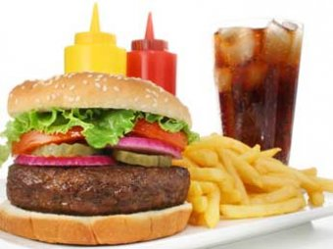
the beautiful pictures with perfect burgers, pizzas or kebabs are so perfect only in magazines and promos

Slide 16
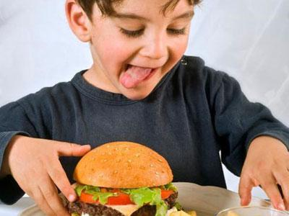
the biggest problem of fast food is that it's very easy to find and very accessible for kids; during childhood, they need healthy food, water or natural juice, not soda and activity.

Slide 17
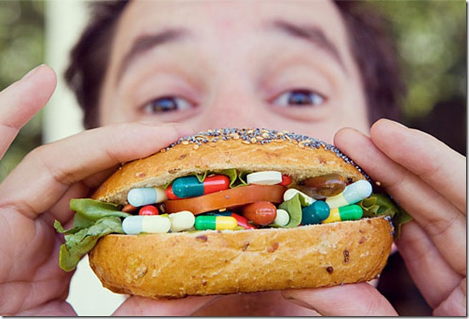
fast food represents elevate risk for diabetes an increased risk of developing insulin resistance

Slide 18
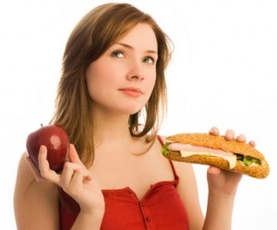
fast food is loaded with calories from refined sugar and fats; it's high in sodium, coming from common salt and other additives and deficient in dietary fiber and essential micro-nutrients like vitamins and minerals

Slide 19
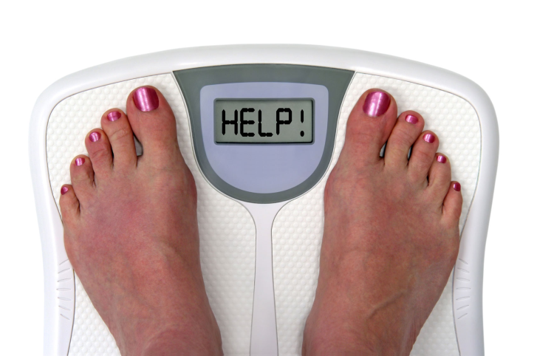
fast food means empty calories in the body, stored as body fat. A regular meal at McDonald's (a Big Mac, large fries, and a large Coca-Cola) has 1430 calories. We need 2000 calories for an entire day (depending on factors such as weight, height, physical activity and gender)

Slide 20
Conclusion
As for me, fast food is a great decision if you need a fast and a tasty food, but only sometimes. At all, this unhealthy lifestyle can bring you many problems.
So, if you want to keep fit and save your health you should do sport and eat more home food. It’s more delicious and undangerous.

