Slide 1
Stratford-upon-Avon
Presentation
Oksana Vasurchak
Form 10

Slide 2
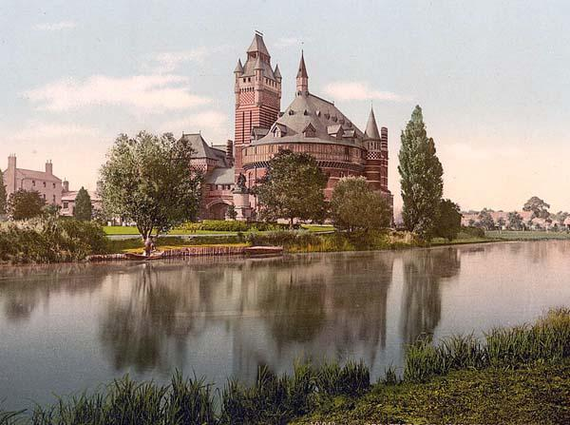
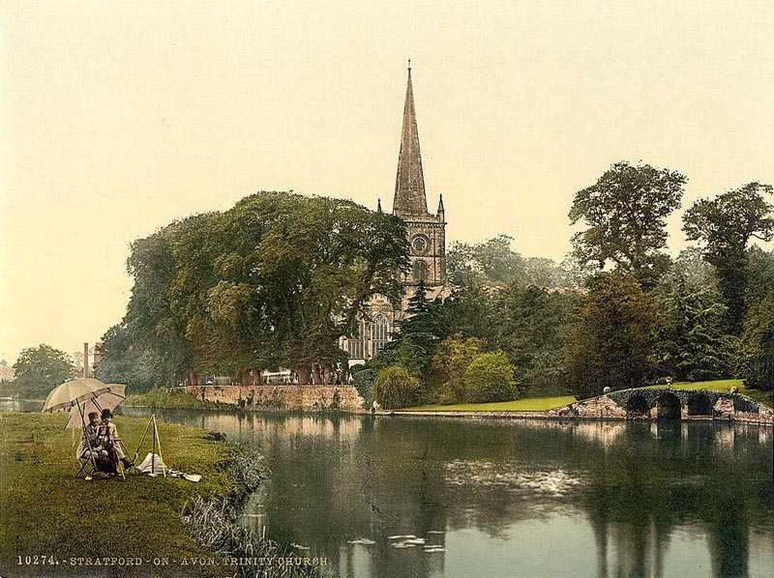
Stratford-upon-Avon
is a picturesque town
beautifully situated on
The River Avon with a
Wealth of black and
white timber framed
buildings. It is, of course, most
famous for being the birtplace of the English greatest playwrighter,
William Shakespeare.

Slide 4
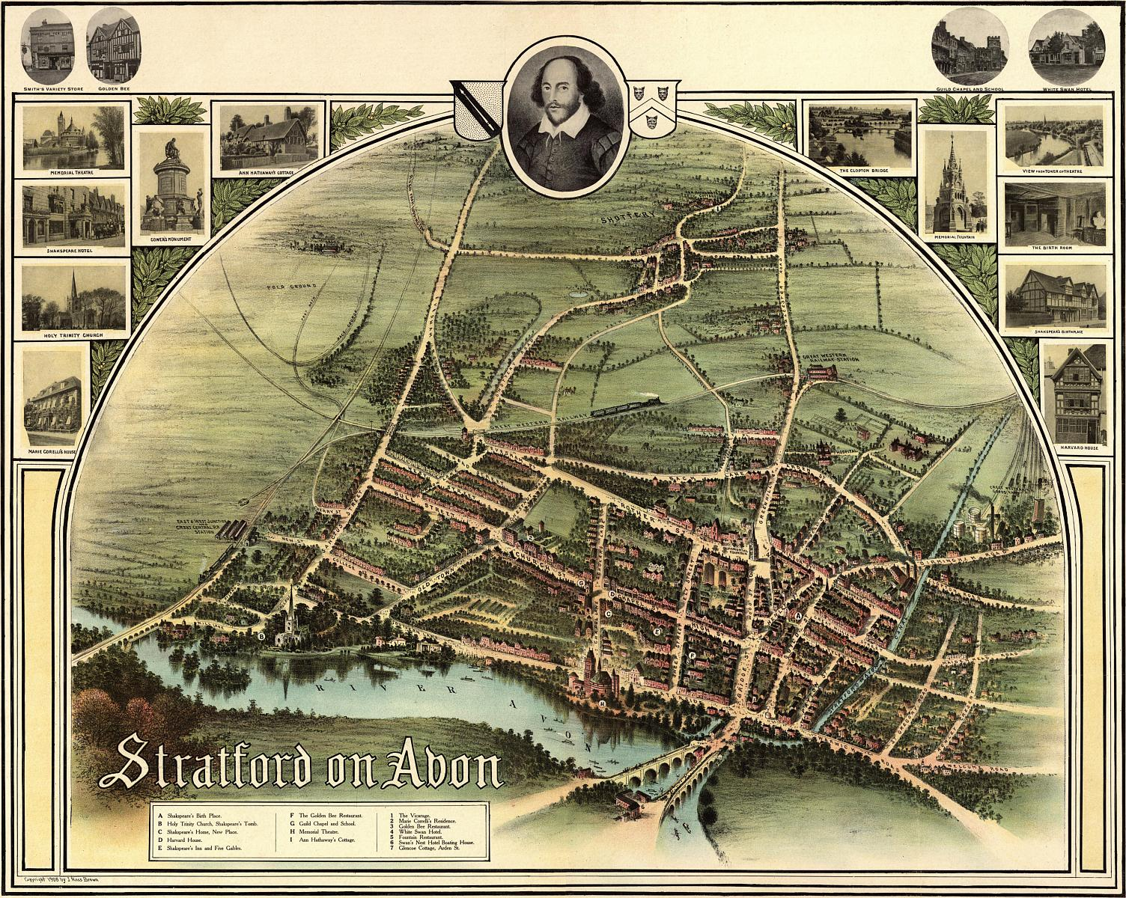

Slide 6
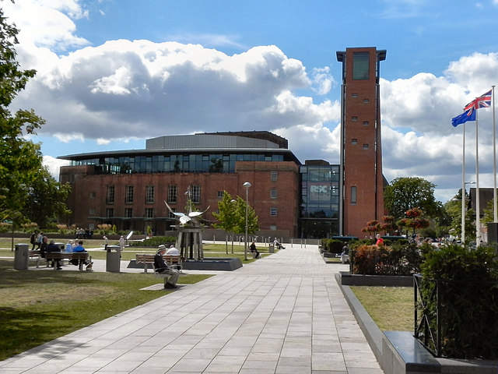
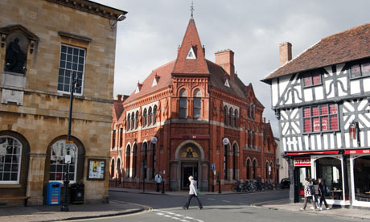
General information
Stratford-upon Avon is a
market town and civil parish
in south Warwickshire,
England. It lies on the River Avon, 22 miles 35 km south
east of Birmingham and
13 km south west of Warwick.
It is the largest and most
populous town of the non-
metropolitan district Stratford-on-Avon.

Slide 7
History
Stratford has Anglo-Saxon origins, and grew
up as a market town in medieval times. The
original charters of the town were granted
in 1196, making Stratford officially over800
years old. The name is a fusion of the Old
English strǣt, meaning "street", and ford,
meaning that a Roman road forded the
River Avon at the site of the town.

Slide 8
Geography. Destinations
Redditch, Birmingham |  | Sutton Coldfield, Solihull |  | Warwick, Coventry
Alcester, Worcester, Droitwich |  | Stratford Upon Avon |  | Southam, Daventry
Evesham, Tewkesbury, Gloucester |  | Chipping Norton, Witney, Cirencester, Swindon |  | London, Oxford,Banbury, Reading
A

Slide 9
Geography. River Anon
It’s a river that flows throw the countries of
Leicestershire, Northamptonshire,
Warwickshire, Worcestershire and
Gloucestershire in the Midlands of England.
It’s also known as the “Warwickshire Avon”
or “Shakespeares Avon”, it has been
divided since 1719 into the Lower Avon,
below Evesham, and the Upper Avon, from
Evesham to above Stratford-upon-Avon.

Slide 11
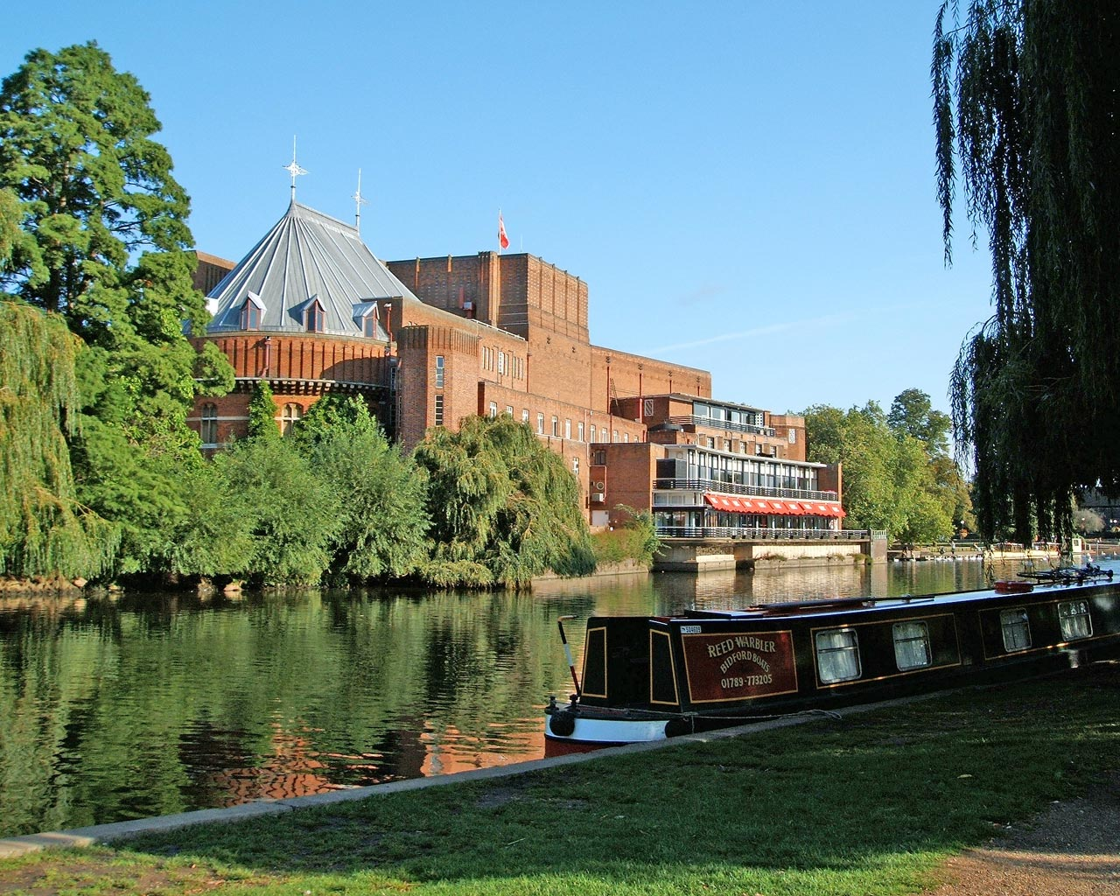

Slide 13
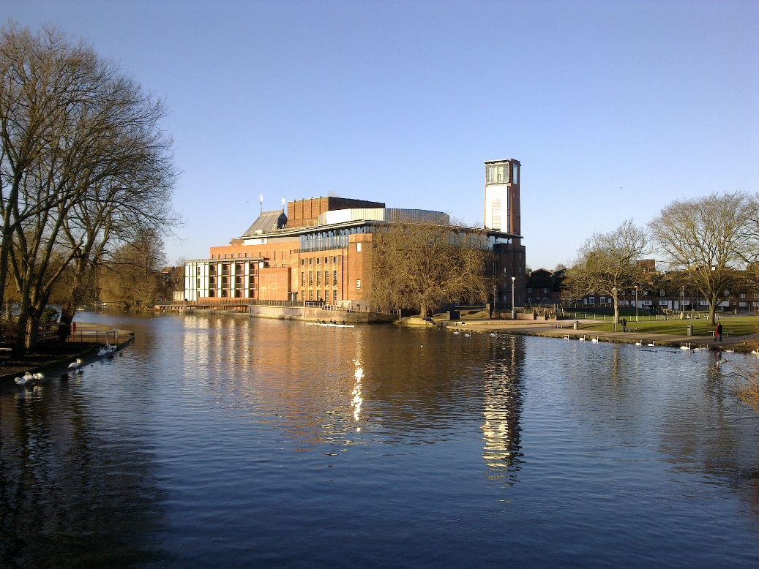

Slide 15
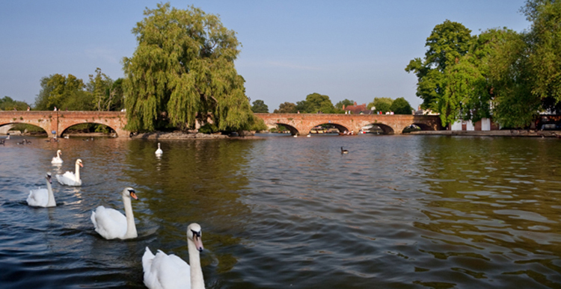

Slide 17
10 things to do in Stratford
Stratford is drenched in rich history and heritage and offers much to
explore both within the town centre and further afield.
Visit the world's most famous playwright at the Shakespeare's Birthplace
Watch a production at the Royal Shakespeare Theatre
Visit Shakespeare’s last residence – New Place
Visit one of the five Shakespearean properties – Nash house
Discover this history of the town with a guided walk around Stratford town centre
Visit Holy trinity church
Visit Hall’s croft
Enjoy a romantic afternoon sailing along the River Avon on one of the many boat tours
Visit the world famous Anne Hathaway’s Cottage
Explore Mary Arden's House in Wilmcote, with its countryside museum, 2 historic farms and more!

Slide 18
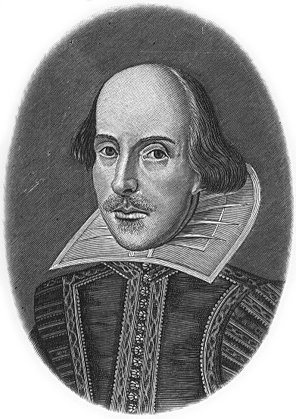
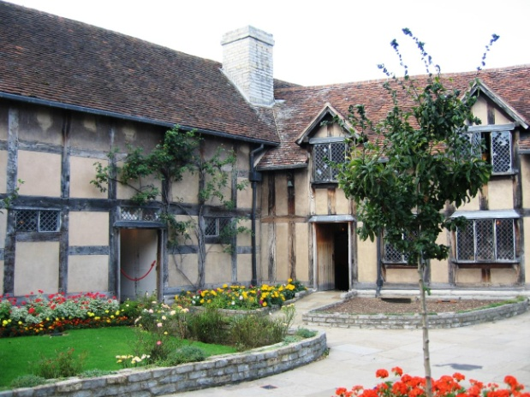
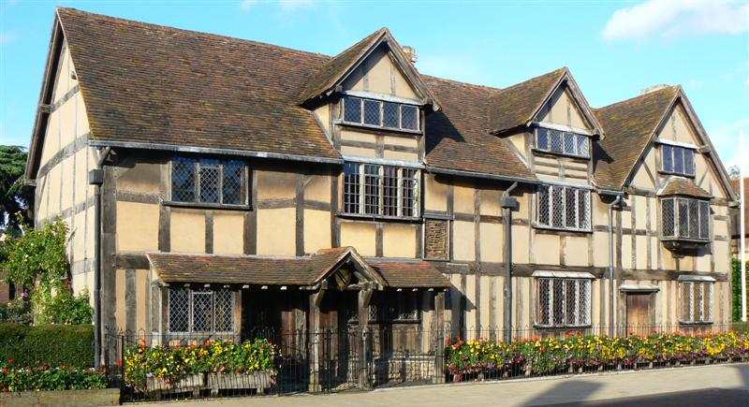
Shakespeare's Birthplace
This building is located in Henley Street and it’s the house where it is believed that William Shakespeare was born in 1564 and spent his childhood years.
It has been restored in the 16thcentury and now it’s a small museum open to visitors. Moreover the State owns it since 1847.
The building is not outstanding architecturally and typical of the times was constructed in wattle and daub around a wooden frame. In the house everyone can see a lot of work objects of Shakespeare’s dad, John, who was a glove maker and wood dealer. There’s also the first William’s work.

Slide 19

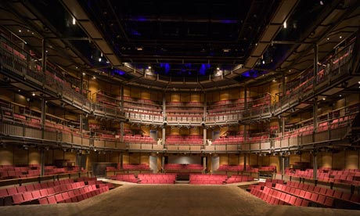
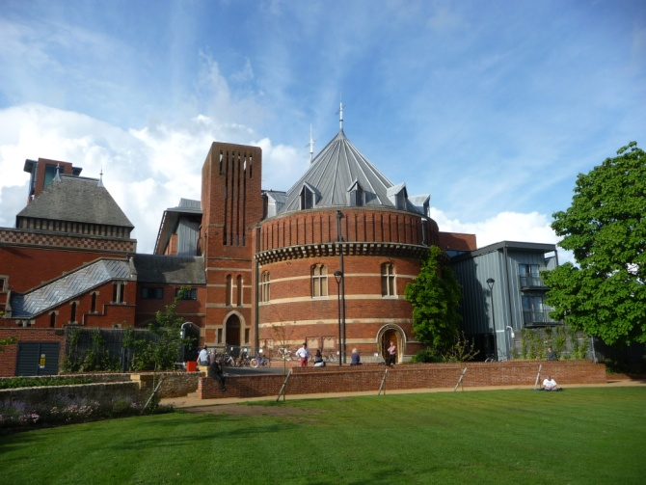
Royal Shakespeare Theatre
It is the famous theatre dedicated to the poet and playwright William Shakespeare. It was opened on 23rd April 1932 and stood on the same area, where once there were the Shakespeare Memorial Theatre (it was destroyed on 19th April 1879because of a fire).
This new theatre, besides being an incredible tribute to this poet, it’s also an important building: in fact it is considered the first edifice built in this country by a woman (Elisabeth Scott). Moreover, the Royal Shakespeare Company stage inside the theatre many plays.

Slide 20
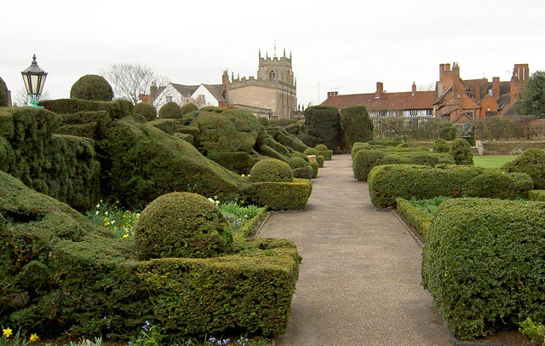
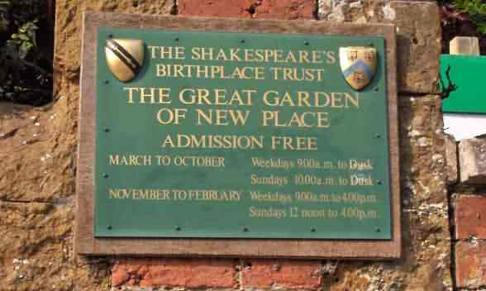
New Place
New Place was Shakespeare’s last residence before his death in 1616. Built in 1483 by Hugh Clampton, the future Mayor of London, it was the second biggest dwelling of London and it had a lot of owners. The first was the famous English poet William Shakespeare: he bought it in 1597, but he didn’t move into until 1610.
After his death, the house passed to his daughter Susan Hall, and then to his granddaughter Elizabeth Hall respectively. Afterwards during 18 TH century it passed to Reverend Francis Gastrell, who decided to demolish it in 1759 and finally in 1891 the Shakespeare Birthplace Trust bought the property.

Slide 21
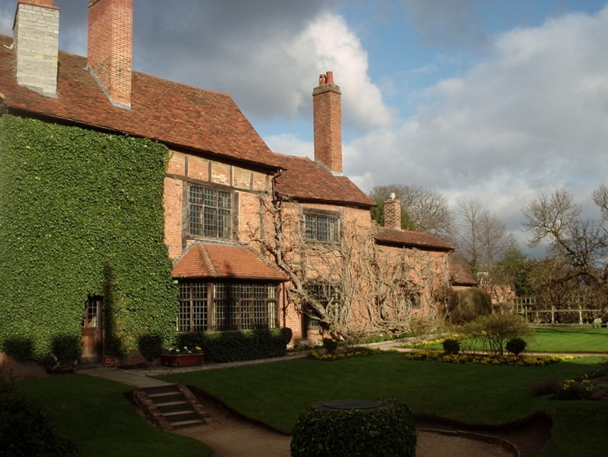
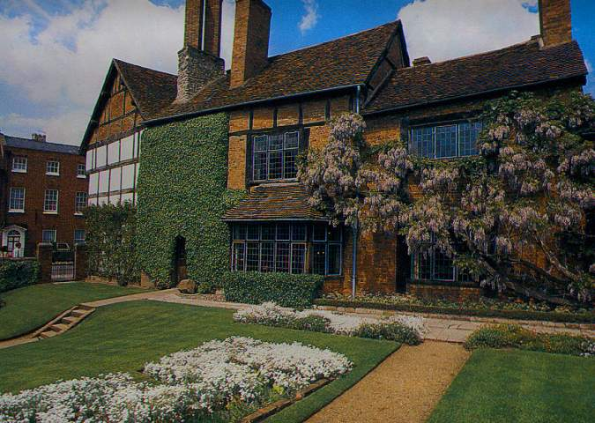
Nash house
At the end of Chapel Street, next to New Place, you can find Nash House. This house belonged to Thomas Nash, who in 1626 married Elizabeth Hall, Shakespeare’s granddaughter.
This house is one of the five Shakespearean properties and now is in use as a museum. Inside you can see many beautiful pieces of antique furniture, contemporary to the period of the building (17th century).

Slide 22
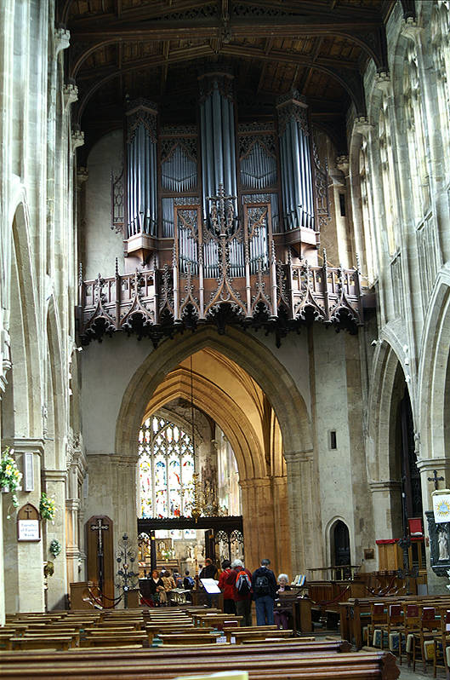
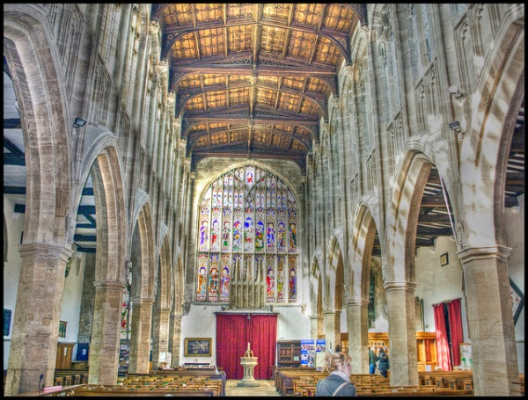
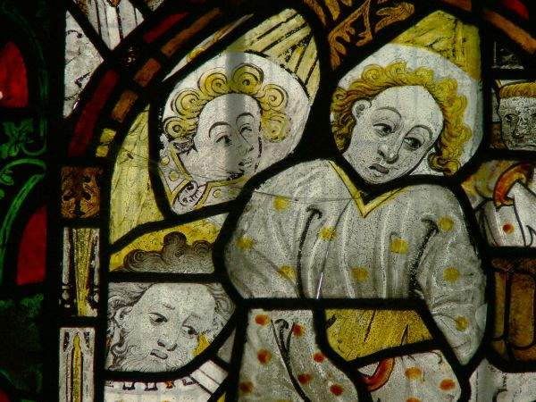
Holy trinity church
Apart from its association with Shakespeare the church is well worth a visit, containing as it does architectural features that date back to the early13th century. It is located in a lovely location on the banks of the River Avon, a short walk from most of the major Shakespeare sites in the town centre.
In this wonderful church is preserved Shakespeare’s grave but you can also see the parish registers that recorded his birth and his death.

Slide 24
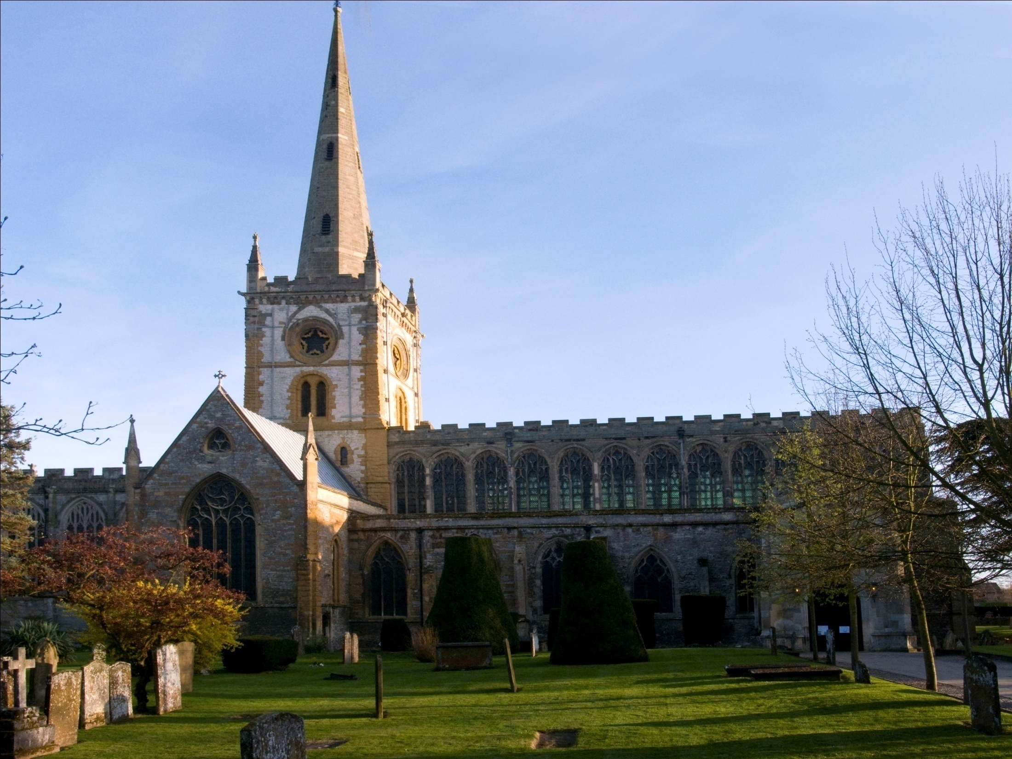
Church

Slide 26
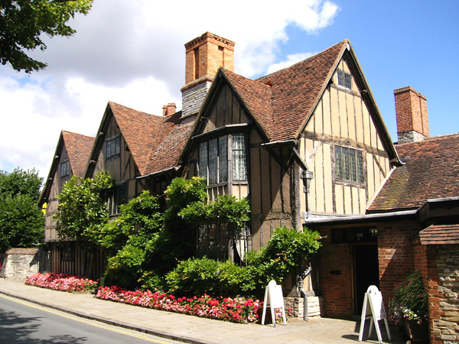
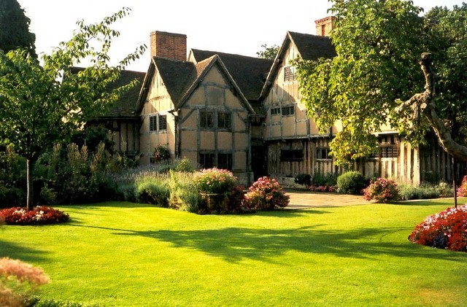
Hall’s croft
This building is located close to Holy Trinity church and it’s a timber-framed house. It was owned by William Shakespeare’s daughter, Susanna Hall, and her husband Dr John Hall.
Now it contains a collection of 16th and 17th century painting sand furniture. There is also an exhibition about Doctor John Hall and the obscure medical practices of the Tudor period. A small walled garden stands beside the house, which contains many plant varieties that were used in medical treatments in the late Elizabethan age. Then when Shakespeare died, the couple moved to New Place.

Slide 28
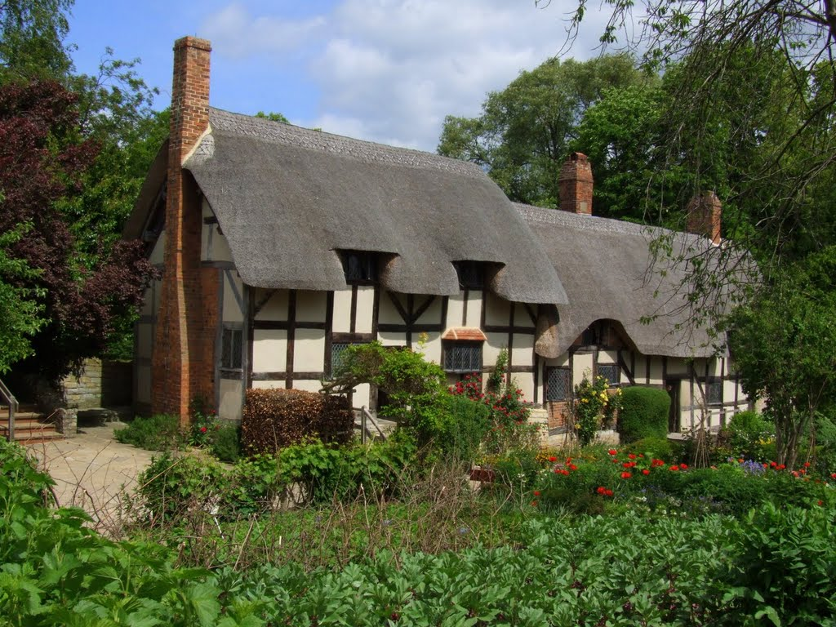
Anne Hathaway’s Cottage

Slide 30
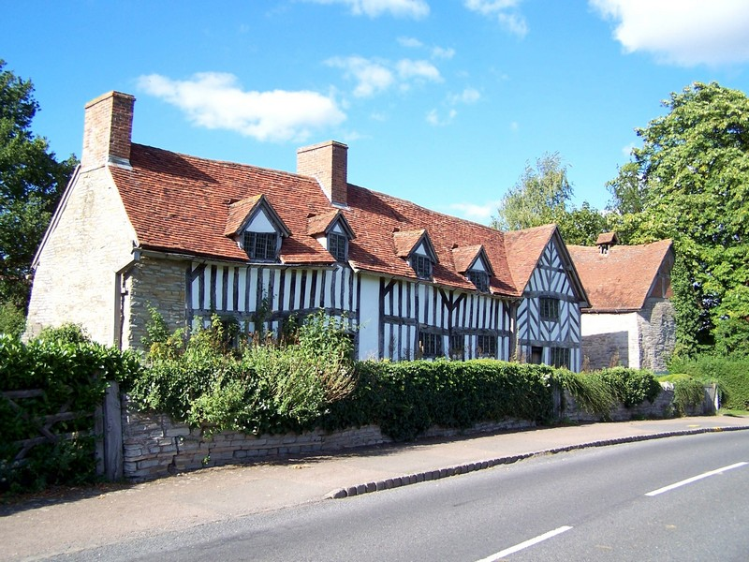
Mary Arden's House

Slide 32
Famous people
William Shakespeare, English poet.
Sarah Douglas, actress, best known for her film and TV career, was born and raised in the town.
Simon Pegg, actor, studied at Stratford-upon-Avon College
David Bradley, actor
Labour MP and actor Andrew Faulds lived in Old Town, Stratford, until his death in 2000, aged 77
Marc Elliot, actor

Slide 33
Other famous people
Adrian Newey, famous Formula 1 engineer.
George Macaulay Trevelyan, historian
J. B. Priestley died here.
Arthur C. Clarke, writer
John Profumo, gormer Secretary of State for War
Marie Corelli (real name Minnie Mackay), the romantic novelist
Dion Dublin, footballer
Simon Gilbert & Neil Codling of the band Suede
Klaxons and Pull Tiger Tail, members of indie bands
W. W. Quatremain, local landscape painter
Gordon Ramsay, noted celebrity chef, and star of several cooking related shows
Brad Moran, Australian Rules Footballer
Andrew Pozzi, 110m hurdler
Julia Suzuki, author
Annie Sanders, author
John Krasinski, actor

Slide 34
THANKS
FOR
WATCHING

