Slide 1
William Turner- British painter
prepared:
Alyona Kalchenko

Slide 2
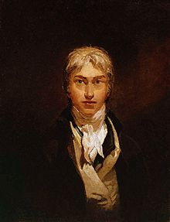
Joseph Mallord William Turner (1775-1851)
Joseph Mallord William Turner-British painter, a master of romantic landscape, watercolorist and printmaker.
Turner carefully studied the past masters and modern artists. He was particularly
admired Claude Lorrain.
His works include water colors
and oils.

Slide 3
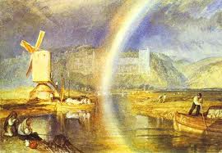
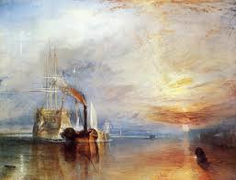
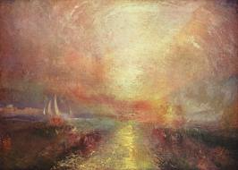
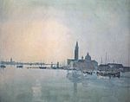
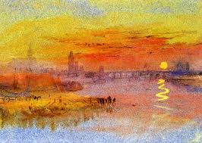
The most famous master paintings

Slide 4
“Water mill”
This picture made ​​famous artist.

Slide 5
“Blizzard. Hannibal crossing the Alps”

Slide 6
“Dido, the founder of Carthage”

Slide 7
“Rainbow over Arundel Castle”

Slide 8
“Grand Canal”

Slide 9
“The last flight of the ship "Brave"

Slide 10
“Rain, steam and speed”

Slide 11
Conclusion
Britain has produced many talented artists.
William Turner has a special place in the world culture of English painters.
His work was exhibited when he was still a teenager. His entire life was devoted to his art.
Turner bequeathed much of his work to the nation. The great majority of the paintings are now at Tate Britain.

Slide 12
Thank you!

