Slide 1

Georgian cuisine

Slide 2
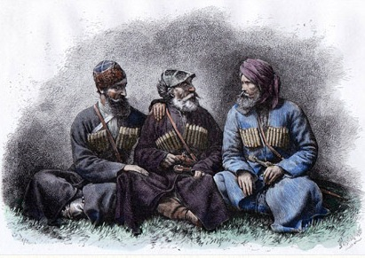
Georgian cuisine refers to the cooking styles and dishes with origins in the nation of Georgia and prepared by Georgian people around the world.

Slide 3
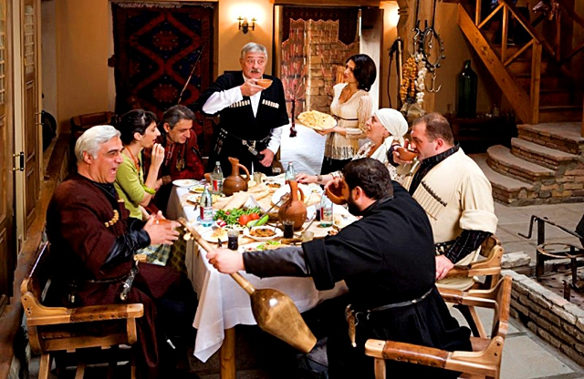
The importance of both food and drink to Georgian culture is the best observed during a feast called supra, when a huge assortment of dishes are prepared, always accompanied by large amounts of wine, and that can last for hours.

Slide 4
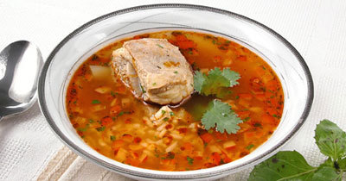
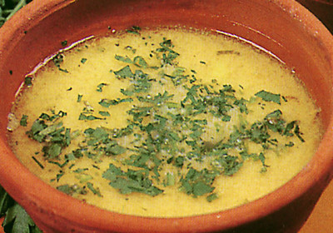
soup kharcho
classical georgian chikhirtma
Georgian vegetable soups almost no thicker. Kharcho is the National Georgian beef soup with rice and walnuts on a special acid-based. Classical Georgian chikhirtma consists of chicken, wheat flour, mint, cinnamon and spices drugh.

Slide 5
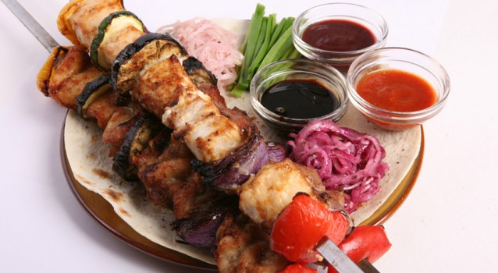
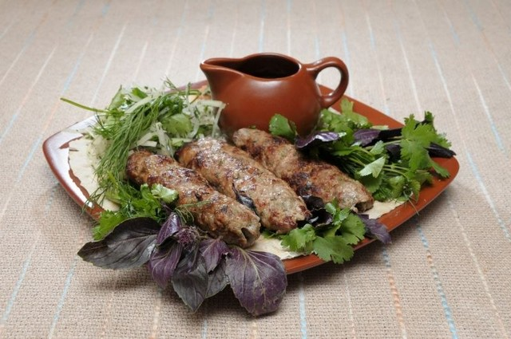
Georgian barbecue
lula kebab
Georgian meat dishes can be made of pork, lamb, beef and poultry.
Georgian barbecue made from lamb and spices. Lula kebab is minced meat threaded on a skewer and roasted on the grill. It is made mostly of minced lamb.

Slide 6
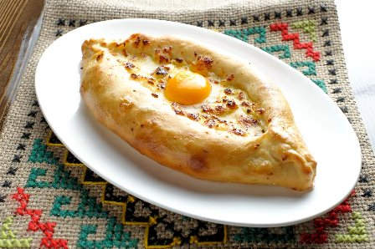
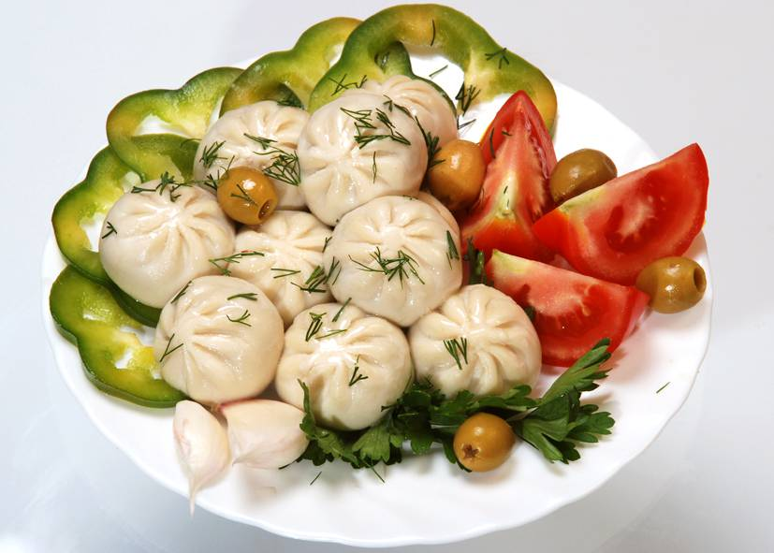
Adzharske hachapurі
khinkali
Georgian cuisine is unimaginable without products from the dough, such as khinkali and khachapuri. Khachapuri pride of Georgia.

Slide 7
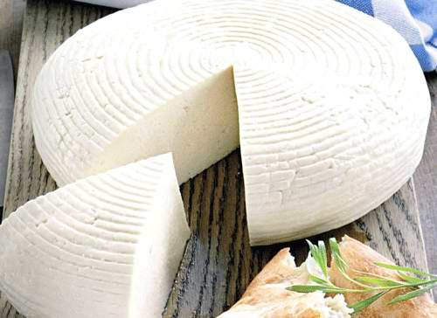
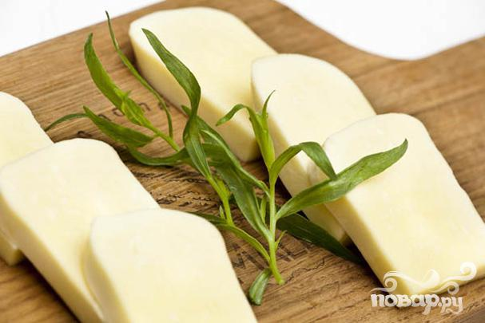
Imereti cheese
suluguni
Cheese in Georgia is an integral part of the national cuisine. They are prepared in jars and skins and used as a snack and as an ingredient for food and cakes.

Slide 8
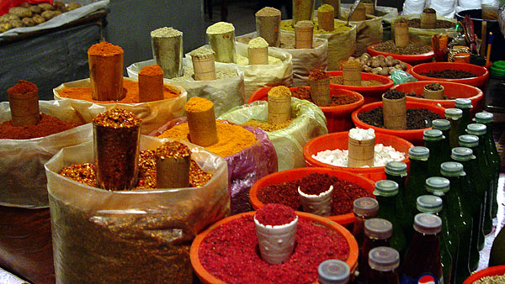
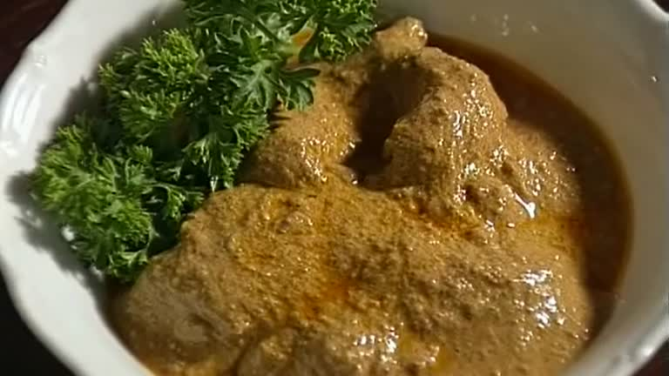
spices
satzivi
Georgian cuisine is an abundance of all kinds of spices, seasonings, sauces. Georgian cuisine use spise for taste.

Slide 9
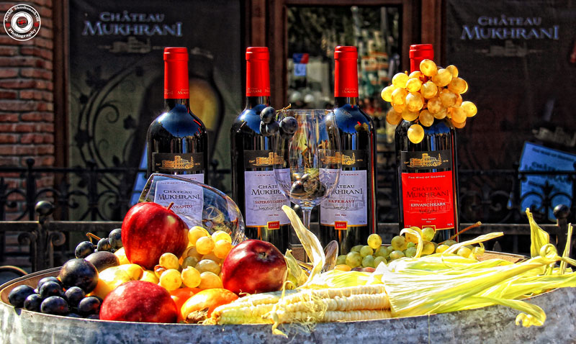
Alcoholic drinks from Georgia include chacha and Georgian wine. Wine culture in Georgia dates back thousands of years, and many Georgian wines are made from traditional Georgian grape varieties

Slide 10
The presentation was prepared
Shostak Maxim
Good luck

