Slide 1
Slide show on the theme:
‘My favorite kind of sport’
10 Form
Furman Olha

Slide 2
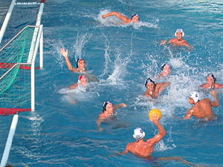
My favorite sport is swimming. It is very interesting, also in Kaniv possible go to the beach almost every day in the summer.
By the classification of swimming as a sport includes: the actual swimming, water polo, diving and synchronized swimming.

Slide 3
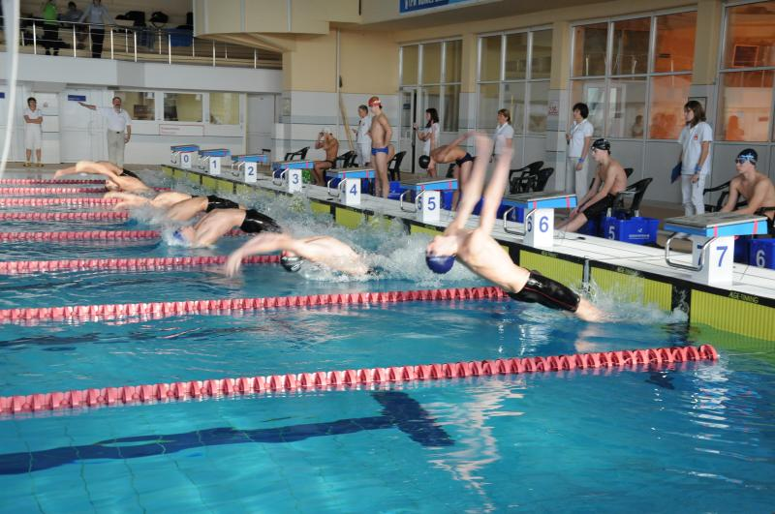
Coordinating the development of water sports in the world is engaged in the International Swimming Federation carrying out the world championships since 1973, and in Europe - Ligue of European swimming championships conductive Europe since 1926.

Slide 4
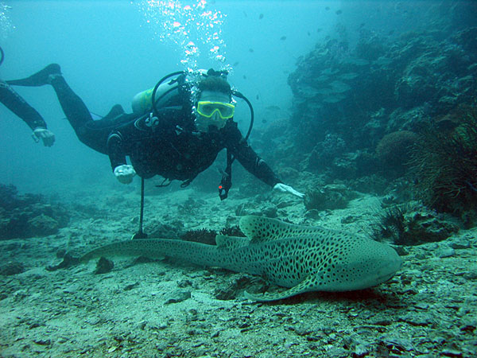
Swimming has a very long history. Drawings on the archaeological findings show that people in ancient Egypt, Assyria, and in many other countries were able to swim for a few thousand years before our era. In those times, swimming was purely applied character - for fishing, hunting for waterfowl game, underwater fishing and military affairs.

Slide 5
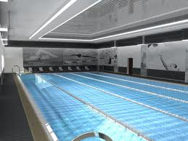
The first swimming competition took place in the XV-XVI centuries. The first sports organization swimmers originated in England in 1869, followed by similar organizations appeared in Sweden (1882), Germany, Hungary (1886), France (1887), The Netherlands, USA (1888), New Zealand (1890), Russia (1894) , Italy, Austria (1899) and many others ... The growth of popularity of competitive swimming at the end of XIX century is associated with the construction of artificial pools.

Slide 6
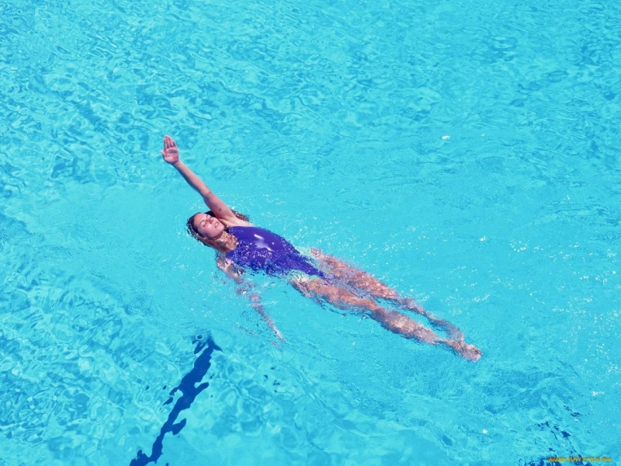
In 1896, the swimming was included in the program of the first Olympic Games, and has since been included in the Olympic program. In 1899, in Budapest held major international competitions with the participation of athletes from several European countries, then they have been held every year in different European countries and were designated the "European Championship"

Slide 7
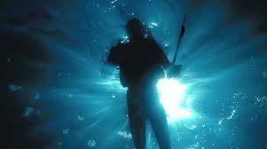
Individual heats and then the competition over long distances in open water bodies have been held at the end of XIX century. Probably the most famous of them - swim across the English Channel, first crossed the English Channel in 1875, the Englishman Matthew Webb.

Slide 8
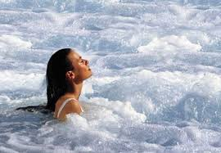
Since 1991, swimming in open water is included in the program of the World Championships in Aquatics, and since 2000, in even years are also held separate championships in swimming in open water.

Slide 9
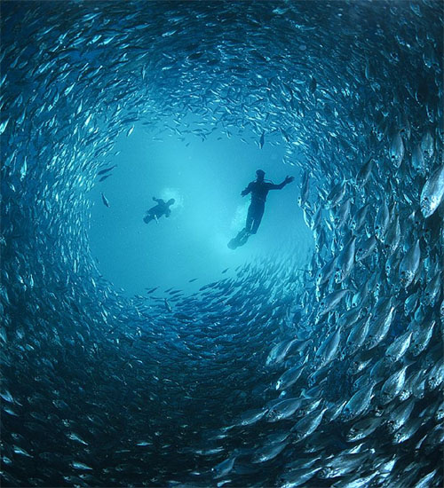
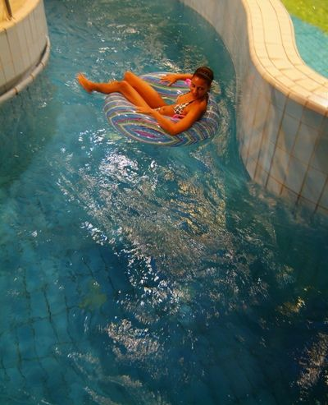
Some professions need swimming skills. For example, miners and abalone pearls to swimming and diving to earn a living, as well as underwater hunters. Swimming - a special kind of sport that is useful for almost all systems of the body and also helps to relax.

