Slide 1
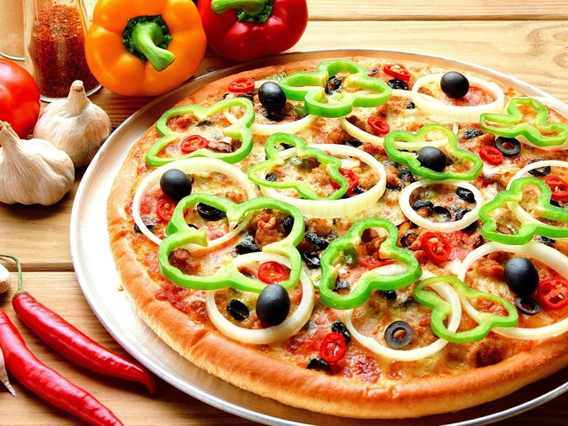
Italian cuisine

Slide 2
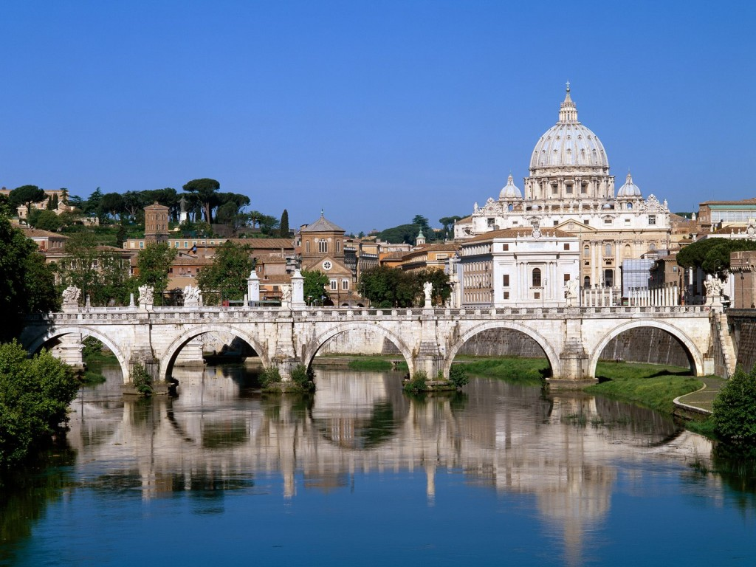
Italy is country in a south Europe.
This country has a glorious history and a rich cultures.

Slide 3

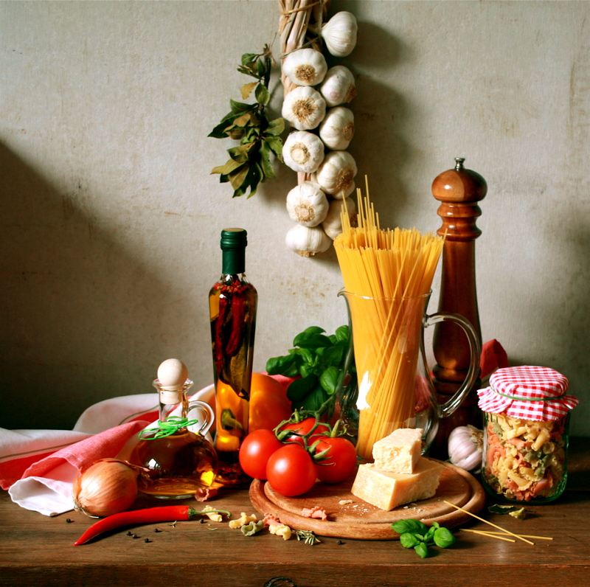
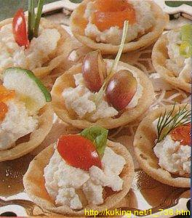
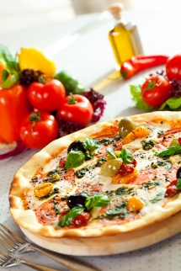
Italian dishes are very popular in the world. Italian food is one of the best in Europe.

Slide 4
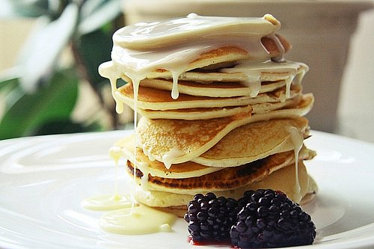
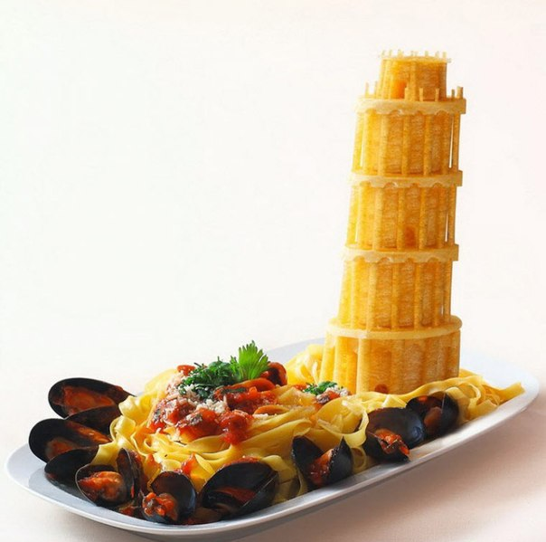
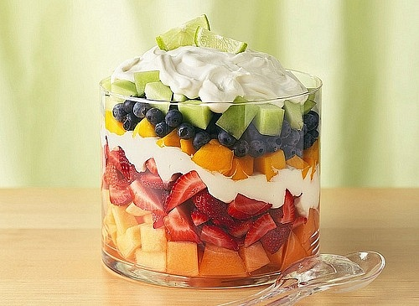
This food is diverse and link many nutty tastes.

Slide 5
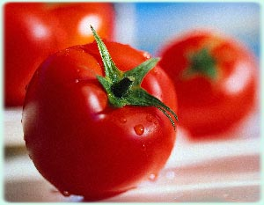
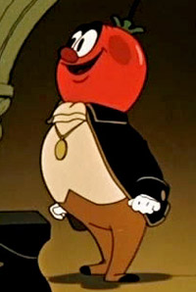
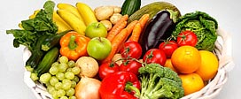
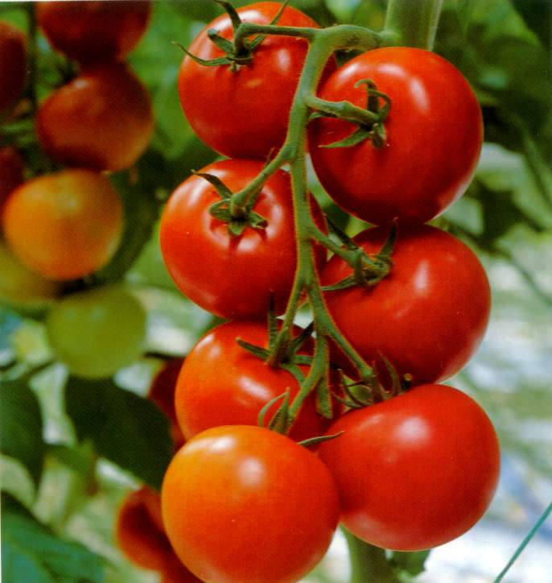
Vegetables rules in Italian kitchen, but their king is tomato.

Slide 6
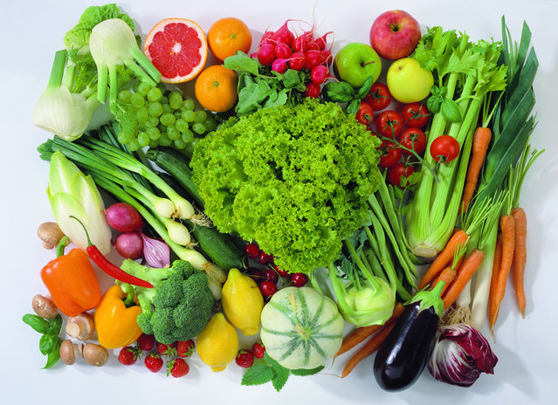
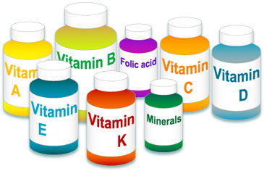
Italian food is very useful, because majority dishes consist of vegetables.
Italians use only naturals products.
Their food has many vitamins and nutrients . So italians are very healthy.

Slide 7

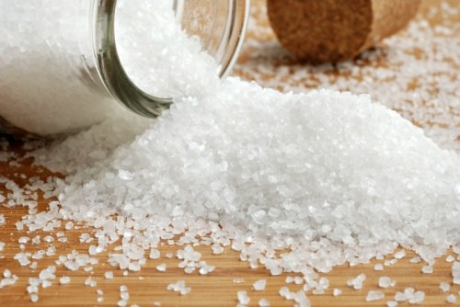
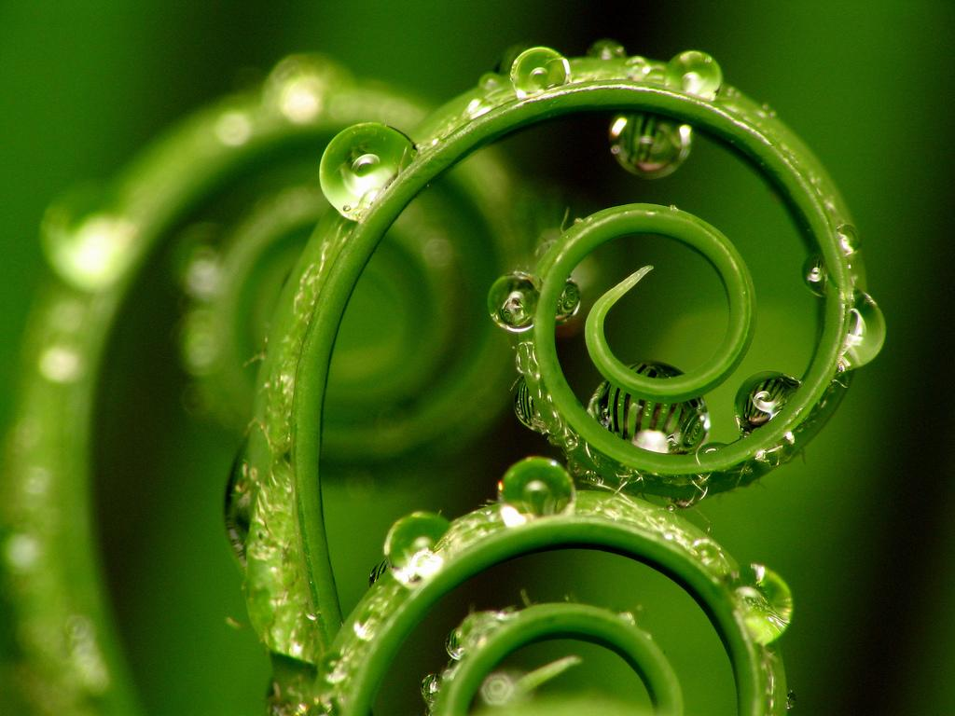
Salt is the main seasoning. They use
greenery and cheese too.

Slide 8
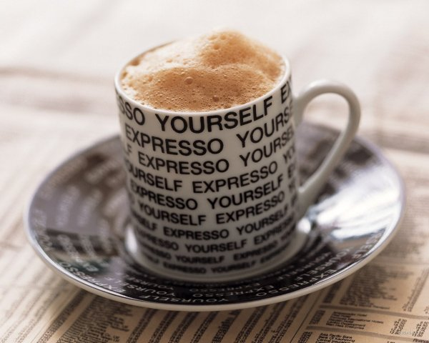
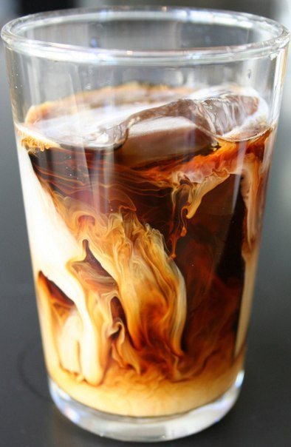
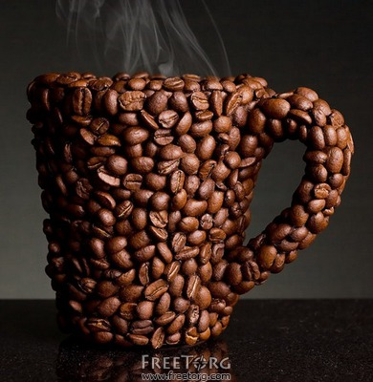
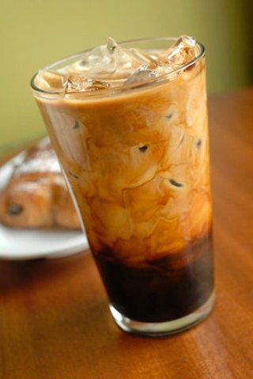

The favourite drink in Italia is coffee.
Every people in Italia start your day with cup of coffee.

Slide 9
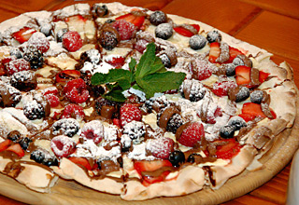
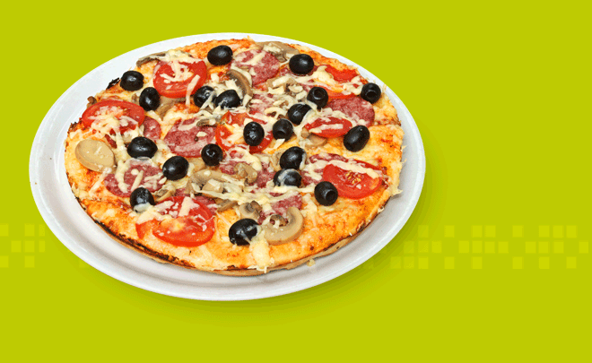
The popular Italy food:
Pizza

Slide 10
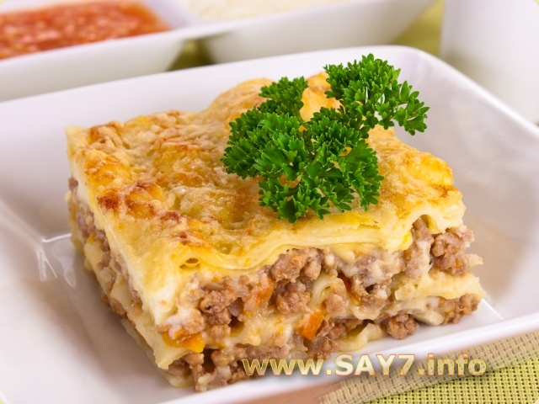
Lasagna

Slide 11
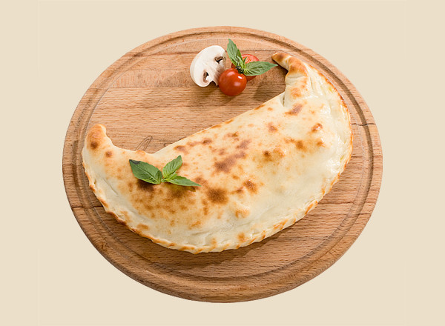
Calzone

Slide 12
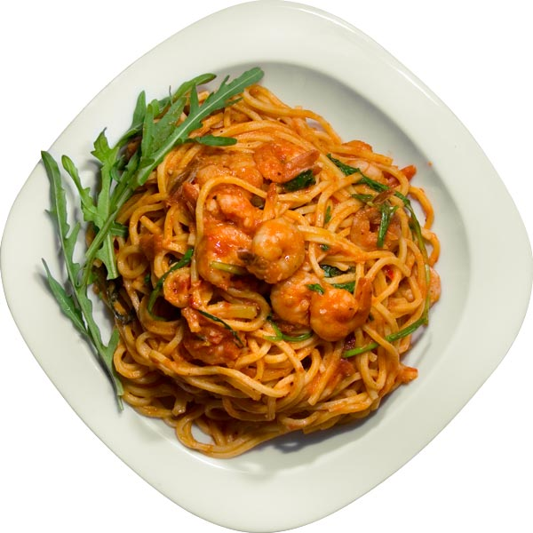
Pasta

Slide 13
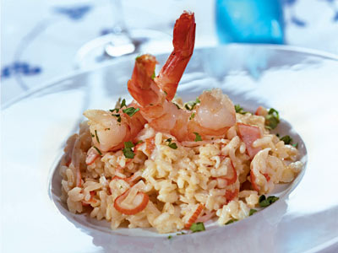
Risotto

Slide 14
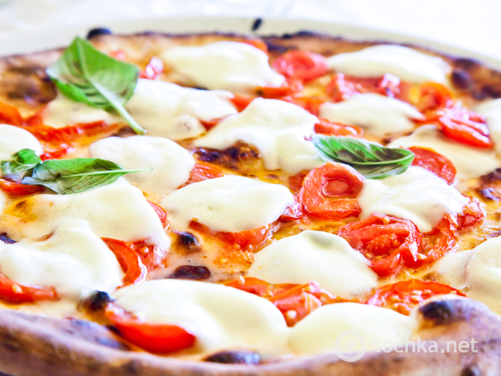
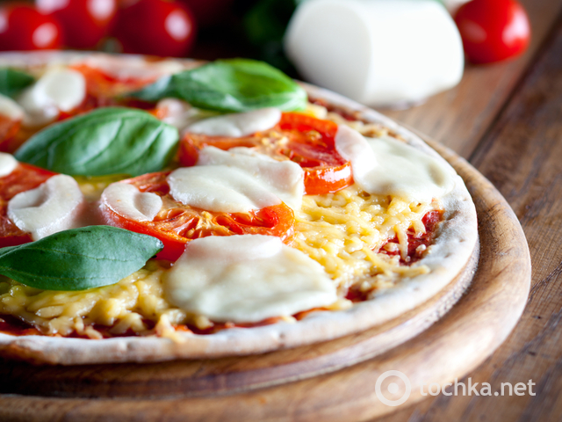
Recipe of pizza “Margarita”

Slide 15
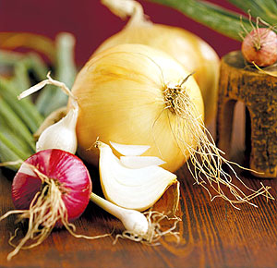
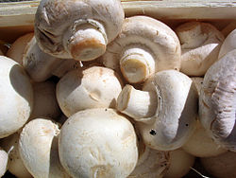
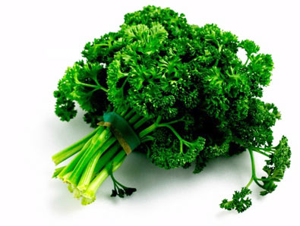
Products:
Paste
Mushroom – 450 gram
Cheese – 150 gram
Onion – 1 thing
Tomatoes – 2 things
Eggs – 2 things
Milk – 0.5 liter
Parsley
salt

Slide 16
Procedure
The first roll a paste.
After that rub a cheese on paste.
The next bake a paste in oven(Temperature 170-180) for a 10 minutes.
Fry a mushrooms and onion on frying pan.
In the end lay out mushrooms and onion on paste and powder a salt.

Slide 17
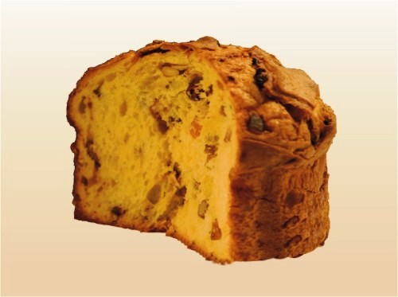
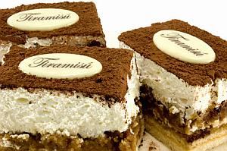
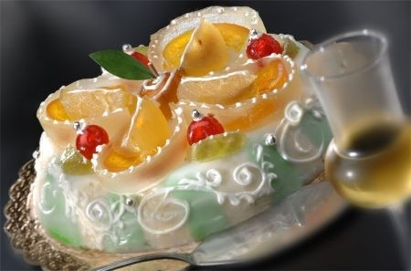
Italian cuisine has many delicious desserts.
Tiramisu
Panettone
kasata

Slide 18
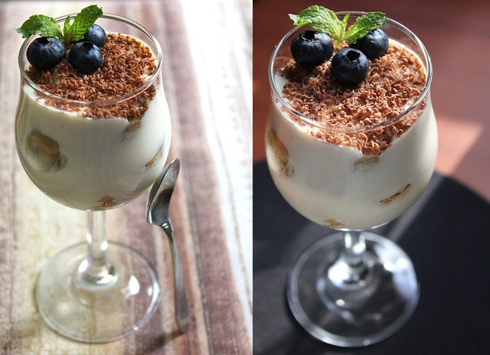
Recipe of dessert “Tiramisu”.
Products:
Cream cheese – 110 gram
condensed milk – 50 gram
Cream – 50 gram
Vanilla
Coffee – 1 cup
Cookies – 200 gram
Chocolate – 100 gram

Slide 19
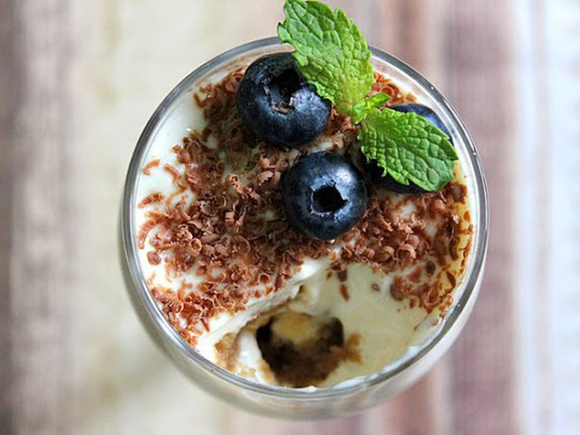
Procedure
The first you must churn cream cheese, condensed milk, cream, vanilla. After that lower cookies in coffee . Put cookies in a glass and put our mix layers . In the end you can pour chocolate.

Slide 20
Words
Nutty – пряний
Nutrients – поживні речовини
Seasoning – приправа
Greenery – зелень
Lasagna – лазанья
Calzone – кальцоне
Risotto – різотто
Paste – тісто
Parsley - петрушка
Cream cheese- вершковий сир
condensed milk – згущене молоко

Slide 21
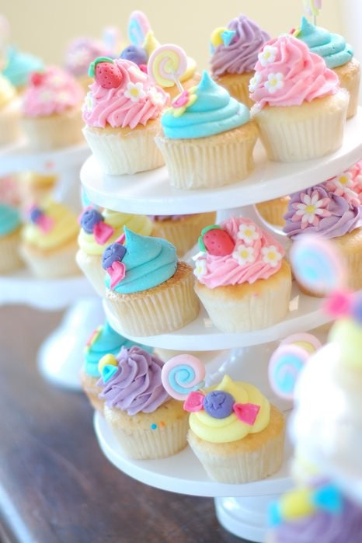
Petryna Maria form 10 – B class

