Slide 1
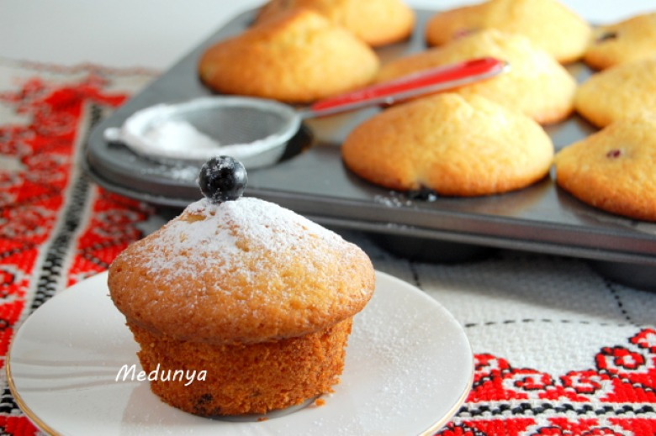
Sour cream cakes with currants

Slide 2
Ingredients
sour cream 1 cup
Sugar 1 cup
Egg 2 pcs.
vegetable oil 100 g
wheat flour 2 cups
Weeder 2 tsp
Blackcurrant 1 cup
Up to 6 servings

Slide 3
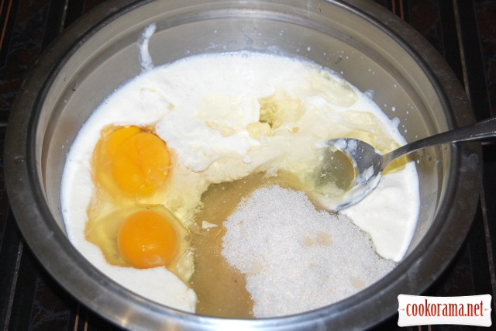
PREPARATION
Combine in the eggs, sugar, cream, butter.
Well rub or beat with a mixеr.

Slide 4
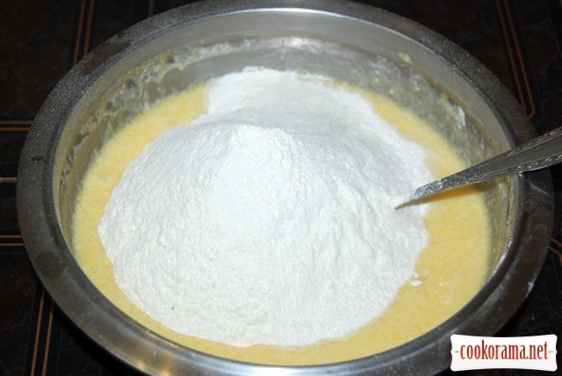
Add flour, sifted with ripper:

Slide 5
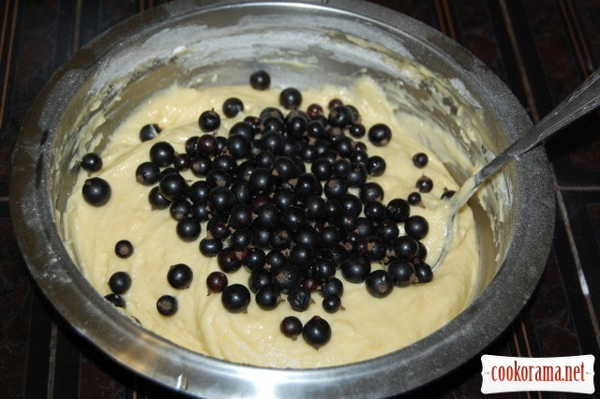
Stir currants:

Slide 6
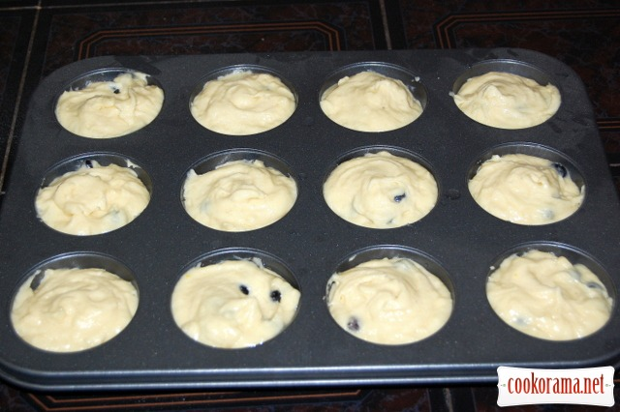
Spread in greased:

Slide 7
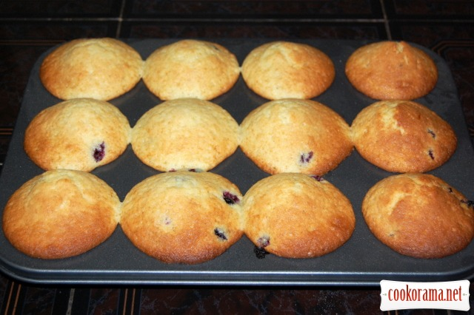
Bake 25 minutes at 200 * C:

Slide 8
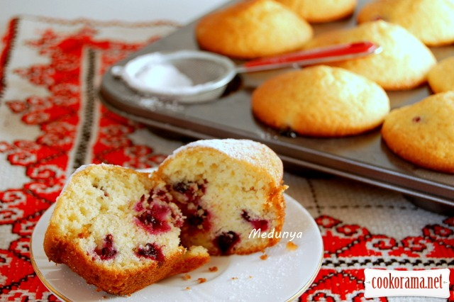
and delicious cupcakes ready

