Slide 1
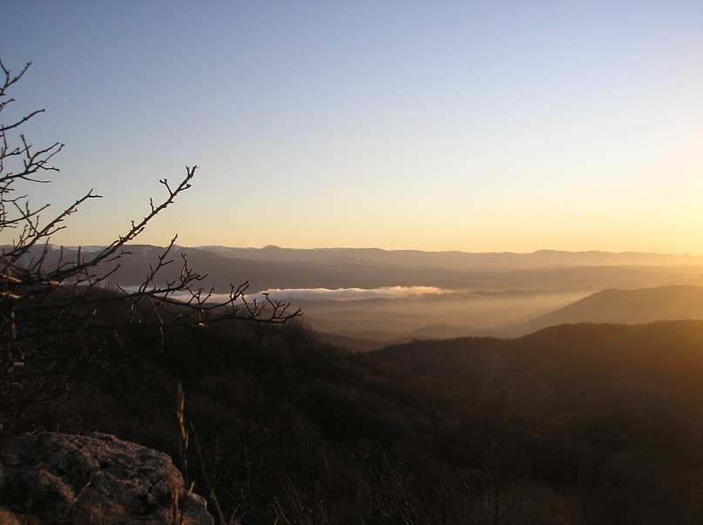
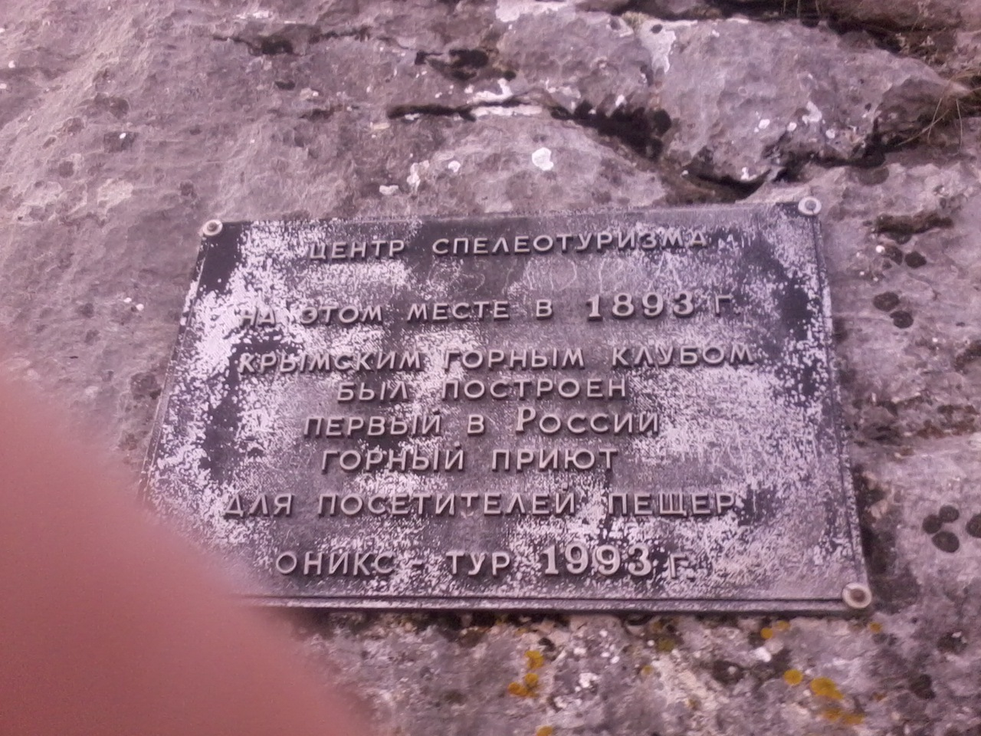
Crimean Caves
Chatyrdag

Slide 2
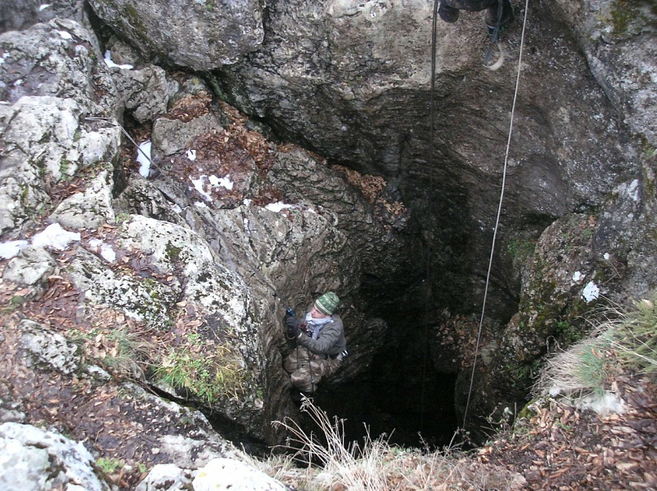
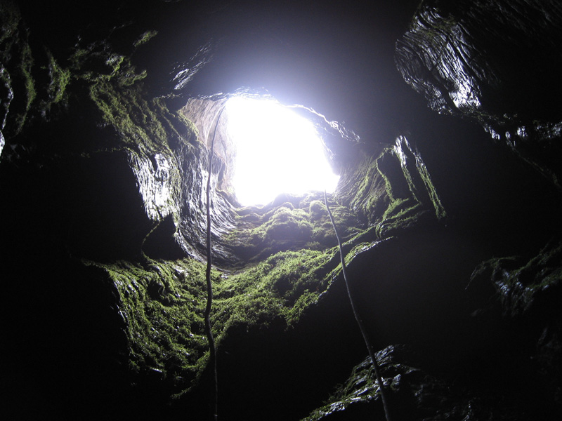
Gugerdzhin-Khosar (Pigeon well)
Gugerdzhin-Khosar (Pigeon well) - karst pit in the Crimea on the lower plateau Chater-Dag 62 meters long This cave with a simple 22-meters vertical well, perfect for the first speleological expeditions.

Slide 3
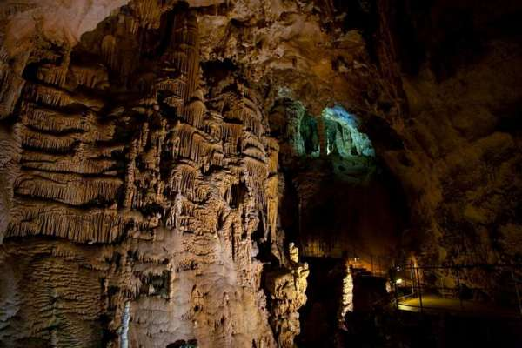
Emine-Bair-Khosar
Emine-Bair-Khosar (another name - Mammoth) - located near the Marble Cave. The cave - 1460 meters. Depth - 120 meters.
First described in 1927, when a group of researchers has discovered a huge hall, later named chief.
The only entrance to the cave used to be a 16 meter vertical well. Now, for convenience, far from it carved sloping 12 meters long tunnel running along the ancient river bed, which washed the cave in the limestone rocks of the plateau Chater-Dag.

Slide 4
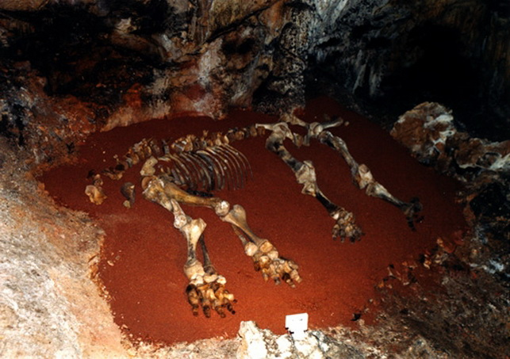
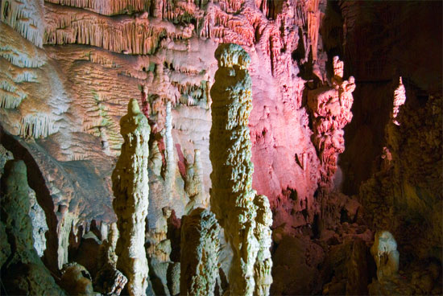
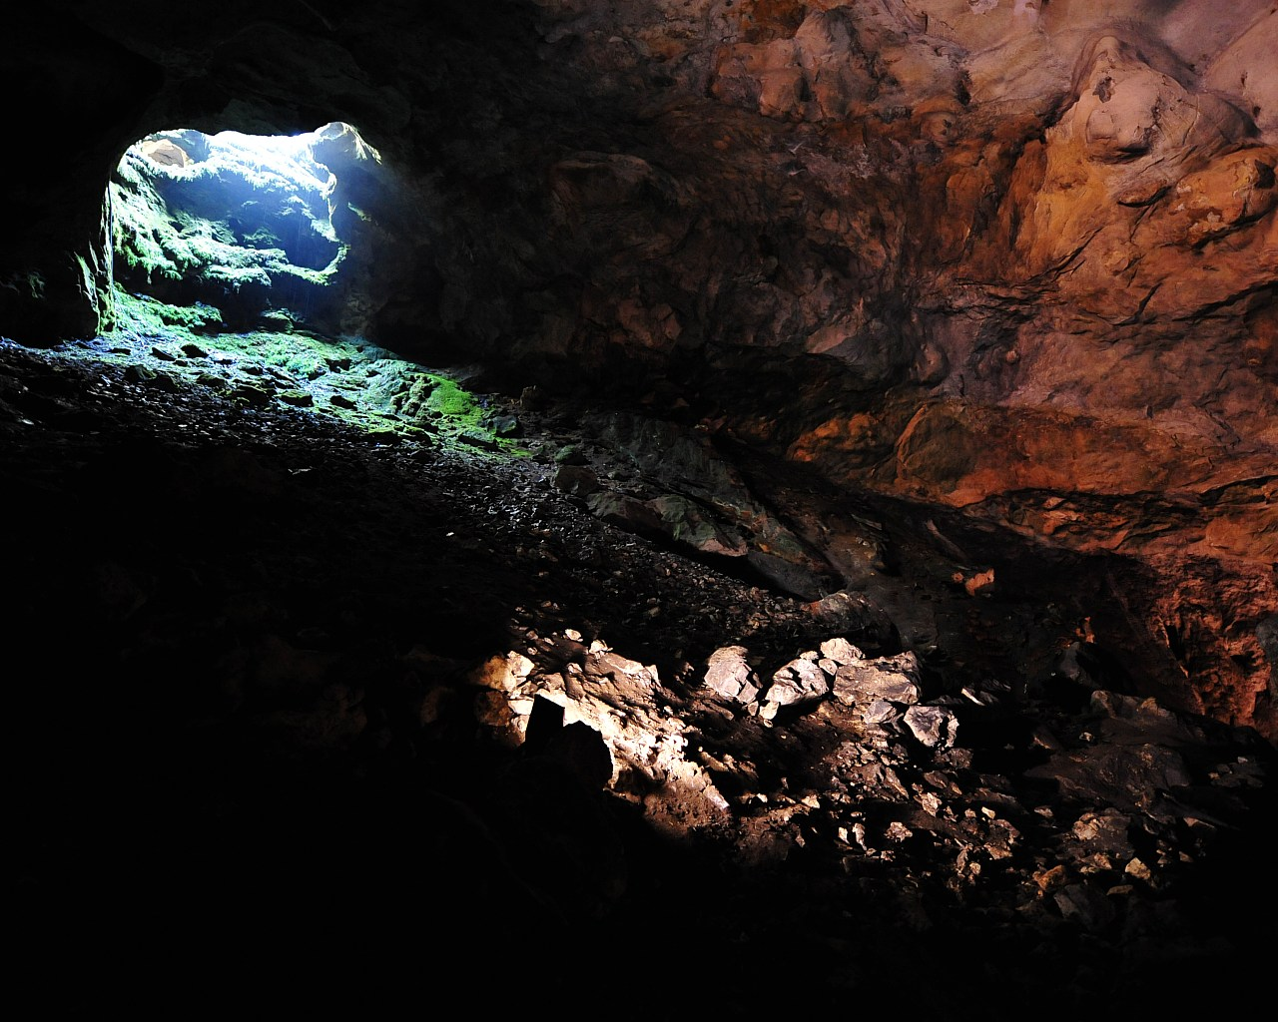
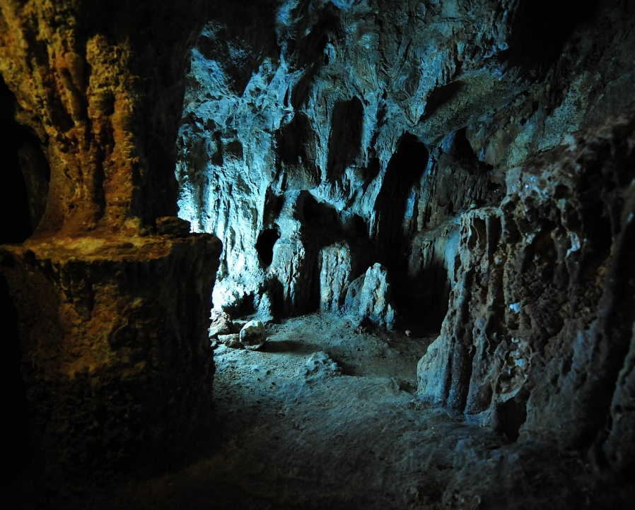

Slide 5
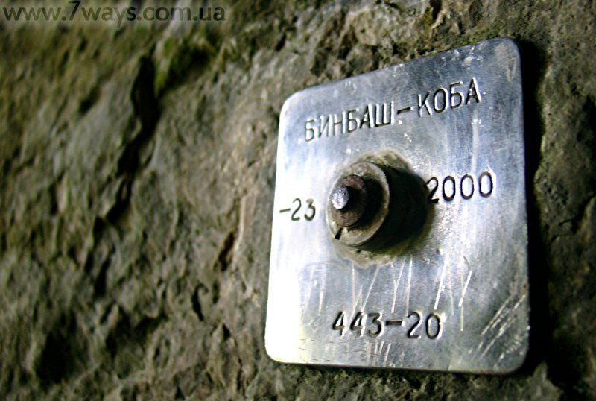
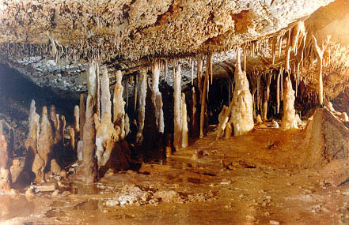
Cave Thousand (Binbash-cob )
Cave Thousand (Binbash-cob) - Cave in the Lower Chater-Dag. The name "Binbash-Koba" translated from Turkish as "Cave of a thousand heads." Hence its second name - Thousand. Cave in length - 110 m

Slide 6
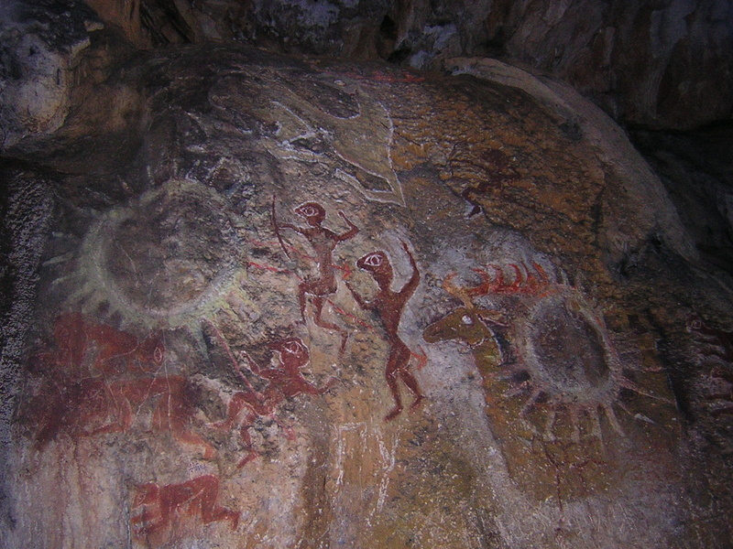
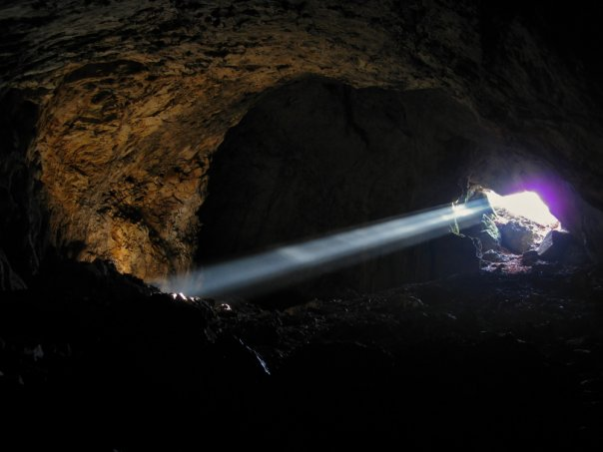
Suuk-Koba Cave
Suuk-Koba Cave of the Lower Chater-Dag. The name "Suuk Koba" translates to "Cold Cave". Probably due to a temperature of 6 degrees inside.
Suuk Koba starts with a huge, up to 25 meters, the hall. There is growing composition of stalactites: many stone icicles weaved into one structure, similar to organ pipes.

Slide 7
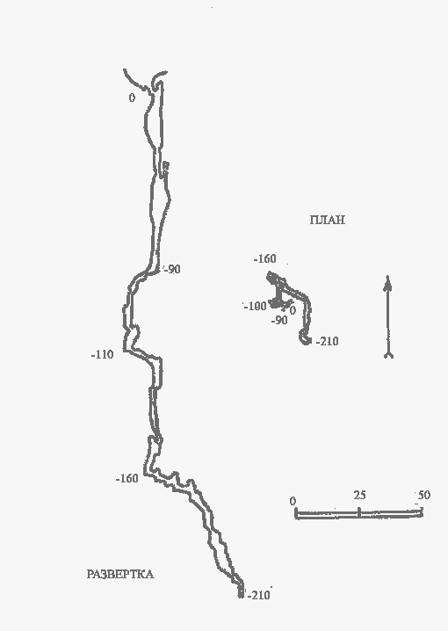
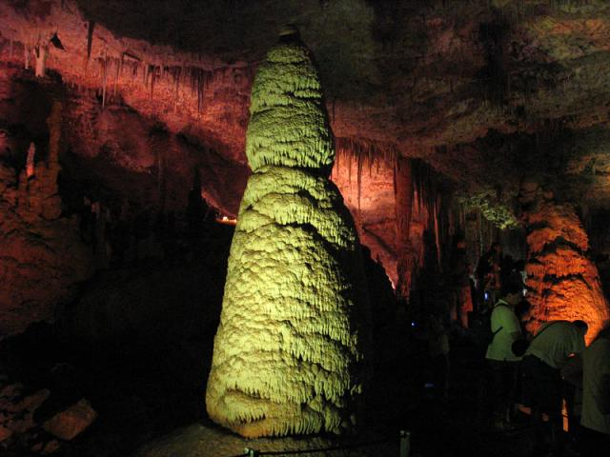
Cave of The Knight
The Knight - Karst mine (the cave of the vertical type) in the Crimea at Chater-Dag. Length - 278 m, depth - 217 m, category 3A difficulties. It is the deepest in the Chaterdag mine.

Slide 8
Thank you for your attention

