Slide 1
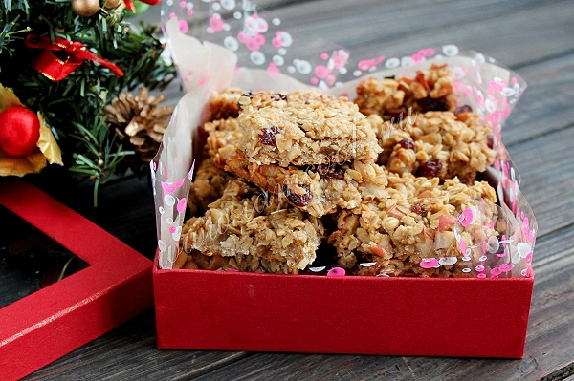
Flepjeck

Slide 2
This cookie was invented by an English mother which could not feed her children porridge

Slide 3
Now it is a national British delicacy which served with tea or coffee

Slide 4
For cooking flepjack you will need:
Porridge (preferably cereal) - 250 grams;
Butter - 100 grams;
Sugar - about 100 grams;
Honey - about 100 grams;
Apple - 1 piece;
Raisins - 0.3 cups;
Nuts or pralines - 2 tbsp. spoons;
Water - 1-2 tbsp. spoon.

Slide 5
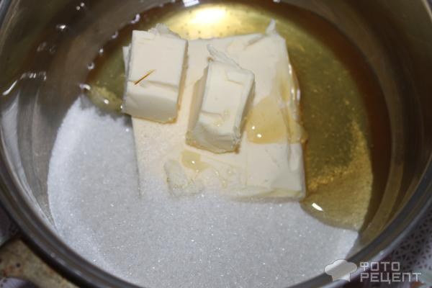

Slide 6
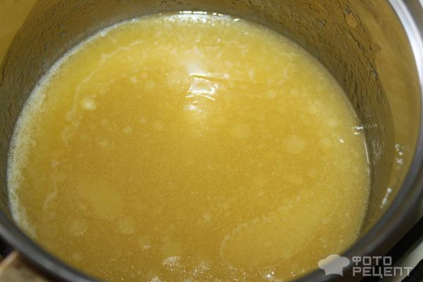

Slide 7
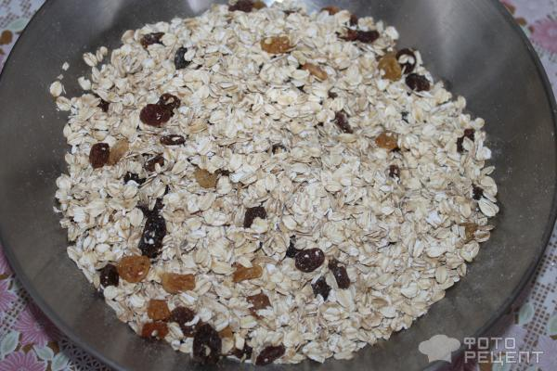

Slide 8
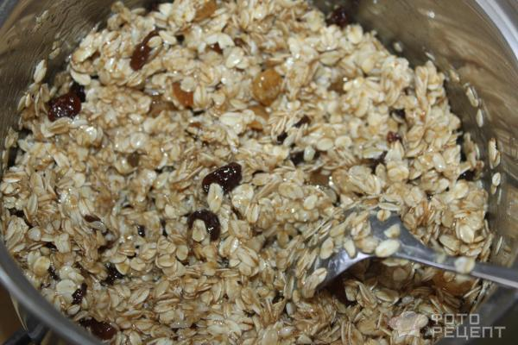

Slide 9
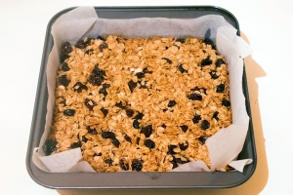

Slide 10
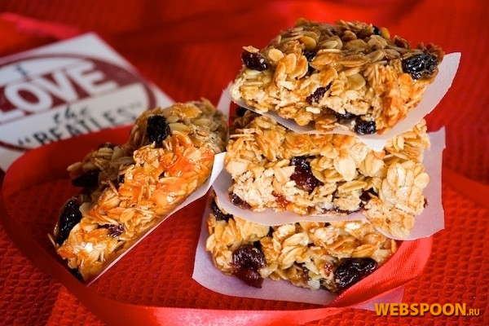

Slide 11
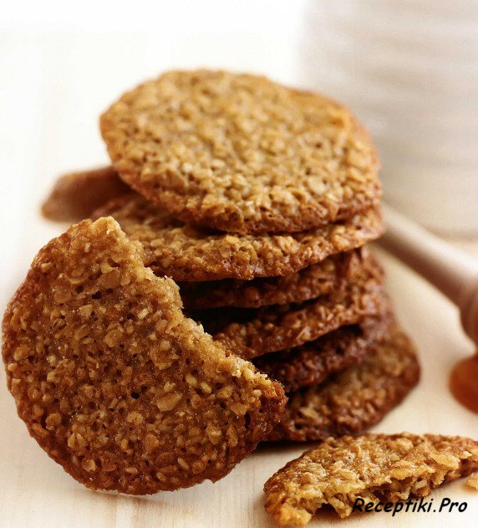

Slide 12
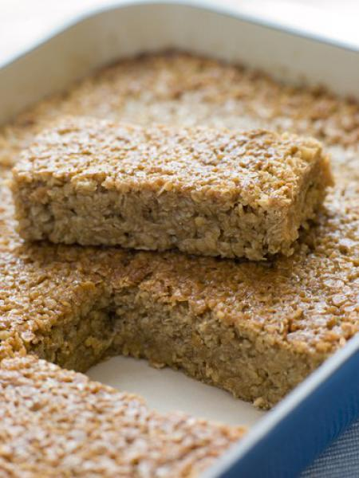

Slide 13
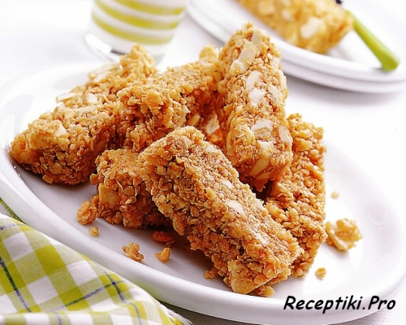

Slide 14
Thank you for your attention
Enjoy your meal

