Slide 1
Benjamin Franklin
(17,01,1706—17,04,1790)

Slide 2
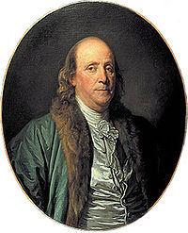
Origin
Father Joseph Franklin Benjamin Franklin was born in the town of Acton in Northamptonshire.
Mother Benjamin Franklin Ebien Folher born in the town of Nantucket Massachusetts.
Benjamin Franklin

Slide 3
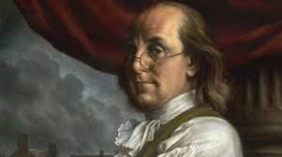
Views
At the core the political views of Benjamin Franklin lay concept of natural and inalienable rights, which he attributed to life, liberty, property.

Slide 4
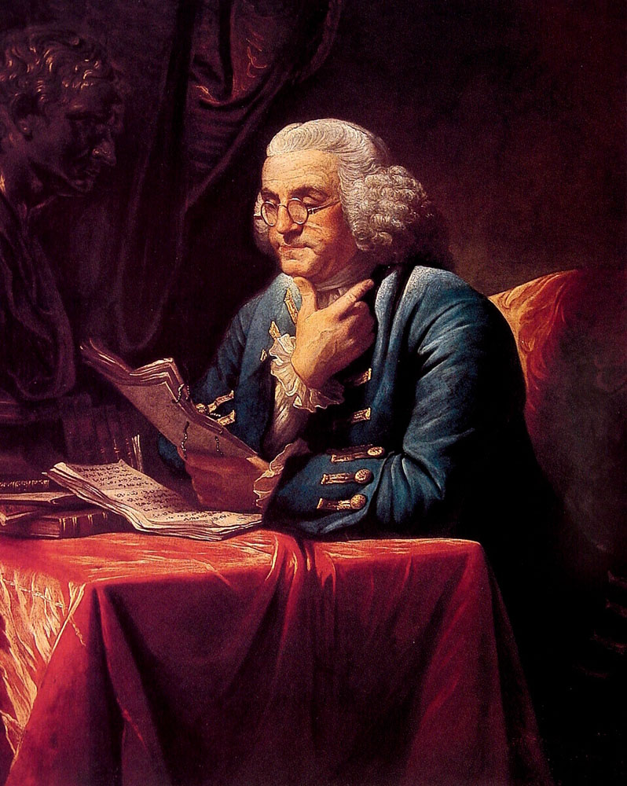
As a scientist, he was a prominent figure in the history of physics, making discoveries in the field of electricity. As a political writer and activist he more than any other was the author of the idea of ​​the American nation.

Slide 5

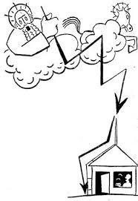
Inventions
The most prominent inventions are: earth electrode, explaining the principle of the Leyden jar, use an electric spark to ignite the dust
Leyden jar
earth electrode

Slide 6
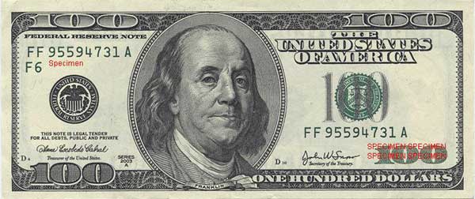
Glory
Benjamin Franklin pictured on the U.S. $ 100 banknote

Slide 7
Thank you

