Slide 1
Comparison of activity of Brotherhood of Saints Cyril and Methodius and of Ruska trinity
By Taras Shevchenko m.II-25

Slide 2
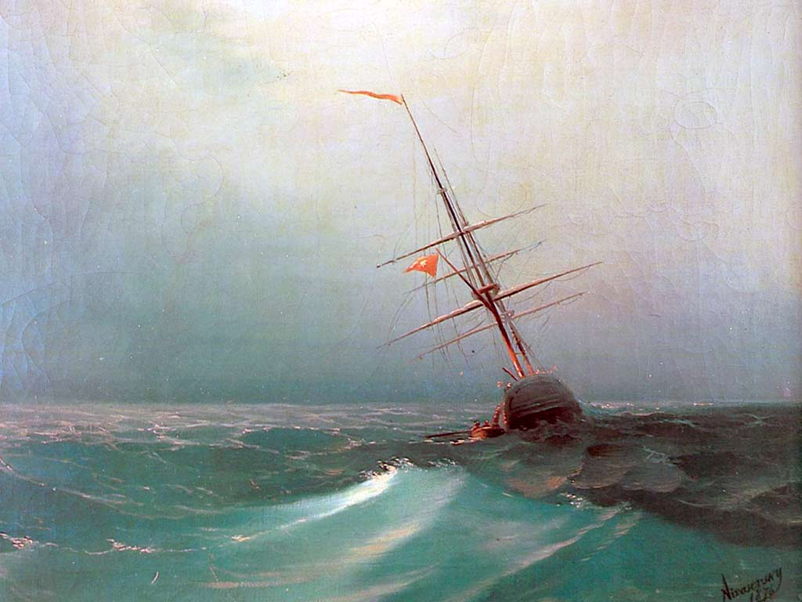
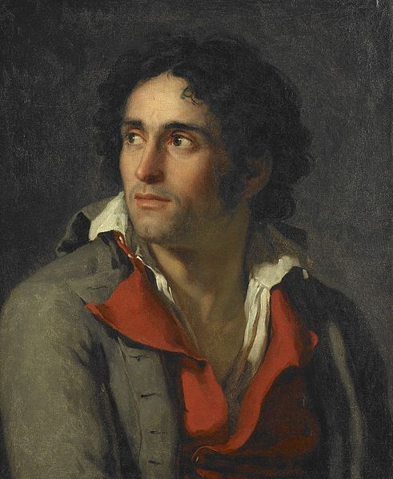
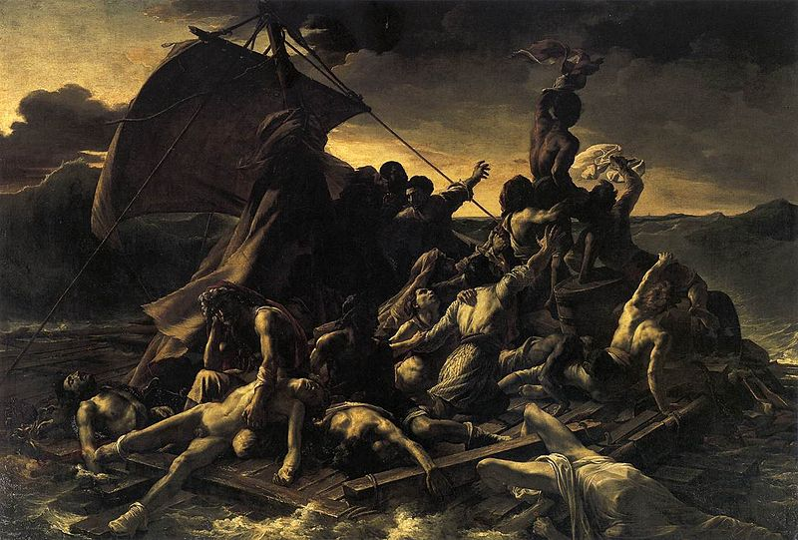
Historical Time
Romanticism - an ideological movement in literature and art, which emerged in the late 18th century in Germany, England and France, has spread from the early 19th century in Russia, Poland and Austria

Slide 3
The main principles of Romanticism in Ukraine
Romanticism emerged against the background of social crisis as a manifestation of disagreement with the trends of the XVIII century.
Central in romanticism became idealism in philosophy and the cult of feelings, appeal to the nation, collecting the folklore and folk artistic creativity.

Slide 4
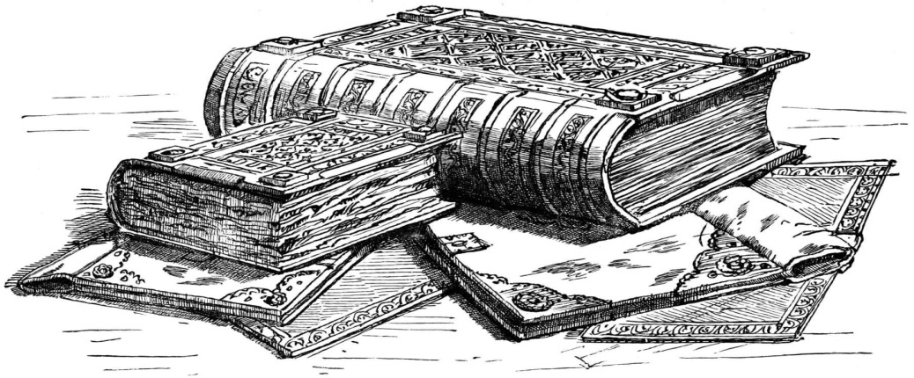
Groups romanticists
Thus in Ukraine there are many groups that are beginning to collect folklore, interested in his own history and origin. Each of them had a great effect in Ukraine (XIX – XX). The most important were: Kharkov and Kiev range of romantics, Brotherhood of Saints Cyril and Methodius and of Ruska trinity.

Slide 5
«Brotherhood of Saints Cyril and Methodius» Years of activity: 1845-1847 Place: Kyiv Literary line: Romanticism Work: "Book of Genesis of the Ukrainian people“ The main idea: Ukrainian national revival, autonomy and democracy throughout Ukraine Persons: M. Kostomarov, T. Shevchenko, V. Bilozerskyy, M. Hulak, P. Kulish.
«Ruska trinity» Years of activity: 1833-1837 Place: Lviv Literary line: Romanticism Work: “Rusalka Dnistrova” The main idea: national and cultural revival in Western Ukraine. Persons: M.Shashkevych, I.Vahylevych, J. Holovatsky.

Slide 6
Conclusions
Both Brotherhood have a huge impact on the further development of Ukraine. In my opinion, these groups began the cultural and national revival in the 19th century in Ukraine.
Also it was the first step in the revival of a nation as Ukraine.

Slide 7
Thanks for your attention!

