Slide 1
Salvador Dalí
Prepared by: Shevchenko Eleonora

Slide 2
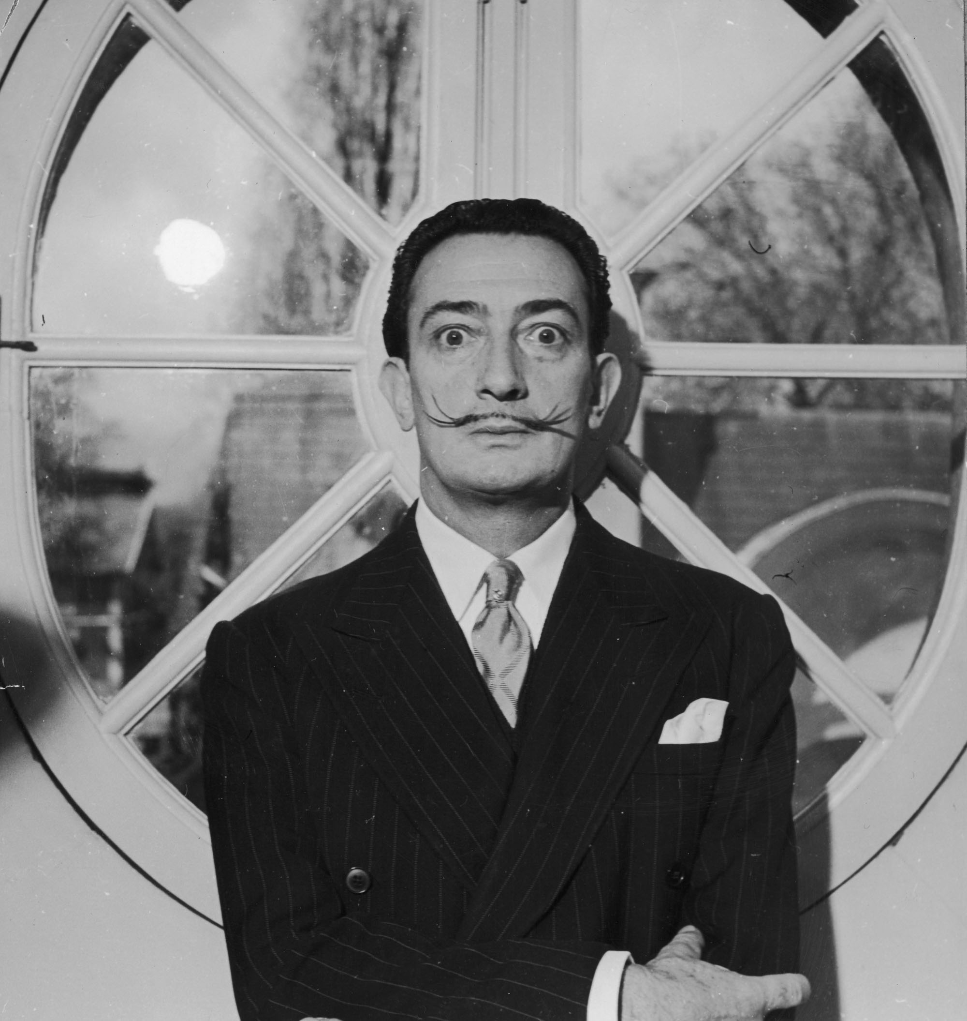
Salvador Dalí
Spanish artist and Surrealist icon Salvador Dalí is perhaps best known for his painting of melting clocks, The Persistence of Memory. Dalí was a skilled draftsman, best known for the striking and bizarre images in his surrealist work.

Slide 3
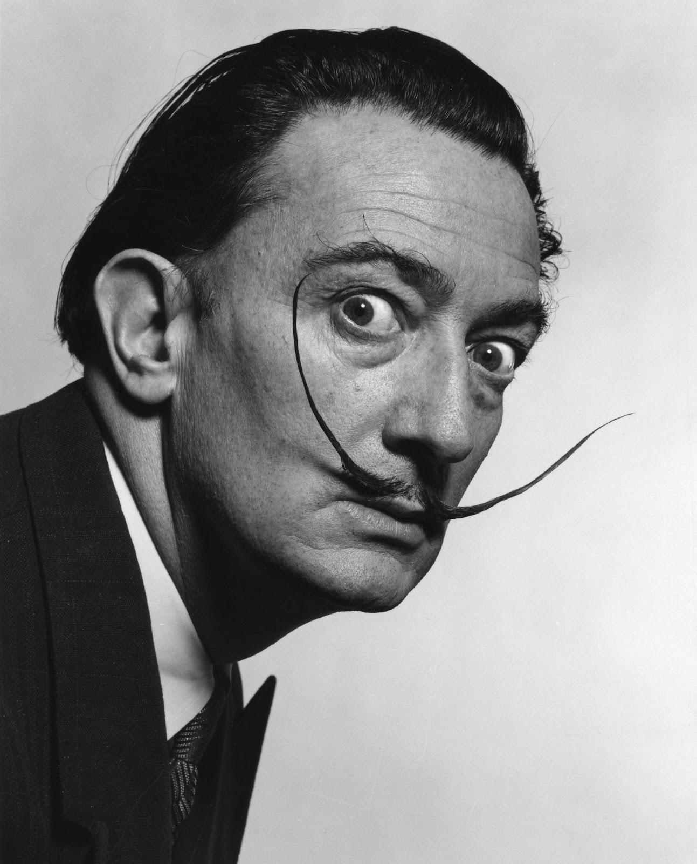
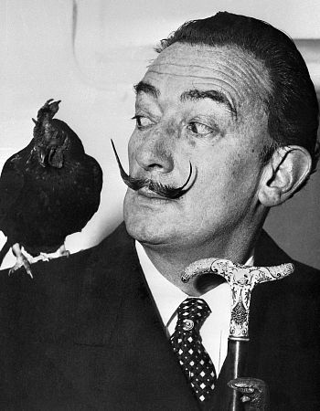
Dalí was highly imaginative, and also enjoyed indulging in unusual and grandiose behavior.

Slide 4
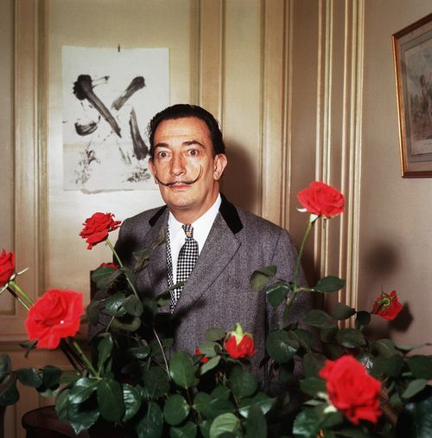

Slide 5
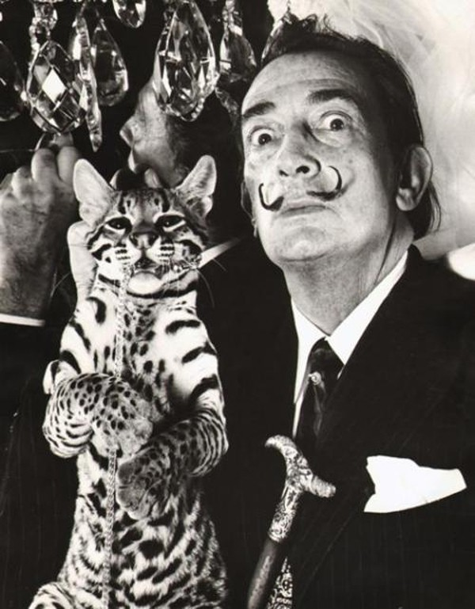
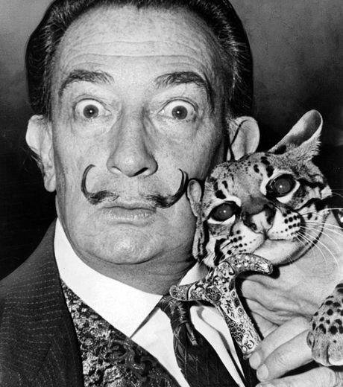
A Colombian ocelot called Babou.
Dalí and Babou at the St. Regis hotel, New York where Dalí had a suite, 1965
One of the most popular accounts of Dalí and Babou is that of the painter bringing the wild cat into a Manhattan restaurant .

Slide 6
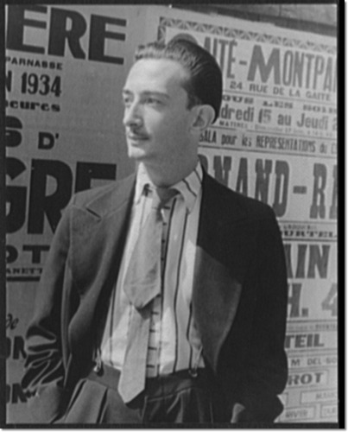
Art School
Salvador Dalí was born on May 11, 1904, in Figueres, Spain. From an early age, Dalí was encouraged to practice his art and would eventually go on to study at an academy in Madrid. Dalí was expelled from the Academia in 1926, shortly before his final exams when he was accused of starting an unrest.
In art school, Dalí began exploring many forms of art including classical painters like Raphael, Bronzino and Diego Velázquez (from whom he adopted his signature curled moustache). He also dabbled in avant-garde art movements such as Dada.

Slide 7
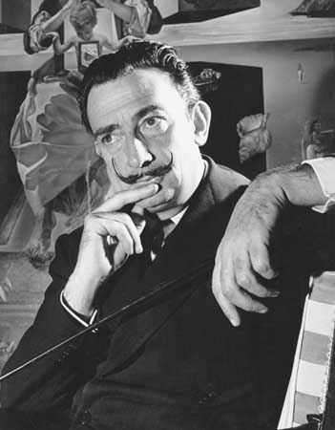
Art
Dalí was working with styles of Impressionism, Futurism and Cubism. Dalí's paintings became associated with three general themes:
man's universe and sensations,
sexual symbolism
ideographic imagery.
All of this experimentation led to Dalí's first Surrealistic period in 1929.

Slide 8
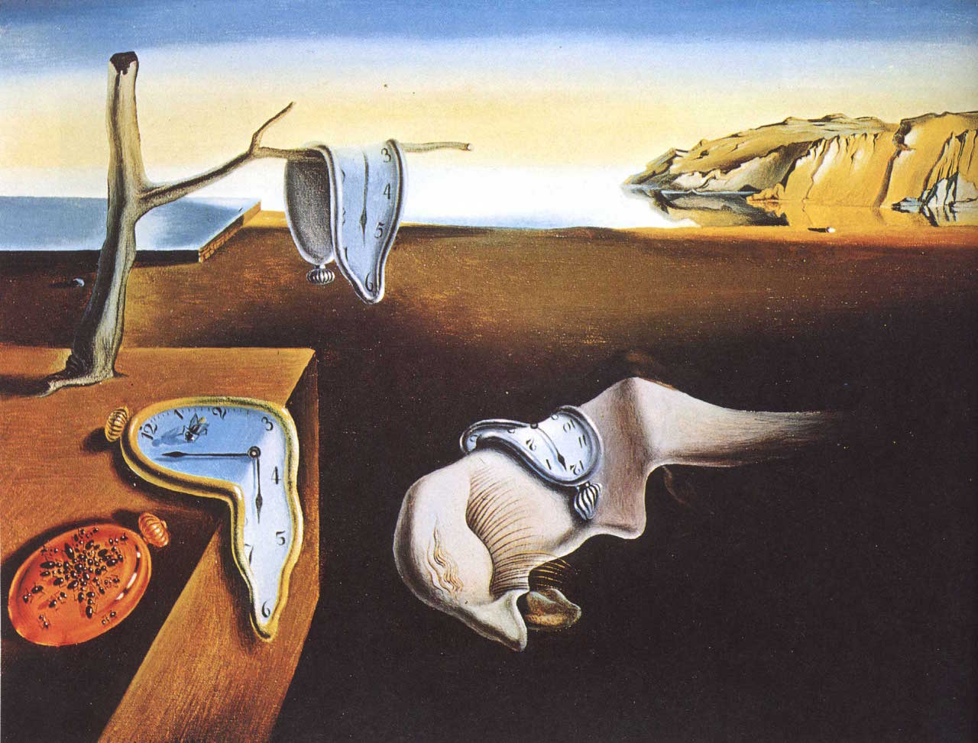
One of Dalí's most famous paintings produced at this time—and perhaps the best-known Surrealist work—was The Persistence of Memory (1931). The painting, sometimes called Soft Watches, shows melting pocket watches in a landscape setting. It is said that the painting conveys several ideas in the image, chiefly that time is not rigid and everything is destructible.

Slide 9
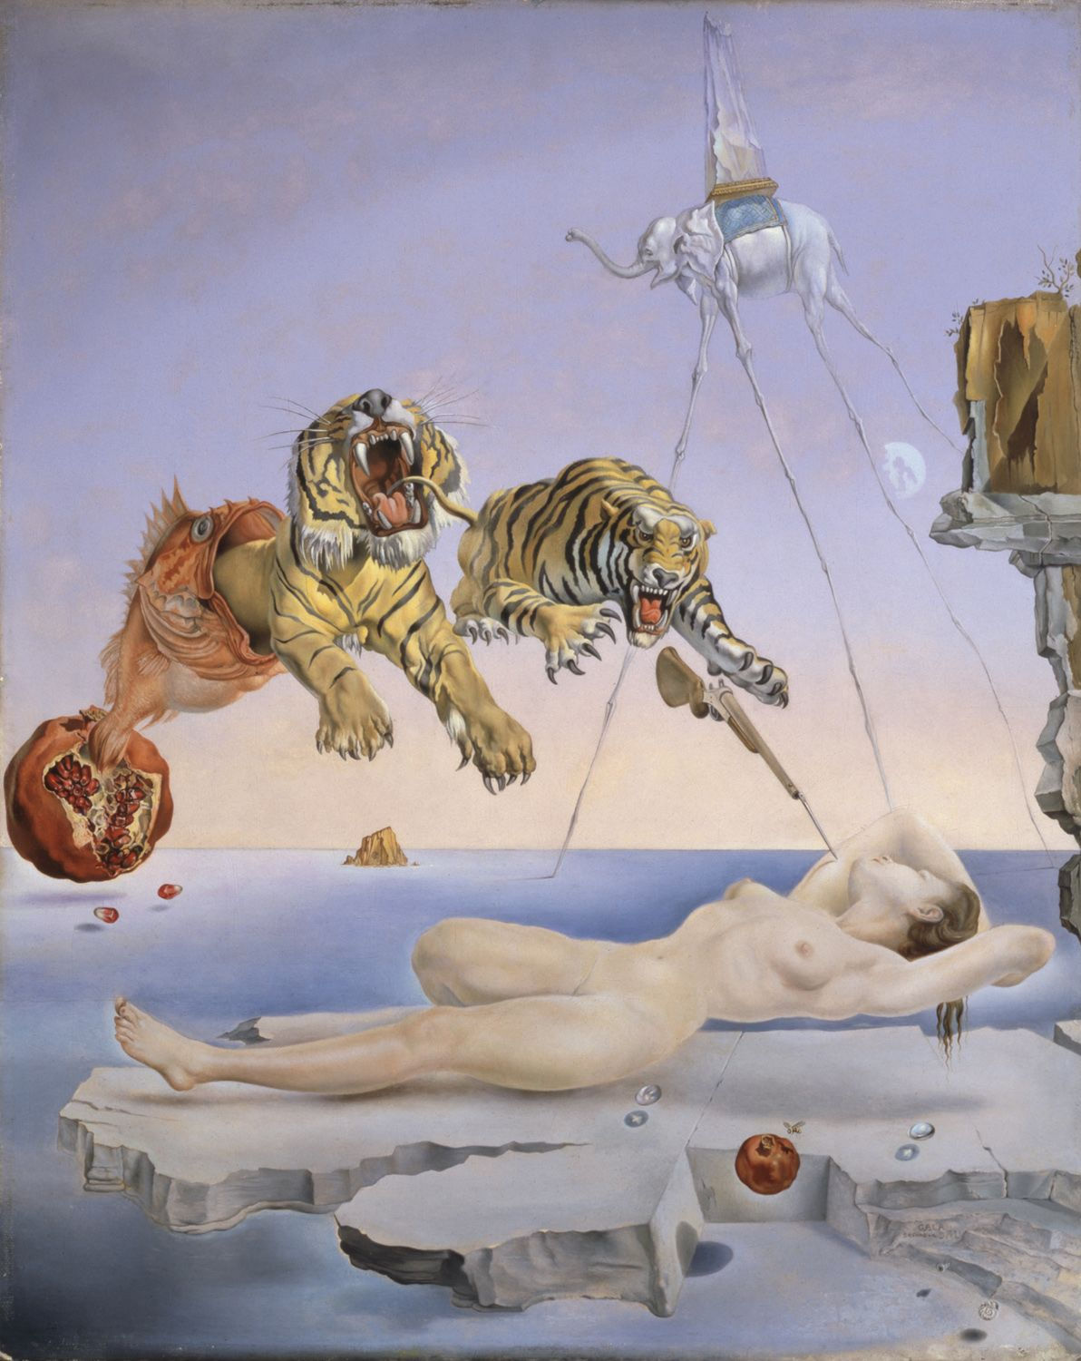
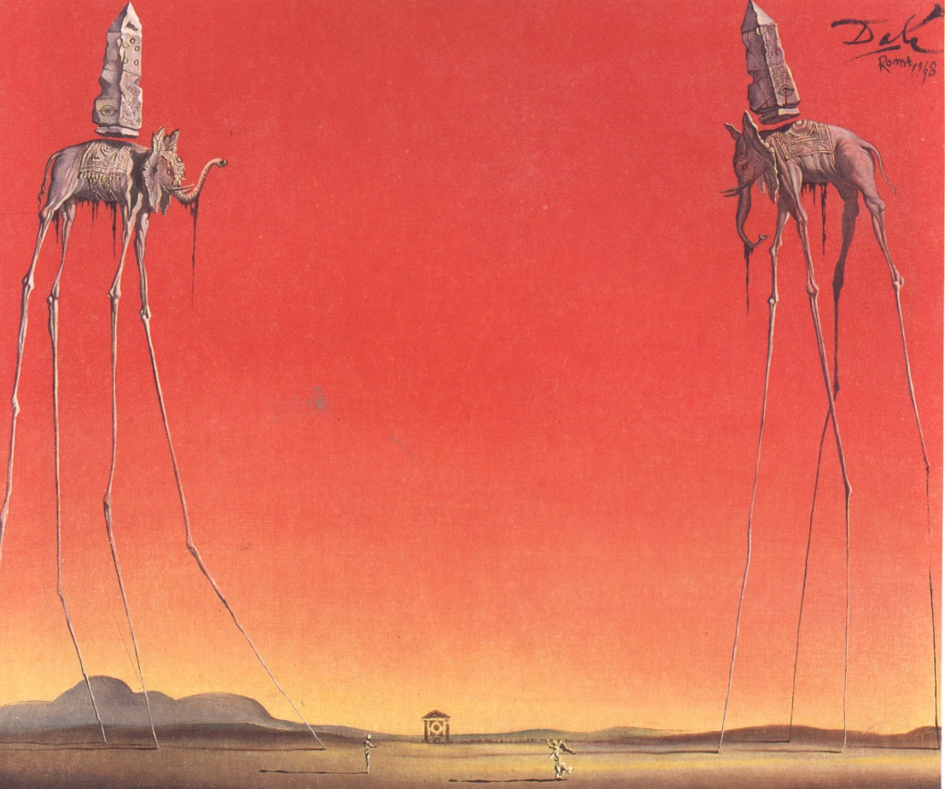
Dream Caused by the Flight of a Bee
around a Pomegranate a Second Before Awakening
The elephants

Slide 10
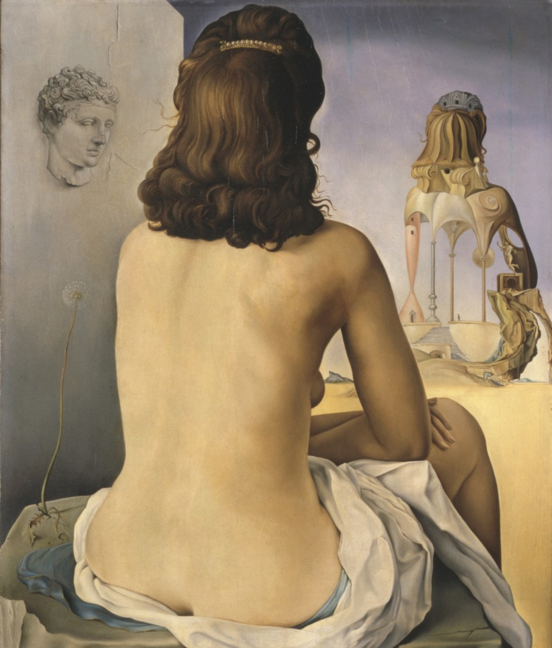
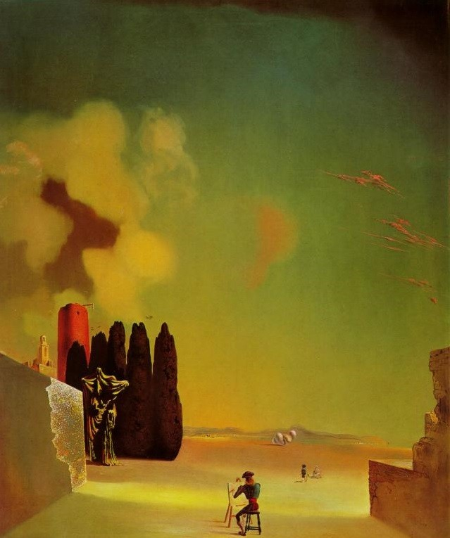
My wife, naked looking at her own body, which is transformed into steps, three vertebrae of a column, sky and architecture.
Enigmatic Elements in a Landscape.

Slide 11
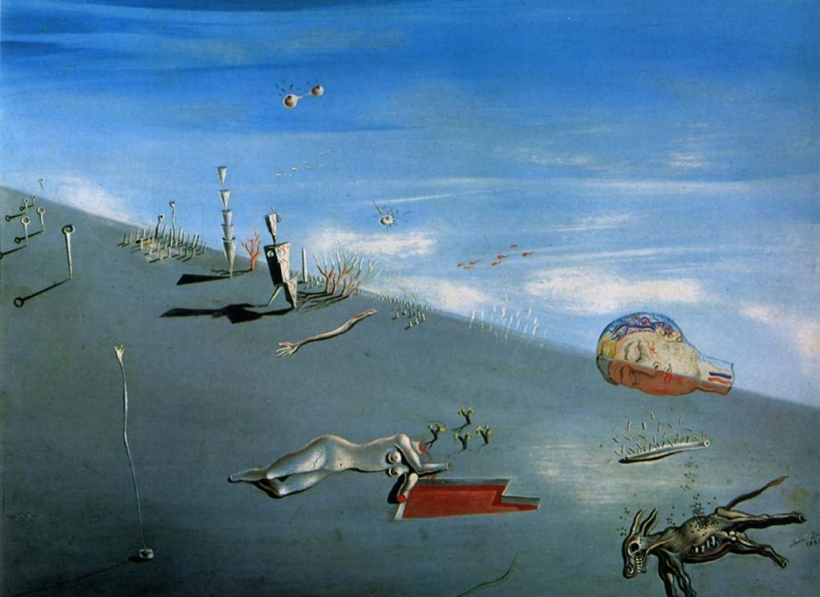
Study for ‘Honey is Sweeter than Blood’

Slide 12
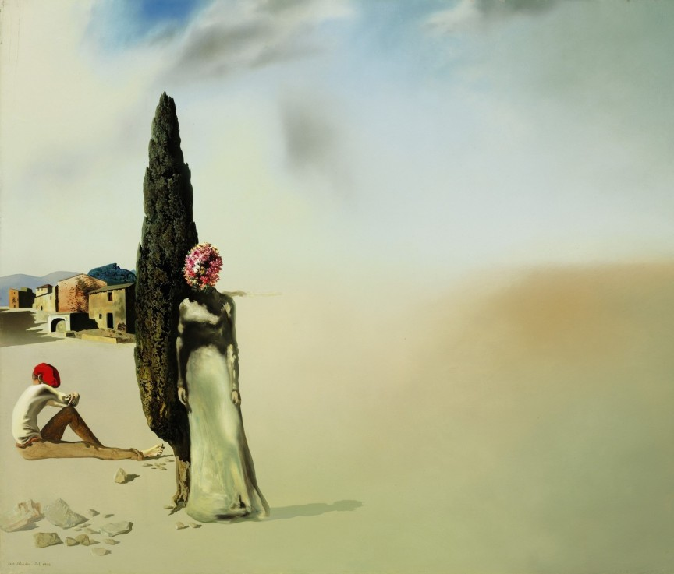
Set in a barren desolate desert, the type of landscape Dali preferred in many of his works, Printemps necrophilique, or Necrophiliac springtime stands as an allegory for the painter's paranoia, his conscience shifting toward illusion. Painted in 1936, Printemps necrophilique depicts a seated seated man and a flower-headed woman on the left, separated by a cypress tree, the woman looking toward the viewers, while the man gazes at the blurred landscape. The desert slowly fades from hyperrealistic to hallucinatory.
Necrophiliac springtime

Slide 13


Slide 14
