Slide 1
John William Cheever
Prepared by Natali Burgelya

Slide 2
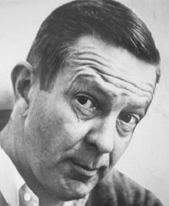
John William Cheever (May 27, 1912 – June 18, 1982) was an American novelist and short story writer. He is sometimes called "the Chekhov of the suburbs." His fiction is mostly set in the Upper East Side of Manhattan, the Westchester suburbs, old New England villages based on various South Shore towns around Quincy, Massachusetts, where he was born, and Italy, especially Rome.

Slide 3
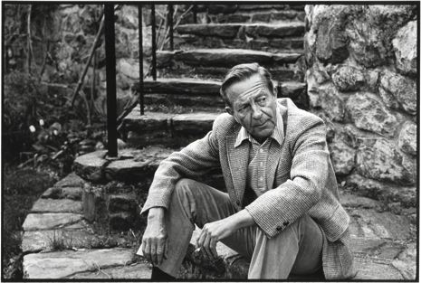
He is "now recognized as one of the most important short fiction writers of the 20th century." While Cheever is perhaps best remembered for his short stories (including "The Enormous Radio," "Goodbye, My Brother," "The Five-Forty-Eight," "The Country Husband," and "The Swimmer"), he also wrote four novels, comprising The Wapshot Chronicle (National Book Award, 1958), The Wapshot Scandal (William Dean Howells Medal, 1965), Bullet Park (1969), Falconer (1977) and a novella Oh What a Paradise It Seems (1982).

Slide 4
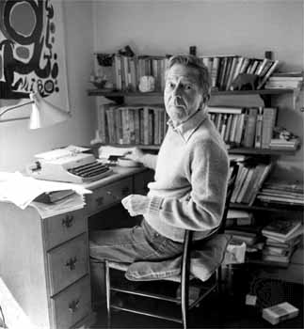
His main themes include the duality of human nature: sometimes dramatized as the disparity between a character's decorous social persona and inner corruption, and sometimes as a conflict between two characters (often brothers) who embody the salient aspects of both – light and dark, flesh and spirit. Many of his works also express a nostalgia for a vanishing way of life (as evoked by the mythical St. Botolphs in the Wapshot novels), characterized by abiding cultural traditions and a profound sense of community, as opposed to the alienating nomadism of modern suburbia. A compilation of his short stories, The Stories of John Cheever, won the 1979 Pulitzer Prize for Fiction and a National Book Critics Circle Award, and its first paperback edition won a 1981 National Book Award.

Slide 5
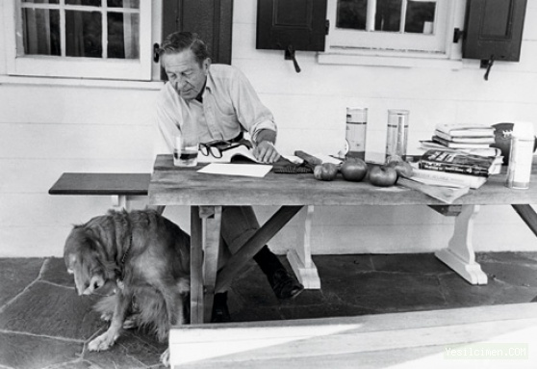
On April 27, 1982, six weeks before his death, Cheever was awarded the National Medal for Literature by the American Academy of Arts and Letters. His work has been included in the Library of America.

Slide 6
Short Stories
collections
-The Way Some People Live (1943)
-The Enormous Radio and Other Stories (1953)
-Stories (with Jean Stafford, Daniel Fuchs, and William Maxwell) (1956)
-The Housebreaker of Shady Hill and Other Stories (1958)
-Some People, Places and Things That Will Not Appear In My Next Novel (1961)
-Reunion (1962)
-The Brigadier and the Golf Widow (1964)
-The World of Apples (1973)
-The Stories of John Cheever (stories, 1978)
-Fall River and Other Uncollected Stories (1994)

Slide 7
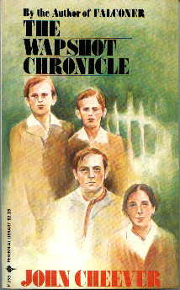
Novels The Wapshot Chronicle (1957) The Wapshot Scandal (1964) Bullet Park (1969) Falconer (1977) Oh What a Paradise It Seems (1982) Collections The Letters of John Cheever, edited by Benjamin Cheever (1988) The Journals of John Cheever (1991) Collected Stories & Other Writings (Library of America) (stories, 2009) Complete Novels (Library of America) (novels, 2009)

