Slide 1
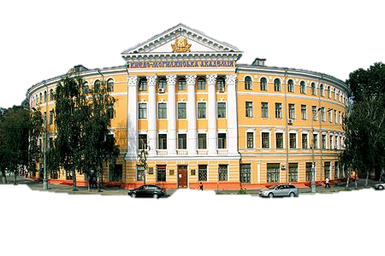

Slide 2
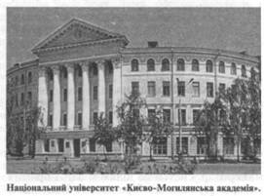
History

Slide 3
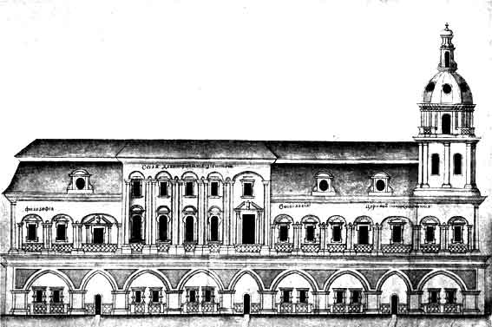
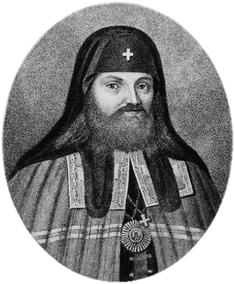
1615 October 15 is Official Day of the Founding of Kyiv-Mohyla Academy 1632 Kyiv Brotherhood School and Kyiv Lavra School merged, and Kyiv Brotherhood College established by St. Petro Mohyla 1658 Kyiv-Mohyla College is granted legal status of a higher school and the title «Academy» (according to Hadiatska Uhoda, ratified by the Sejm of Rzeczpospolita in May, 1659)

Slide 4
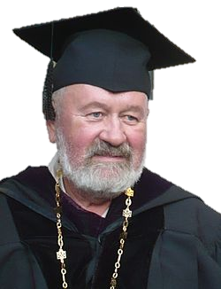
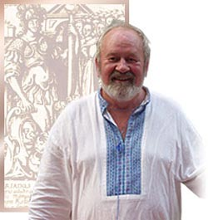
1991 Decree of the Chairman of the Ukrainian Verkhovna Rada «On the revival of Kyiv-Mohyla Academy on its historic territory as an independent Ukrainian institution of higher education — University of Kyiv-Mohyla Academy» issued. Vyacheslav Briukhovetskyi, Doctor of Philology, nominated UKMA president (September 19) 1992 University of «Kyiv-Mohyla Academy» officially opened; the first entrants accepted as students (August 24) 1994 Decree of the President of Ukraine awarding «Kyiv-Mohyla Academy» the status of a «National University» (May 19) 1994 NaUKMA accredited at the fourth (highest) level of university accreditation (June 30)

Slide 5
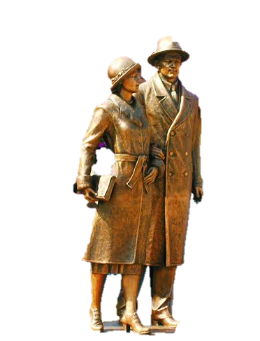
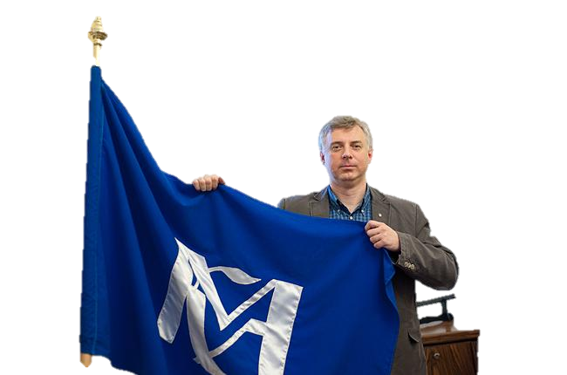
2007 The Tetiana and Omelyan Antonovych Library opened (May 24) 2007 The 16th session of the NaUKMA Academic Conference elects a new NaUKMA president — Dr. Serhiy Kvit (June 29) 2009 NaUKMA granted a title of self-ruling (autonomous) Research University (Resolution № 799, Cabinet of Ministers of Ukraine) (July 29)

Slide 6
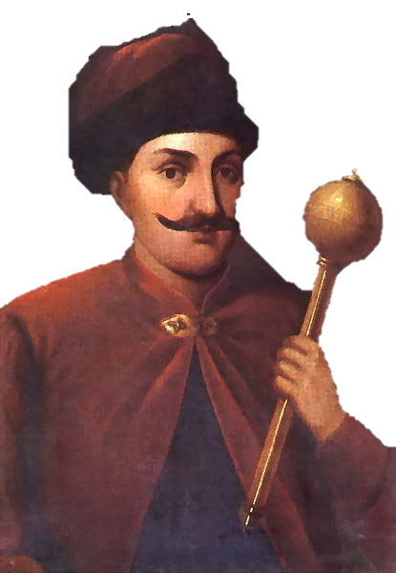
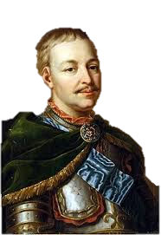
Figures During the period of its prosperity (17–18th centuries), Kyiv-Mohyla Academy considerably influenced the intellectual, scientific, educational, cultural and spiritual life of Ukraine. Its alumni shaped social and political views, influenced the national consciousness of Ukrainians.
Prominent personalities associated with Kyiv-Mohyla Academy Writer Petro Hulak-Artemovskyi, Philosopher Hryhoriy Skovoroda
Hetmans of Ukraine (students of Kyiv-Mohyla Academy) Ivan Vyhovsky, Pavlo Teteria
The Kyiv-Mohyla Academy Founders Petro Mohyla (canonised), Ivan Mazepa

Slide 7
FACULTY OF HUMANITIES — History — Literature and Foreign Languages — Philosophy and Religious Studies — Ukrainian Language FACULTY OF ECONOMICS — Economic Theory — Finance FACULTY OF COMPUTER SCIENCES — Mathematics — Multimedia Systems — Network Technologies FACULTY OF SOCIAL SCIENCES AND SOCIAL TECHNOLOGIES — Political Science — PR Studies — Psychology and Pedagogics — Sociology FACULTY OF NATURAL SCIENCES — Biology — Chemistry — Physics and Mathematics FACULTY OF LAW — Applied Legal Studies — International Law — Legal Philosophy and Constitutional Law — Jean Monnet Chair in European Union Law
Departments

Slide 8
General library collection is 1 036 801 items , including 362 067 items of electronic editions. This is a serious collection of scientific, educational books and periodicals, that provides research and academic mission of NaUKMA. Library printed collection is fully represented in the electronic catalogue.
Collection development of the NaUKMA Library – is a unique example of creating in a short time (since February 1992) from zero to more than one million items. 70% of the Printed Collection are books and periodicals, donated by more than 5 thousands of individuals, institutions and organizations from around the world.
The Collection is multilingual: Ukrainian editions are 51%, English - 23%, others - in other languages (99 languages). Significant historical, cultural and scientific value brings the Rare Books special collection, that covers more than 10 000 items.

