Slide 1
What should be the perfect husband?

Slide 2
It is always interesting and exciting.

Slide 3
I think, that ideal husband
should :

Slide 4
Be
kind,
caring.

Slide 5


Slide 6


Slide 7
Be responsible.

Slide 8


Slide 9
Trust his wife.

Slide 10


Slide 11
Be
a Good
dad.

Slide 12


Slide 13
Show and receive trust.

Slide 14
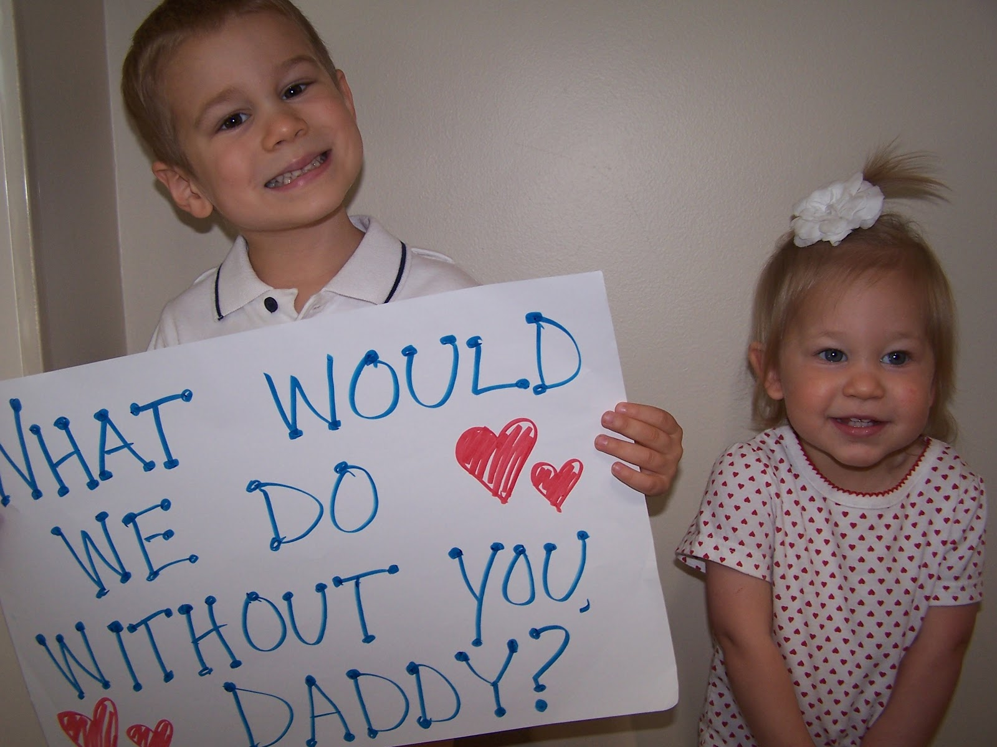

Slide 15
Keep a healthy lifestyle and be a good example for children.

Slide 16


Slide 17
Provide if that is a role he has chosen. If he is the provider in the family, he must, naturally, 'provide'. It is his primary duty and is no obligation to those for whom he provides.

Slide 18


Slide 19
Love his wife.

Slide 20
Everyone has its drawbacks.
But a man is always ideal for those who love him.

Slide 21


