Slide 1
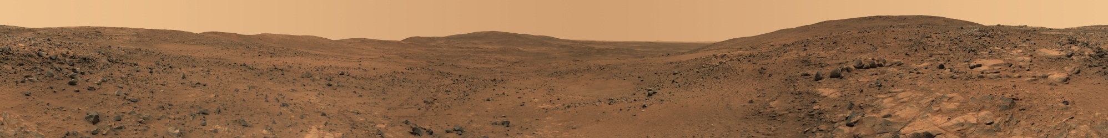
A Trip To Mars

Slide 2
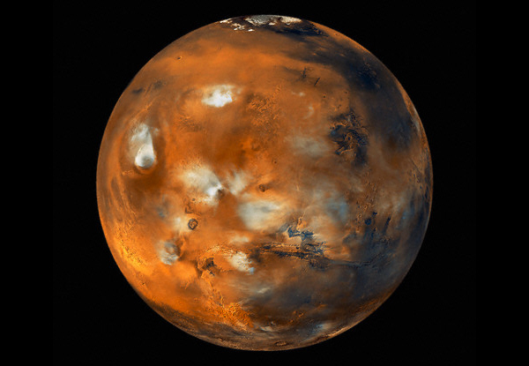
Mars
Mars is the fourth planet from
the Sun
in the Solar System.
It is often
described as the “Red Planet”.
Mars has two moons,
Phobos and
Deimos, which
are small and irregularly shaped.

Slide 3
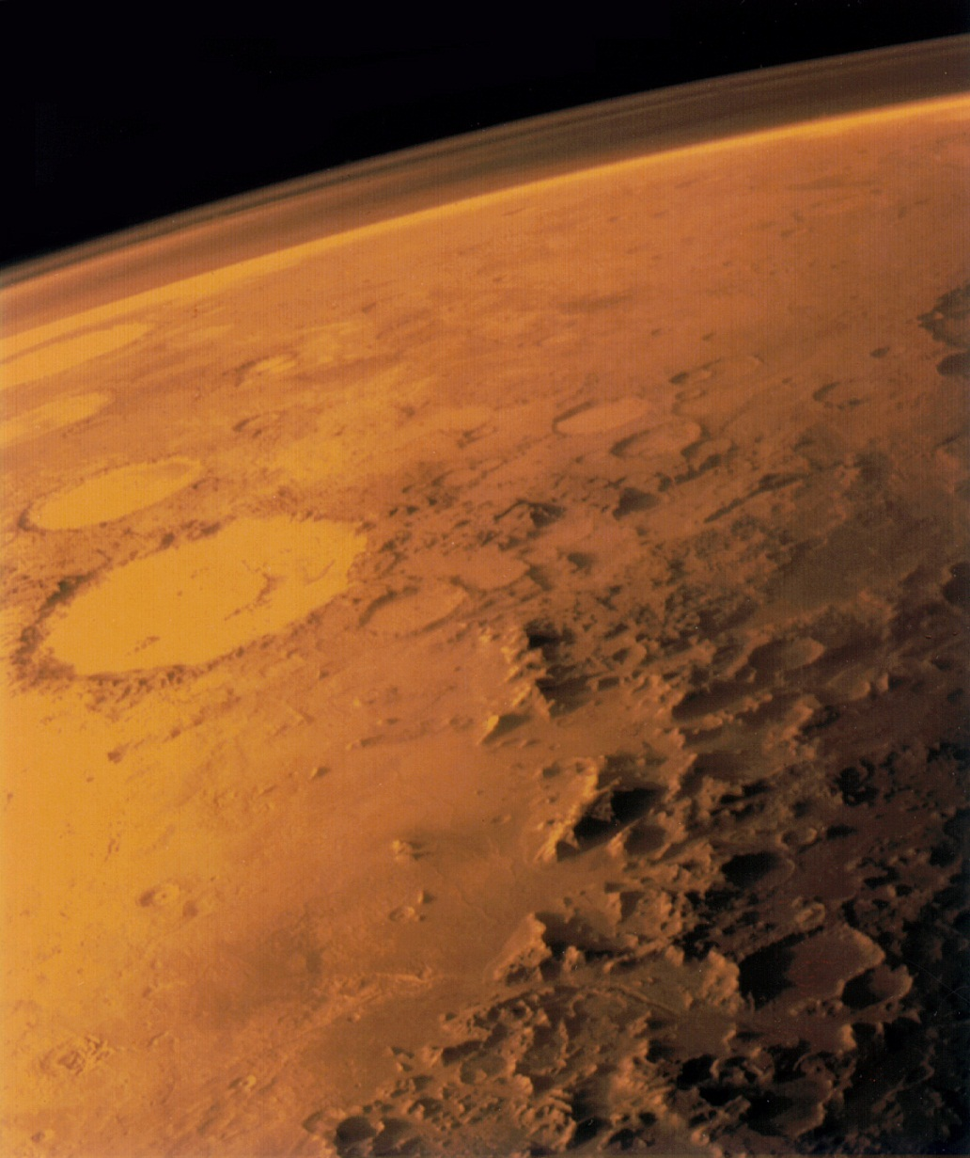
Trip to Mars is an old dream of mankind.
During it travels may open new natural resources,
which will improve life of humanity in the future.

Slide 4
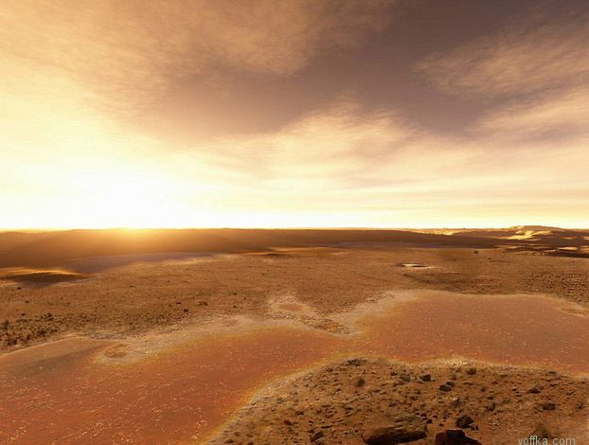
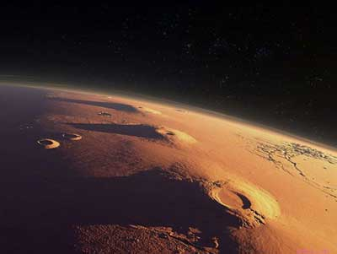
Mars is unknown planet, that hides a lot of secrets.
Currently we know, that life on Mars doesn’t exist,
but scientists continue to explore the planet.

Slide 5
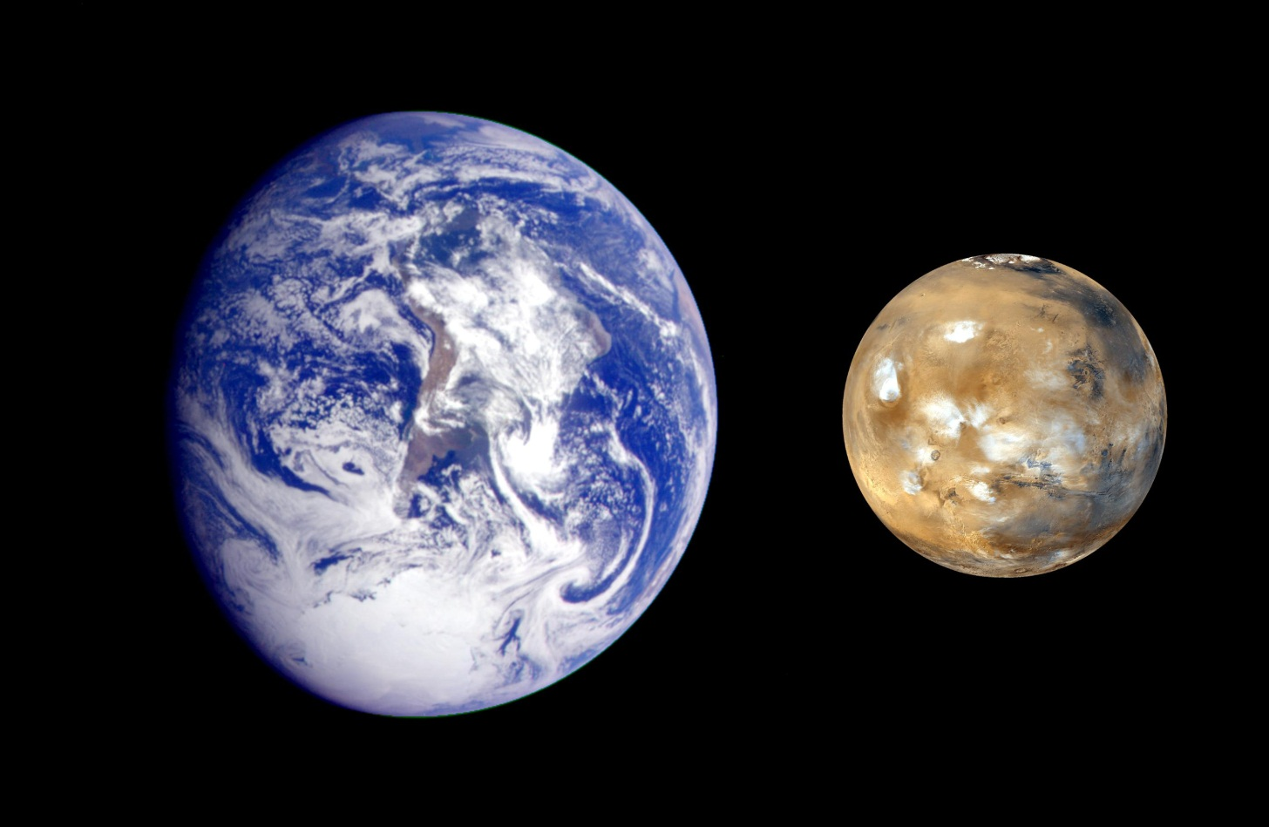
Life on Mars is very different from life on Earth. The main difference is gravity, temperature, lack of water pressure and carbon dioxide instead of oxygen.

Slide 6
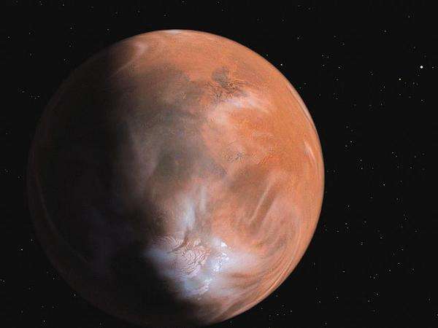
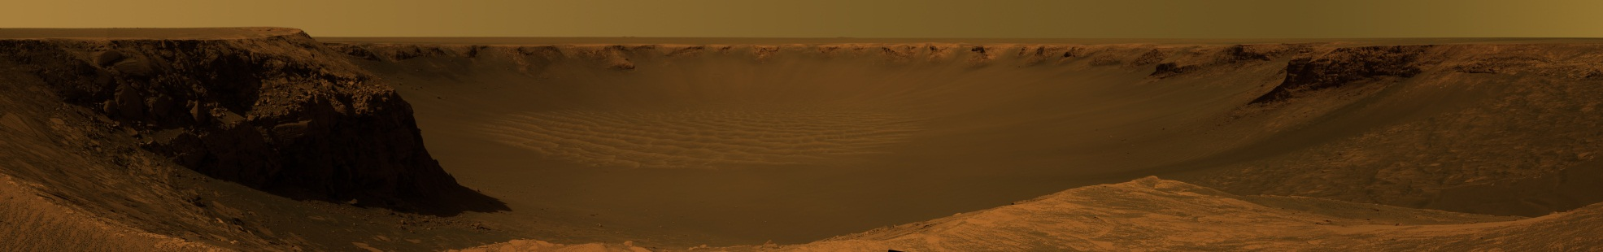
During a trip to Mars, many things can go wrong.
For example breakage of equipment.
Large amount of radiation and dust storms are a threat to human health.

Slide 7
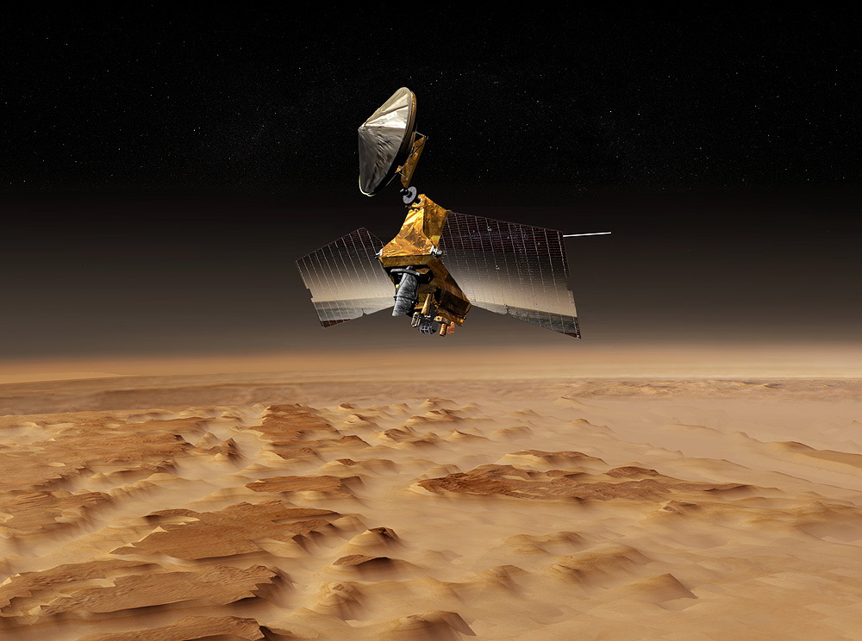
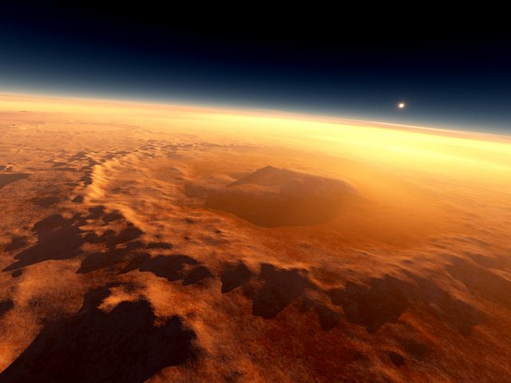
Trip will be important for human civilization,
if one takes the first step to another planet to colonize it later. Colonization of Mars can play a big role in saving mankind in the case of some global catastrophe on Earth, such as a collision with an asteroid.

Slide 8
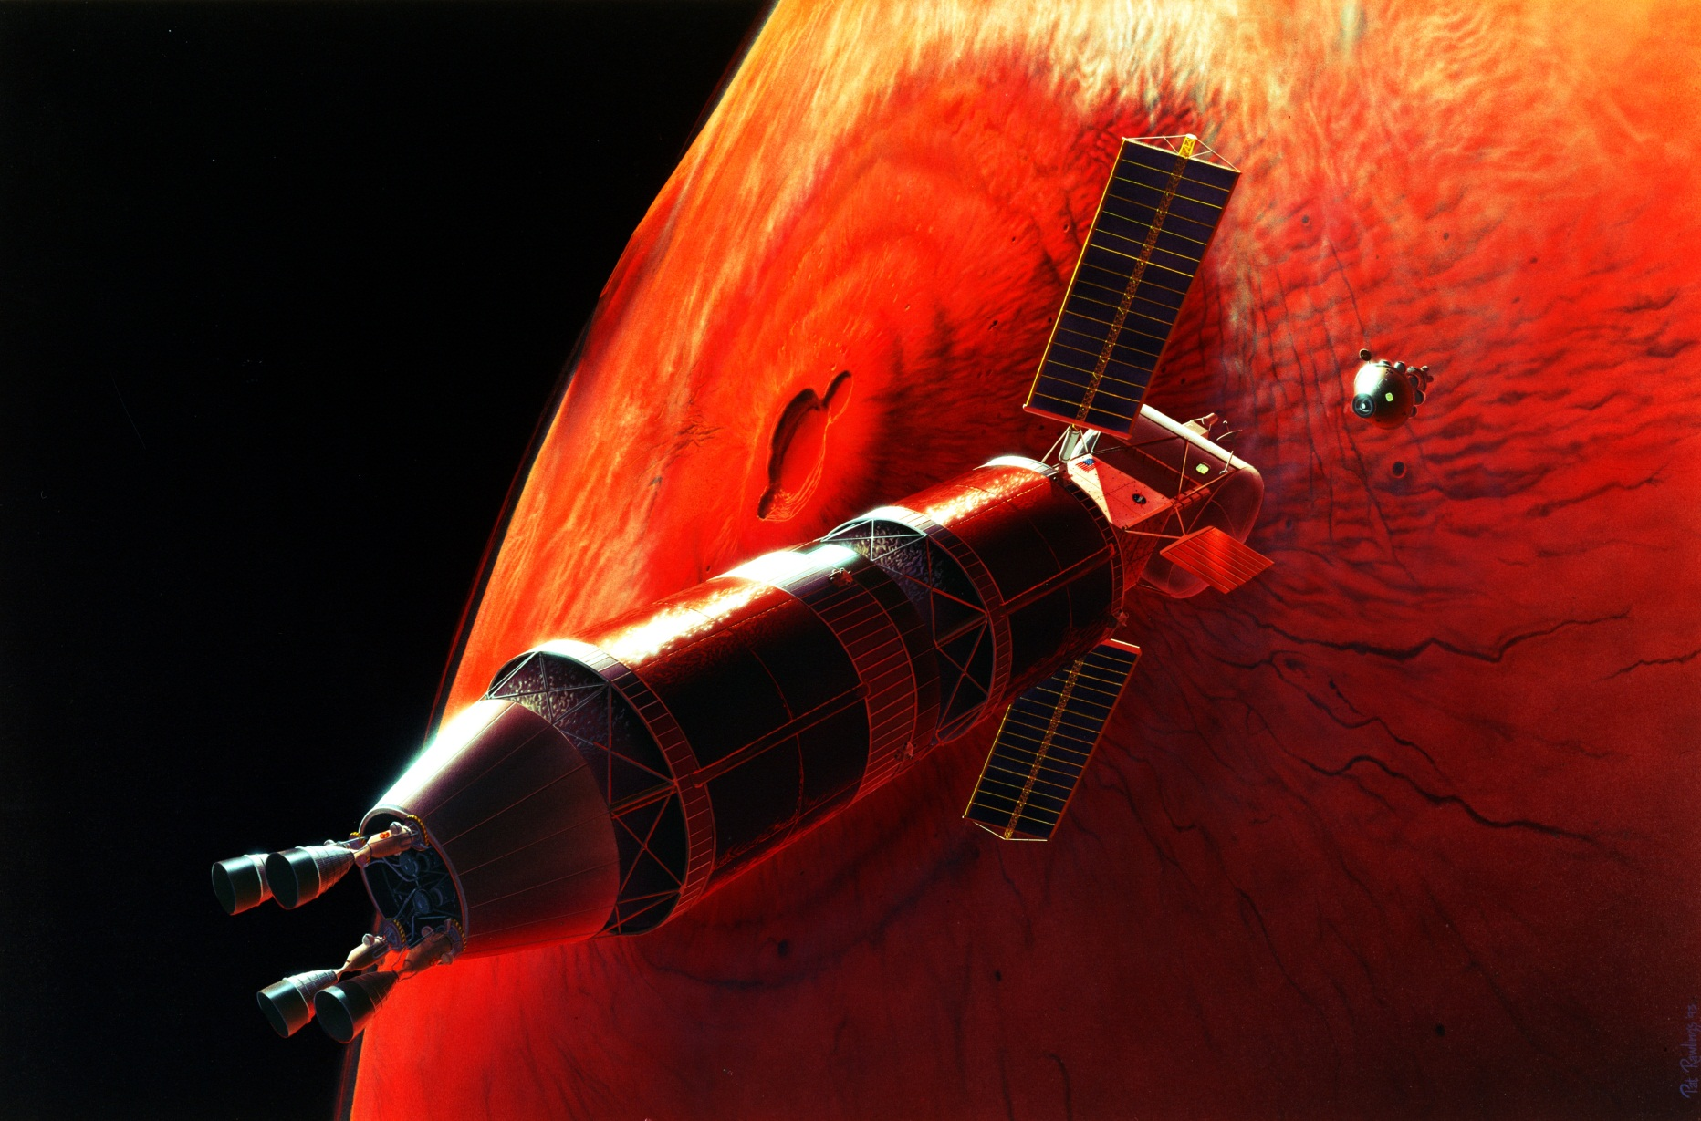
Thank you for your attention!

