Slide 1
Washington
prepared
student 11-a class
Andrew Pryadko
13.11.2014

Slide 2
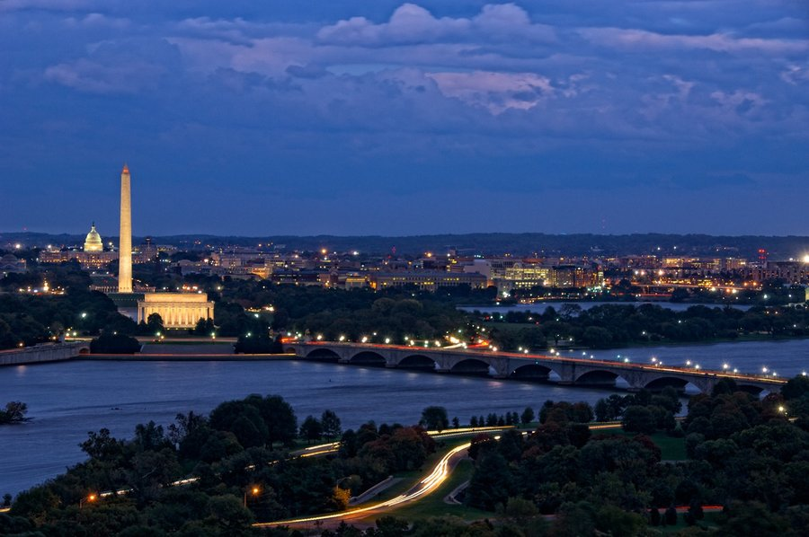
the capital of the USA. The city is not part of any of the United States; administratively is the district of Columbia.

Slide 3
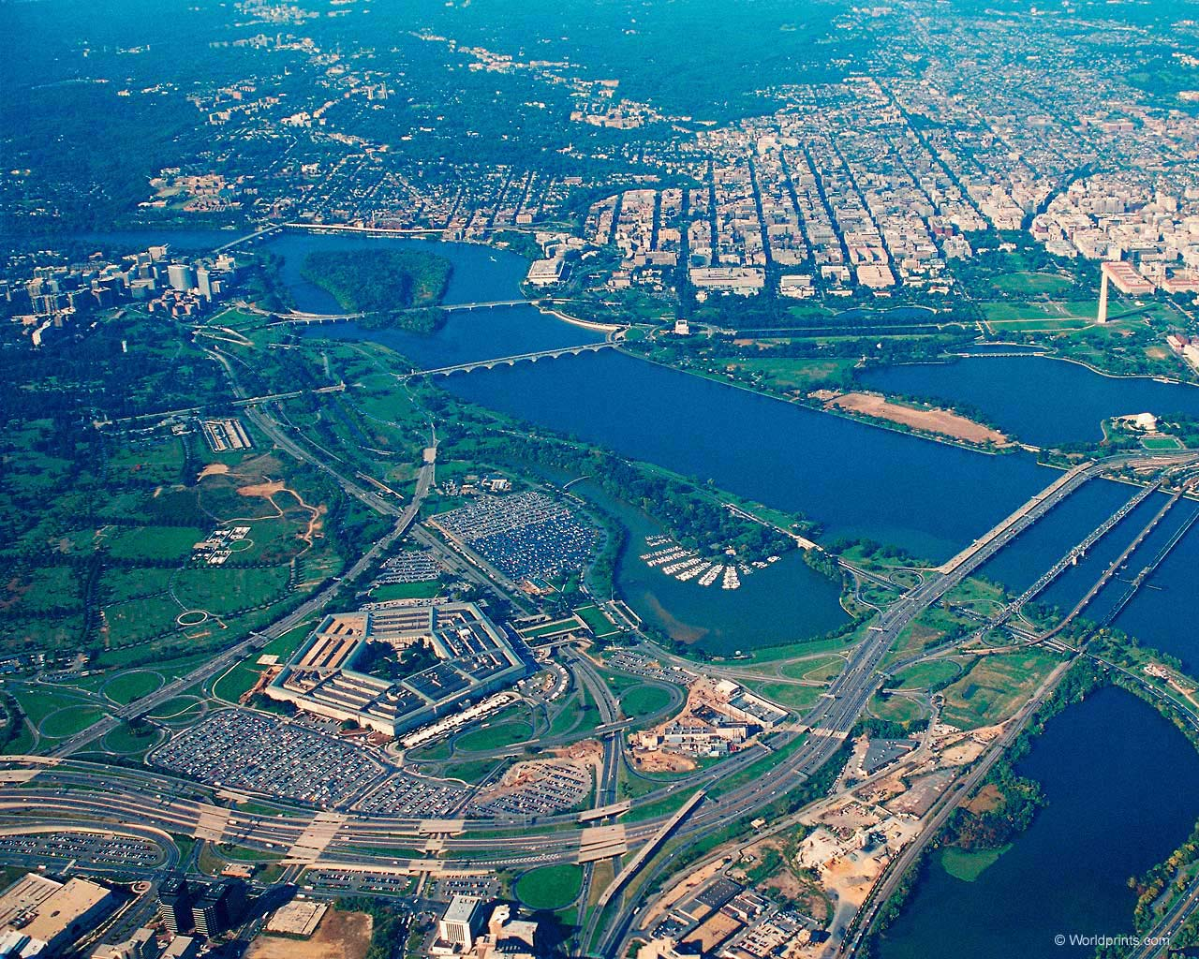
Located on the Potomac river.
The area of 180 km.
Population - 601 723 people

Slide 4
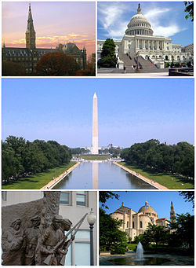
Famous buildings and monuments

Slide 5
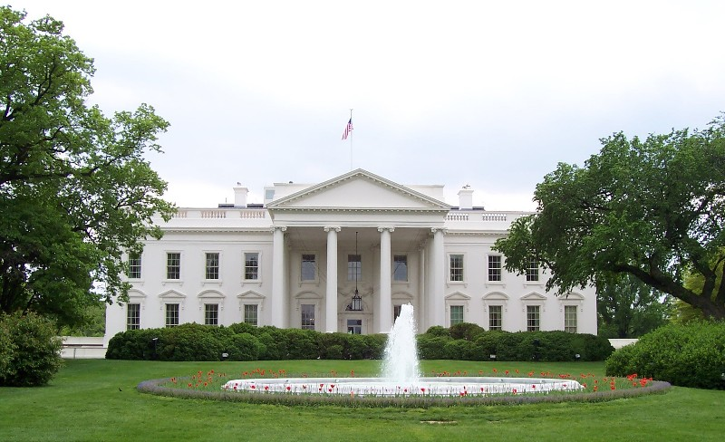
The white house - the residence of the U.S. President in Washington. November 1, 1800 its first owner was the second U.S. President John Adams.

Slide 6
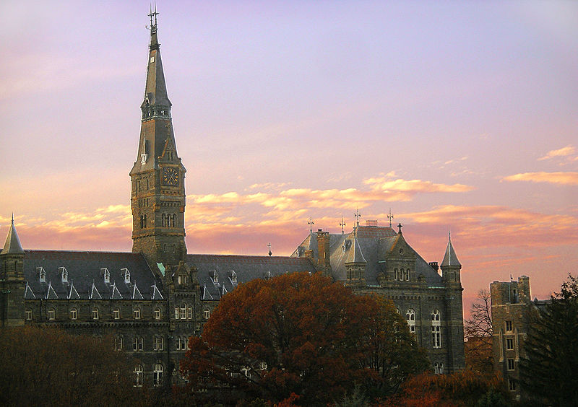
Georgetown University is a private Catholic University. Founded in 1789 by John Carroll, is the oldest Catholic University in the USA.

Slide 7
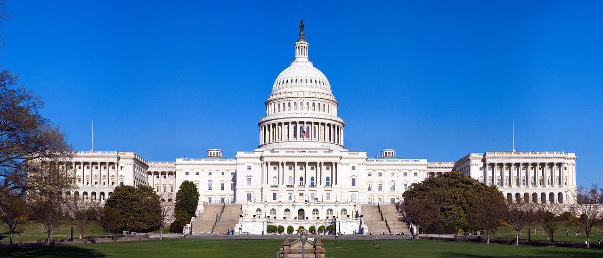
United States Capitol is the seat of the U.S. Congress . Connects to the Washington Monument and the Lincoln Monument 1800-meter National Mall.

Slide 8
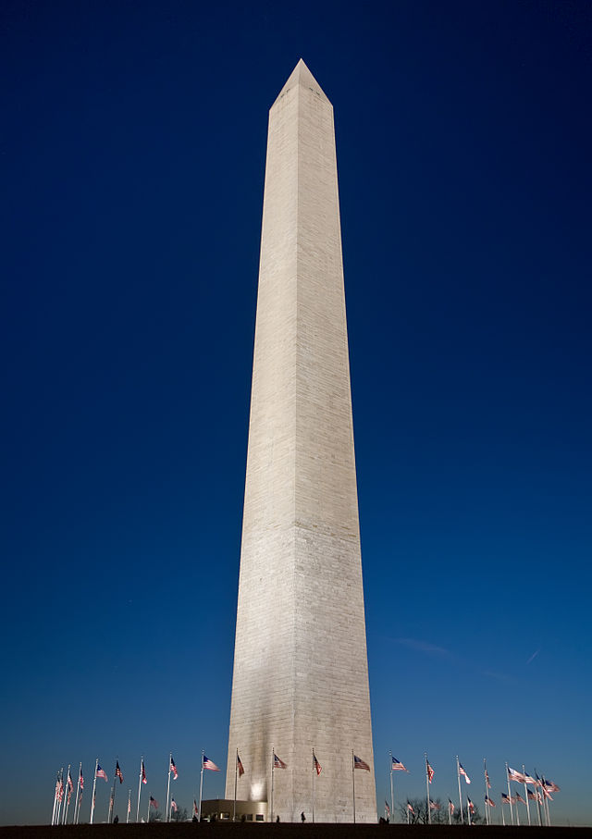
Washington Monument - erected in honor of the first U.S. President George Washington.

Slide 9
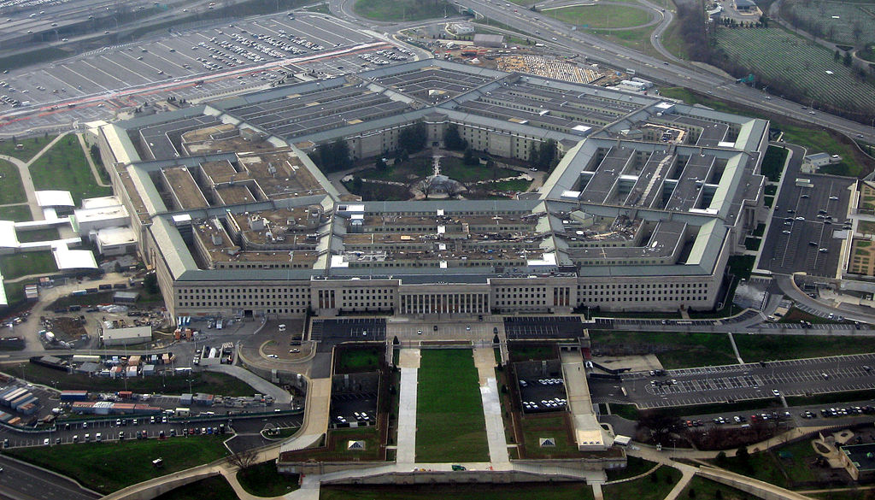
The Pentagon

Slide 10
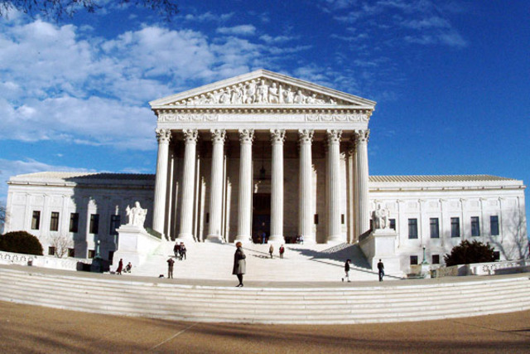
The U.S. Supreme court

