Slide 1

Ivan Karpenko-Kary
(Real name - Ivan Karpovich Tobilevych)
A remarkable Ukrainian writer, playwright, actor of the 19th century.

Slide 2

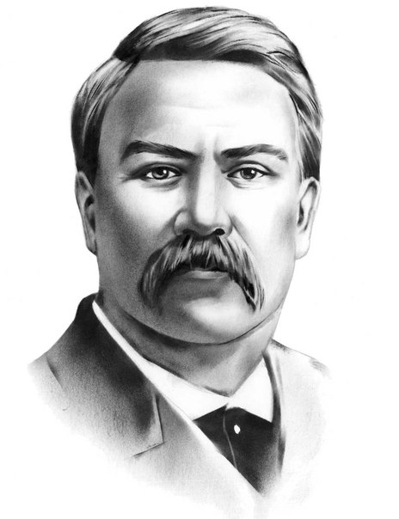
Ivan Tobilevych was born in the village Arsenivka.
His father came from an old noble family and his mother was a simple peasant.

Slide 3
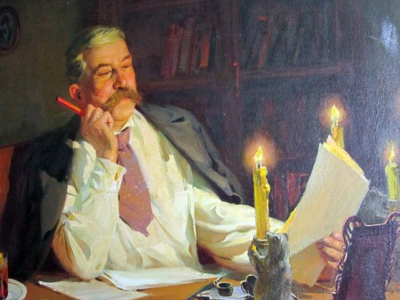
Ivan Karpenko-Kary - the largest figure in Ukrainian drama. A talented playwright enriched the literature works of various genres - socio-psychological drama, social comedy, historical drama.

Slide 4




He made ​​a great contribution to the development of
Ukrainian theater, but left only eighteen plays:
Unlucky (1884)
Hireling (1885)
Money (1889)
Bondarivna (1884)
Burlaka (1883)
Sueta (1903)
Handzya (1902) and
many others.

Slide 5


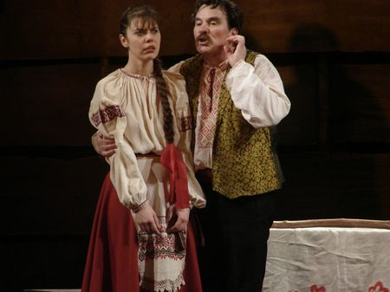
A new phenomenon in Ukrainian drama was a comedy "Martin Borulya."

Slide 6
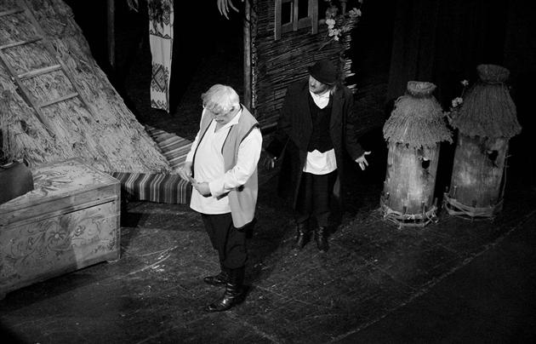

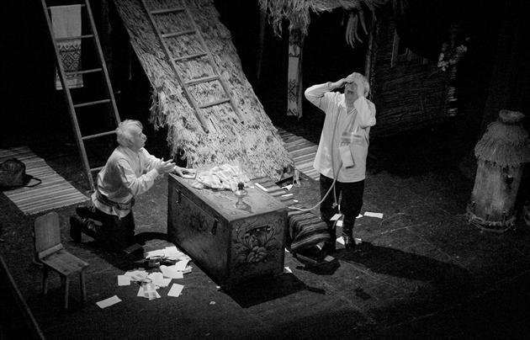
A new step in the creative growth began to play "A hundred thousand."

Slide 7
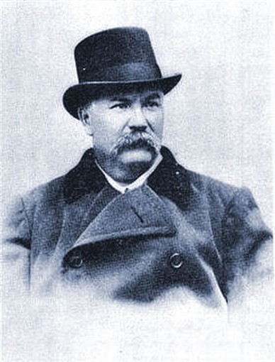
"The scene - my idol, theater - a sacred temple for me!"
(Ivan Karpenko-Kary)

Slide 8
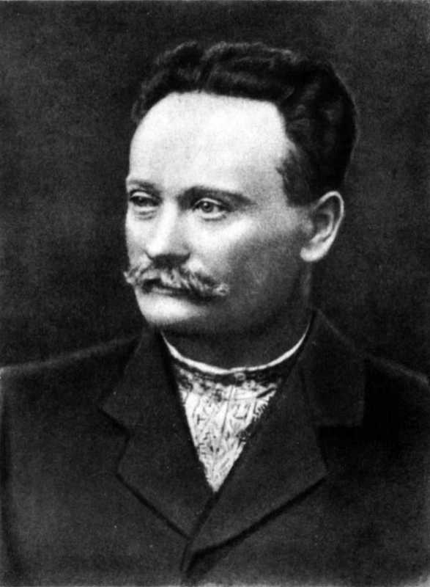
"He was one of the parents ukrainian theater, prominent actor and great playwright, who has no equal "- wrote about him I. Franco.

Slide 9
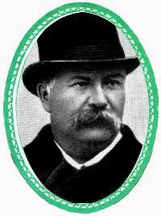
In my opinion, Karpenko-Kary occupies the most prominent place in Ukrainian classical drama. He is rightly called the founder of the social drama.

