Slide 1

Project
Top-6 modern serials
Anastasia Mamonova
Kirill Zhelezcov

Slide 2

№ 6 - Pretty Little Liars
Original run: June 8, 2010 – present
Genre: Teen drama, Mystery-thriller
Country of origin: United States
No. of seasons: 4
No. of episodes: 90

Slide 3
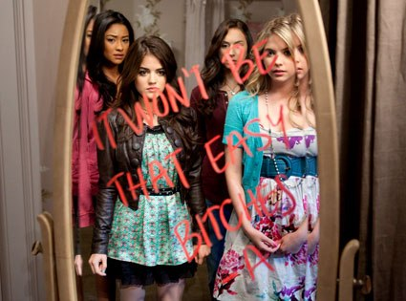
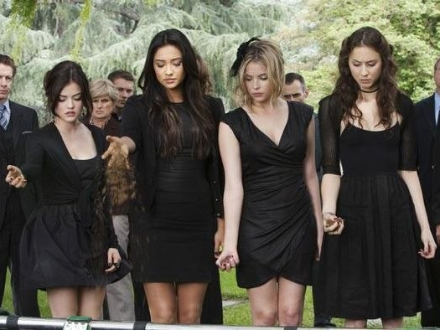
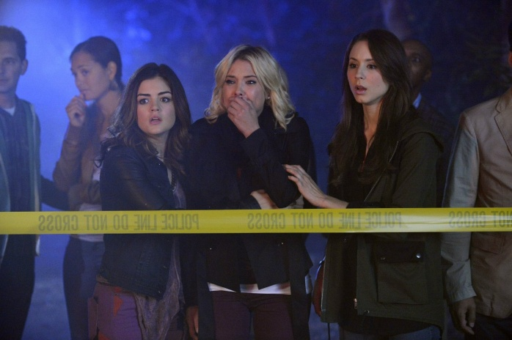
Brief description:
Set in the fictional town of Rosewood, Pennsylvania, the series follows the lives of Spencer Hastings, Hanna Marin, Emily Fields, and Aria Montgomery, who are four girls whose life falls apart after the disappearance of her best friend, Alison DiLaurentis. One year later, they begin receiving messages from a mysterious figure using the name "A", who threatens to expose their secrets. At first, they think it's Alison herself, but after her body is found, the girls realize that someone else knows their secrets—including long-hidden ones they thought only Alison knew. "A" also stalked Alison, and the girls continue to discover more and more information about "A" and Alison's disappearance—all while risking their lives.

Slide 4





Starring:

Slide 5
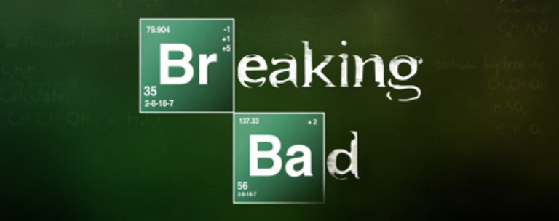
№ 5 - Breaking Bad
Original run: January 20, 2008 – September 29, 2013
Genre: Crime drama, Thriller
Country of origin: United States
No. of seasons: 5
No. of episodes: 62

Slide 6
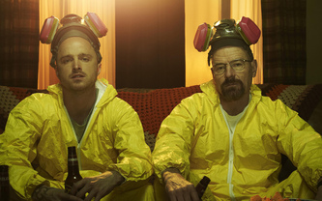
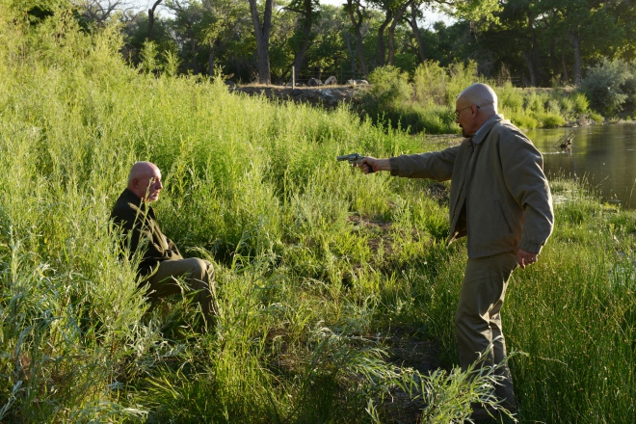
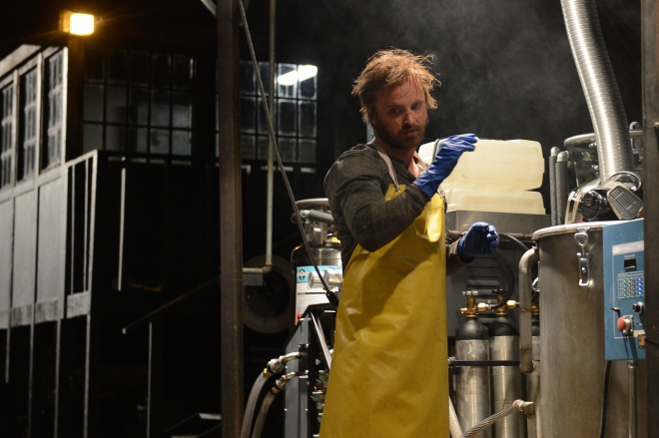
Brief description:
The main plot line develops around school chemistry teacher Walter White, who discovers that he is ill with inoperable lung cancer. Given the difficult financial situation of the family, as well as prospects (Walter's wife, Skyler, is pregnant with her second child, and the son of cerebral palsy), Walter decides to engage in the manufacture of methamphetamine. For this he draws his former student Jesse Pinkman, once expelled from school, with the active assistance of the White. Pinkman himself engaged in the manufacture of meth, but on the eve of the DEA in the raid, he lost his partner in crime and the lab. White learns on the news of the capture of large quantities of drugs, and learns how much revenue you can get engaged in this business. Briefly down to provide for his family he embarks "in all serious."

Slide 7
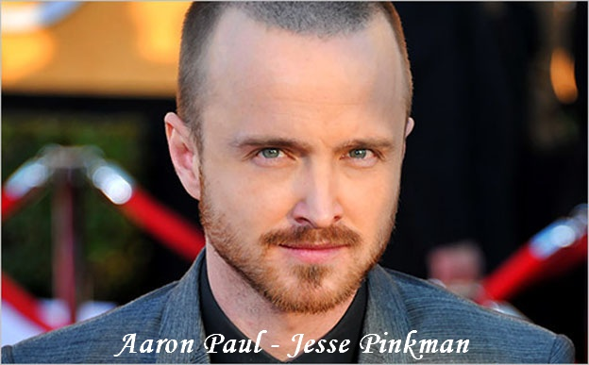
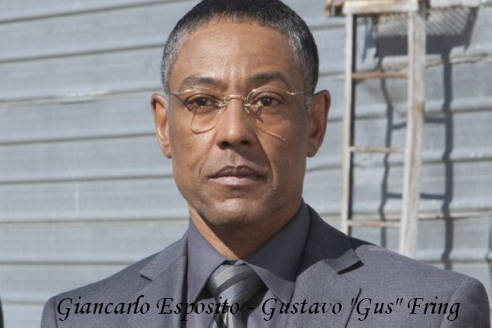

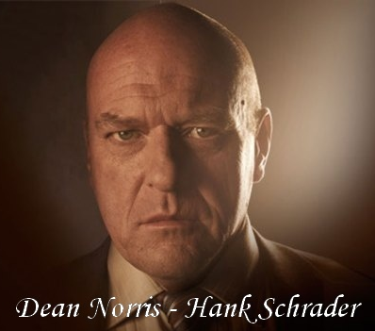
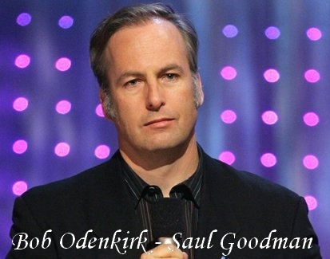
Starring:

Slide 8

№ 4 - Game of Thrones
Original run: April 17, 2011 – present
Genre: Fantasy, Drama
Country of origin: United States
No. of seasons: 3
No. of episodes: 30

Slide 9
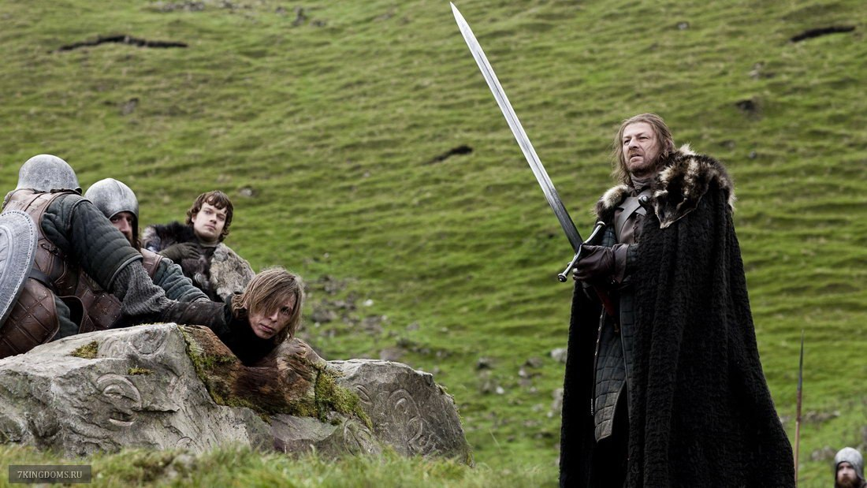
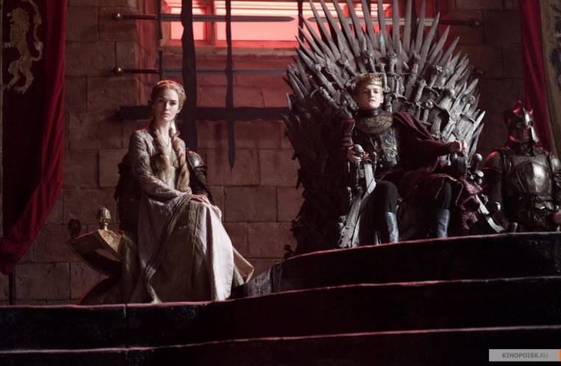
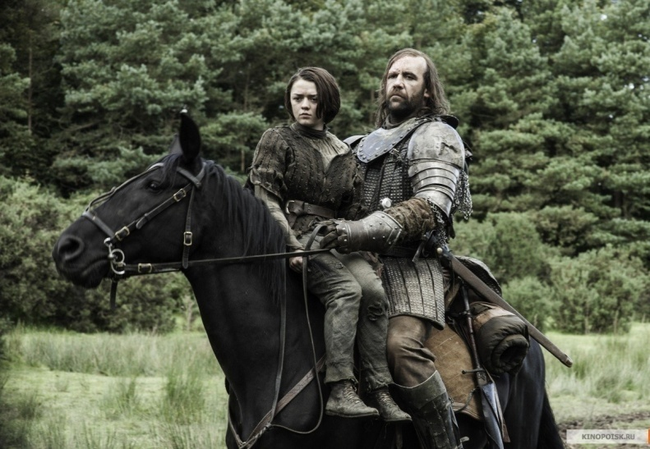
Brief description:
The series, set on the fictional continents of Westeros and Essos at the end of a decade-long summer, interweaves several plot lines. The first follows the members of several noble houses in a civil war for the Iron Throne of the Seven Kingdoms; the second covers the rising threat of the impending winter and the mythical creatures of the North; the third chronicles the attempts of the exiled last scion of the realm's deposed dynasty to reclaim the throne. Through its morally ambiguous characters, the series explores the issues of social hierarchy, religion, loyalty, corruption, sexuality, civil war, crime, and punishment.

Slide 10





Starring:

Slide 11

№ 3 - The Walking Dead
Original run: October 31, 2010 – present
Genre: Horror , Drama
Country of origin: United States
No. of seasons: 4
No. of episodes: 43

Slide 12
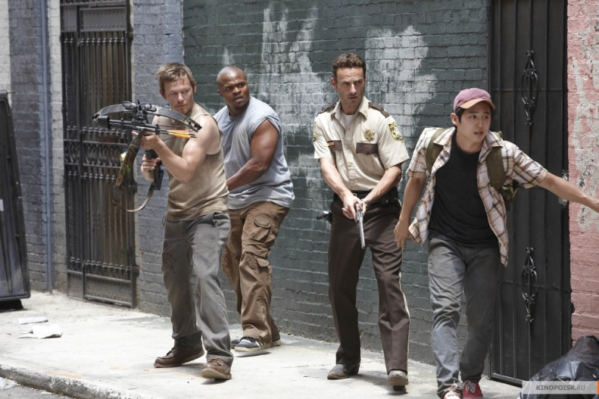

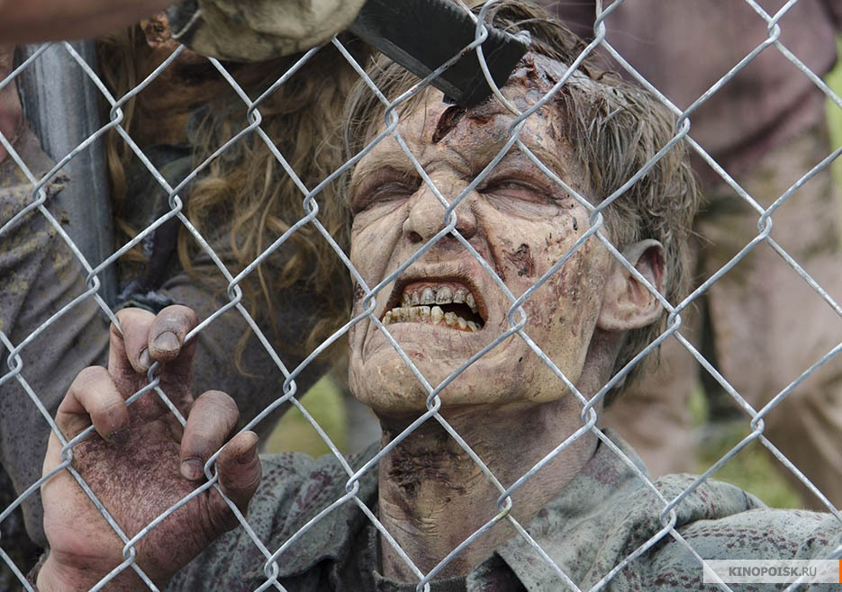
Brief description:
Deputy Sheriff Rick Grimes gets serious gunshot wound during a shootout with criminals, resulting falls into a coma. Waking up in the hospital, he notices that the entire medical staff is absent, and in the building has a ruin. Gradually, he realizes that the tragedy occurred, somehow related to the revived corpses. He is trying by all means to find his wife and son, apparently managed to survive, and help them survive in the new dangerous world. In the plot, he meets with other survivors and thanks to his leadership abilities leads the struggle for survival.

Slide 13

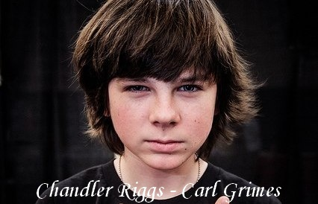
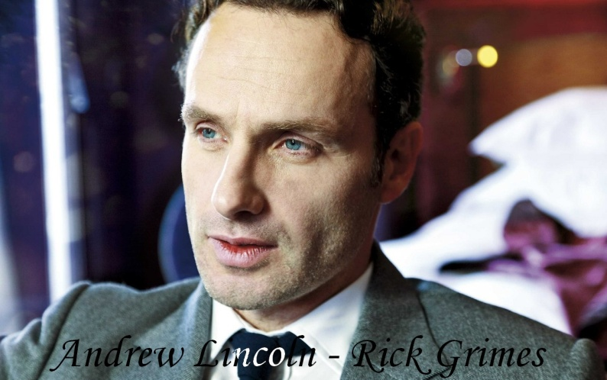


Starring:

Slide 14

№ 2 - Sherlock
Original run: 25 July, 2010 – present
Genre: Crime drama
Country of origin: United Kingdom
No. of seasons: 3
No. of episodes: 9

Slide 15
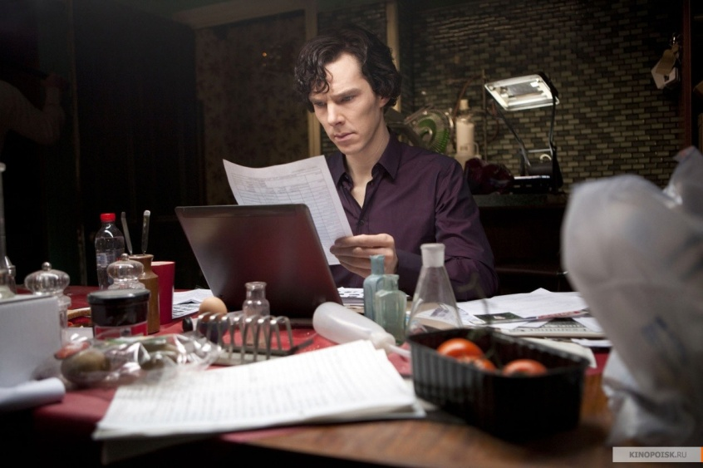
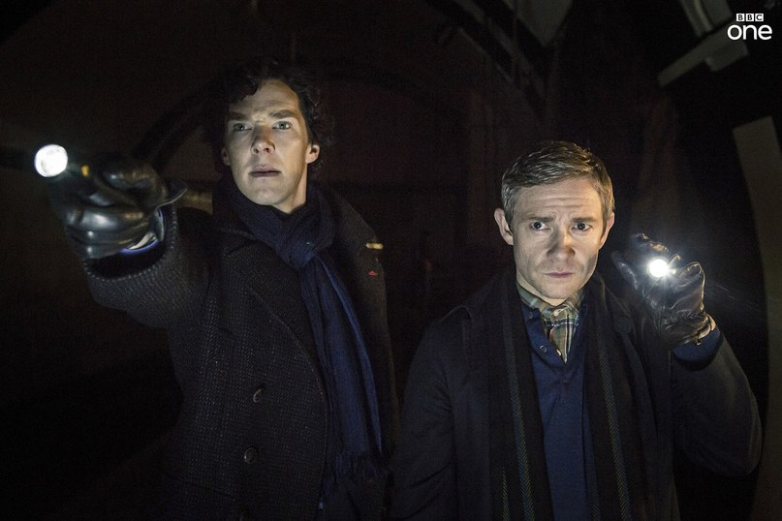
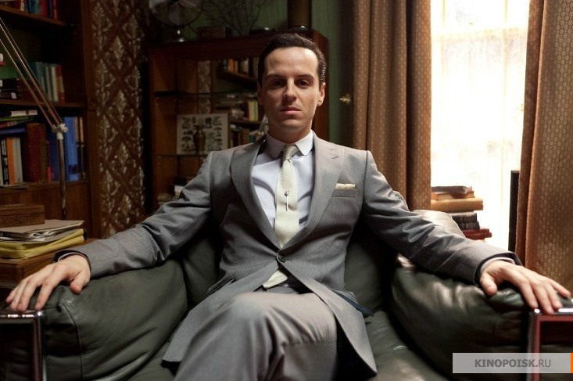
Brief description:
Sherlock is a British television crime drama that presents a contemporary adaptation of Sir Arthur Conan Doyle's Sherlock Holmes detective stories. Sherlock depicts "consulting detective" Holmes, assisting the Metropolitan Police Service, primarily Detective Inspector Greg Lestrade, in solving various crimes. Holmes is assisted by his flatmate, Dr John Watson, who has returned from military service in Afghanistan. Although the series depicts a variety of crimes and perpetrators, Holmes' conflict with his archnemesis Jim Moriarty is a recurring feature. Molly Hooper , a pathologist at St. Bart's Hospital occasionally assists Holmes in his cases.

Slide 16
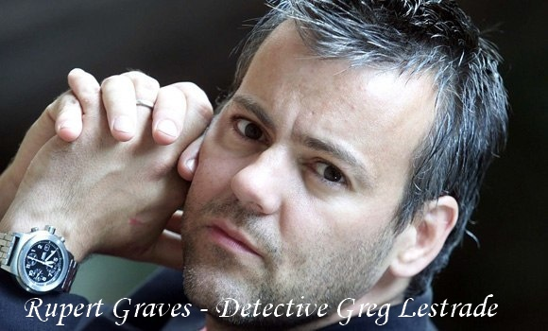


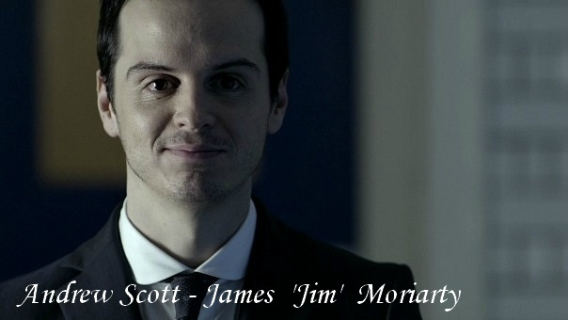

Starring:

Slide 17

№ 1 - The Big Bang Theory
Original run: September 24, 2007 – present
Genre: Sitcom
Country of origin: United States
No. of seasons: 7
No. of episodes: 150

Slide 18
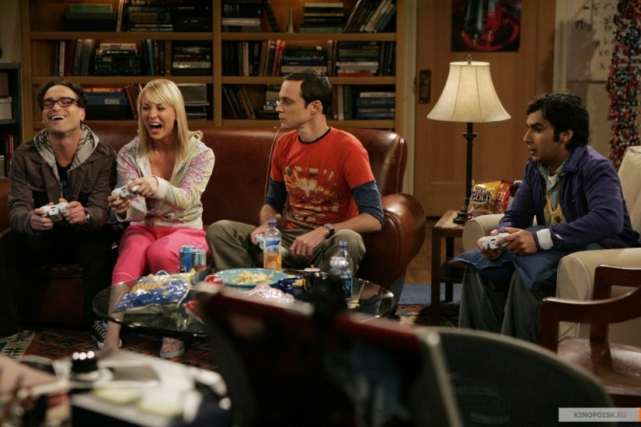
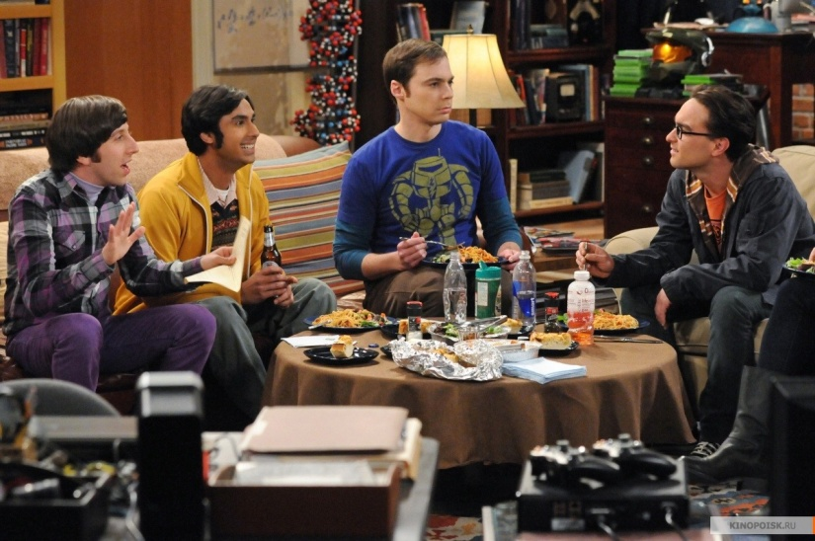
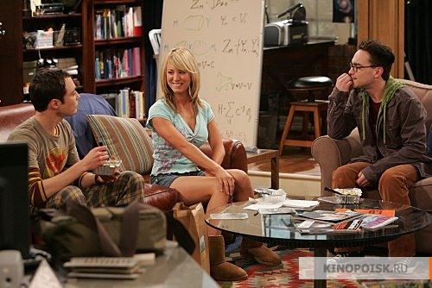
Brief description:
Two brilliant physics, Leonard and Sheldon, consider themselves "great minds" (total IQ - 360: Sheldon's IQ - 187). But their genius does not help them to communicate with people, especially with women. Everything starts to change when in front of them settled pretty girl Penny. Leonard takes an interest in her, but Sheldon realizes that his friend's dreams will not come true. At the main characters have unusual friends Howard Wolowitz, lustful women freak engineer, and Rajesh Koothrappali, indecisive astrophysicist who cannot say a word the girls, if you do not drink even a little alcohol.

Slide 19





Starring:

