Slide 1
SHRi-lanka

Slide 2
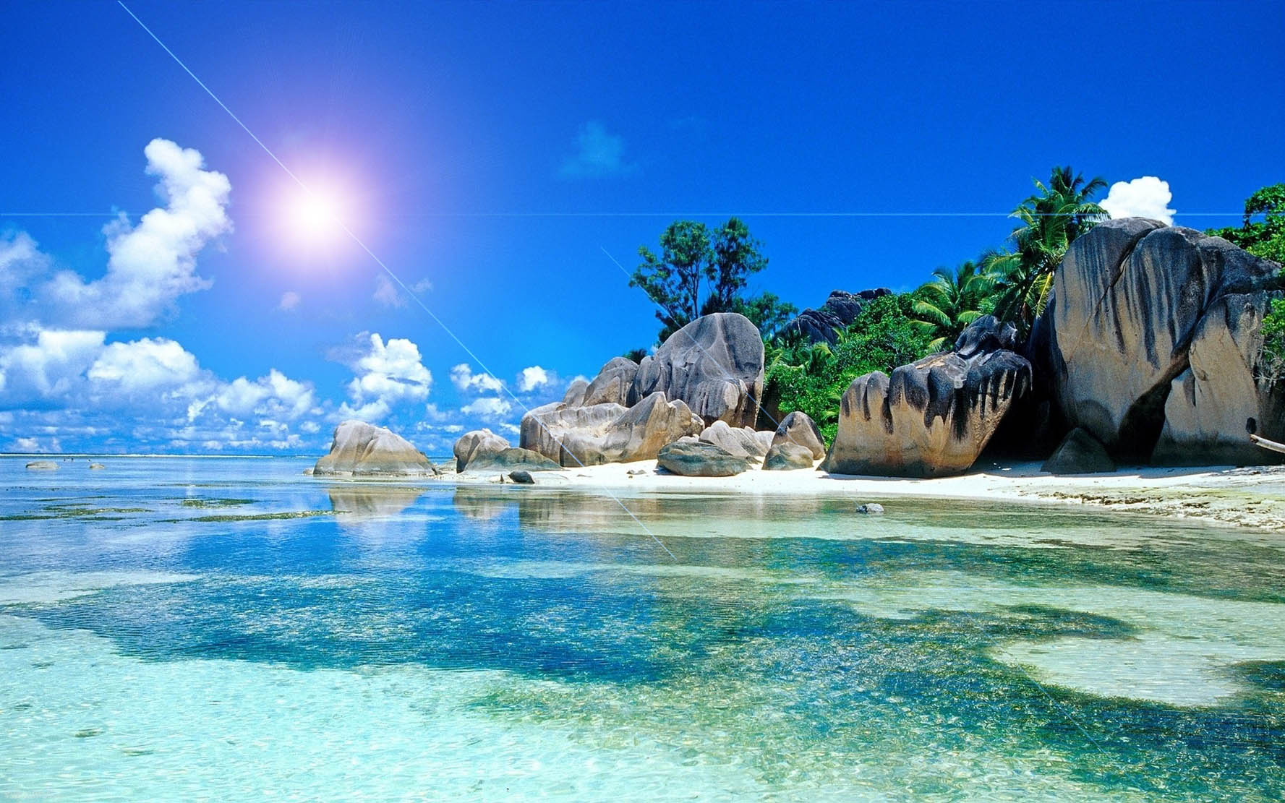
Beaches
Many of hotels are on the island's beautiful beaches. At Mount Lavinia, just 12km from Colombo, relax and enjoy the sea, joining the locals playing cricket and surfing on Sundays. The typical fishing town of Negombo, set amid lush coconut groves, has great, spicy seafood. And south of Colombo, Beruwela marks the beginning of a glorious 130km stretch of beaches, with great bathing in the bay year round.

Slide 3
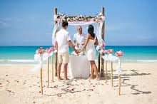
Weddings and Honeymoons
This exotic island is a haven for romance. Take your vows on a perfect beach, in a flower-filled garden, or in the jungle amid the ruins of an ancient kingdom, accompanied by dancers, drummers and traditional singers. Spend your honeymoon relaxing on the beach, enjoying Ayurvedic spa treatments and touring the hill stations, tea plantations and rainforests. Take the most romantic, sea view rooms, or private villas.

Slide 4
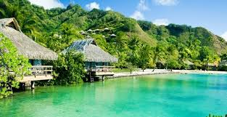
When to go
As a tropical island you'll find two distinct seasons in Sri Lanka, wet and dry. In the southwest and hill country you can expect to use brollies more from May to August whereas from December to March it's mainly sunhats. Always go prepared as inland it can get cooler in the evenings.

Slide 5
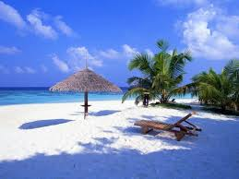
Climate and Topography
The country enjoys near-perfect weather all the year round, with average temperatures hovering around 30° (86° F) in the coastal areas, but much cooler at around 19° (67° F) up in the hills that are central to the island. The mountains create rainy seasons at differing times to different parts of the island: the south-west coast has more rain from May to July, while the north-east coast is wettest in December and January.

Slide 6
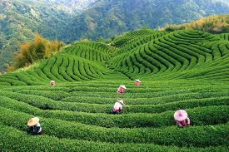
Things to See & Do
Visit a working tea plantation - Fancy a cuppa? Head into the hills to Nuwara Eliya. You'll visit a working tea plantation in this lush and stunning landscape and settle down to a tea-inspired meal. We love Ceylon Tea Trails, which also doubles as a 5V boutique hotel.

Slide 7
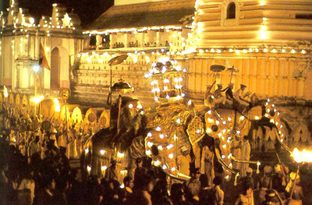
Feel the festive spirit: Party Sri Lankan style. Heaps of festivals and public holidays happen throughout the year, like Vesak, a May festival that commemorates the Buddha's birthday. Lanterns light up the streets while pilgrims flock to the temples. And if you feel like fire-dancing might spark your mojo, check out Kandy's Esala Perahera in July or August.

Slide 8
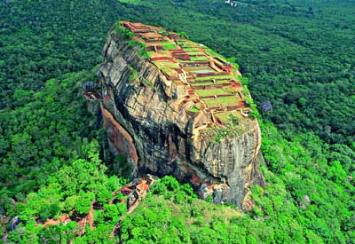
Climb the Sigiriya Rock Fortress: Play the conquering hero and breach the walls of this ancient rock fortress. When you're finished celebrating your victory, head to the Sinharaja Forest Reserve. A UNESCO heritage site, it's packed with amazing wildlife - from horned lizards to Asian elephants.

Slide 9
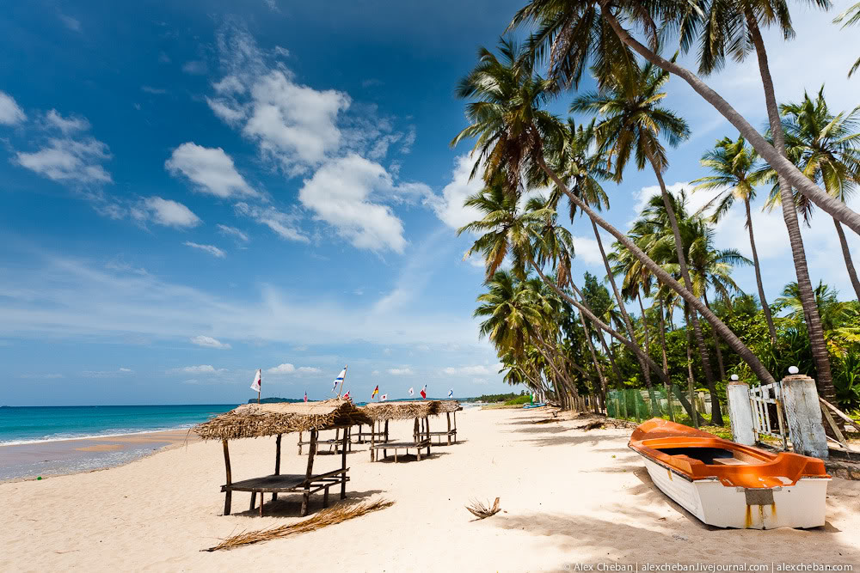
Trincomalee: Known as Trinco to the locals, this unspoilt destination was visited by Horatio Nelson who described it as having the finest harbour in the world! With a thriving market at its centre and wonderful beaches you can bask in the sun or engage in something a little more active with surfing, diving and even whale and dolphin watching.

Slide 10
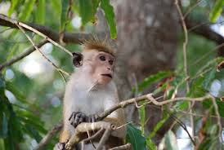
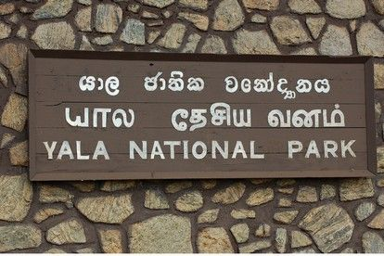
Yala National Park: Reminiscent of the African bush and recognised as one of the best parks in the world to observe and photograph leopards, Yala is also an ideal background to view animals such as crocodile, elephants and wild boar.

Slide 11
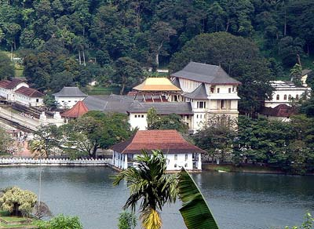
Kandy: Founded in the 14th Century and home to the Temple of the Tooth, a sacred Buddhist site, Kandy is a delightful mix of old shops, antique and gemstone specialists and a bustling market in its centre.

Slide 12
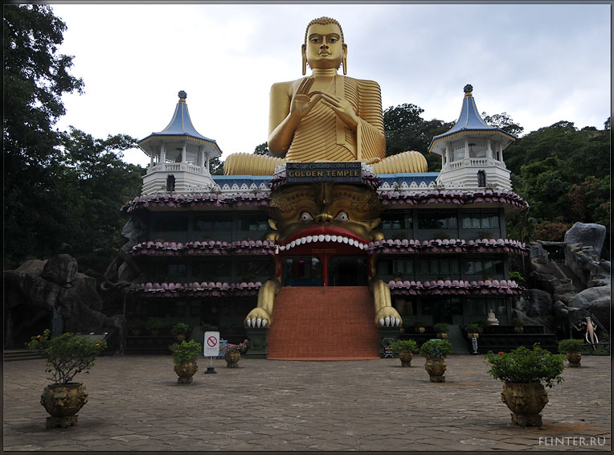
Culture
Sri Lanka's tally of 7 UNESCO World Heritage Sites is truly impressive, spanning the country's rich history from 380BC to the Portuguese, Dutch and British colonial eras. It's a treasure trove of both natural and man-made wonders, including ancient and sacred cities, colonial strongholds, cave temples and virgin forests. The sacred city of Anuradhapura once had 9-storey palaces and dagobas (domes). Marvel at its ruins, glimpsing beautiful statues. Explore the cave temples of Dambulla, and the magnificent temples and palaces of the royal city of Kandy.

Slide 13
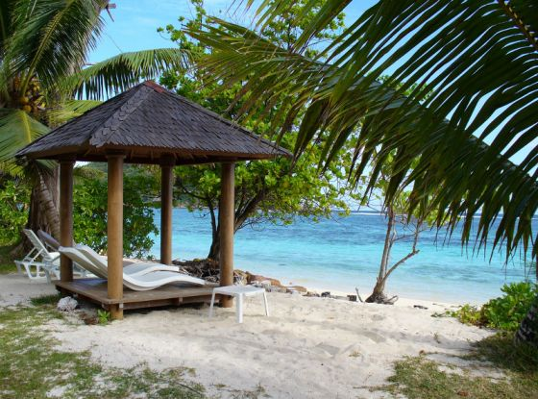
Nature
The largest elephant population is found in Uda Walawe. At the Pinnawela Elephant Orphanage you can feed the babies - great fun. Sinharaja is Sri Lanka's last remaining virgin rainforest with amazing birdwatching. Yala National Park is the country's premier wildlife reserve and is said to have the world's highest concentration of leopard. Other animals include elephant, sloth bear and crocodile. See exotic fish while snorkelling or diving, visit the Peradeniya Royal Botanical Gardens and check out the island's highest waterfall at Bambarakande.

