Slide 1
Vebsayte
Executed
Furka Taras

Slide 2
Vk.com
VK (Originally VKontakte, Russian: ВКонтакте)[3] is a European social network service popular among Russian-speaking users around the world. It is especially popular in Russia, Ukraine, Kazakhstan, Moldova, Belarus, and Israel. VK is a Facebook clone, with several common features, such as university exclusiveness of a network during its early stages, similar color, and similar features and functionality.

Slide 3
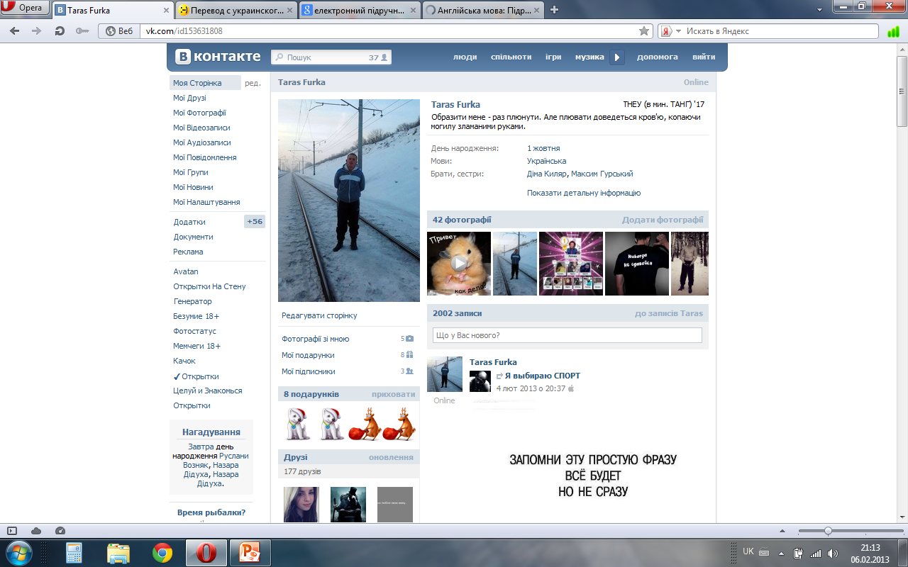

Slide 4
History
Founder Pavel Durov launched VKontakte for beta testing in September 2006, having just graduated from St Petersburg State University. Next month the domain name vkontakte.ru was registered. User registration was initially limited to within university circles exclusively by invitation, but the site still grew quickly.

Slide 5
Popularity
According to Alexa.com VK is one of the most visited websites in the post-soviet countries. It holds the 2nd position in Russia,Ukraine and Belarus and 5th in Kazakhstan.

Slide 6
The end

