Slide 1
Cutlery sets

Slide 2
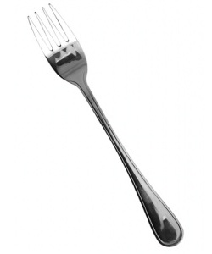
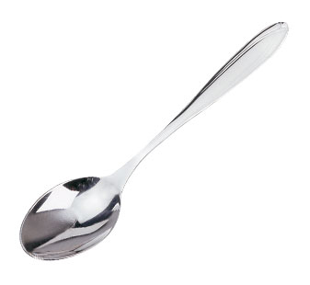
Snack appliance
Snack unit includes a fork and knife. It is served with cold meals and snacks, as well as some hot dishes (pancakes, scrambled eggs). Knife length is the diameter of a diner plate.

Slide 3
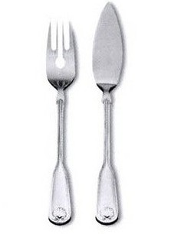
Fishing appliance
Fishing appliance also consists of a knife and fork. It is used with the hot fish. It is different from s snack knife – it looks like a blade, and fork with a bit short teeth.

Slide 4
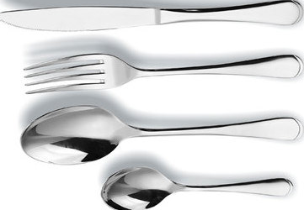
Flatware appliance
Flatware - fork, spoon and knife. With it you can eat first and second hot meal. Knife length is approximately equal to the diameter of dining plates, a fork and spoon are a little shorter.

Slide 5
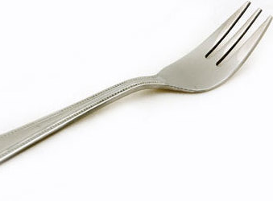
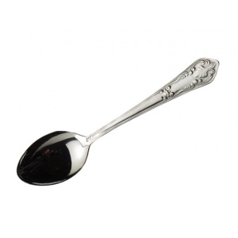
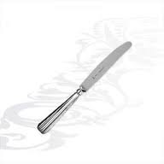
Dessert appliance
It includes a special spoon, fork and knife for sweet dishes. A knife a little narrower than a snack and the tip pointed, fork has three teeth. These two components of the device are used for cheese, cake, cheese, apple charlotte. Spoon is used for meals which are not to be cut.

Slide 6
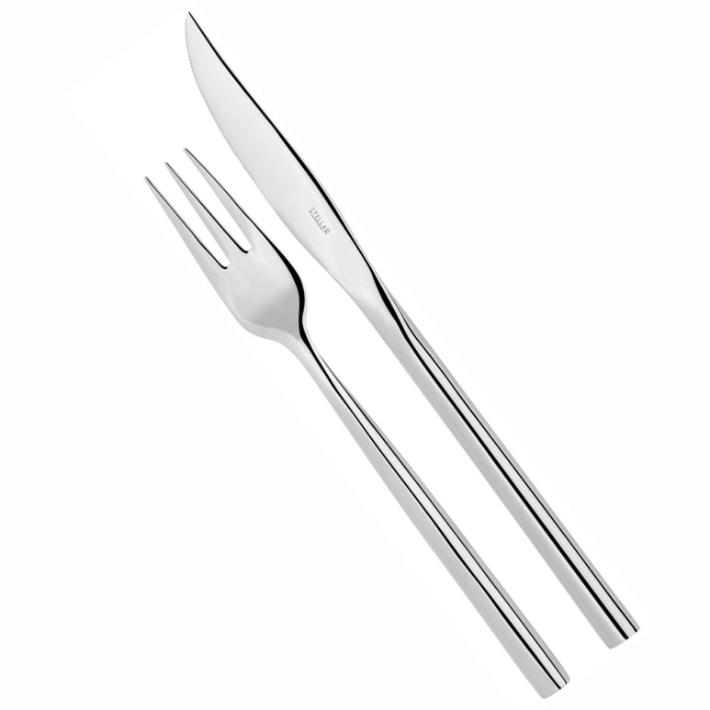
Fruit appliance
Fruit appliance also consists of a knife and fork, which are slightly different from the dessert - they are smaller and the fork has two teeth. It is interesting, that two parts of the same end.

