Slide 1
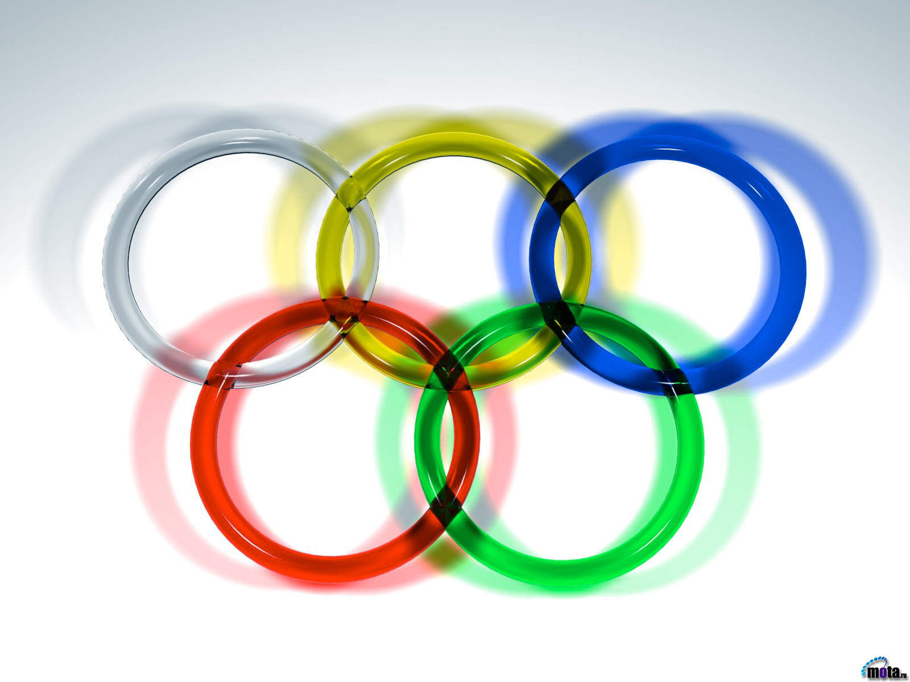
The strangest sports
Prepared
Natalia Semeniyk

Slide 2
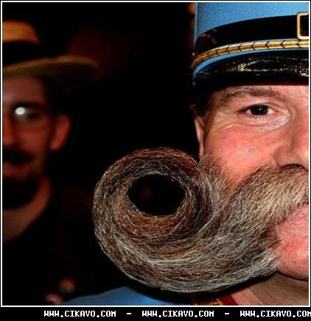
Competitions beards and mustaches
That is, since 2007, this former carnival recognized sporting competition. What sport to wear beards and mustaches - is unclear, but now things are so. You may have heard about this competition, where men boast about who original beard and mustache. There are beautiful specimens alike. But I think that the sport is still not drawn

Slide 3
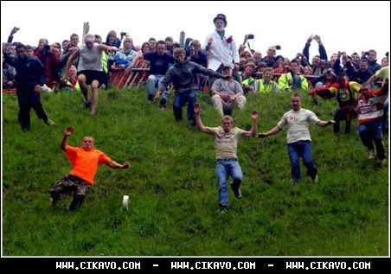
Harassment cheese
Every year in the UK, Gloucester, people going on the slope of hill, cheese and cheese-maker pulls the head of the hill. And rolling very quickly, that's understandable - but a lot of people it seeks to catch up. In principle, more or less sports. Now this - the official sport (well, at least at the Olympic Games is not yet chasing cheese).

Slide 4
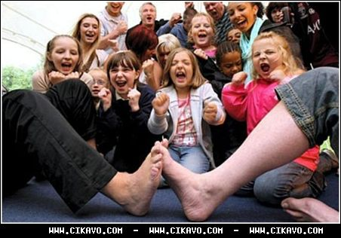
Foot-wrestling
By analogy with the arm-wrestling, here we see foot-wrestling where participants try to beat up another person. Believe it or not, there is another official sport. Generally interesting to see how some "sports", invented by bored at parties guests turn to sport at the official level.

Slide 5
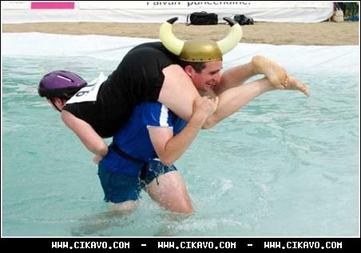
Race with wives
Race with his wife on his shoulders - employment Finnish men who thus compete with each other. The purpose of the race - to win other competitors, and the terrain on which you want to run, not exactly easy - here and pits, water and much more.

Slide 6
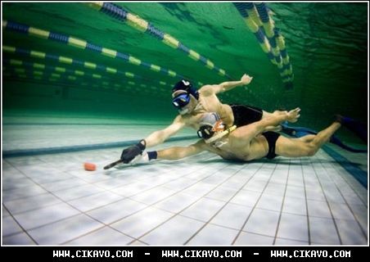
Underwater hockey
Clearly, underwater hockey is not the most spectacular sports - who can observe the movement of small washers under plenty of water, even in the pool? The water is quite inhibits movement participants, and makes the game so ridiculous. And so too will remember that it is also a sport. Perhaps this is the most fun sport of all presented above.

