Slide 1
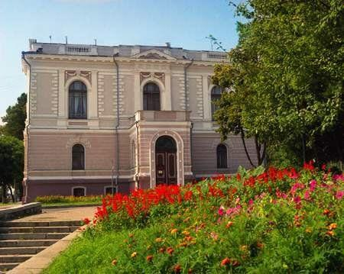
Nikanor Onatskiy art gallery
Sumy regional art museum named after N.Onatskiy is a state museum in the town Sumy. It owes both: works of Ukrainian and foreign art.

Slide 2
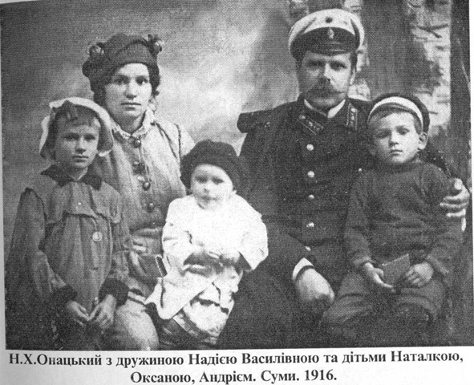
Nikanor Onatskiy with his family
Nikanor Onatskiy (1875-1937) is a prominent Ukrainian artist and teacher. He is one of the students of Ilya Ryepin

Slide 3
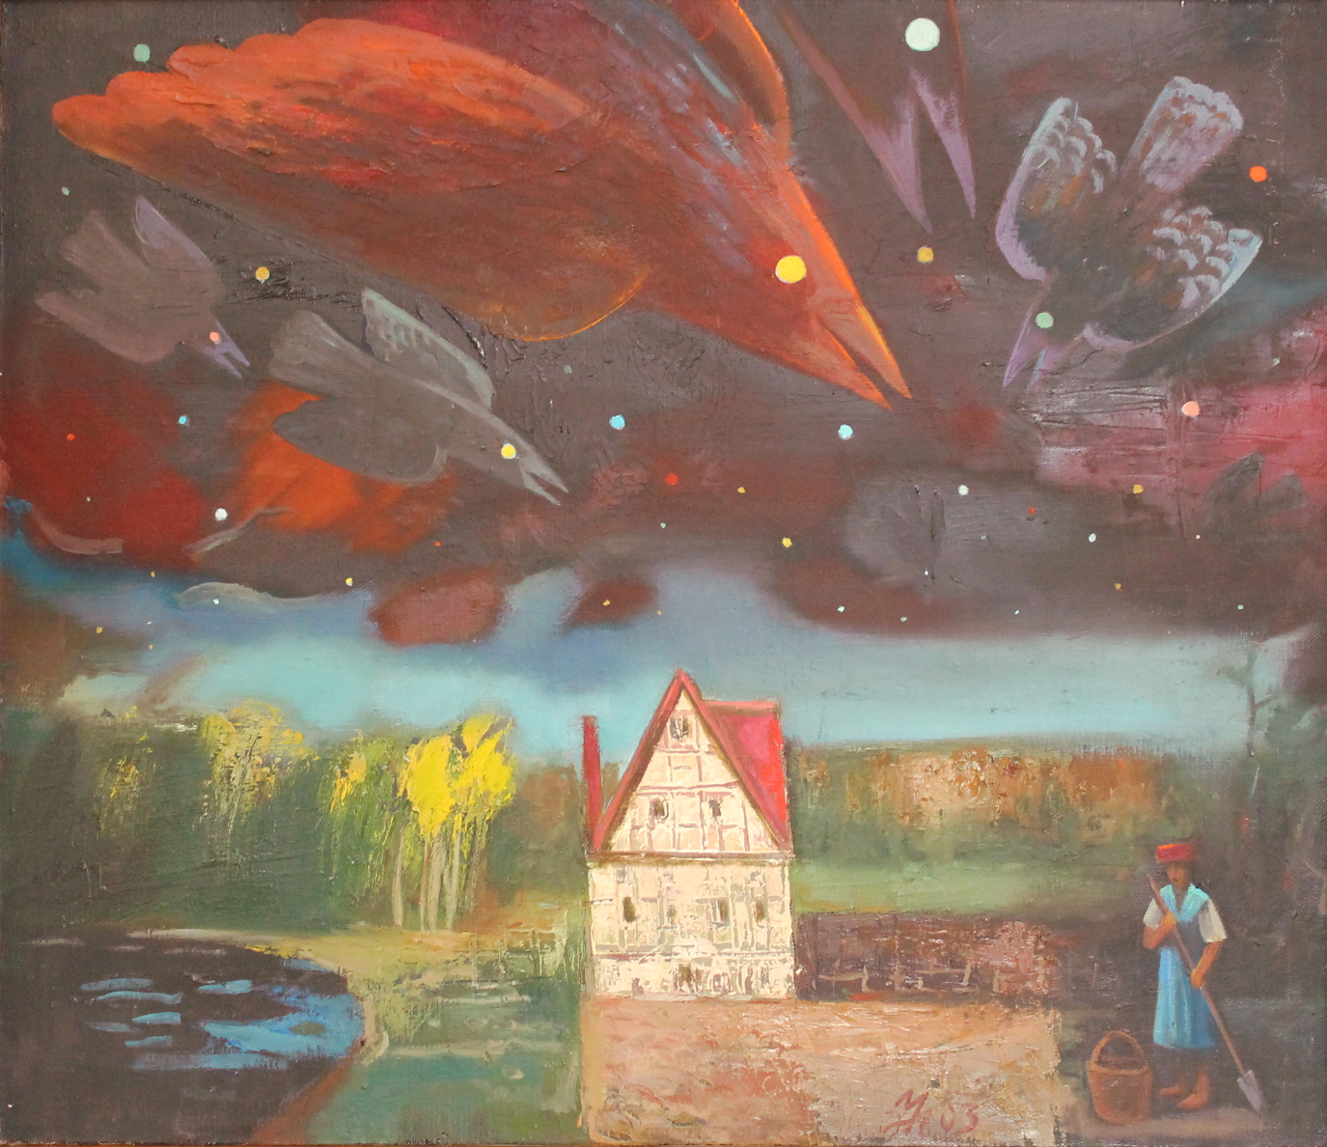
A bit of history
The museum was founded in 1920
The collection mainly consited of art works from private colletions, including the collection of O.Hansen
The building of the museum was built by the architect G.Scholz at the end of the 19th century

Slide 4
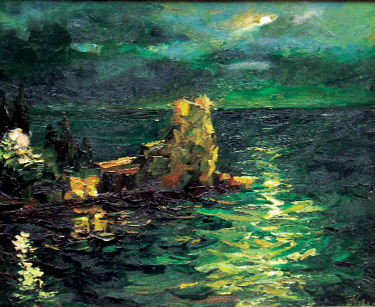
Museum today
The museum is located in Sumy downtown
It has more than 15000 exhibits
The gallery consists of 2 departments: the department of decorative art and the department of folk decorative art;
One can find works of Borovykovskyy, Kiprenskyy, Shevchenko, Zhemchuzhnikov, Ayvazovskiy. The painting on the background was created by Cherednichenko O. and is called ‘The cape, the road’

Slide 5
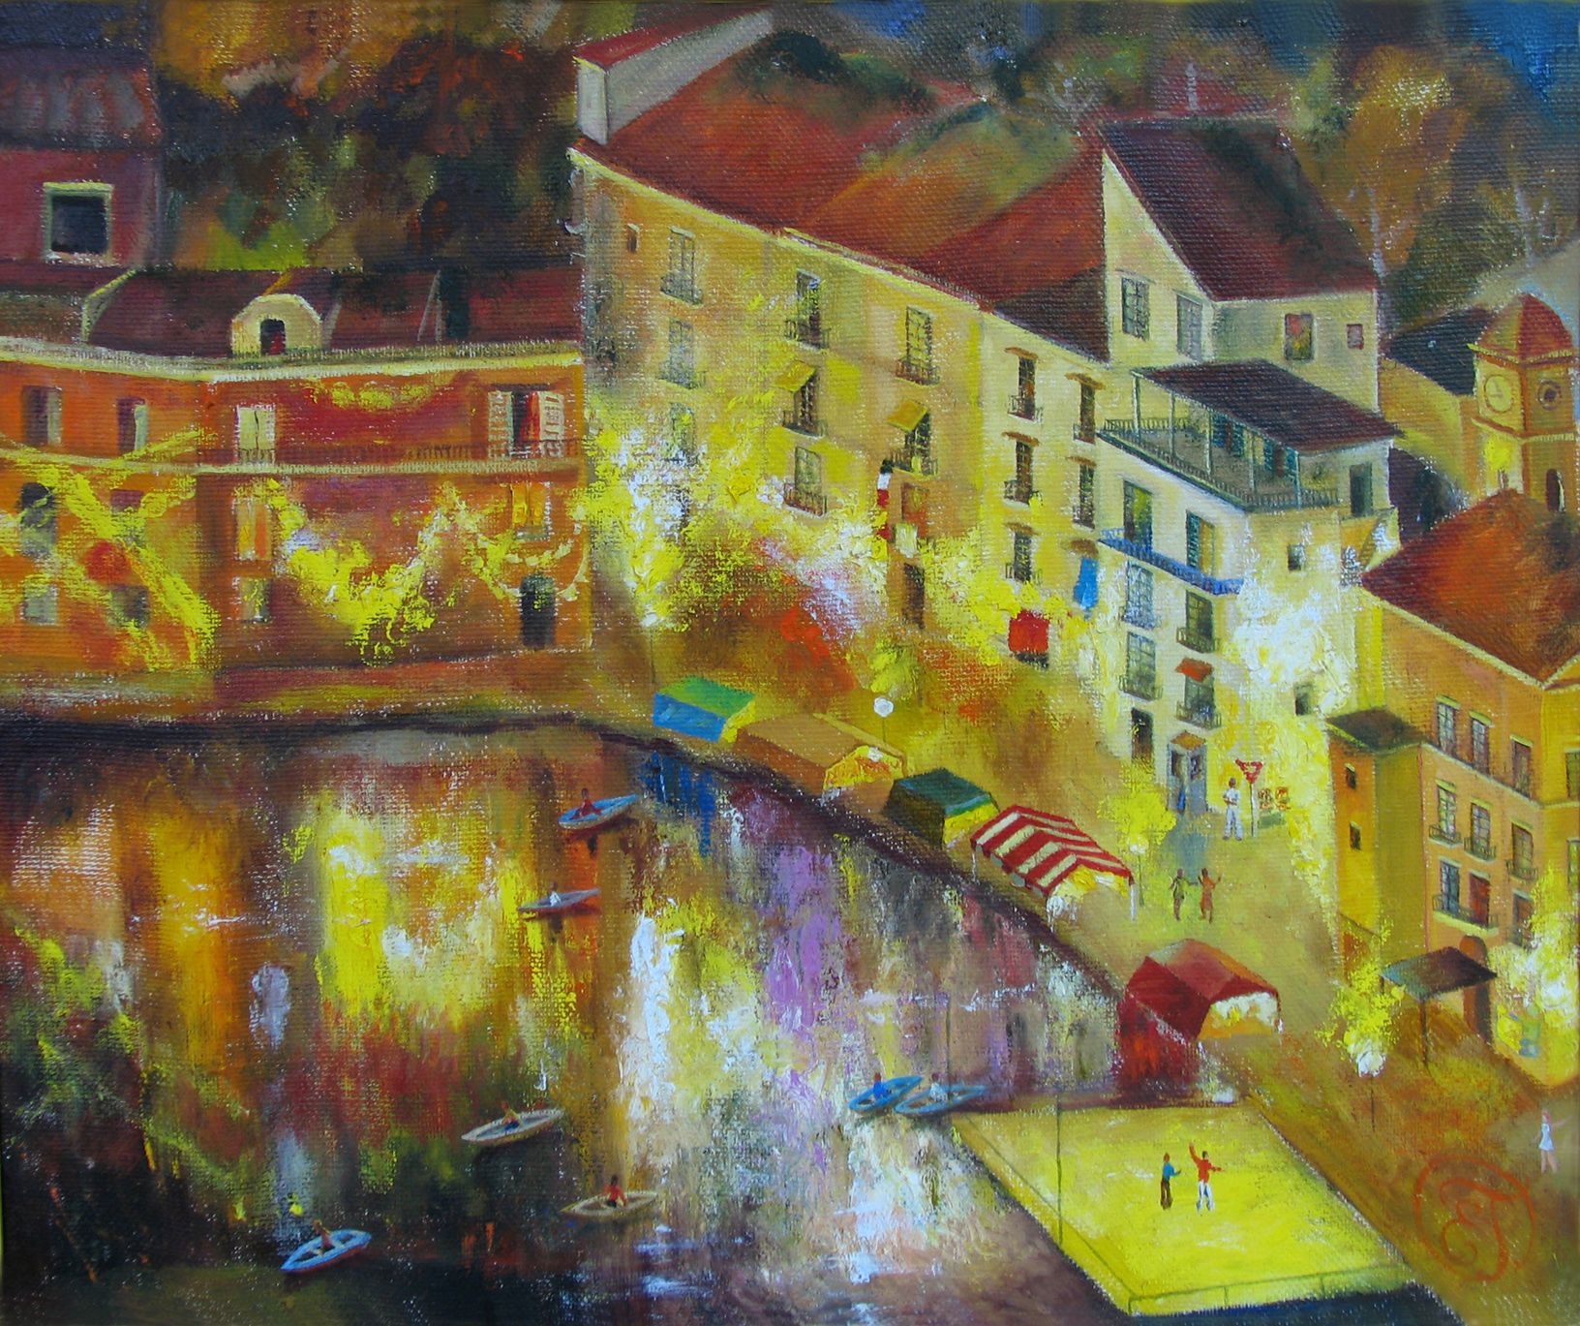
The museum also contains a lot of ancient coins and sculptures
It has recently gained popularity thanks to different exhibitions

Slide 6
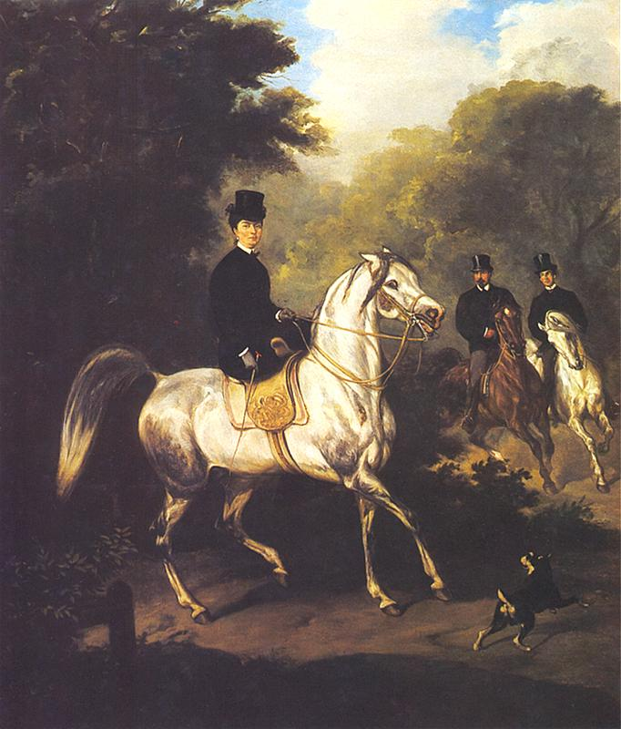
“Horsewoman”,the painting of Polish artist Julius Cossack

Slide 7
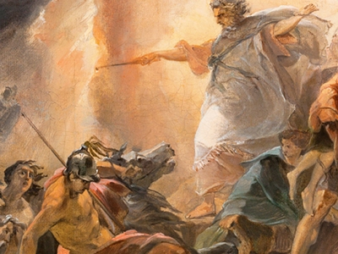
The painting of unknown Italian author,called ‘The sacrifice of Abraham’

