Slide 1
The most unusual pets
Top-5

Slide 2
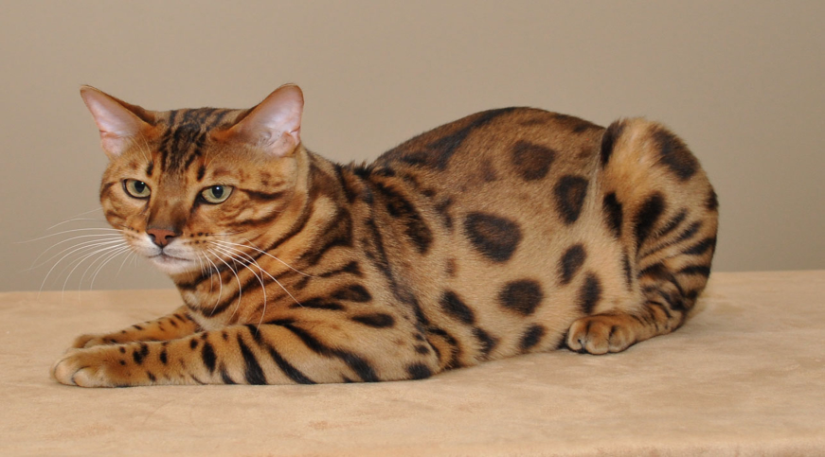
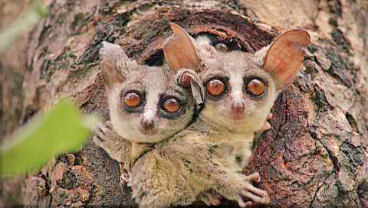
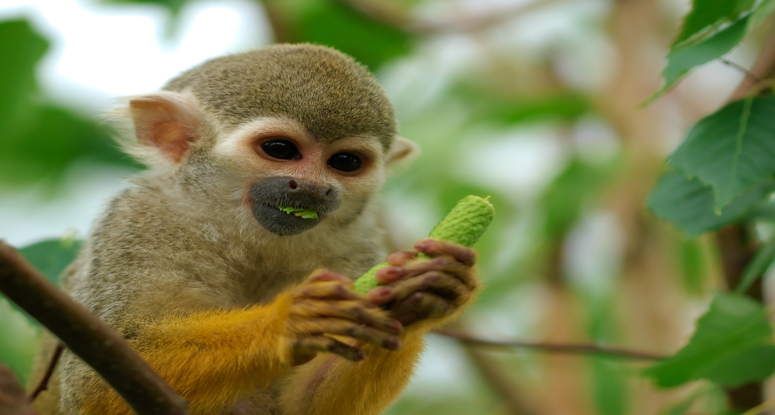
Start
In this presentation I want tell you about more exotic, fun and cute pets. Preferably, these pets don’t live in Ukraine. Exotic pets that can be considered rare or unusual kept by humans as pets. Certain Exotic pets are unfortunately endangered species and others are illegal to own. Exotic pets are attractive because they are different all the absolute cutest!.

Slide 3
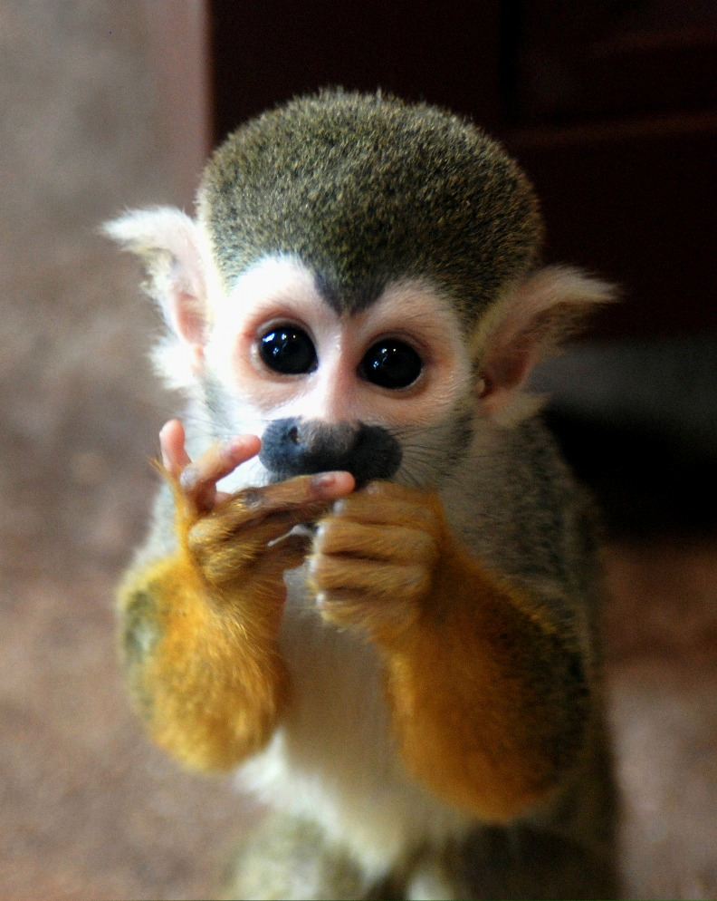
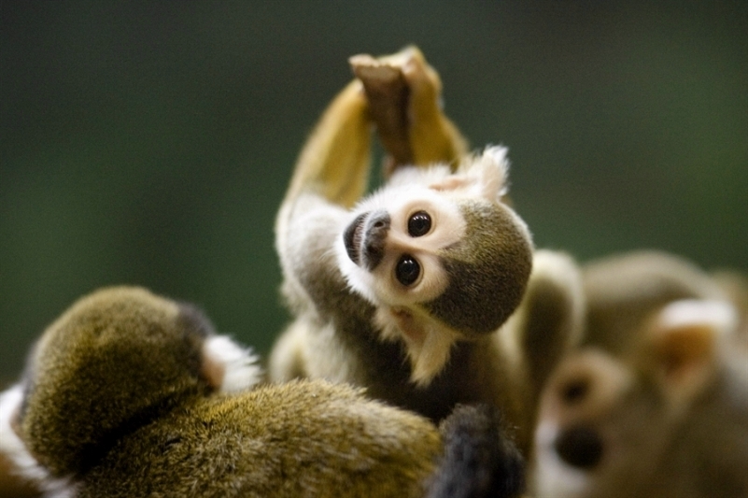
First - Squirrel Monkey
First pet is the cutest monkey I saw. The squirrel monkey is an adorable little primate that lives in the forest of Central and South America.
Squirrel monkey fur is colored olive at the shoulders and yellowish orange on its back and extremities. Their throat and the ears are white and their mouths are black.
Squirrel monkeys grow from 25 to 35 cm long, plus a 35 to 42 cm tail.

Slide 4
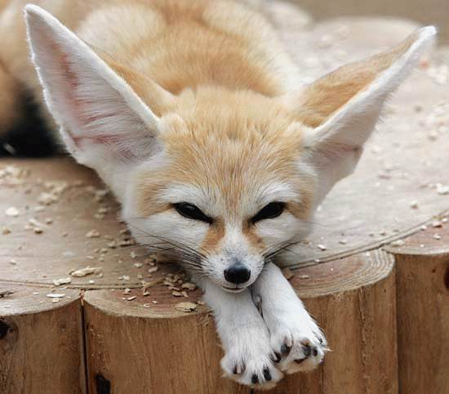
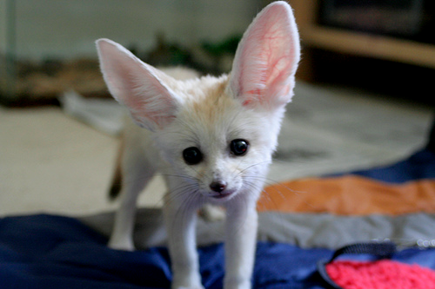
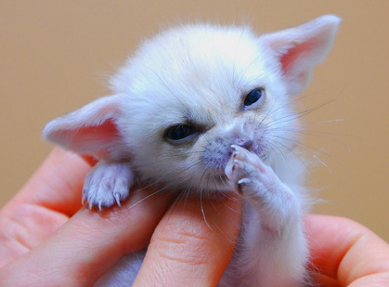
Second - Fennec Fox
Unlike other foxes, these animals make good house pets. Many use a litter box for their little home. They weigh as much as a Chihuahua and are harmless. The fur is often a cream color and fluffy, which deflects heat during the day and keeps the fox warm at night. The ears of a Fennec are sensitive enough to hear very good other animals. Fennec Fox have very big ears!!

Slide 5
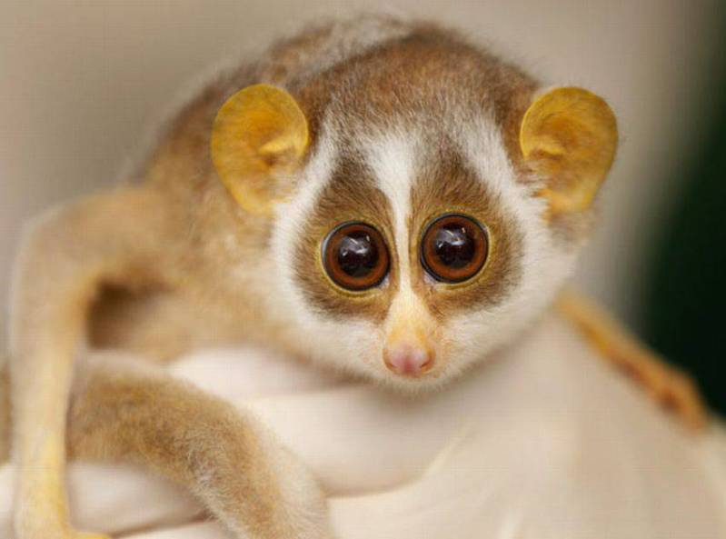
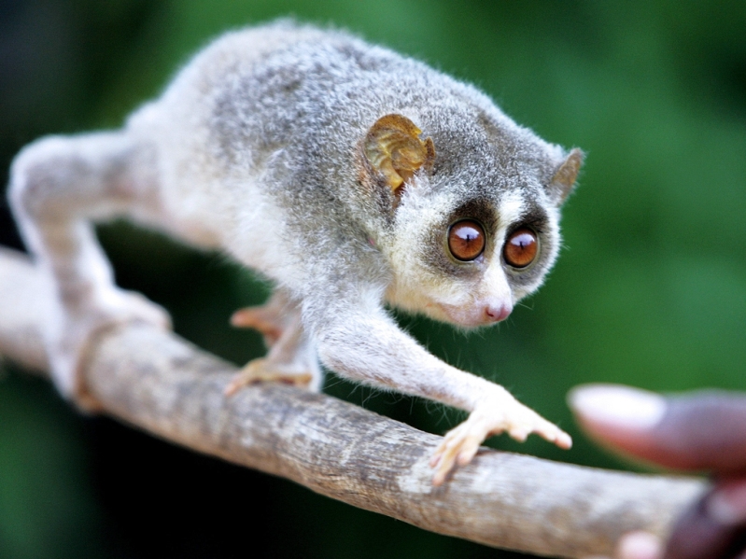
Third-Slow Loris
The Slow Loris is a cute little primate that lives in Asia. It is unfortunately an endangered specie and illegal to own in the USA. The ears are small and look like little lemon. The fur around eyes is dark. Their eyes are large and give stereo vision.

Slide 6
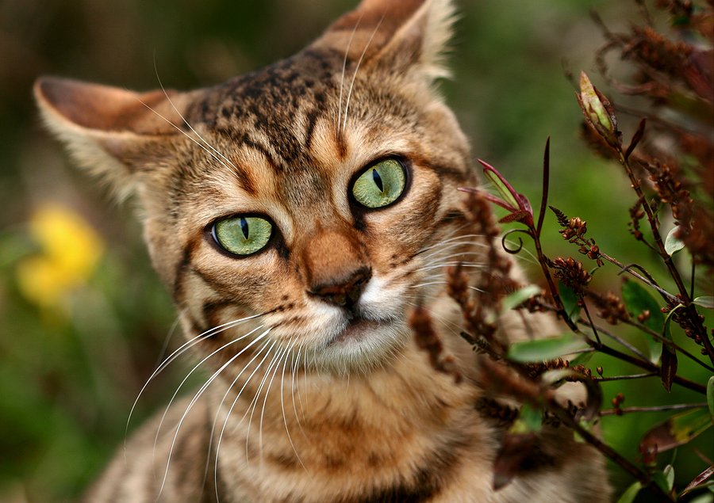
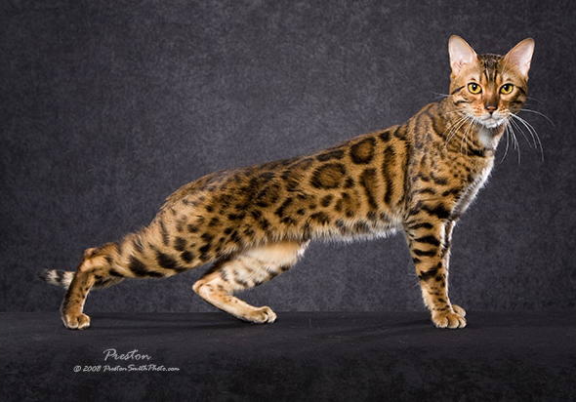
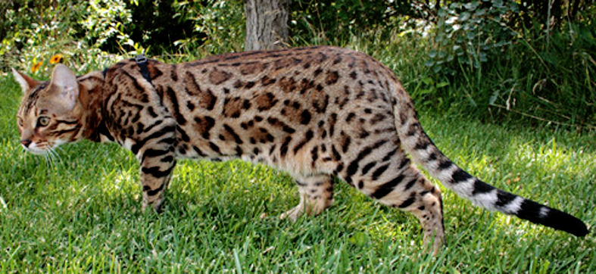
Fours-Bengal Cat
The Bengal Cat it the result of crossing domestic cat with an Asian leopard cat. Bengal cat usually acquired a gentle domestic cat temperament. Bengal cats have "wild-looking" markings. They have large spots, white belly, and a beautiful body like the leopard cat. Minus these cats - they can go blind with age

Slide 7
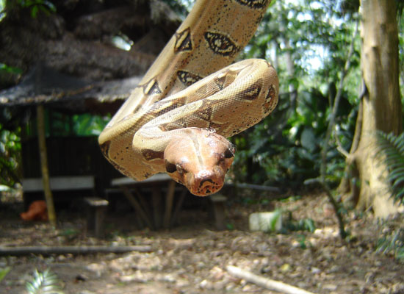
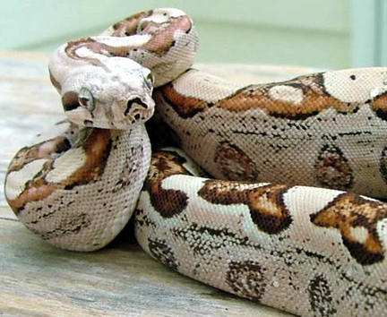
Fifth- Boa Constrictors
All reptiles are to be 'exotic pets', and most of them are harmless. But I'm really afraid of snakes and would never have bought it myself. Boa Constrictors very long and sticky. The coloring of Boa constrictors can vary greatly depending on the locality. However, they are generally a brown, grey or cream base color. Weigh 10 to 15 kg. Male weight 27 kg.

Slide 8


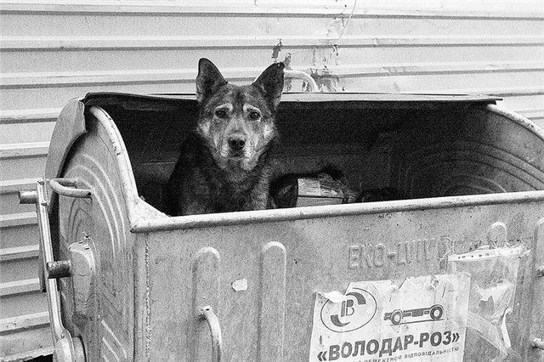
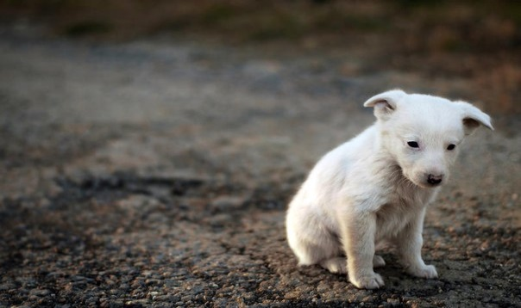
In the end…
I want to tell you that these animals are very cute but they can be very dangerous. Because they are wild and unusual. But even if you buy these animals take care of them.
Remember:
You become responsible forever, for what you have tamed.

Slide 9
Thank you for your attention!
Made by Bonk Veronika

