Slide 1
The most important problems of our environmental
And
How save our planet?

Slide 2
Eco-material
Environmentalists say the air in a modern apartment 4 times dirtier than the outside, and 7 times more toxic. The main source of pollution - finishing materials and furniture.
For construction and repair of premises used harmless substances.
Such material are more friendly for our health

Slide 3
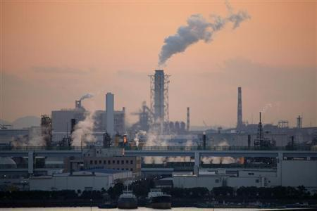
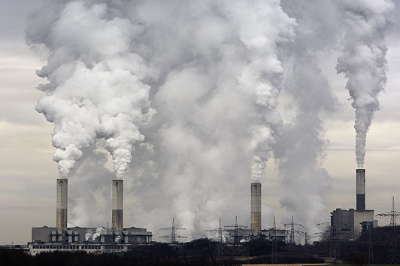
Factories
Pollution from car , factories and power station is causing harmful greenhouse gases to build up in the Earth’s atmosphere.
These gases prevent heat from escaping , and as a result our planet is getting warmer.
This process is know as global warming

Slide 4
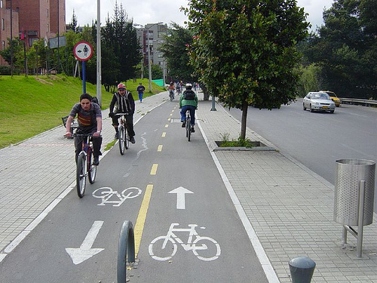
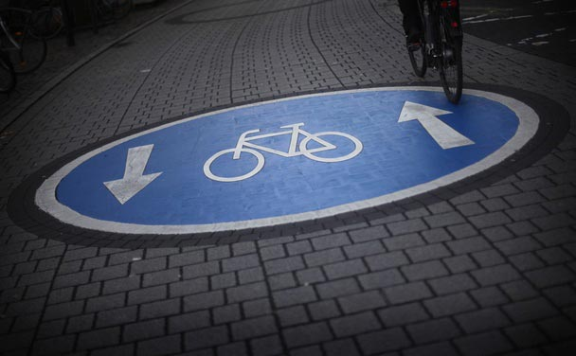
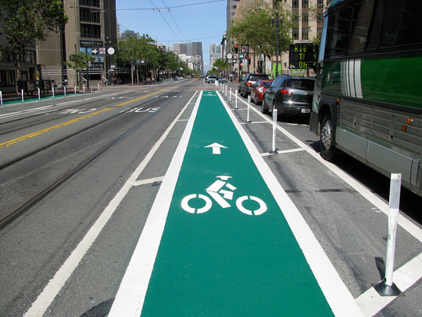
Cycling roads
The biggest polluter today is the car. This problem is especially bad in cities , where the number of cars is increasing every year.
For shorter journeys cycling is a much healthier alternative to driving a car , and many towns have introduced special cycle lanes.

Slide 5
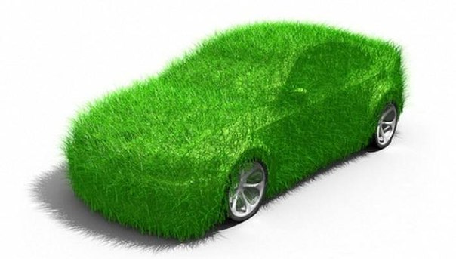
Eco-patrol
The big car companies are also working on developing new engine technology , so that cars can run on clear fuels such as hydrogen instead of petrol .
This reduce the amount of pillution

Slide 6
Eco-label
We can help the environmental by choosing to buy green products , for example organic foods that are produced without using pesticides.
Eco-labels and Green Stickers are labeling systems for food and consumer products.

Slide 7
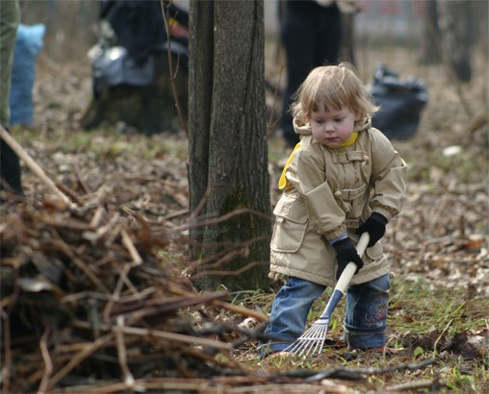
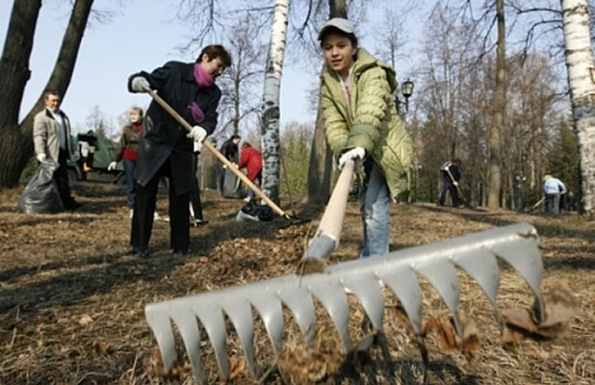
Clean day
In this day people should clean parks , beaches , streets from rubbishes . We have to meet once on week and make our environmental more cleaner. We must take carry about our future.

Slide 8
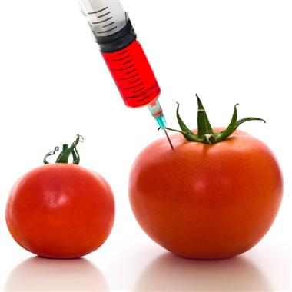
Don’t use pesticides
The term GM foods is most commonly used to refer to crop plants created for human or animal consumption using the latest molecular biology techniques.
Human health risks:
Allergenicity
Unknown effects on human health

