Slide 1
Christmas in Brazil
Liliya Vlasova
Form 11-A

Slide 2
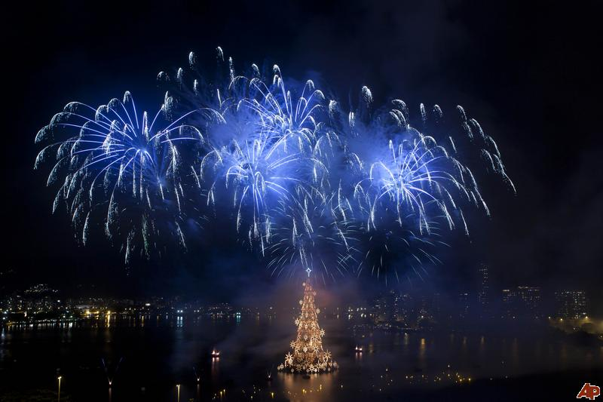
In Brazil, Christmas is one of the most important festive days, or "dia de festas". It is celebrated on 25th December.

Slide 3
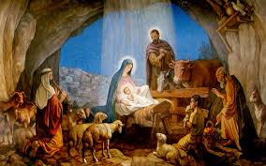
Old Brazilian legend says that even the animals talk to each other about the birth of Christ; the rooster says, "christo nasceu" (Christ is born) the bull asks, "Onde?" (Where?) the chorus of sheep answers, "Em Belem de Juda" (In Bethlehem of Judea)

Slide 4
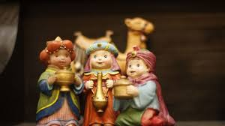
In Brazil there is folk dancing and singing and the festivities go on until January 6th, which the Brazilians refer to as Three Kings Day. January 6th is supposed to be the day when three wise men visited Jesus to bring him gifts.

Slide 5
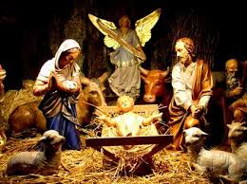
One tradition is to create a nativity scene or Presйpio. The word originates from the Hebrew word "presepium" which means the bed of straw upon which Jesus first slept in Bethlehem. The Presйpio is common in northeastern Brazil. Nowadays presйpios are set up in December and displayed in churches, homes, and stores.

Slide 6
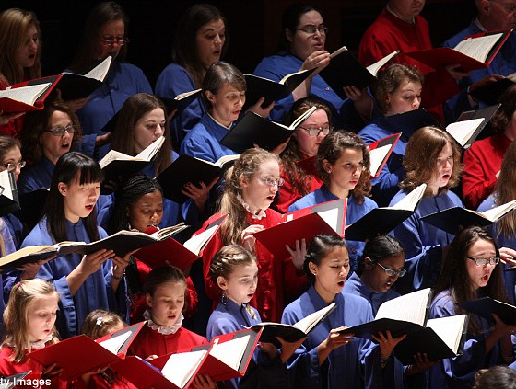
Caroling
Caroling is quite a popular custom here. Various christmas carols are sung during Christmas to commemorate the birth of Christ. A number of Christmas songs (pastorils and others) are sung on the occassion. "Noite Feliz" ("Silent Night") is probably the song most associated with Christmas in Brazil.

Slide 7
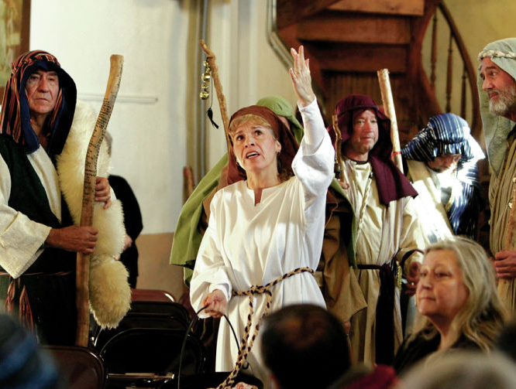
The people of Northern Brazil, as in Mexico, enjoy a version of the folk play Los Pastores or "The Shepherds." In the Brazilian version, there are shepherdesses rather than shepherds and a gypsy who attempts to kidnap the Christ Child.

Slide 8
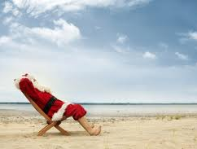
Papai Noel (Father Noel)
Like Santa Claus in the U.S., Papai Noel (Father Noel) is the gift-bringer in Brazil. According to legend, he lives in Greenland and resembles Santa in many ways. Papai Noel can also remind you of Chile's "Viejo Pascuero" (Easter Old Man). This gift-giver of children is depicted as wearing a red fur coat with boots and carrying a bag full of presents. He is believed to secretly leave gifts at the house of every good child on Christmas Day. Children wake up early on Christmas morning to look for gifts from this benevolent character.

Slide 9
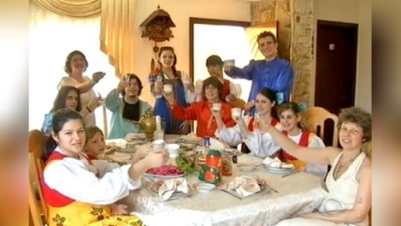
There is a very common tradition among friends and families, called amigo secreto (secret friend). At the beginning of December, participants in the game write their name on a piece of paper. Each participant takes a paper (but does not reveal the name of the person on it). During the month there are exchanges of correspondence among the participants who use apelidos (fake names). On Christmas, family and friends gather to reveal their secret friends and offer them a special gift.

Slide 10
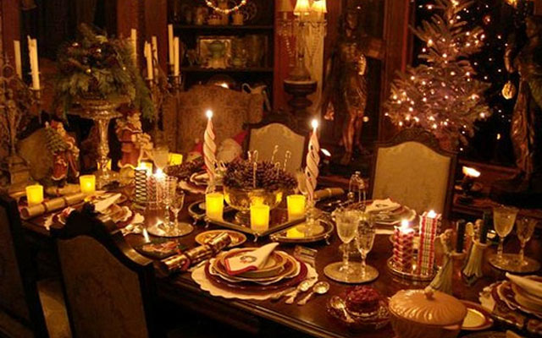
The beginning of the previous century saw many immigrants coming from Europe and other parts of the world and settling in Brazil. As a natural consequence, the festivals celebrated in the country began to be observed in diverse ways and influenced by different traditions that these people brought with them. Christmas is not an exception. The food eaten in Brazil (specially in the South states) during Christmas came from Germany, Italy, Portugal, Spain and other countries. The traditional Christmas dinner here includes roasted turkey, vegetables and fruits. Beer and wine are also served often; a German "Stollen" or an Italian "Panetone" often find their way to a Christmas feast held in the southern parts of the country. A huge Christmas dinner menu includes turkey, ham, colored rice, and wonderful fresh vegetable and fruit dishes.

Slide 11
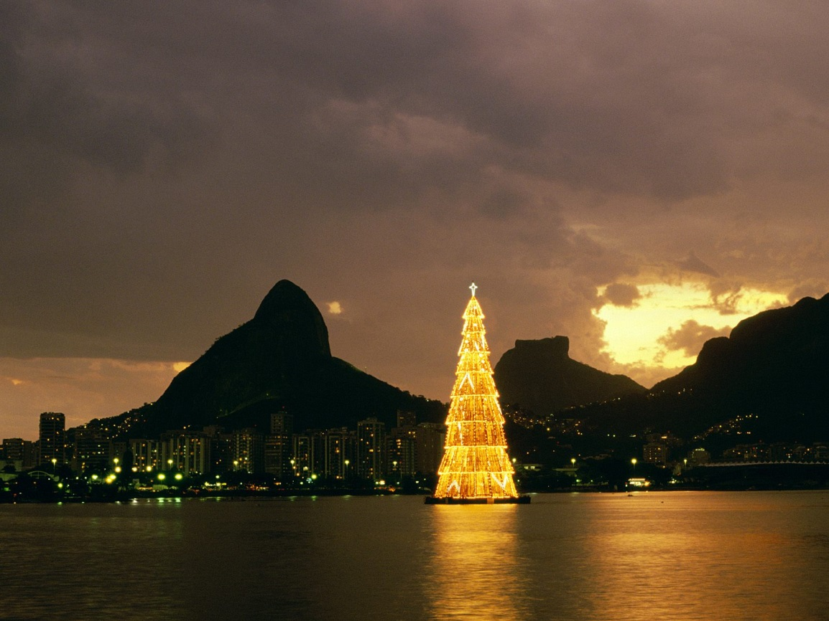
Christmas in Rio
Decorations include fresh flowers picked from the garden. Huge Christmas "trees" of electric lights can be seen against the night skies in major cities such as Brasilia, São Paulo, and Rio de Janeiro throughout the season. Fireworks displays go off to welcome the new year.

Slide 12
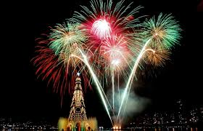
Christmas in brazil Brasilia

Slide 13
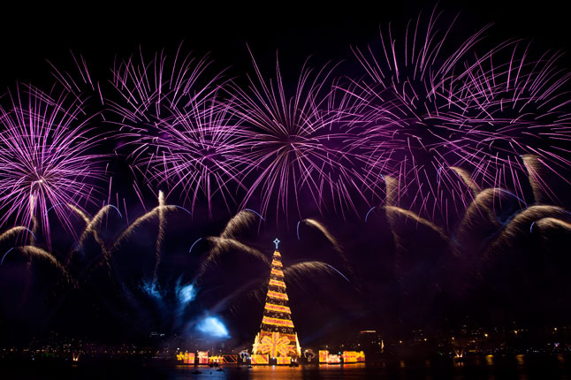
Christmas season in Rio de Janeiro, Brazil

Slide 14
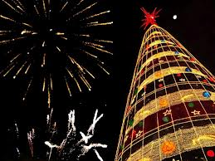
Christmas in brazil Sao Paulo

Slide 15
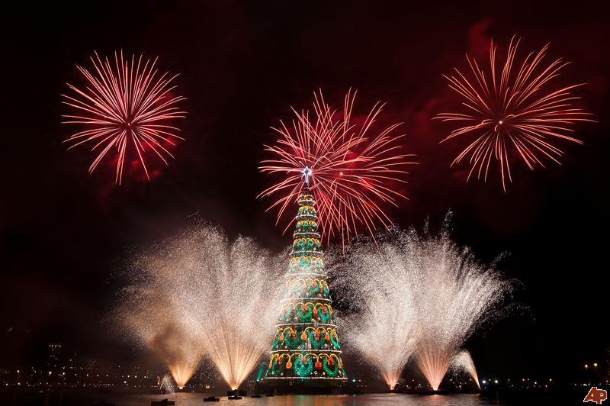
Thank you for your attention

