Slide 1

ENGLAND

Slide 2
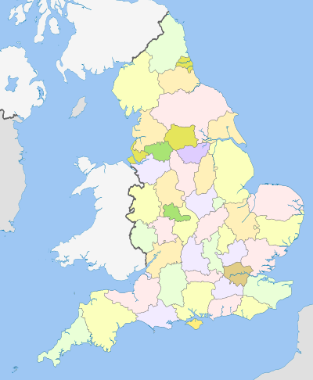
Geographical position of England
England situated in the southeastern part of Great Britain. It borders with Scotland to the north, in the west - with Wales.
The territory of England is 131 km².

Slide 3
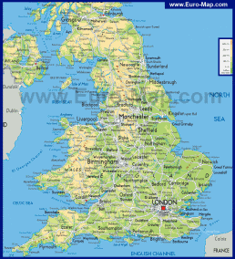
Geographical position of England
It washed by the waters of the
Atlantic Ocean, by the North Sea, by the Irish Sea, and by the waters of the English Channel.
The population of England is about 50 million people.

Slide 4
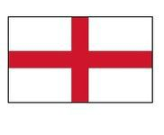
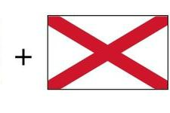
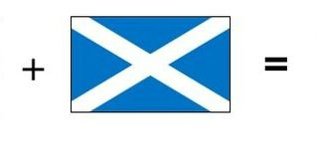

National symbols of England

Slide 5
National symbols of England
The St George's Cross has been the national flag of England
since the 13th century.
Flag of England

Slide 6

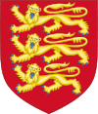
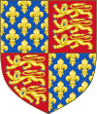
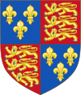
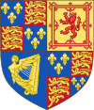


National symbols of England
Coat of arms | Year | Coat of arms | Year
 | 1133—1198 |  | 1198—1340
 | 1340—1406 |  | 1406—1603
 | 1603—1649 |  | 1649—1653
 | 1653—1660 |  | 1660—1707

Slide 7
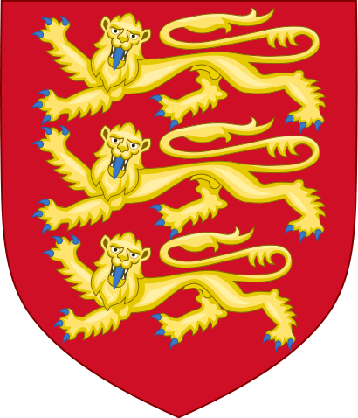
National symbols of England
Three gold lions on a red background appeared in the English coat of arms of Richard the Lionheart after 1195 and are there still.
Coat of Arms of England

Slide 8

National symbols of England
The official original anthem of England
1
God save our gracious Queen,
Long live our noble Queen,
God save the Queen:
Send her victorious,
Happy and glorious,
Long to reign over us:
God save the Queen.
2
O Lord, our God, arise,
Scatter her enemies,
And make them fall.
Confound their politics,
Frustrate their knavish tricks,
On Thee our hopes we fix,
God save us all.
3
Thy choicest gifts in store,
On her be pleased to pour;
Long may she reign:
May she defend our laws,
And ever give us cause
To sing with heart and voice
God save the our Queen.

Slide 9
Unofficial symbols of England
A traditional symbol of England for centuries was a lion

Slide 10
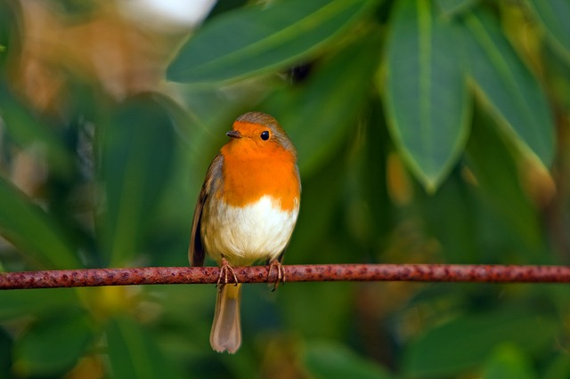
Unofficial symbols of England
Robins

Slide 11

Unofficial symbols of England
Red rose

Slide 12
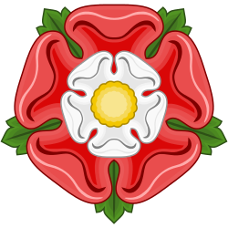
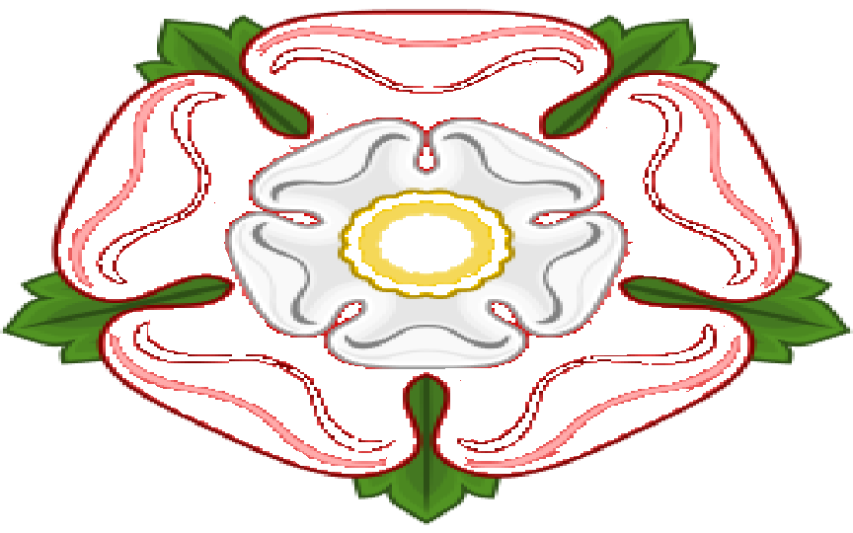
Unofficial symbols of England
Lancastrians
Yorkists

Slide 13
Thank you
for your attention
Oxana Bondar
Form 7(11) B
Gimnasium 1

