Slide 1

Academic vacations
Prepared by
Kubaychuk Victoria
and Chulkowa Ann

Slide 2

Summer part-time jobs for students
The school year is over, put session, all student community is actively undermining took over the search. And where you can get without experience and education.

Slide 3

Looking for "profile" place
In summer, many students try to find a job in their field, and often it is they do. According vacancies published on specialized sites, have a good chance to forge pros - programmers, web-designers, system administrators. However, employers need students to "experience" - at least, after the 3rd year.

Slide 4
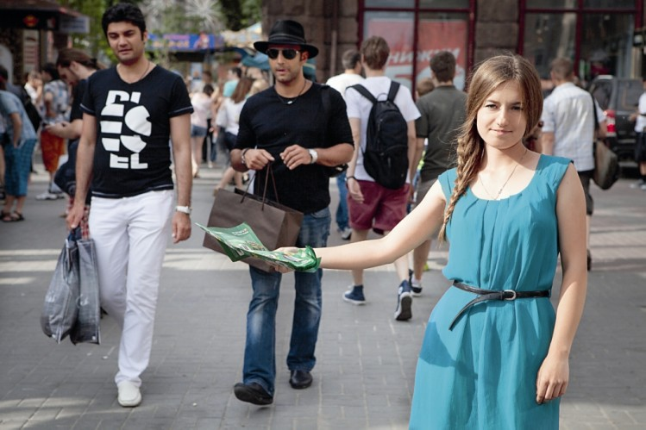
Without training
With future profession coincides not every temporary job, but it does not matter. After all, there are many jobs that do not require any special preparation.
One of the most common types of employment for students is courier work. As a temporary monetary reinforcements many fit and work promoter.

Slide 5

And in the restaurant ...
One of the places that are easy to get but hard to resist - a work in fast food restaurants.
To get a job, just go to any restaurant and fill out a form. All you need communication skills, good look, right speech and sanitary book.

Slide 6
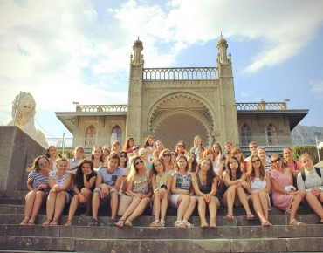
Go to extras
Young people can look for jobs in the crowd on TV.
Subscribe in extras is quite simple - catch enough ads on the internet about a set audience.

Slide 7
Sources of information
https://translate.google.ru/#uk/en/%D0%94%D0%B6%D0%B5%D1%80%D0%B5%D0%BB%D0%B0%20%D1%96%D0%BD%D1%84%D0%BE%D1%80%D0%BC%D0%B0%D1%86%D1%96%D1%97
https://www.google.com.ua/search?q=%D1%81%D1%82%D1%83%D0%B4%D0%B5%D0%BD%D1%82%D0%B8+%D0%BD%D0%B0+%D0%BA%D0%B0%D0%BD%D1%96%D0%BA%D1%83%D0%BB%D0%B0%D1%85&rlz=1C1GKLB_enUA604UA604&espv=2&biw=1024&bih=677&source=lnms&tbm=isch&sa=X&ei=aAs-VKz-D-Ke7gbl7IH4Bg&ved=0CAYQ_AUoAQ#facrc=_&imgdii=_&imgrc=apaHC-ms4PDlwM%253A%3Bo7qvsOZ1l1V8KM%3Bhttp%253A%252F%252Fproryazan.com%252Fwp-content%252Fuploads%252F2014%252F08%252F222-370x290.jpg%3Bhttp%253A%252F%252Fproryazan.com%252F2014%252F08%252F20%252F46329%3B370%3B290
http://robota.lviv.ua/for-students/55-summer-earnings-for-students

