Slide 1
Olympics 2012 (London)
The presentation was prepared
Ilchyshyn Adrian

Slide 2
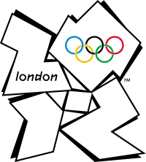
The 2012 Summer Olympics, formally the Games of the XXX Olympiad and commonly known as London 2012, was a major international multi-sport event celebrated in the tradition of the Olympic Games, as governed by the International Olympic Committee. It took place in London, United Kingdom and a lesser extent across the country from 25 July to 12 August 2012. The first event, the group stage in women's football began on 25 July at the Millennium Stadium in Cardiff. More than 10,000 athletes from 204 National Olympic Committees participated. It was officially started however on Friday 27 July 2012 at 0:00.

Slide 3
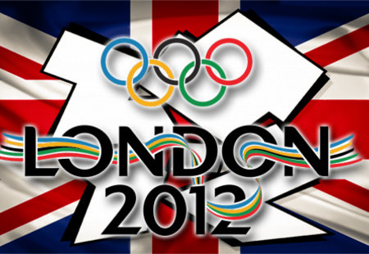
Following a bid headed by former Olympic champion Sebastian Coe and then-Mayor of London Ken Livingstone, London was selected as the host city on 6 July 2005 during the 117th IOC Session in Singapore, defeating bids from Moscow, New York City, Madrid and Paris. London was the first city to host the modern Olympic Games three times,having previously done so in 1908 and in 1948.
Construction for the Games involved considerable redevelopment, with an emphasis on sustainability. The main focus was a new 200-hectare Olympic Park, constructed on a former industrial site at Stratford, East London. The Games also made use of venues that already existed before the bid.

Slide 4
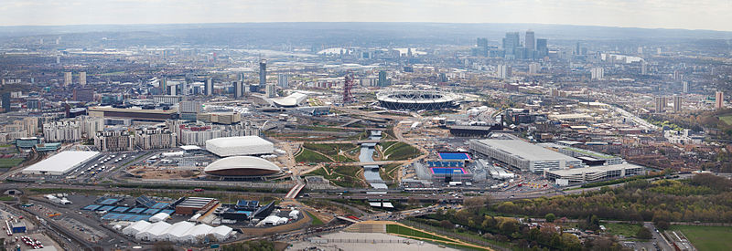
Olympic Park

Slide 5
The 2012 Summer Olympic programme featured 26 sports encompassing 39 disciplines and 302 events.
Medal count
A total of 85 National Olympic Committees (NOCs) won medals, 54 of those countries winning at least one gold medal. Bahrain, Botswana, Cyprus, Gabon, Grenada (a gold medal), Guatemala, and Montenegro won their first ever Olympic medals. The United States finished at the top of the table winning 46 gold medals and winning 104 medals overall. China finished second with 38 gold medals and 88 medals overall. Hosts Great Britain came in third place winning 29 gold medals and 65 medals overall in their best performance since London hosted its first Summer Olympic Games back in 1908 pushing Russia into fourth place who won 24 gold medals although they won 81 medals (16 more than Great Britain) overall.

