Slide 1

Simple Linear Regression
as an example of the actual processes description
Research work
Pavel Shevchenko

Slide 2
Goals
To confirm hypothesis: the anxiety level of computer addict is in direct proportion to the amount of time he spent on computer games;
To predict the dependency between the average score of for assessment and evaluation of of the selected object;
Find a major factor getting a high average score on the example of students from 9-A grade in public institution Dneprorudnenskaya High School "Sofia" in the 2011-2012 school year.

Slide 3
Preamble
The Method of Regression analysis has a big popularity nowadays. It has been successfully applied in the analysis of experimental data in the various fields of science: psychology, economics, sociology, physics, chemistry, geology, automation and others.
For example, in the economy of these methods can be used to find the relationship between the cost of advertising a product and generate revenue from sales.
This example will start a conversation about Simple Linear Regression, which can be used to describe the actual processes.

Slide 4
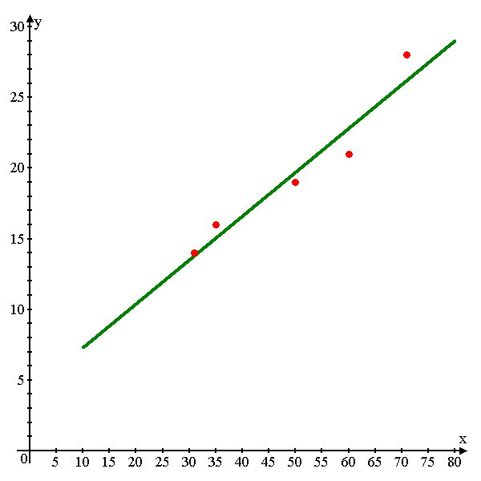
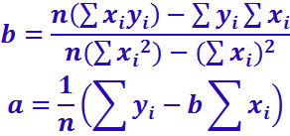
General Ideas and Conceptions
Regression - functional relationship between independent variables and conditional mathematical expectation (average mean) response variable (regressand) .
Simple Linear Regression expressed by a linear function:
у=bx+a+ε.
Example of a graph of the linear regression
Formulas for finding the coefficients
regression equation:
реклама
продажа

Slide 5
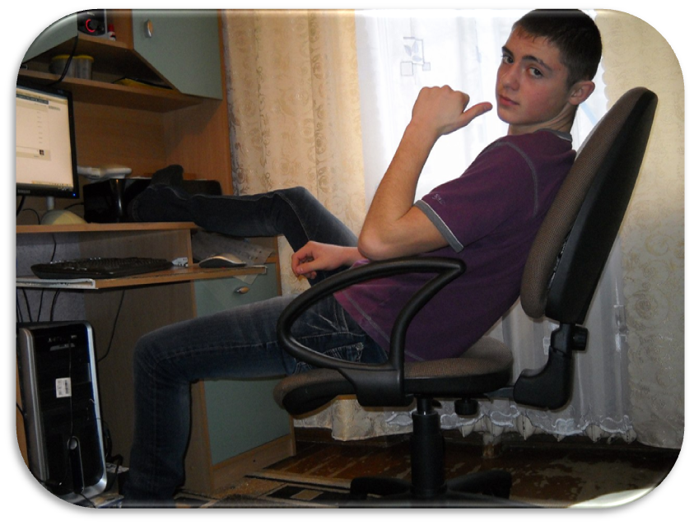


Relationship of Human’s Anxiety Level
and Amount of Time,
Spending in Computer Games

Slide 6
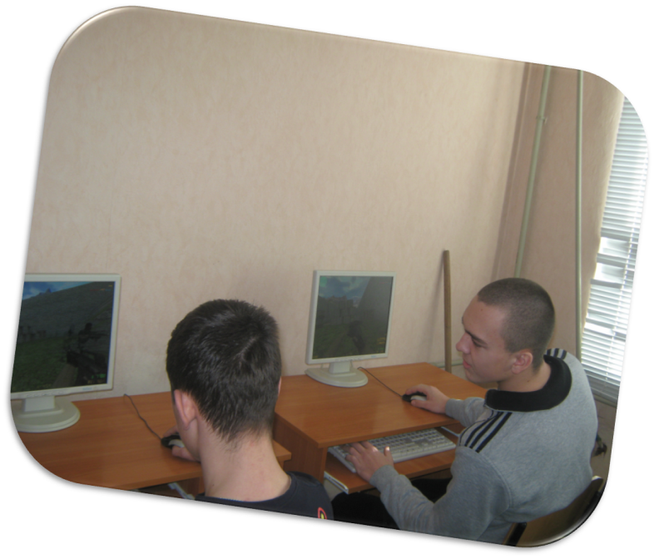

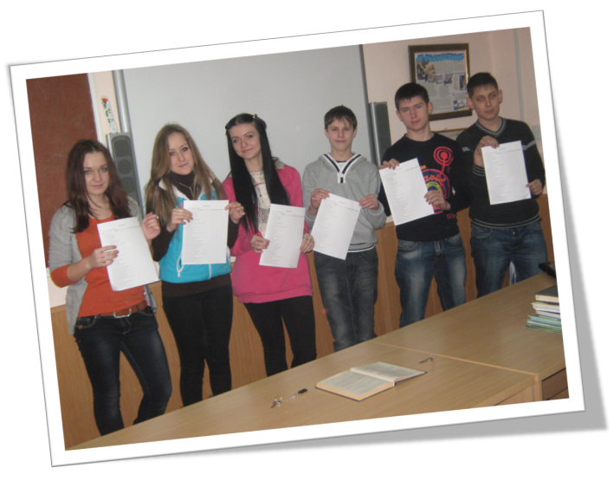
Summary table of data
№ | Surname, name, class, age | Quantity of hours (in a week) | Anxiety laevel
1 | Анпилов Александр, 10-А, 15 лет | 25,53 | 2,275
2 | Гайдаш Екатерина, 10-А, 15 лет | 16,3 | 1,525
3 | Иванников Виталий, 10-А, 16 лет | 32,3 | 3,125
4 | Клименко Дмитрий, 10-А, 14 лет | 22,32 | 2,075
5 | Команчи Дмитрий, 10-А, 15 лет | 29,87 | 2,75
6 | Короткова Лилия, 10-А, 15 лет | 21,78 | 1,675
7 | Куприн Кирилл, 10-А, 15 лет | 33,7 | 3,025
8 | Мартиросян Арам, 10-А, 15 лет | 21,62 | 1,875
9 | Хлопов Артём, 10-А, 14 лет | 26,85 | 2,25
10 | Якуба Александр, 10-А, 15 років | 37,43 | 3,05
The auxiliary table for calculation of coefficients of regression
№ | х_{і} | у_{і} | х_{і}² | х_{і}у_{і} | у_{і} ^{р} | (у_{і} ^{р} – у)² | (у_{і} – у)²
1 | 25,53 | 2,275 | 651,78 | 58,08 | 2,255 | 0,0111 | 0,01
2 | 29,87 | 2,75 | 892,22 | 82,14 | 2,632 | 0,0741 | 0,15
3 | 32,3 | 3,125 | 1043,29 | 100,94 | 2,844 | 0,2338 | 0,59
4 | 22,32 | 2,075 | 498,18 | 46,31 | 1,975 | 0,1479 | 0,08
5 | 21,78 | 1,675 | 474,37 | 36,48 | 1,928 | 0,1863 | 0,47
6 | 16,3 | 1,525 | 265,69 | 24,86 | 1,452 | 0,8251 | 0,70
7 | 21,62 | 1,875 | 467,42 | 40,54 | 1,914 | 0,1985 | 0,24
8 | 33,7 | 3,025 | 1135,69 | 101,94 | 2,965 | 0,3664 | 0,44
9 | 26,85 | 2,25 | 720,92 | 60,41 | 2,369 | 0,0001 | 0,01
10 | 37,43 | 3,05 | 1401,00 | 114,16 | 3,290 | 0,8646 | 0,48
 | 267,7 | 23,625 | 7550,57 | 665,87 |  | 2,91 | 3,16

Slide 7






Let's calculate coefficients of linear regression on the given formulas:
Thus, required regression dependence looks like:
Let's find determination coefficient on a formula:
n
i
n
i
Regression Statistics
R-square | 0,920855
Observation | 10
Coefficients
Y-interacting | 0,033684
independent X | 0,086993
;

Slide 8
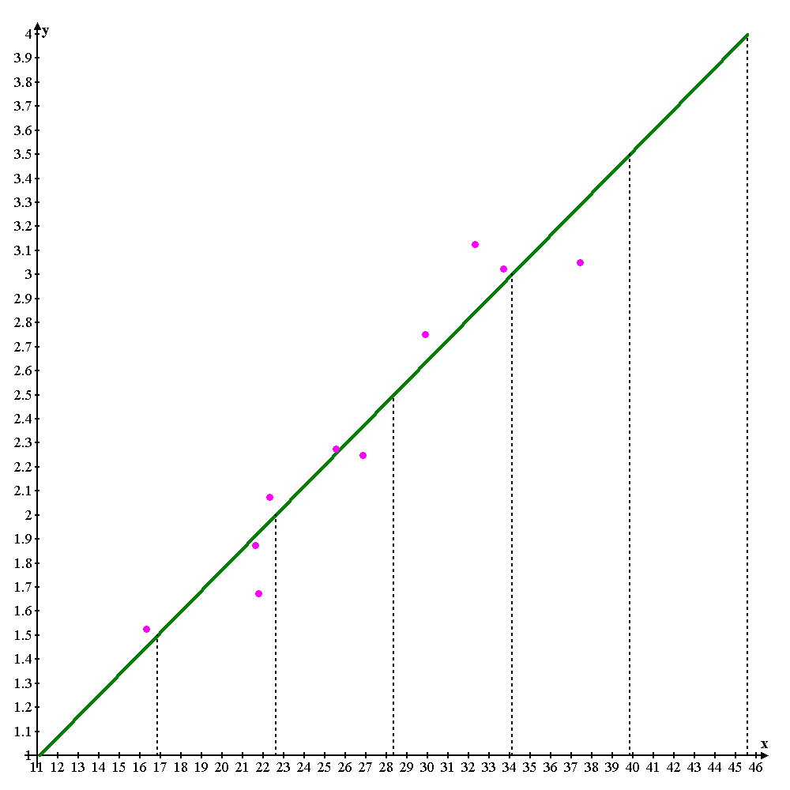
Anxiety Levels
The First (minimum):
The second (low):
Third (satisfactory):
Fourth (unsatisfactory):
The Fifth(High):
The Sixth(extreme):
More than 40 hours

Slide 9
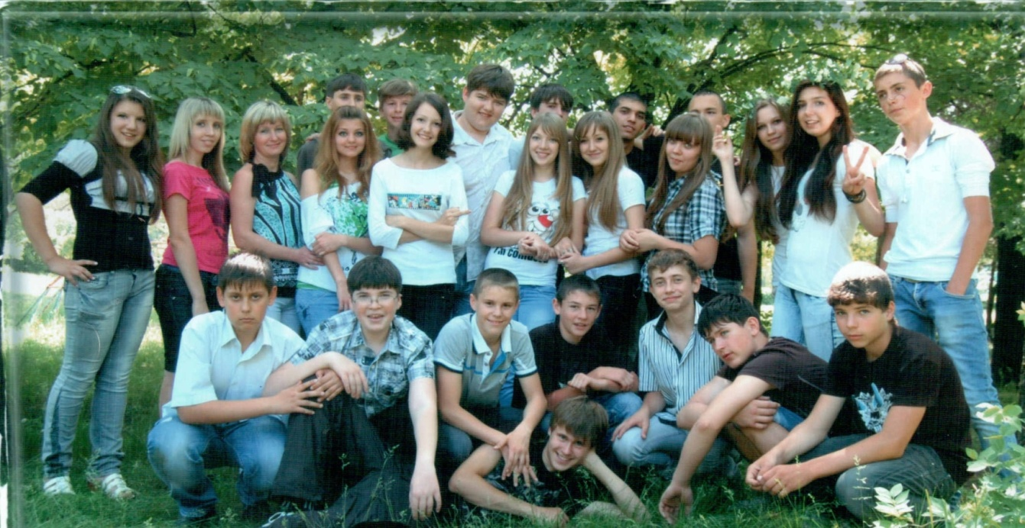
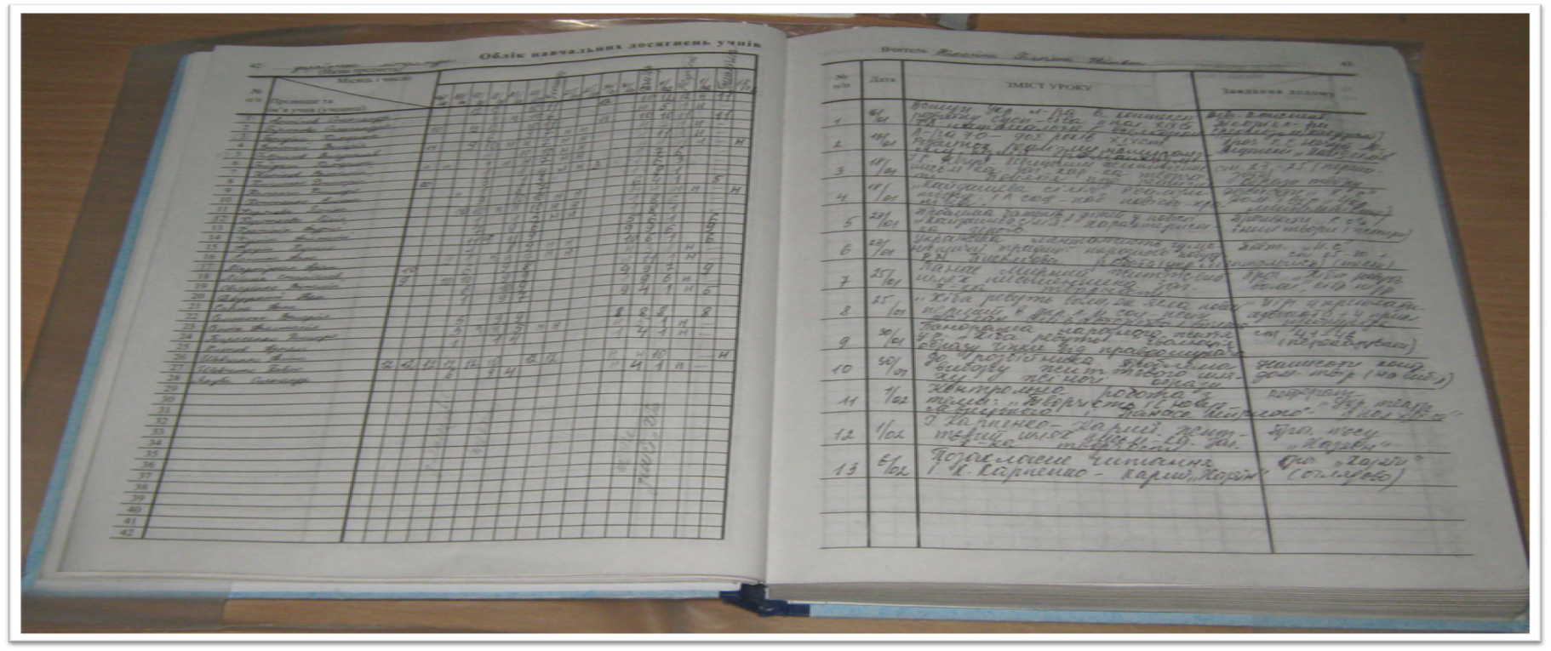
Dependence of a GPA of progress
and estimates in the chosen subject

Slide 10
 | Укр. язык | Укр. Лит | Англ. Яз. | Франц/ Немец | Рус. Яз. | Литер. | Истор. Укр. | Всем. Истор. | Право | Алгебр | Геометр. | Биолог | географ. | физика | химия | худ. Культ. | труды | информ. | черчен. | О.Б.Ж.
Анпилов | 9 | 10 | 9 | 9 | 10 | 11 | 10 | 10 | 10 | 8 | 8 | 12 | 8 | 8 | 8 | 8 | 9 | 9 | 8 | 9
Бабич | 5 | 4 | 4 | 4 | 5 | 5 | 6 | 5 | 8 | 4 | 4 | 4 | 5 | 6 | 5 | 5 | 8 | 7 | 4 | 6
Бирюкова | 8 | 5 | 5 | 10 | 8 | 8 | 8 | 8 | 8 | 4 | 4 | 5 | 6 | 5 | 4 | 8 | 10 | 9 | 8 | 10
Бородина | 9 | 9 | 8 | 10 | 10 | 11 | 10 | 10 | 10 | 10 | 10 | 9 | 9 | 8 | 9 | 12 | 11 | 8 | 12 | 10
Воропай | 5 | 6 | 4 | 7 | 6 | 7 | 7 | 8 | 6 | 4 | 4 | 6 | 6 | 6 | 3 | 7 | 10 | 7 | 5 | 10
Гаврилов | 7 | 8 | 4 | 8 | 7 | 8 | 8 | 8 | 6 | 7 | 6 | 6 | 7 | 6 | 5 | 7 | 7 | 9 | 6 | 10
Герда | 4 | 3 | 5 | 5 | 6 | 4 | 4 | 4 | 5 | 4 | 3 | 4 | 4 | 3 | 3 | 5 | 8 | 9 | 4 | 8
Иваников | 7 | 8 | 7 | 6 | 9 | 7 | 9 | 8 | 7 | 8 | 7 | 8 | 9 | 8 | 7 | 8 | 9 | 10 | 7 | 9
Клименко | 5 | 3 | 4 | 5 | 5 | 6 | 5 | 4 | 3 | 4 | 4 | 4 | 4 | 3 | 2 | 5 | 8 | 6 | 4 | 5
Команчи | 4 | 3 | 4 | 3 | 5 | 4 | 5 | 6 | 3 | 3 | 3 | 4 | 3 | 3 | 2 | 3 | 8 | 8 | 1 | 3
Кононенко | 7 | 4 | 5 | 6 | 7 | 8 | 7 | 7 | 7 | 4 | 4 | 5 | 6 | 5 | 4 | 6 | 10 | 9 | 4 | 7
Коржова | 7 | 7 | 8 | 7 | 8 | 9 | 9 | 9 | 8 | 9 | 8 | 7 | 10 | 7 | 8 | 9 | 11 | 10 | 7 | 10
Короткова | 9 | 9 | 8 | 8 | 10 | 9 | 9 | 10 | 8 | 8 | 8 | 8 | 8 | 7 | 9 | 8 | 9 | 11 | 8 | 9
Кретинин | 5 | 2 | 3 | 4 | 4 | 4 | 5 | 5 | 5 | 3 | 3 | 4 | 4 | 3 | 2 | 4 | 7 | 5 | 5 | 9
Кулиш | 6 | 4 | 4 | 4 | 6 | 5 | 6 | 7 | 6 | 4 | 5 | 5 | 5 | 4 | 4 | 5 | 9 | 8 | 5 | 6
Куприн | 7 | 9 | 7 | 8 | 8 | 9 | 8 | 8 | 7 | 10 | 10 | 8 | 7 | 10 | 8 | 7 | 8 | 10 | 8 | 10
Лашина | 8 | 6 | 6 | 7 | 8 | 8 | 8 | 8 | 7 | 4 | 4 | 6 | 6 | 6 | 6 | 7 | 9 | 7 | 6 | 9
Мартиросян | 9 | 9 | 9 | 7 | 10 | 10 | 8 | 9 | 7 | 10 | 10 | 9 | 7 | 9 | 10 | 9 | 9 | 10 | 7 | 9
Мишин | 9 | 7 | 8 | 8 | 9 | 9 | 9 | 9 | 9 | 9 | 8 | 7 | 8 | 7 | 6 | 8 | 9 | 9 | 4 | 10
Овчаренко | 7 | 6 | 8 | 6 | 7 | 6 | 8 | 8 | 7 | 8 | 9 | 7 | 7 | 9 | 8 | 7 | 9 | 10 | 7 | 9
Приймак | 7 | 7 | 9 | 7 | 8 | 8 | 8 | 9 | 10 | 7 | 6 | 6 | 8 | 6 | 5 | 8 | 9 | 10 | 6 | 9
Ревуцкий | 8 | 7 | 5 | 7 | 9 | 8 | 7 | 7 | 7 | 4 | 4 | 6 | 8 | 5 | 4 | 7 | 9 | 9 | 5 | 9
Савина | 6 | 3 | 3 | 5 | 7 | 6 | 7 | 9 | 5 | 5 | 4 | 4 | 4 | 5 | 6 | 6 | 10 | 8 | 5 | 9
Семенько | 11 | 11 | 10 | 10 | 11 | 11 | 10 | 10 | 10 | 10 | 10 | 10 | 10 | 9 | 10 | 10 | 10 | 11 | 10 | 11
Сенюк | 8 | 8 | 6 | 6 | 7 | 9 | 8 | 8 | 9 | 6 | 4 | 6 | 7 | 5 | 6 | 9 | 10 | 8 | 7 | 9
Тарасенко | 5 | 3 | 4 | 5 | 6 | 4 | 6 | 6 | 3 | 4 | 4 | 4 | 3 | 4 | 3 | 4 | 8 | 8 | 4 | 4
Хлопов | 4 | 4 | 5 | 4 | 6 | 4 | 5 | 4 | 4 | 3 | 3 | 4 | 4 | 3 | 2 | 4 | 8 | 7 | 6 | 4
Шевченко А. | 7 | 3 | 3 | 8 | 7 | 8 | 7 | 6 | 5 | 4 | 4 | 5 | 6 | 5 | 4 | 7 | 9 | 9 | 3 | 8
Шевченко П. | 11 | 12 | 10 | 12 | 10 | 11 | 10 | 10 | 10 | 12 | 12 | 10 | 10 | 10 | 11 | 10 | 11 | 11 | 10 | 11
Якуба | 4 | 2 | 4 | 3 | 6 | 4 | 5 | 6 | 5 | 4 | 4 | 6 | 4 | 2 | 3 | 3 | 8 | 8 | 5 | 5

Slide 11
№ | Subject | Regression equation | R²
1. | Ukrainian | -0,056427Х+0,460754 | 0,017192
2. | Ukrainian Literature | 0,410689Х-3,674509 | 0,361694
3. | English | 0,018284Х-1,070215 | 0,000985
4. | French/German | -0,011133Х-0,165561 | 0,000314
5. | Russian | -0,131005Х+1,564919 | 0,099026
6. | Russian Literature | 0,138371Х-0,416191 | 0,071131
7. | Ukrainian History | 0,132193Х-0,371958 | 0,073561
8. | World History | -0,137436Х+1,643689 | 0,078221
9. | Government | -0,049057Х+0,305199 | 0,006299
10. | Algebra | 0,301833Х-2,851595 | 0,197649
11. | Geometry | 0,265489Х-2,849642 | 0,135763
12. | Biology | 0,003642Х-0,618085 | 0,000049
13. | Geography | 0,015582Х-0,55993 | 0,001238
14. | Physical Science | 0,061598Х-1,43993 | 0,012897
15. | Chemistry | 0,3185131Х-3,572711 | 0,247366
16. | Esthetical Science | 0,0470855Х-0,3196468 | 0,010362
17. | Трудовое обучение | -0,665022Х+6,738602 | 0,700871
18. | Computers | -0,463331Х+5,034262 | 0,435323
19. | Technical Drawing | -0,028611Х-0,676069 | 0,001623
20. | Life Science | -0,12703Х+2,306156 | 0,028974

Slide 12



The regression equation for algebra
Let's calculate coefficients of linear regression on the given formulas:
Thus, required regression dependence looks like:
Let's find determination coefficient on a formula:
n
i
n
i

Slide 13
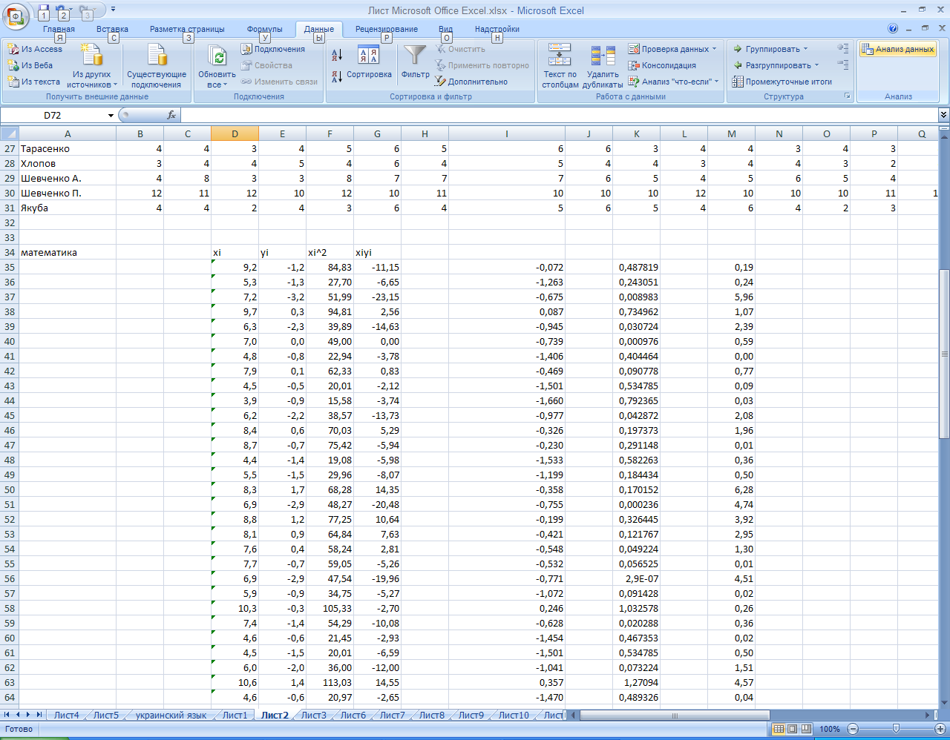
Let's carry out the regression analysis in the MS Excel Regression mode. Work with the program is presented ​​ in the following drawings:

Slide 14
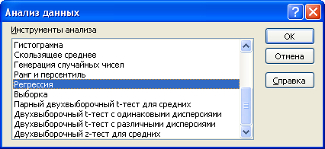
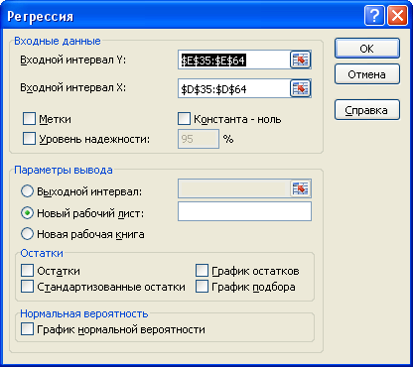
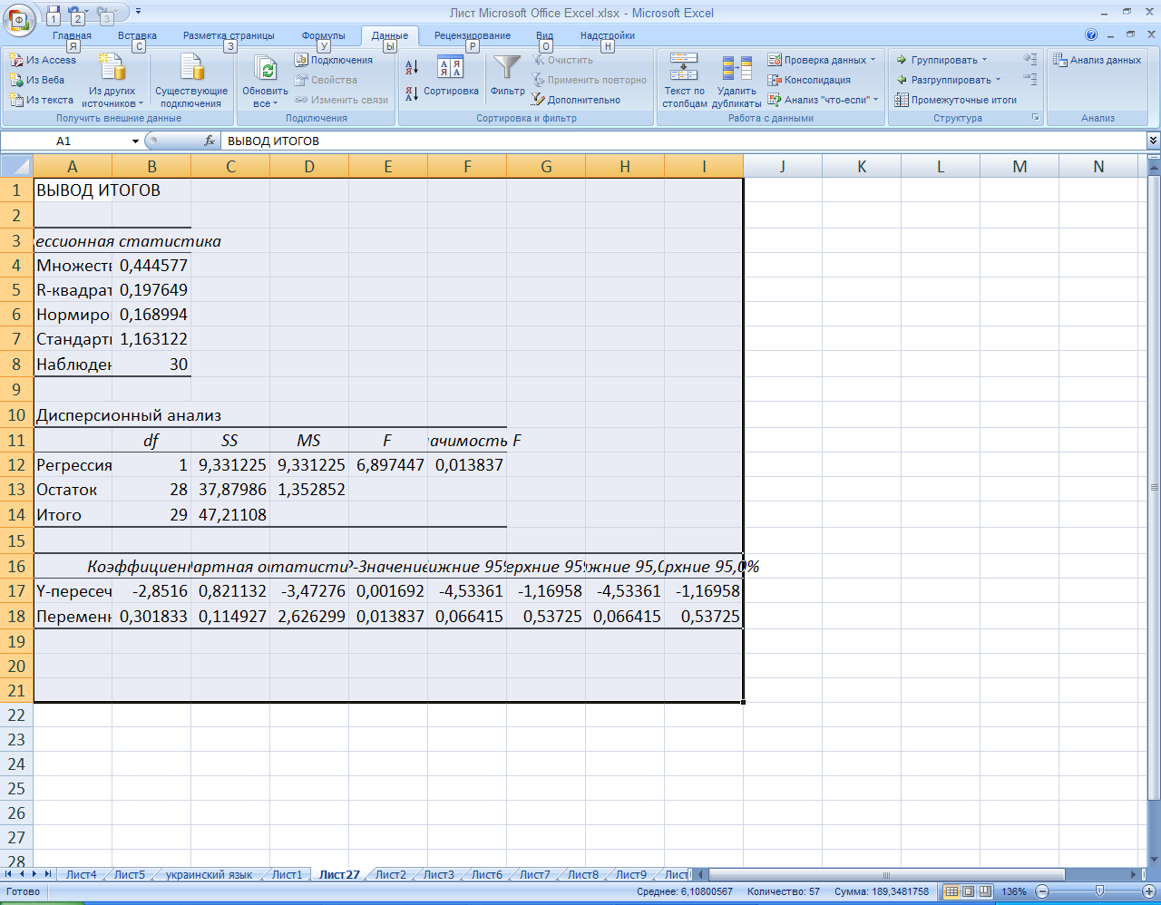
;
.
Let's generate results on regression statistics are necessary and we will present them in the table:
Регресійна статистика
R-квадрат | 0,1976
Спостереження | 30
Коэффициенты
Y-пересечение | -2,851595
Переменная X | 0,301833
Proceeding from calculations, we can write down the regression equation as follows:

Slide 15
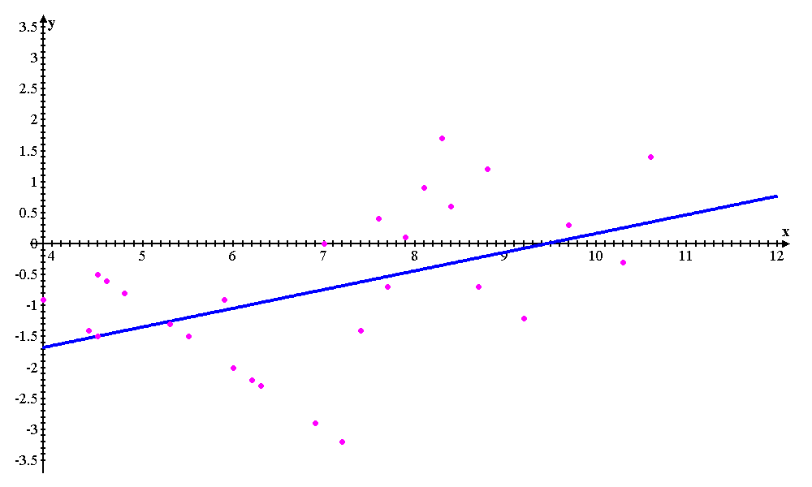

Slide 16



The regression equation for labor Science
Let's calculate coefficients of linear regression on the given formulas:
Thus, required regression dependence looks like:
Let's find determination coefficient on a formula:
n
i
n
i

Slide 17

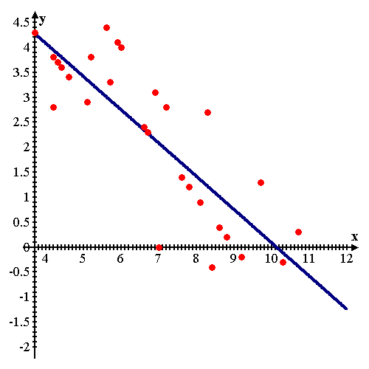
Let's carry out the regression analysis in the MS Excel Regression mode for confirmation of settlement data.
Регрессионная статистика
R-квадрат | 0,700865
Наблюдения | 30
Коэффициенты
Y-пересечение | 6,738609
Переменная X | -0,665023
Proceeding from calculations, we can write down the regression equation as follows:
;
.

Slide 18
Finding of the main factor of receiving by the pupil of a high GPA of estimation
№ | Family name | GPA | Number of Absences | Time for hw | (IQ)
1 | Анпилов | 9,2 | 184 | 15,5 | 126
2 | Бабич | 5,2 | 239 | 7 | 86
3 | Бирюкова | 7,1 | 145 | 9,52 | 101
4 | Бородина | 9,8 | 161 | 8,48 | 129
5 | Воропай | 6,2 | 203 | 7,44 | 89
6 | Гаврилов | 7,0 | 74 | 8,97 | 107
7 | Герда | 4,8 | 111 | 4,65 | 83
8 | Иваников | 7,9 | 168 | 16,36 | 111
9 | Клименко | 4,5 | 58 | 5,63 | 84
10 | Команчи | 3,9 | 198 | 4 | 83
11 | Кононенко | 6,1 | 67 | 17,69 | 90
12 | Коржова | 8,4 | 280 | 23,54 | 115
13 | Короткова | 8,7 | 148 | 16,52 | 122
14 | Критинин | 4,3 | 137 | 3,85 | 78
15 | Кулиш | 5,4 | 50 | 6,48 | 92
№ | Family name | GPA | Absences | Time for hw | (IQ)
16 | Куприн | 8,4 | 30 | 21,46 | 117
17 | Лашина | 6,8 | 47 | 13,28 | 100
18 | Мартиросян | 8,9 | 181 | 17,87 | 128
19 | Мишин | 8,1 | 108 | 16,01 | 114
20 | Овчаренко | 7,7 | 124 | 19,32 | 113
21 | Приймак | 7,7 | 298 | 18,63 | 110
22 | Ревуцкий | 6,8 | 84 | 17,5 | 101
23 | Савина | 5,9 | 127 | 15,2 | 98
24 | Семенько | 10,3 | 202 | 14,42 | 131
25 | Сенюк | 7,3 | 65 | 18,51 | 107
26 | Тарасенко | 4,6 | 287 | 8,3 | 84
27 | Хлопов | 4,4 | 169 | 4,98 | 88
28 | Шевченко А. | 5,9 | 57 | 11,37 | 95
29 | Шевченко П. | 10,7 | 116 | 12,87 | 136
30 | Якуба | 4,6 | 283 | 5,63 | 89

Slide 19

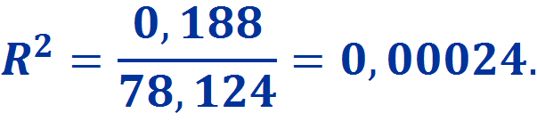
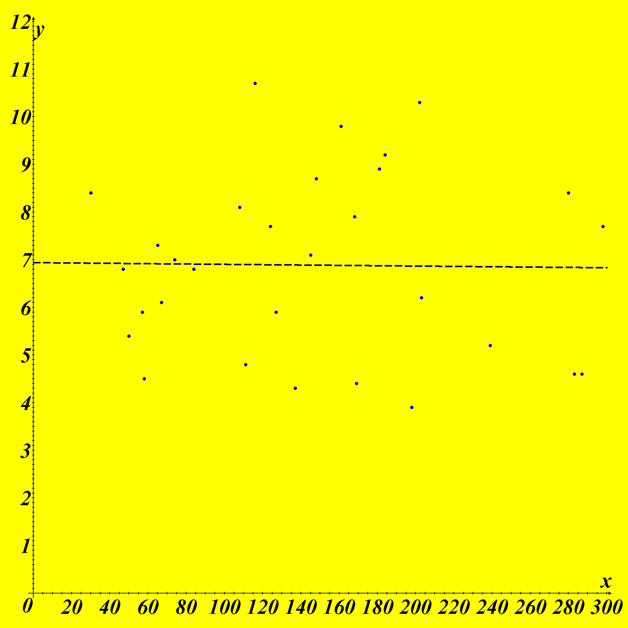
Factor No. 1: Visit of lessons
Regression Equation —
Determination Coefficient —
The schedule and the chart of dispersion visually prove lack of linear dependence. The theoretical line of regression passes almost parallel to abscissa axis, and it states lack of linear dependence between variables x and at. That is it is possible to interpret that attendance of lessons isn't the main factor of receiving a GPA of training. Then we will review the following examples.

Slide 20

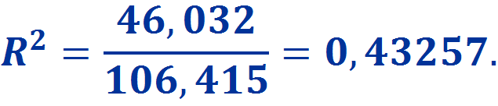
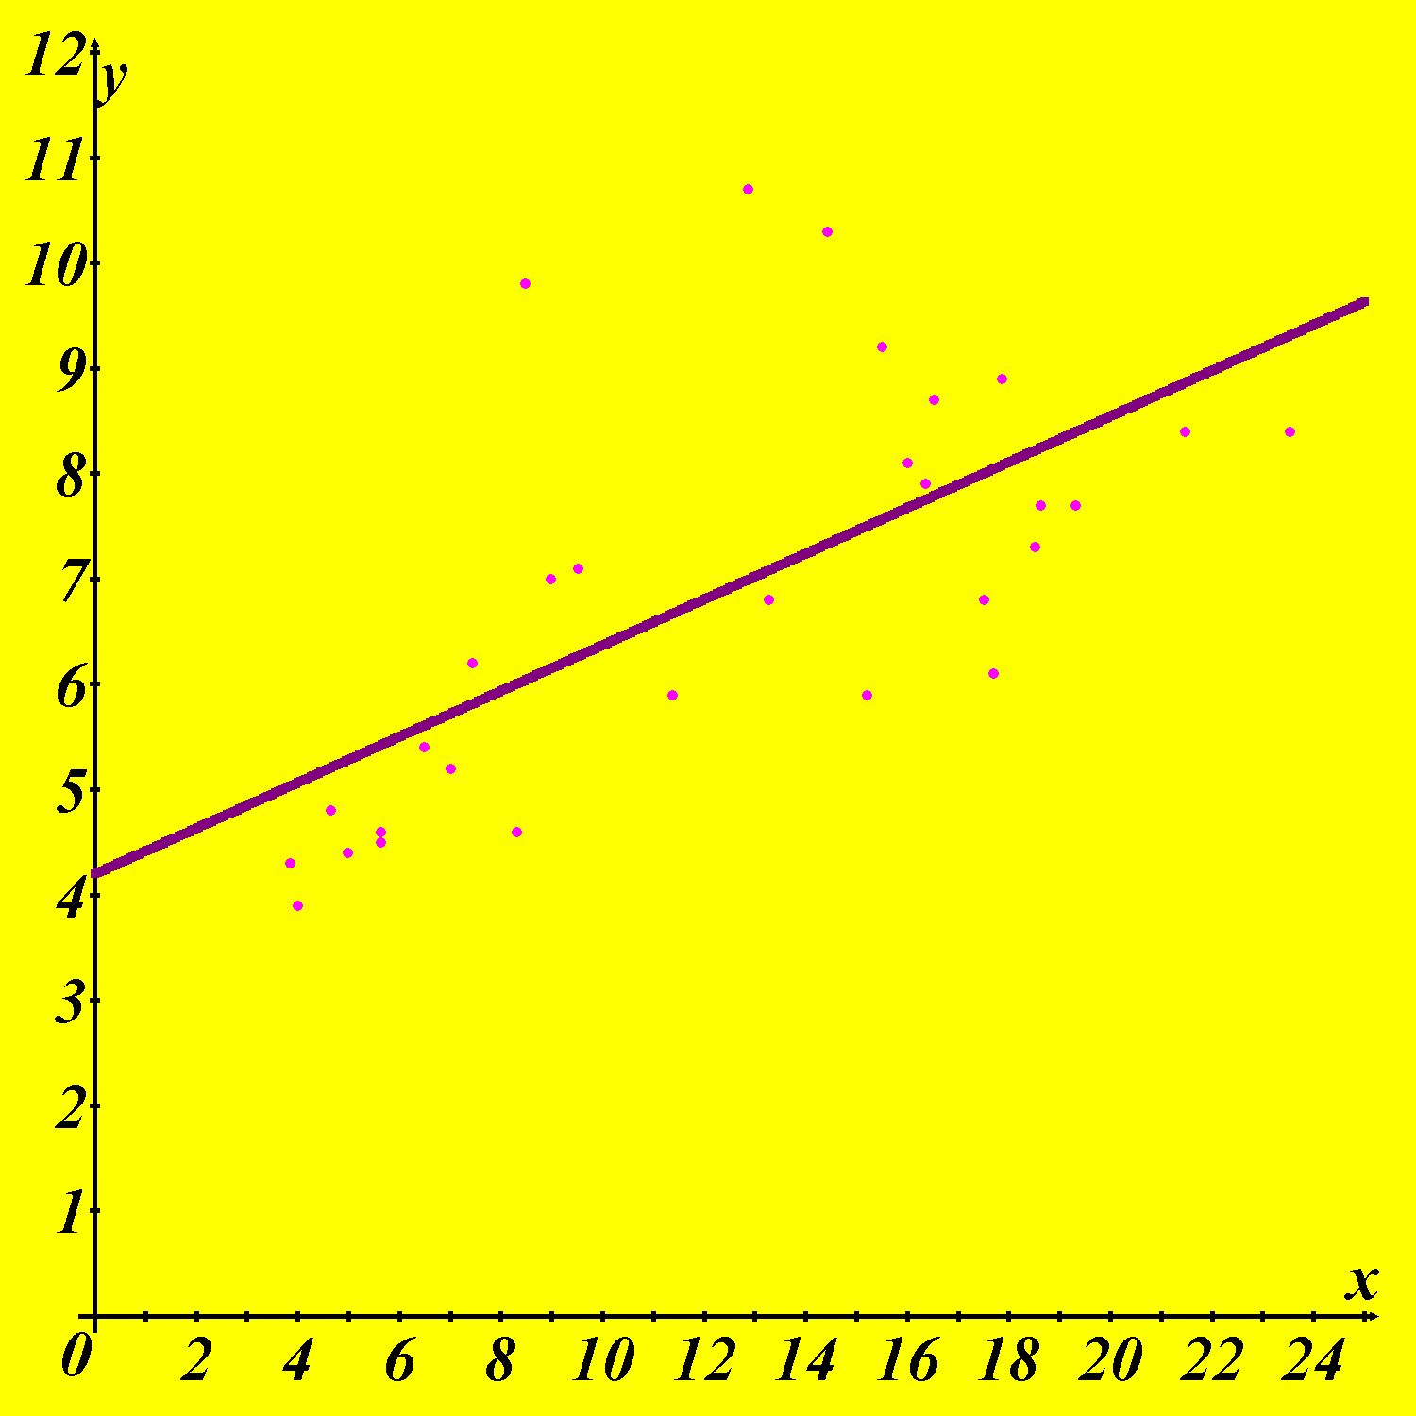
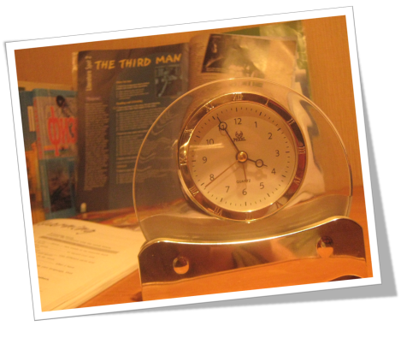
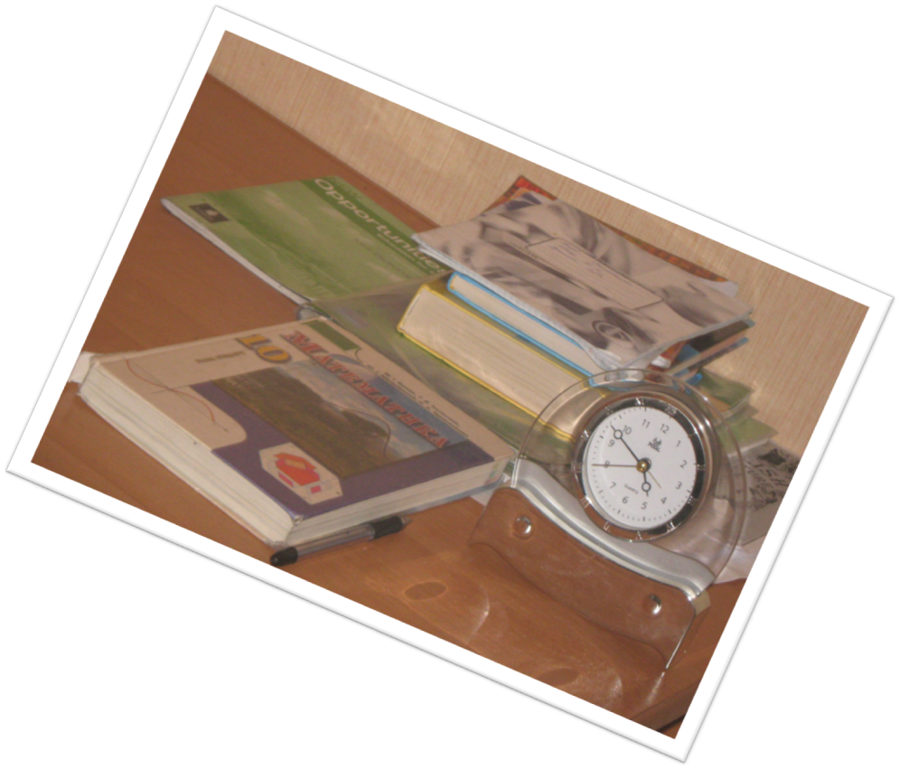
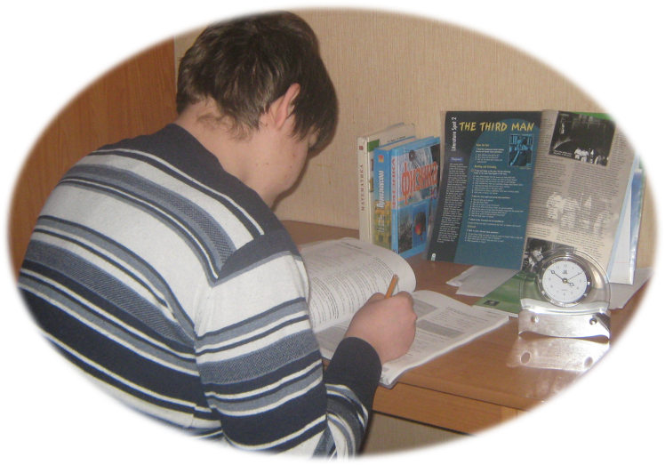
Factor No. 2: Time of homework
Regression Equation —
Determination Coefficient —
About a half of points are at a straight line, as confirms determination coefficient. That is if diligence, persistence and definiteness in achievement of the purpose also isn't the main factor for receiving an appreciation, precisely is a component of this process.

Slide 21
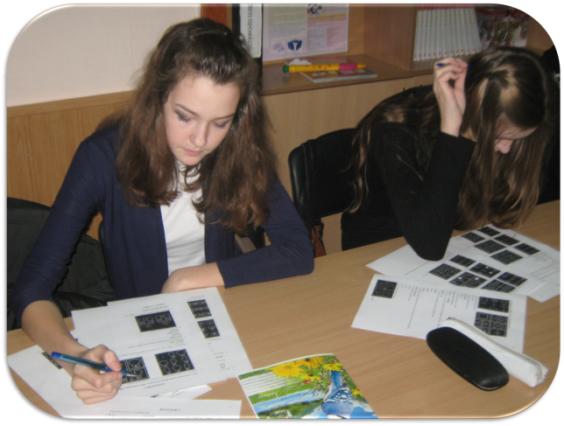

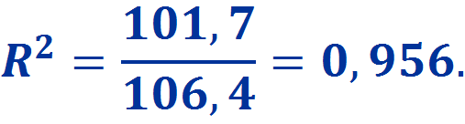
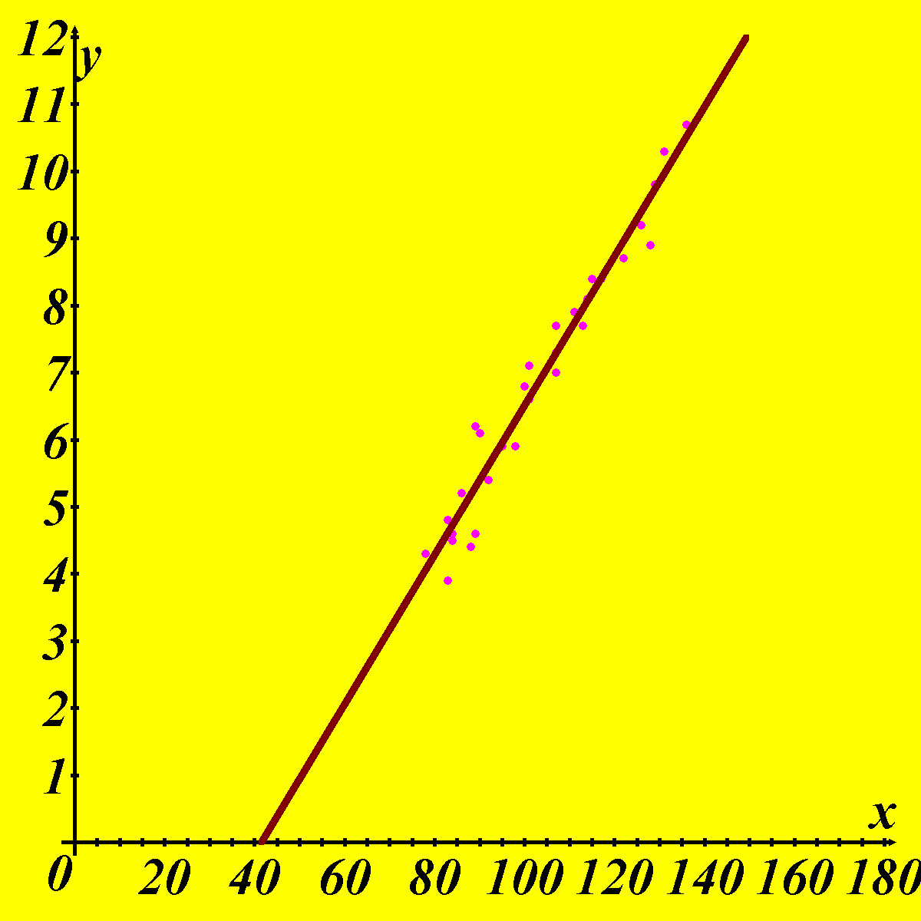
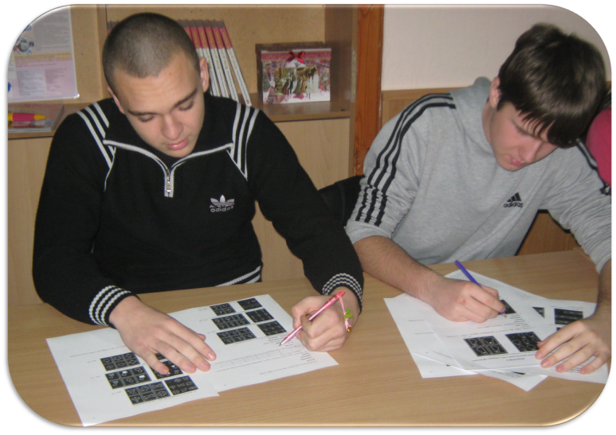
Factor No. 3: Level of intelligence (IQ))
Regression Equation —
Determination coefficient —
Summing up this section it is necessary to tell the following: from the mathematical point of view it is proved that the main factor in training is erudition and intelligence, but also it is necessary to consider that all the same study - compound process it is possible to achieve which highest success only in that case when all considered factors are considered.

Slide 22
Conclusion
Research objective of real processes are attempts to give the idea of possible ways of further succession of events, to predict this or that situation, to expect the future of values of influencing factors, to specify instruments of studying of a situation in the desirable direction.
So, for example, in this work use of pair linear regression for forecasting of various examples of the description of a picture of training of pupils of one (local) class was considered. Are also found negatively and positively influencing factors on further process. Practical value of this work also consists in it.

