Slide 1
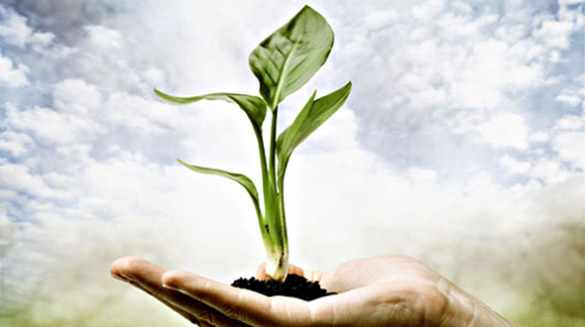
Earth Day

Slide 2
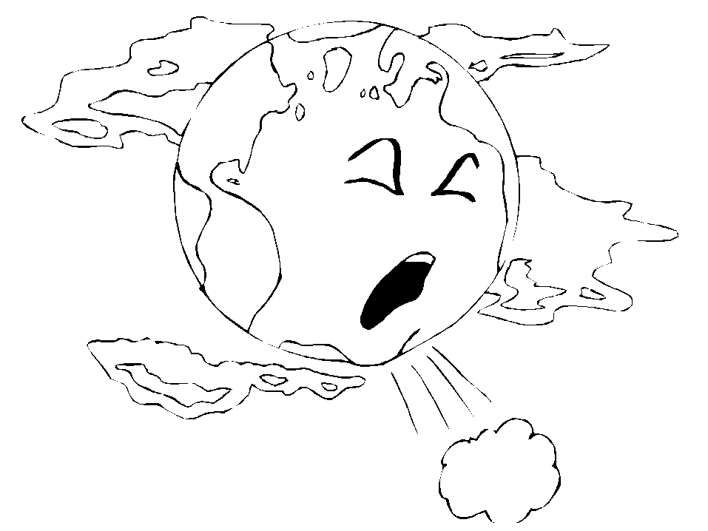
Recently the situation has deteriorated so much
that many areas of ecological disaster declared areas.

Slide 3
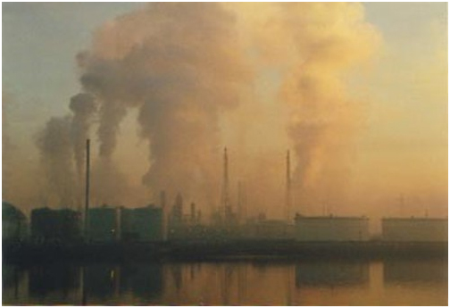
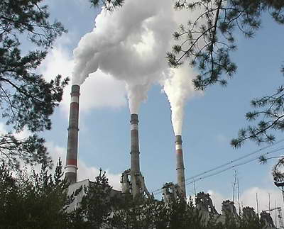
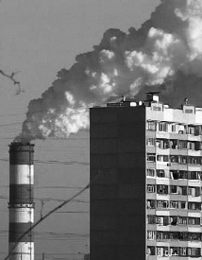
The main sources of waste are chemical, machinery, fuel and energy, construction industries, agriculture and areas of communal services. The largest amount of waste produced by the chemical and engineering industries.

Slide 4
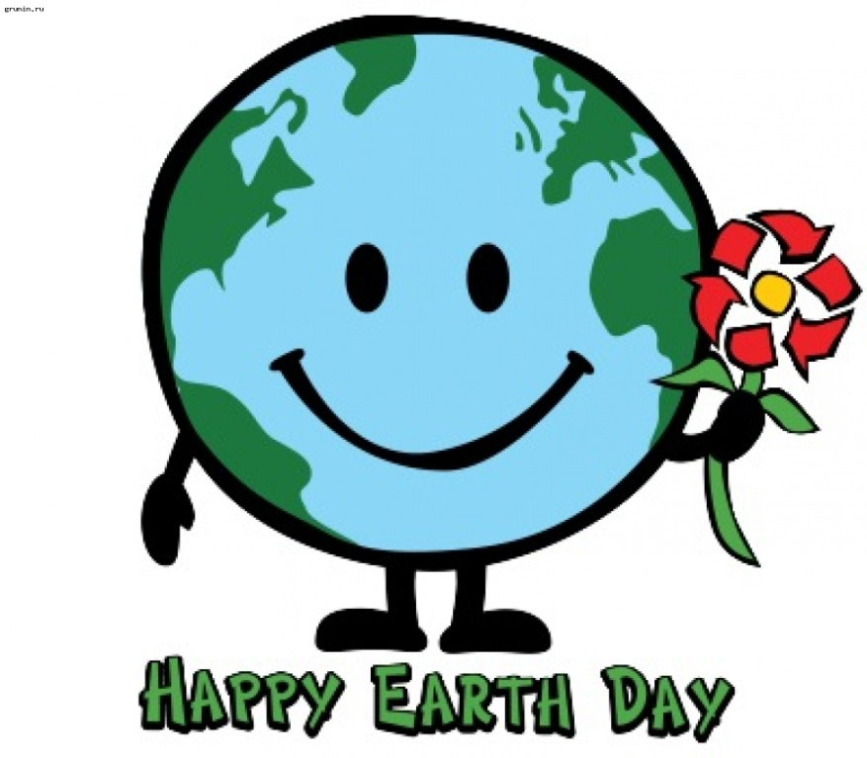
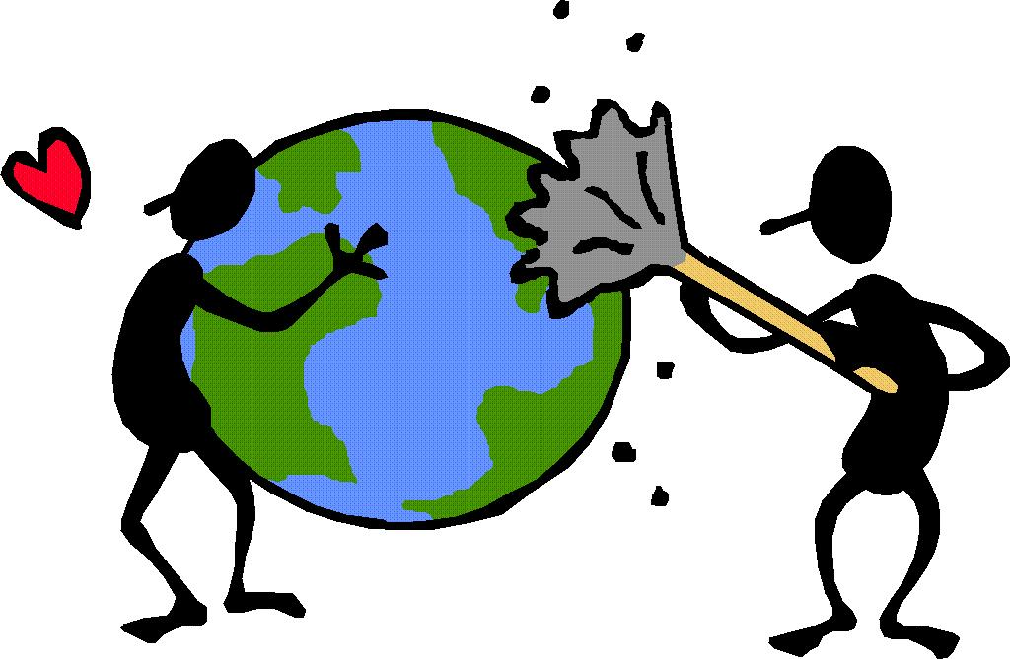
Earth Day - the name that you can use for various activities that are conducted in the spring to encourage people to be more attentive to the fragile and vulnerable environment of planet Earth.

Slide 5
Earth Day - a civil initiative, open to accession by any individuals, groups and organizations.

Slide 6
The original Earth Day, on the March equinox
Earth's global holiday
Drawing together peoples of all nations, cultures, and religions
To advance Peace, Justice, and Earth Care

Slide 7
The symbol of the day is green Greek letter (theta) on a white background.

Slide 8
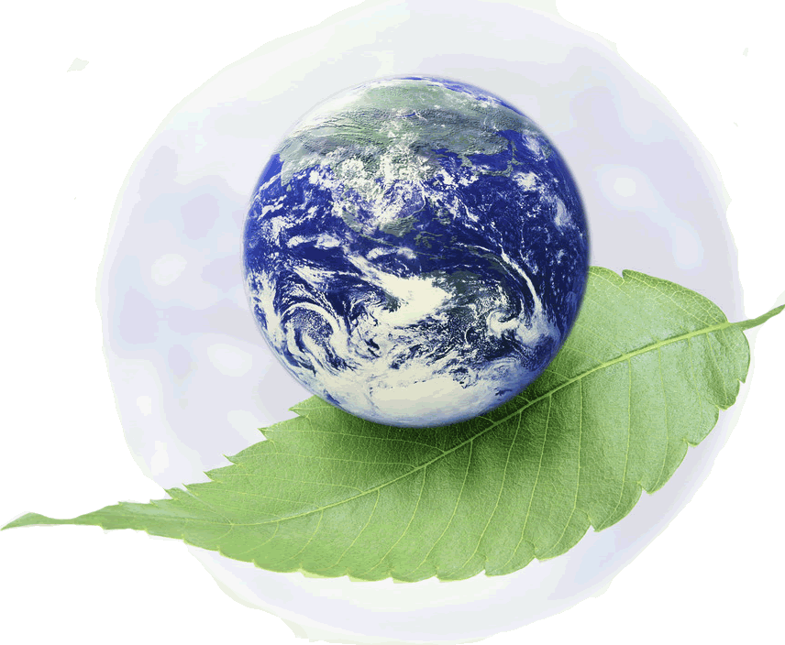
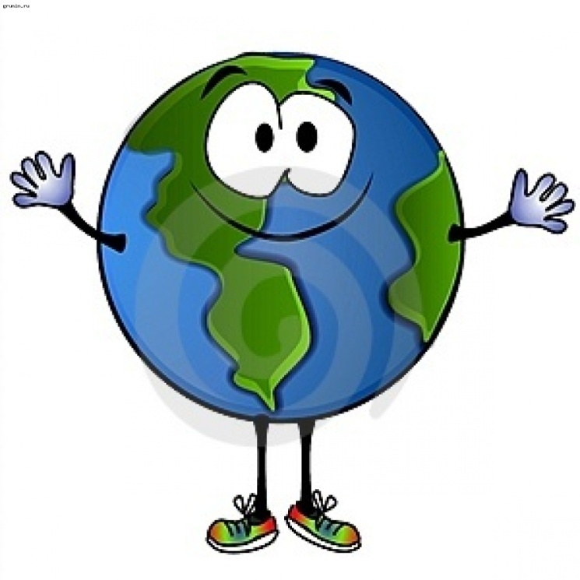
Bell of Peace in Earth Day On Earth Day in different countries, according to tradition, the bell ringing for peace, calling on the people of
Earth feel the planetary community and make efforts to protect world peace and to preserve the beauty of our common home.

Slide 9
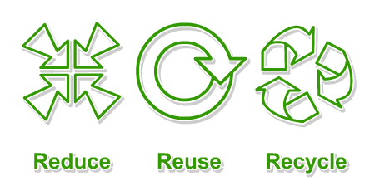
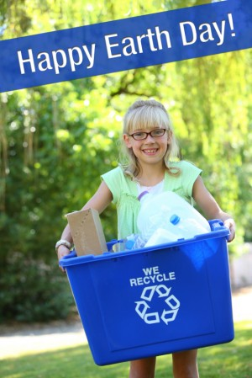

Slide 10
Bell of Peace - a symbol of peace, peaceful life and friendship, eternal brotherhood and solidarity of nations. At the same time - a call to action in the name of peace and life on Earth, save the Man and Culture.

