Slide 1
The Irish People

Slide 2
Introduction
The Irish people are an ethnic group who originate in Ireland, an island in northwestern Europe. Ireland has been populated for around 9,000 years.

Slide 3
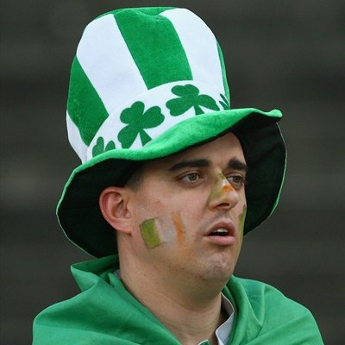
Shamrocks
The Irish national holiday – St. Patrick’s Day. This man has a hat with an Irish symbol – shamrocks.

Slide 4
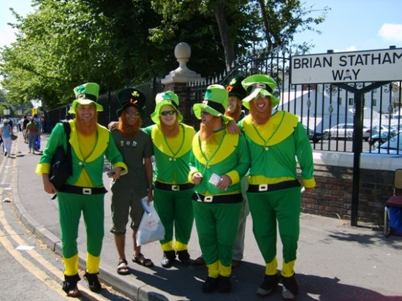
Friendship in Ireland
This people can demonstrate us well that Irish are very friendly nation.

Slide 5
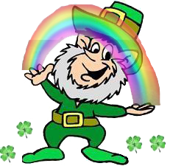
The Leprechaun
A leprechaun is a type of fairy in Irish folklore, usually taking the form of an old man in a green coat.

Slide 6
The end! ☺

