Slide 1
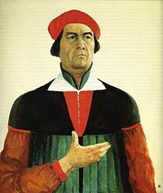
Kazimir Severinovich Malevich
Self-portrait, 1933

Slide 2
biography
Kazimir Malevich was born in 23 February 1879 to a Polish family who settled near Kiev.
Kazimir father managed a sugar factory. Kazimir was the first of fourteen children. His family moved often and he spent most of his childhood in the villages of Ukraine.
He studied drawing in Kiev form 1895 to 1896. then he studied in Moscow, there he was influenced by the works of avant-garde painters, he absorbed cubist principles and began using them in his works and he is known as a pioneer of geometric abstraction.
He exhibited his works in Poland, Germany and they finaly brought him international recognition.
Kazimir Malevich died in 15 May 1935 in Leningrad.

Slide 3
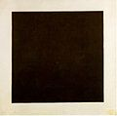
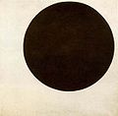
Gallery
Black Square, c.1923
Black Circle, 1915

Slide 4

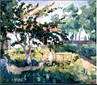
Flower Girl, 1903
Summer Landscape, 1929

Slide 5
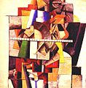

Portrait of Matiushin, 1913
Englishman in Moscow, 1914

Slide 6
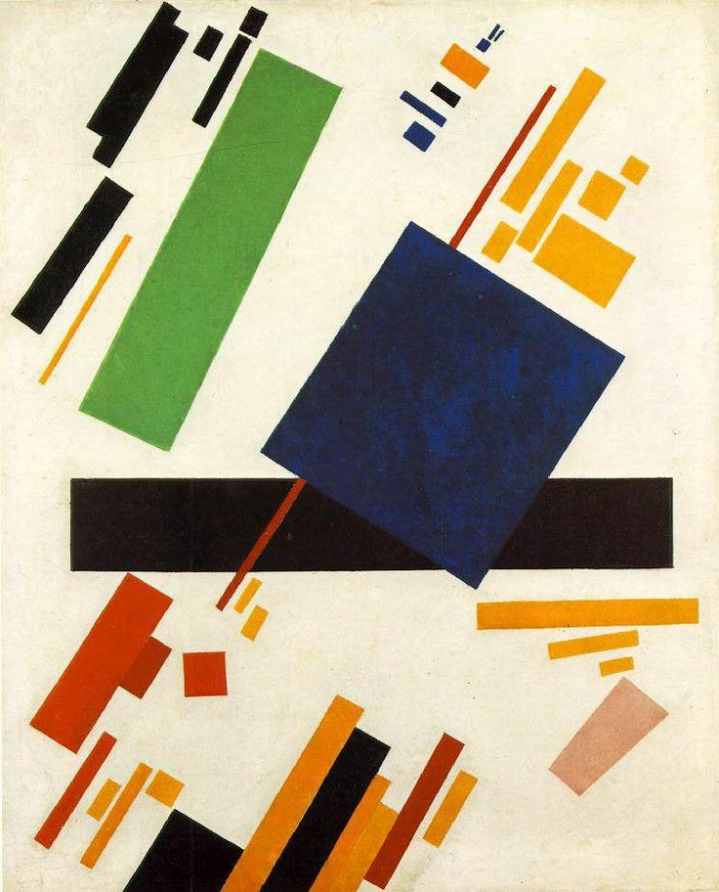
Malevich works are held in several major art museums in Moscow, in New York in Amsterdam and in Greece.
In 2008 a work by Malevich entitled Suprematic Composition from 1916 was sold at Sotheby`s in New York for just over 60 million dollars

