Slide 1
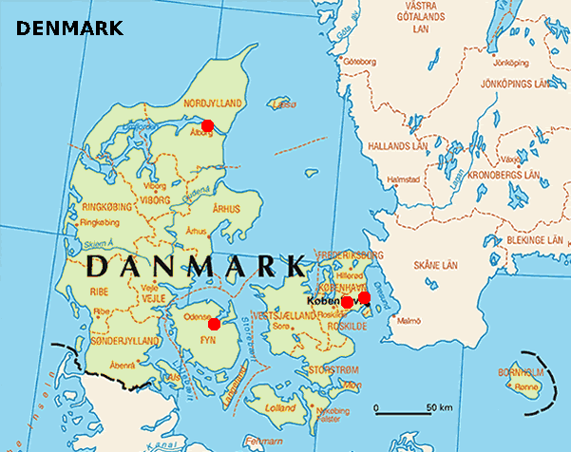
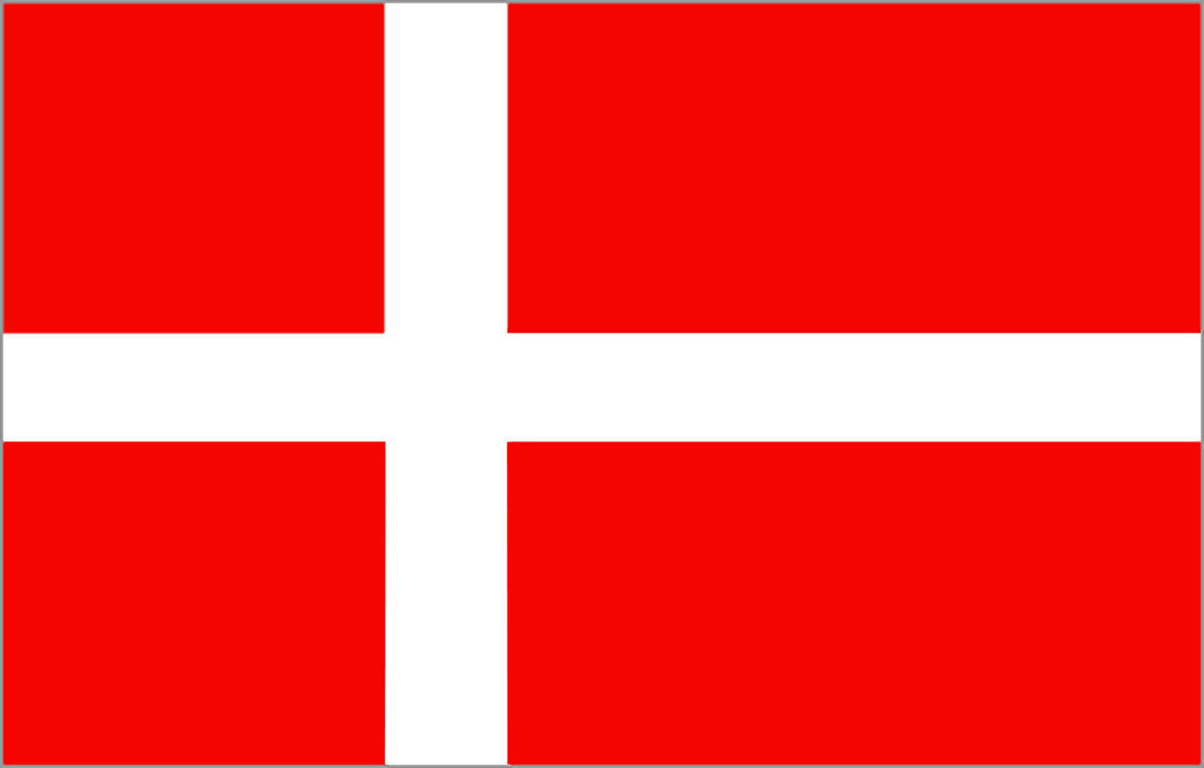
Facts about Denmark

Slide 2
Land & People

Slide 3
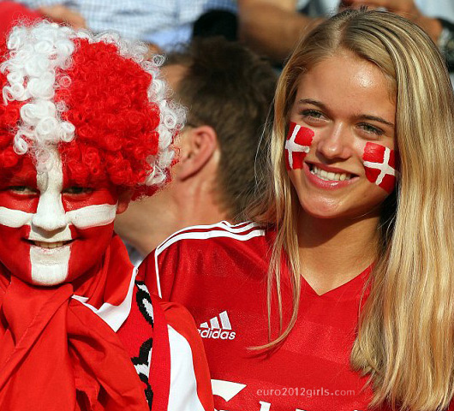
According to the WHO (2002 stats), Danish women have the lowest incidence of obesity in the EU.

Slide 4
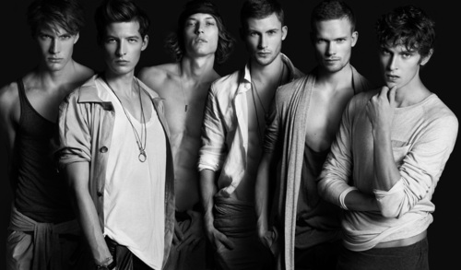
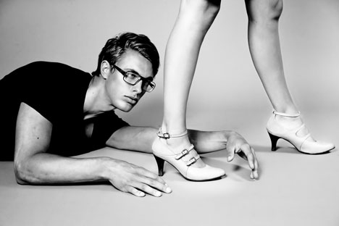
Danish men marry the oldest of all Europeans - at 32 years old in average.

Slide 5
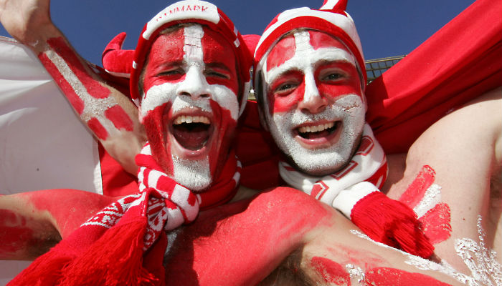
Separate studies have ranked Danish people as the happiest in the EU (2007 Cambridge University study), and happiest people in the world (2006 Leicester University study) or 2nd happiest in the world (World Database of Happiness 2000-2009).

Slide 6
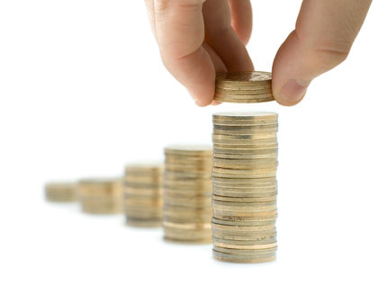
Danish people have the lowest income inequality in the world, with a Gini index of 24.7 in 1997.

Slide 7

The World Audit ranks Denmark as the world's most democratic and least corrupted country in 2008. It is also second for freedom of press.

Slide 8
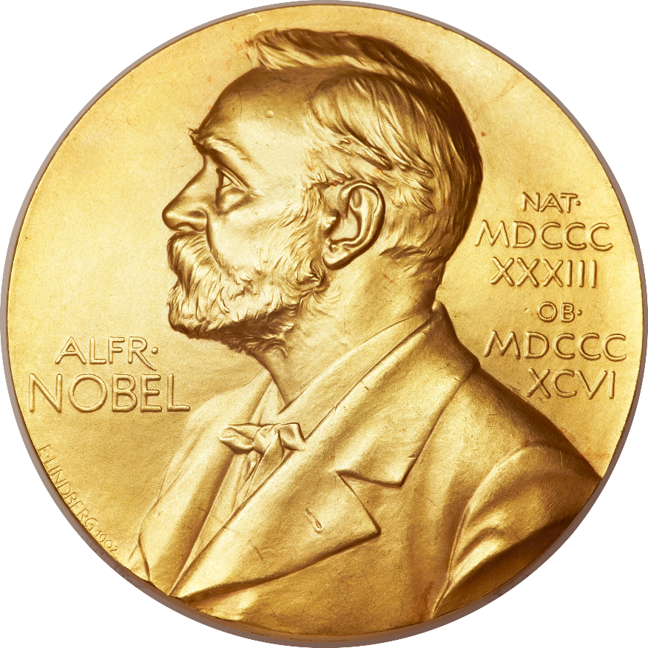
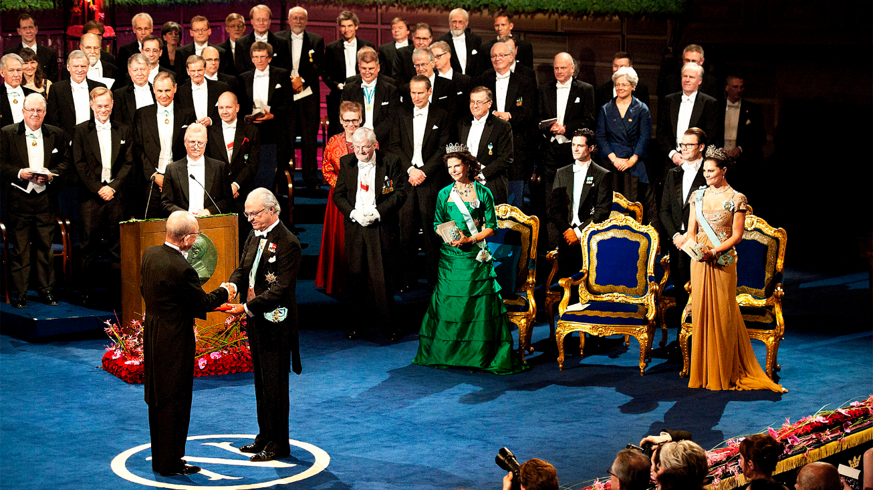
Denmark has had no less than 14 Nobel laureates, including 4 in Literature, 5 in Physiology or Medicine, and one Peace prize. With its population of about 5 million, it is one of the highest per capita ratio of any country in the world.

Slide 9
History & Culture

Slide 10
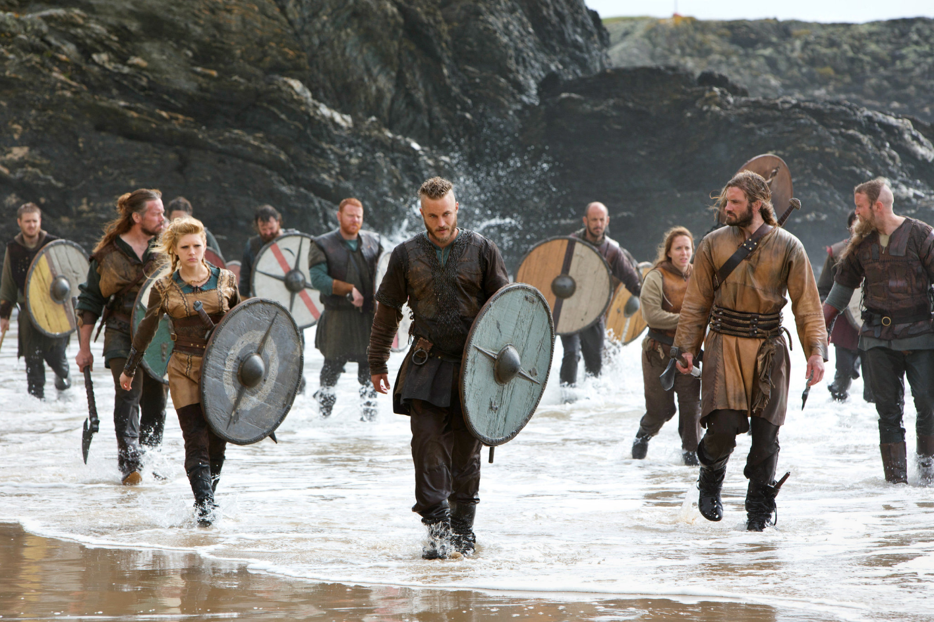
Denmark is the homeland of the Germanic ethnicity and culture. The Franks, Burgundians, Jutes, and the Norses (Vikings) all trace their origin back to Denmark.

Slide 11
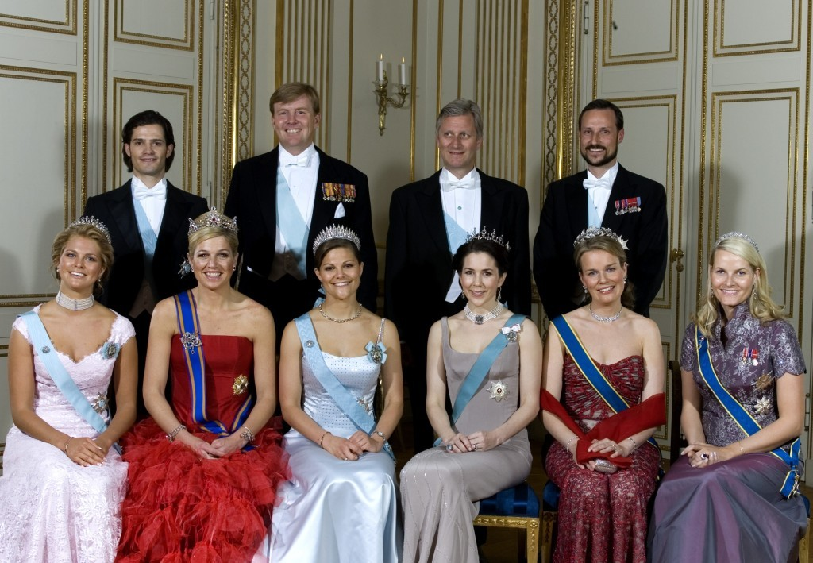
The Danish royal family is probably the oldest uninterrupted European monarchy. Gorm the Old, the first king of the "official line", ruled from 934 C.E.

Slide 12
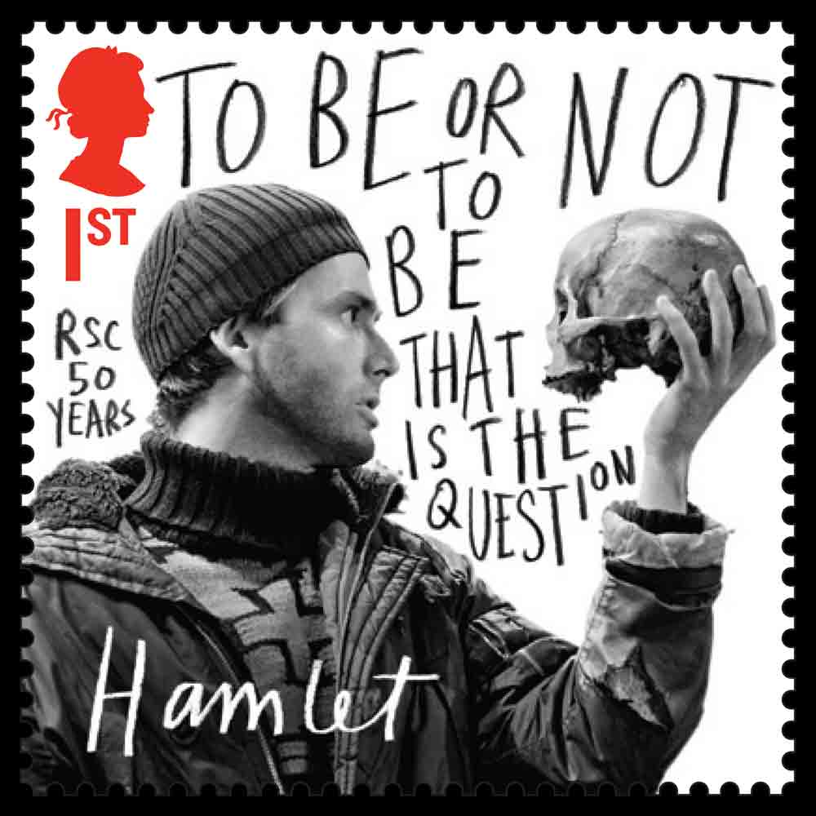
The Danish prince Hamlet, the fictional character of William Shakespeare's famous play, was inspired by an old Danish myth of the Viking Prince Amled of Jutland

Slide 13
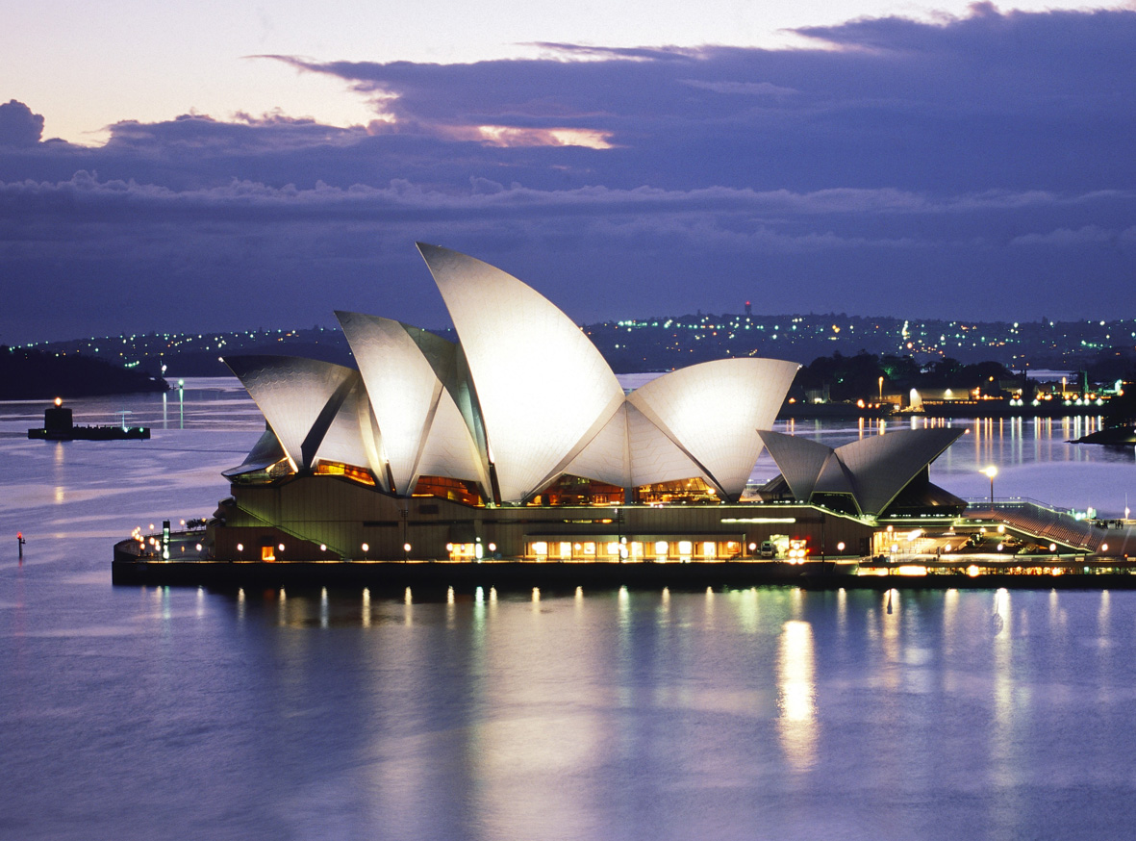

The architect of the iconic Sydney Opera House was the Dane Jørn Utzon (1918-2008). In 2007, he became only the second person to have his work recognised as a World Heritage Site while he was still alive

Slide 14
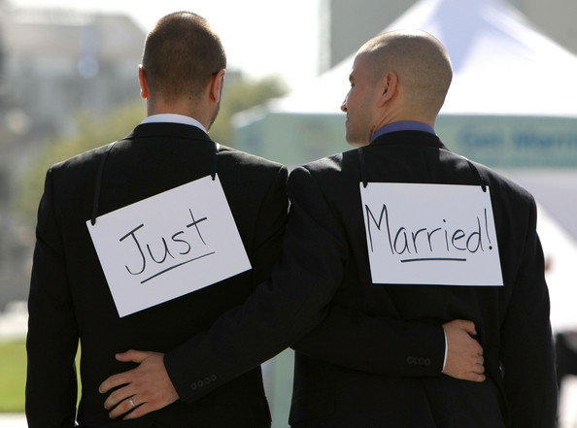
In 1989, Denmark became the first country to legalise same-sex unions (although same-sex marriage was not granted until 2012)

Slide 15
Business & Economy

Slide 16
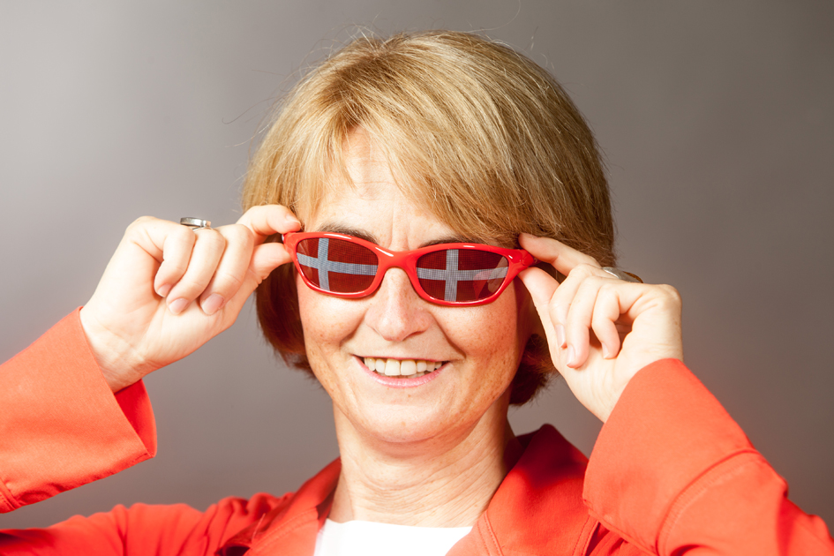
Denmark has the highest employment rate in Europe (75%)

Slide 17

In 2012 Denmark enjoyed the 2nd highest nominal GDP per capita in the European Union. At purchasing power parity (PPP), Denmark was ranked in 8th position within the EU.

Slide 18
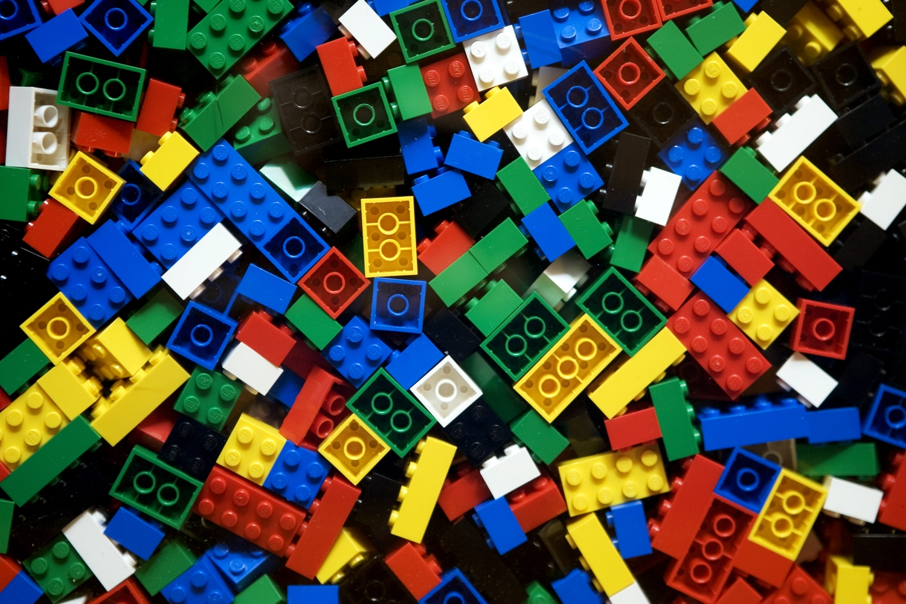
The world famous building toys Lego are from Denmark

Slide 19
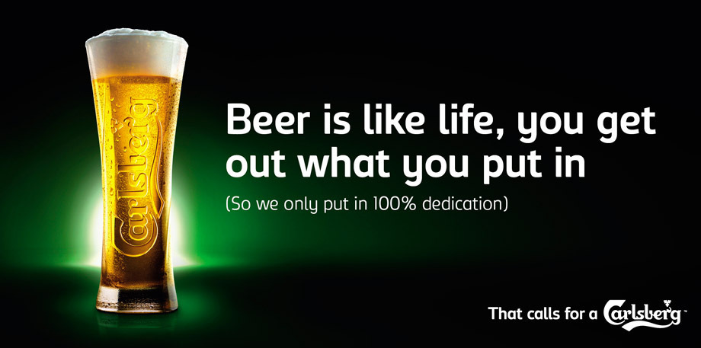
Carlsberg and Tuborg are two of the most famous Danish beer brands

Slide 20
THANK YOU FOR YOUR ATTENTION!

