Slide 1
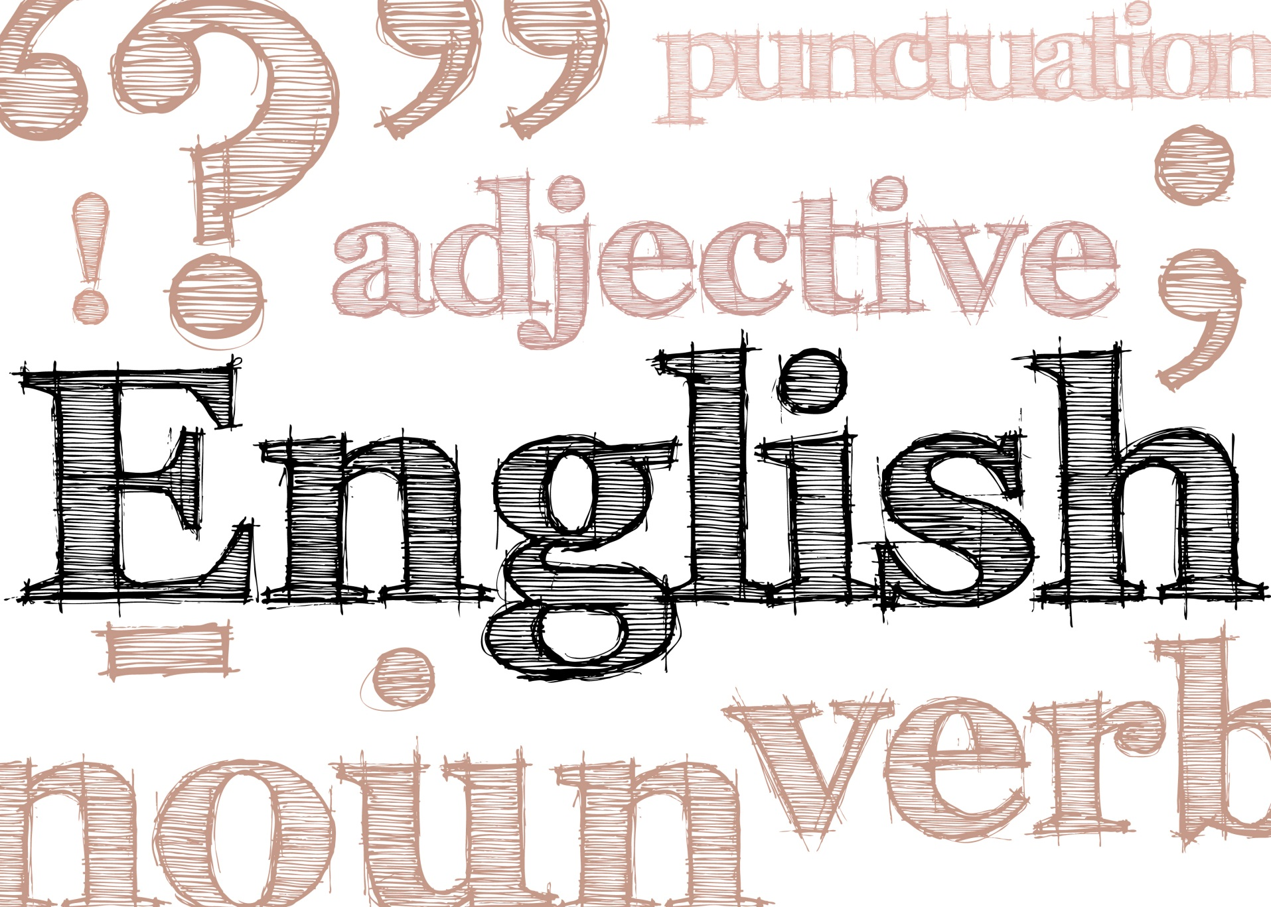
Translator

Slide 2
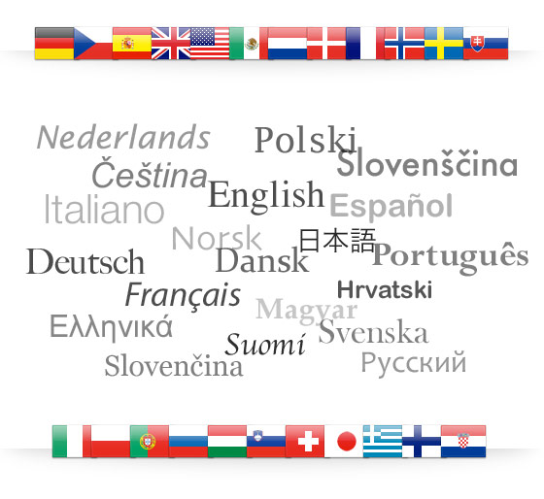
Translators convert written material from one or more 'source languages' into the 'target language', ensuring that the translated version conveys the meaning of the original as clearly as possible. The target language is normally the translator’s mother tongue.

Slide 3

Transcreating may also be part of the job and is a mix of translation, localisation and copywriting, where the text is culturally and linguistically adapted to suit the reader.

Slide 4

Translators work on:
scientific;
technical;
commercial;
literary;
legal;
and educational documents.

Slide 5
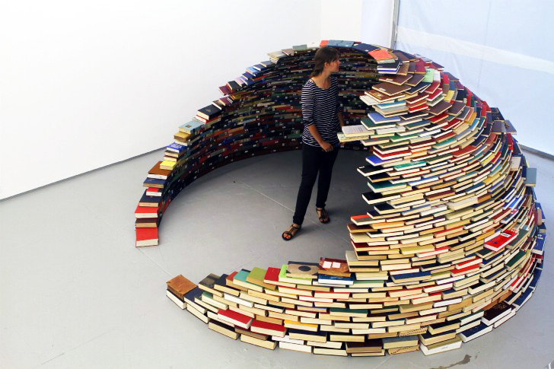
Most translators work freelance from home, either for translation agencies or directly for clients, although some organisations employ in-house translators.

