Slide 1
Underestimated places in Ukraine

Slide 2
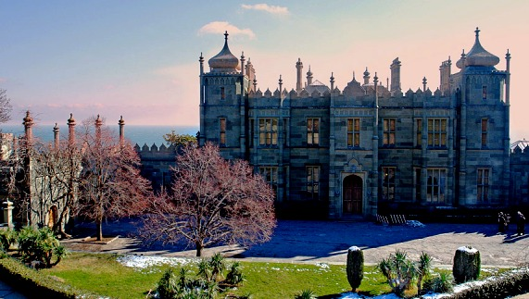
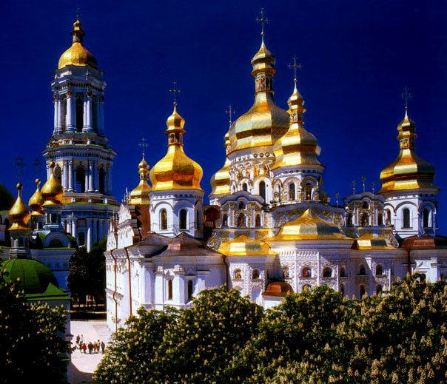
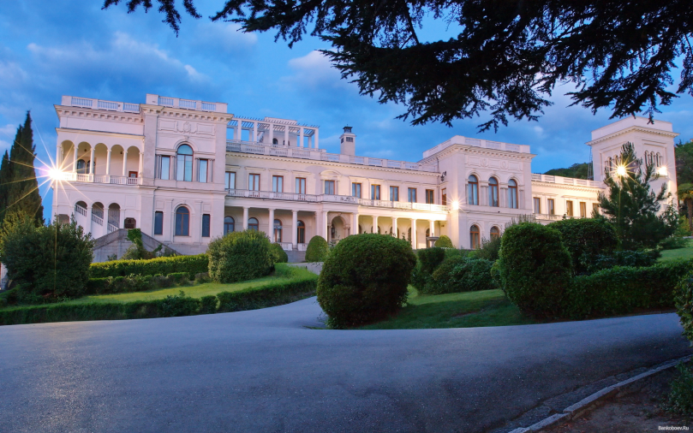
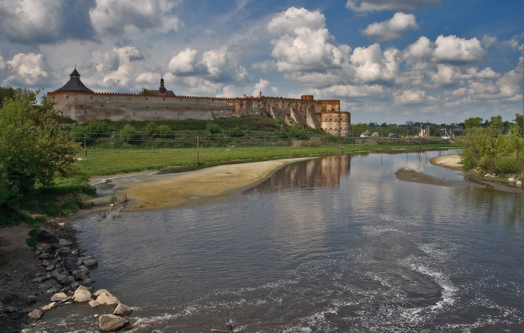
Everyone who loves Ukraine visited places such as: the Kiev-Pechersk Lavra, the Vorontsov Palace, the Medzhybizh Fortress, the Livadia Palace. I can list many more popular destinations, but I want to tell you about the most underestimated places in Ukraine in my opinion.

Slide 3
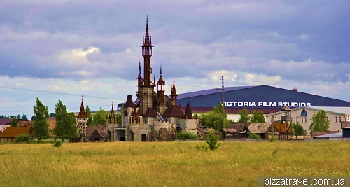
Fairytale castle near Kiev
Victoria Film Studios
Where located: | If you go to Kiev to Zhitomir highway, turn right, 700 meters from the road
Why visit: | many beautiful photos A lot of interesting sceneries amazing sculptures It is like little Disneyland in Ukraine☺
Cons: | It is forbidden to go inside the castle

Slide 4
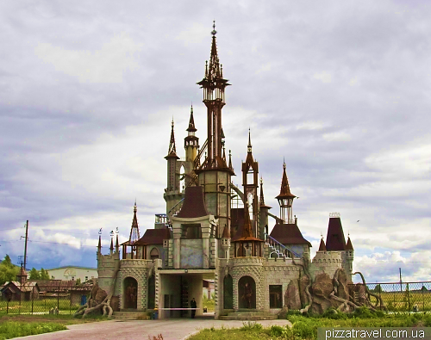

Slide 5
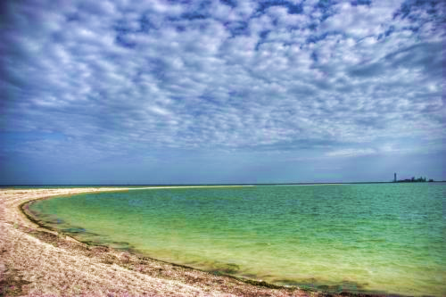
A Small Island
Biruchiy island(also here the Azov-Syvash National Park)
Where located: | Spit in the Sea of Azov
Why visit: | The coastline reminds a tropical resort Beach and the island very clean If you're lucky, you can see the local horses and deer Many beautiful photos
Cons: | you must be here only with a guide☹

Slide 6
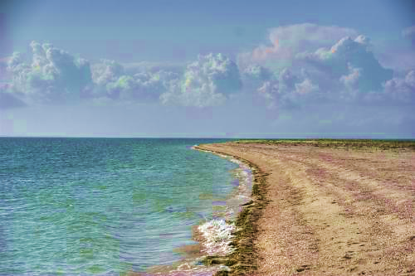

Slide 7
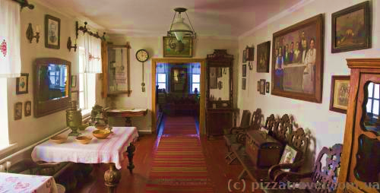
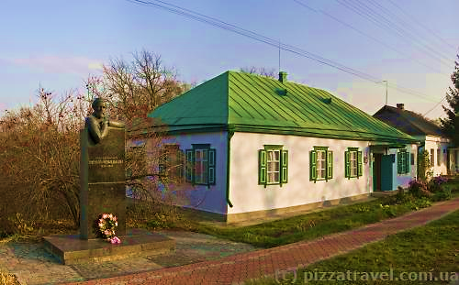
Manor Ukrainian writer Ivan Nechuy-Levytsky
Stebliv
Where located: | Cherkasy region
Why visit: | interesting museum breathtaking waterfall spectacular views of the river Ros very beautiful sunsets
Cons: | no cons ☺

Slide 8
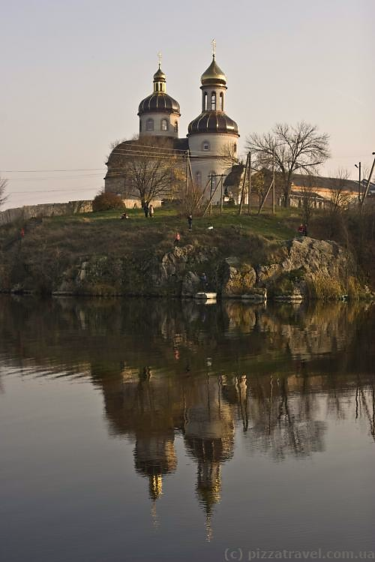
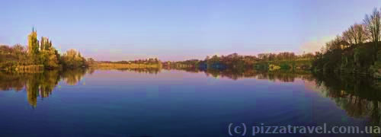
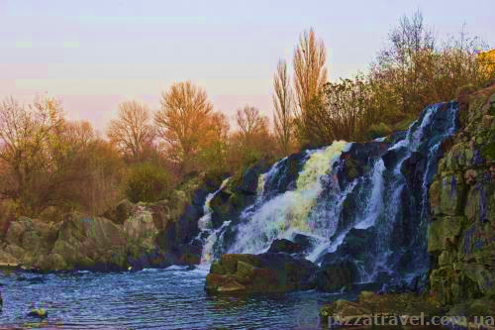

Slide 9
I hope you enjoy these amazing places! And I will be pleased If you visit these gorgeous architecture building and other. Love our country and we should know all our underestimated places!

Slide 10
Thank you for your attention!!
Made by Bonk Veronika 11-A

