Slide 1
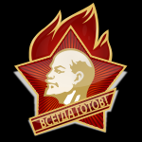
Organizations in the Soviet Union

Slide 2
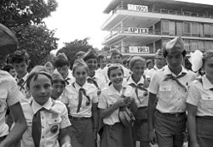
The main goals and duties of Young Pioneers and requirements of membership were specified by the Regulations of the Young Pioneer organization of the Soviet Union
On May 19, 1922 the second All-Russian Komsomol Conference adopted the scoutmasters' suggestions and decided to "work on the question of a children's movement by using the re-organized system of scouting.“ May 19, 1922 was later on considered the birthday of the All-Union Pioneer Organization

Slide 3
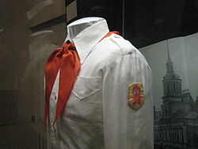
Structure
children of 10–11 years were called Young Pioneers of the first stage; 11–12 years were Young Pioneers of the second stage; 13–15 years were Young Pioneers of the third stage. At age 15, Young Pioneers could join Komsomol, with a recommendation from their Young Pioneer group.
The main governing body was the Central Soviet of the Young Pioneer organization of the Soviet Union, which worked under the leadership of the main governing body of Komsomol.
Its official newspaper was Pionerskaya Pravda.

Slide 4

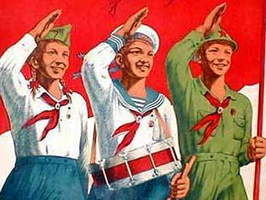
The main symbols of Young Pioneers were the red banner, flag, Young Pioneer's red neck scarf and the organizational badge. Attributes: the bugle, the drum, the organizational uniform (with badges of rank). Some rituals and traditions of the organization were: the Young Pioneer salute, Young Pioneer parade, color guard duty and flag raising. Most common traditions were the Young Pioneers rally (usually round a bonfire, similar to Scout Jamborees) and festivals.

Slide 5
