Slide 1
Presentation
"The National Portrait Gallery in London"
Form 10

Slide 2
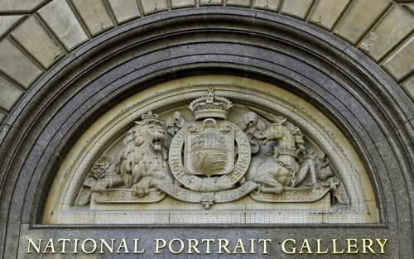

Slide 3
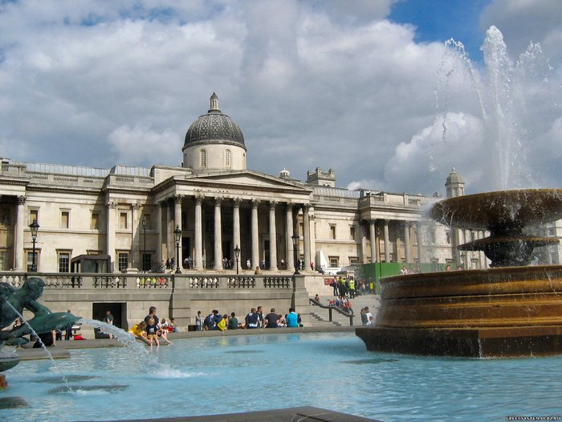

Slide 4
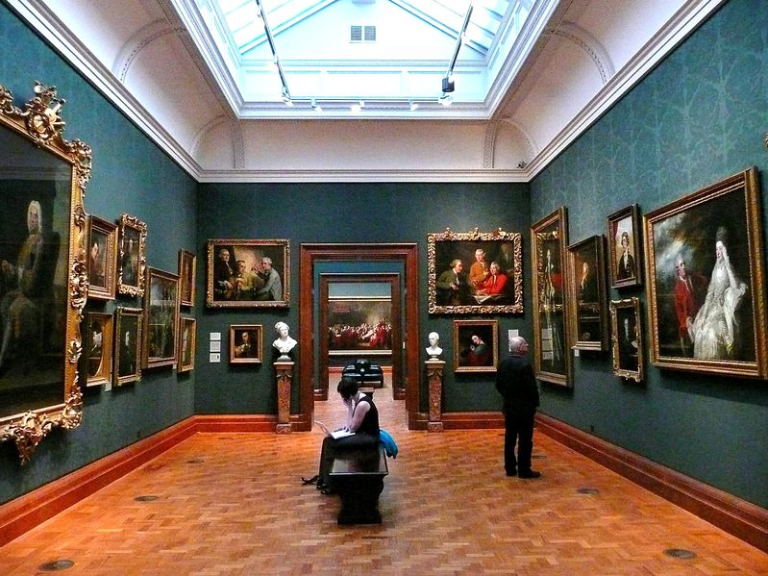
National Portrait Gallery in London - is an art gallery in London, founded in 1856, which exhibited portraits, miniatures, paintings, busts and photographs (Photo Gallery) famous and well known British. Since 1896 the National Portrait Gallery is a neo-Renaissance building in the square of St. Martin

Slide 5
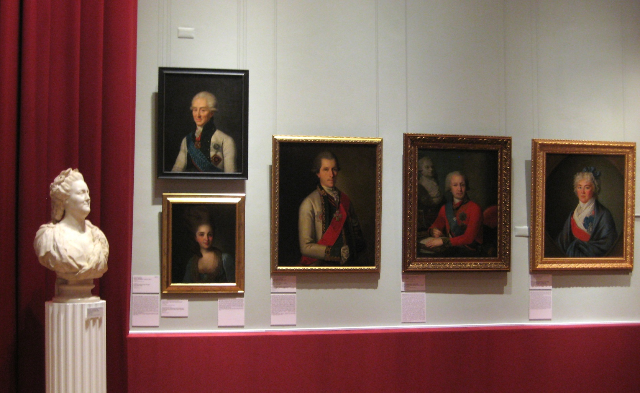
Gallery opened its doors to visitors in 1859. Portraits distributed through the halls on the basis of lifetime individual depicted on them , starting with the Tudor . When replenishing meeting preference not artistic merit works, and historical and cultural significance of the model. In this connection, until 1969 operated a ban on the purchase of portraits of those Britons who have not yet died . Works by famous artists in the gallery Continental few , mostly portraits of British monarchs and their courtiers brush Holbein , Rubens and Van Dyck .

Slide 6
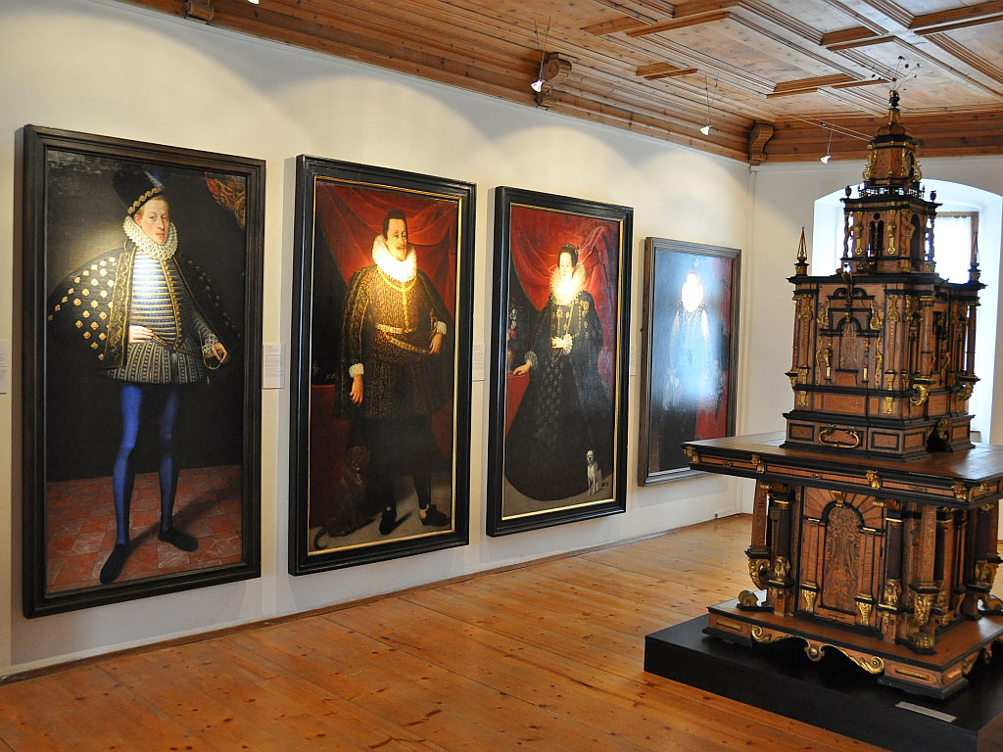
Will interesting National Portrait Gallery children? Certainly, if the adults will give the names of those who submitted to the paintings. After all, if the lessons of history before the children only heard the names of the heroes of the past centuries: kings and queens, generals, scientists, artists and sculptors, now these persons in the child's perception "will find the person" will be perceived not "pages of history," but real people ..

Slide 7
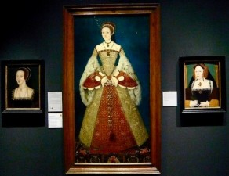
Better to start viewing the collection from the top floor (which take the elevator) - so it will be chronologically correct. In this case, you start with the portraits of the Tudors, and then, walking down century after century familiar with all the prominent characters .

Slide 8
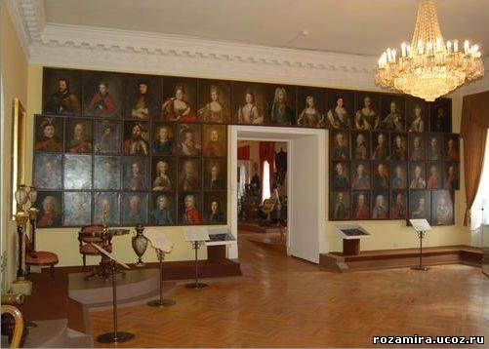

Slide 9
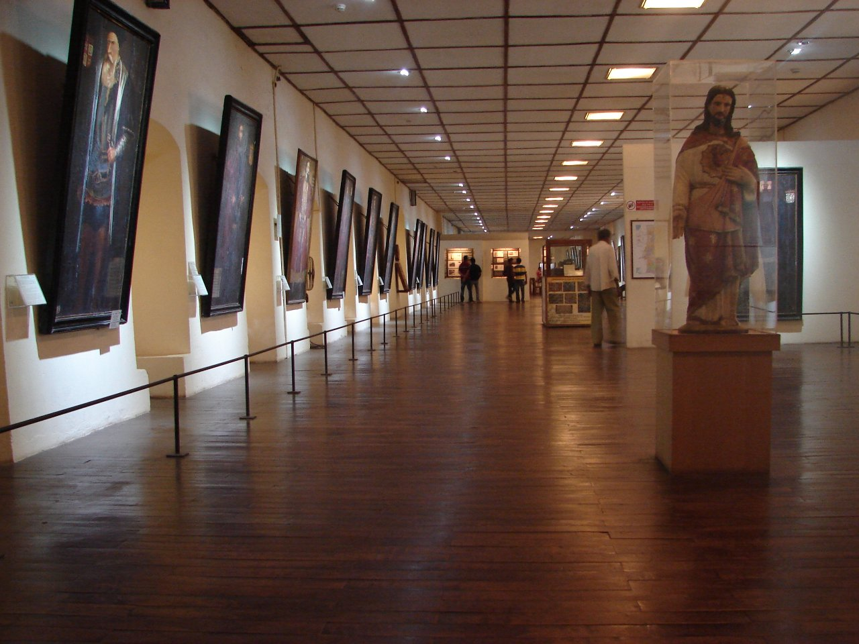

Slide 10
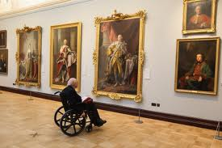
In general, the National Portrait Gallery in London will be interesting, inspection exposure should take you at least an hour ..

Slide 11
