Slide 1
What should be a five-star hotel?

Slide 2

Tourism is impossible without hotels. This truth is known to every traveler. However, very often the case that the room price is irrelevant to the service of the hotel.

Slide 3
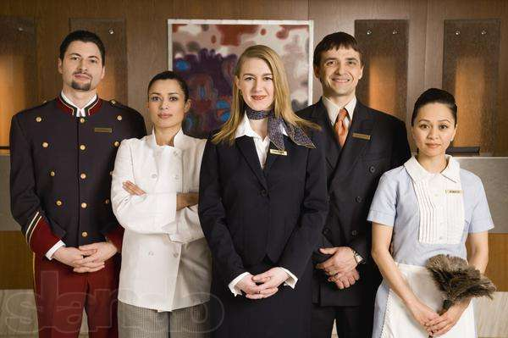
So, the five-star hotel, first of all, the staff is highly qualified. It depends on the staff half the success of a hotel. Hotel workers, whether doorman, maid or administrator must know the answers to all the questions of guests.

Slide 4

Maximum courtesy and smiles - it is two qualities that should be possessed every person working at the hotel. It is important that the personnel it was perfect.

Slide 5
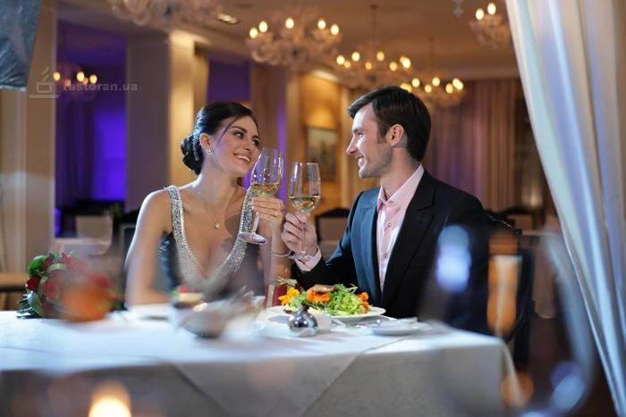
Hotel, awarded five stars, must work around the clock. Even if the guest wants to eat at three in the morning, the hotel and restaurant staff should always be ready to serve the customer.

Slide 6

Good tone for the five-star hotel - fresh flowers. If you see a hotel in artificial bouquets, it is a chance to deprive it of one sprocket.

Slide 7
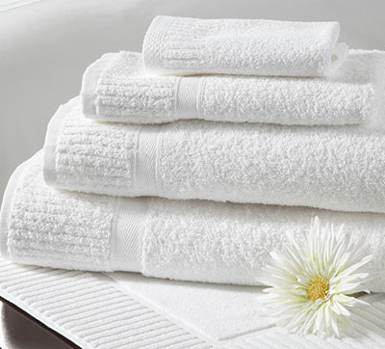

Towels at the five-star hotels are changing at least twice a day, and the music and television should be present everywhere.

Slide 8

And finally, the most important thing: a hotel guest would never, under any circumstances, should not hear from the staff the word "no".

