Slide 1
Christmas Around the World
Christmas Traditions around the world and how Christmas is celebrated in different countries and cultures

Slide 2
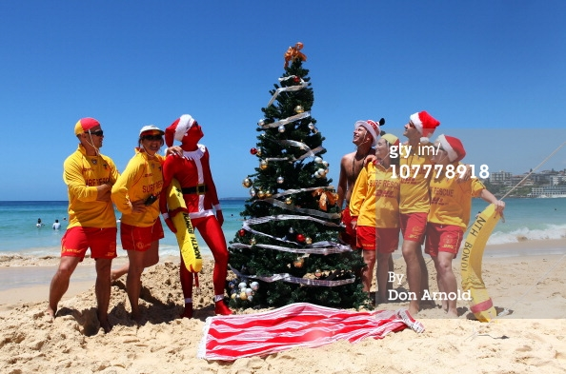
Christmas in Australia

Slide 3
In Australia, Christmas comes in the middle of the summer holidays! Children have their summer holidays from early to mid December to early February.
Australians hang wreaths on their front doors and sometimes go out Christmas carol singing on Christmas eve. People also decorate their houses and gardens with Christmas Trees and Christmas lights. Neighbors sometimes have little competitions to see who has got the best light display.
Most families try to be home together for Christmas and the main meal is normally eaten at lunch time. Most people now have a cold Christmas dinner, or a barbecue with seafood such as prawns and lobsters along with the 'traditional english' food. On Christmas Eve, fish-markets are often full of people queuing to buy their fresh seafood for Christmas day.

Slide 4
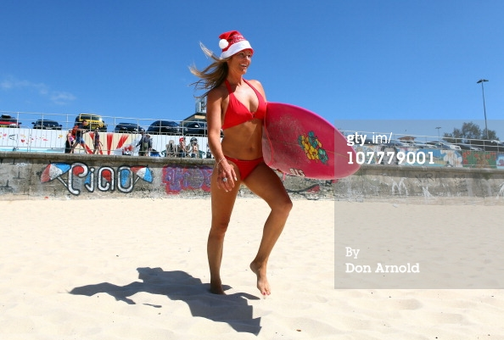

Slide 5
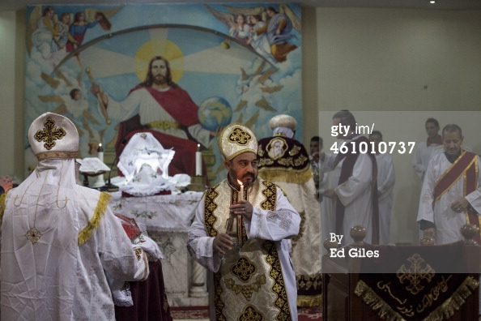
Christmas in Egypt

Slide 6
In Egypt about 15% of people are Christians.
Christmas Day celebrated on 7th January.
People sing special praise songs on Saturday nights before the Sunday Service.
When the Christmas service ends people go home to eat the big Christmas meal. All the foods contain meat, eggs and butter.
One popular course is 'Fata' a lamb soup which contains bread, rice, garlic and boiled lamb meat.
In Egypt, Santa is called Baba Noël (meaning Father Christmas). Children hope that he will climb through a window and will leave some presents!

Slide 7
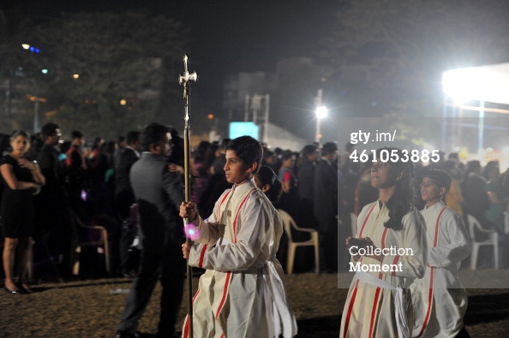
Christmas in India

Slide 8
Compared to other religious festivals, Christmas is quite a small festival in India, due to the number of people who are Christians (about 2.3%) compared to people who belong to other religions. Having said this, the population of India is over 1 Billion, so there are over 25 million Christians in India!
Instead of having traditional Christmas Trees, a banana or mango tree is decorated (or whatever tree people can find to decorate!). Sometimes people use mango leaves to decorate their homes.
In India, Father Christmas or Santa Claus delivers presents to children from a horse and cart.

Slide 9
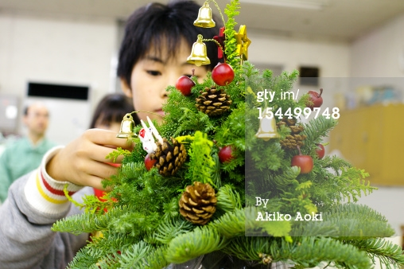
Christmas in Japan

Slide 10
Christmas is not widely celebrated in Japan as not many people there are Christians.
Christmas is not a national holiday in Japan, so schools and businesses are normally open on December 25th
The traditional Japanese christmas food is christmas cake, but it's not a rich fruit cake, but is usually a sponge cake decorated with strawberries and whipped cream.
The Japanese New Year is more like a traditional Western Christmas. New year is the period where families get together, have a special meal, pray and send greetings cards.

Slide 11
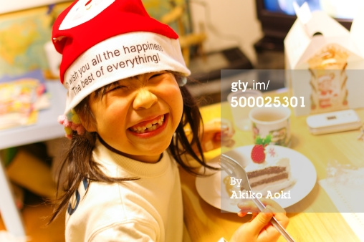

Slide 12
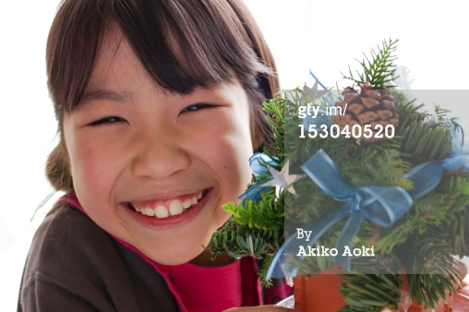

Slide 13
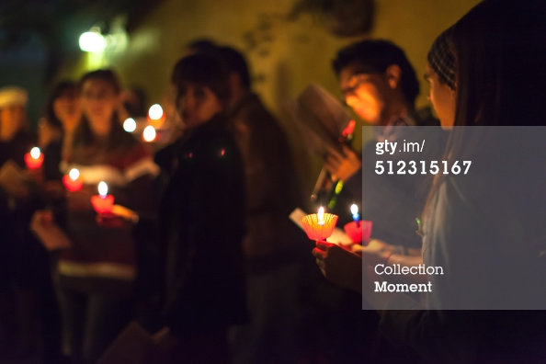
Christmas in Mexico

Slide 14
In Mexico, Christmas is celebrated from the December 12th to January 6th.
Christmas Trees are becoming more popular in Mexico.
Christmas Eve is a family day. People often take part in the final Posada and then in the evening have the main Christmas meal. There are lots of fireworks to celebrate Christmas Day.
It's traditional to eat a special cake called 'Rosca de Reyes' (Three Kings Cake) on Epiphany. A figure of Baby Jesus is hidden inside the cake.

Slide 15
