Slide 1
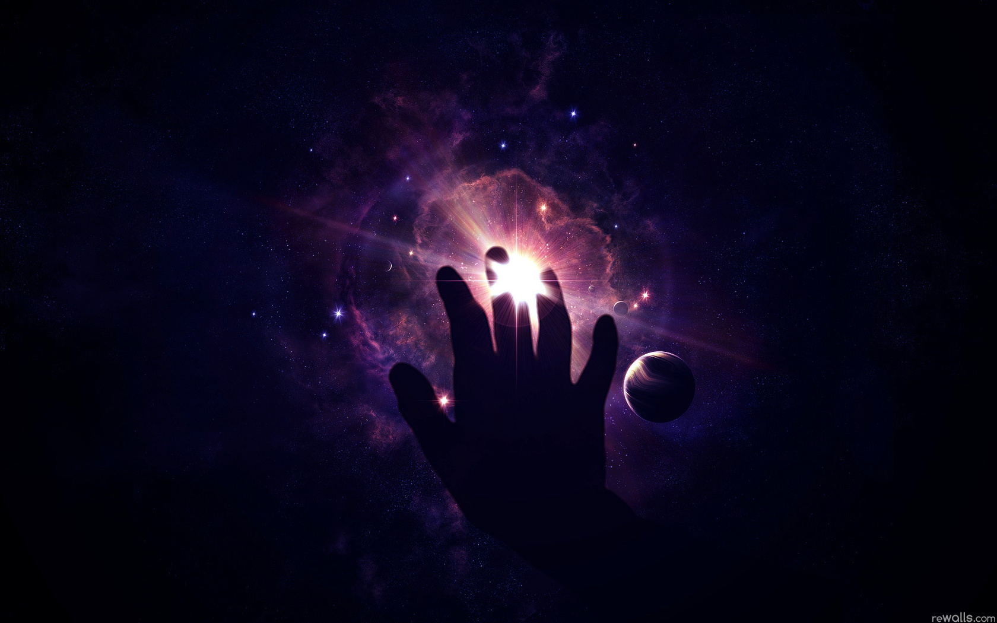
spaceships
Made by Marina Zimenko

Slide 2
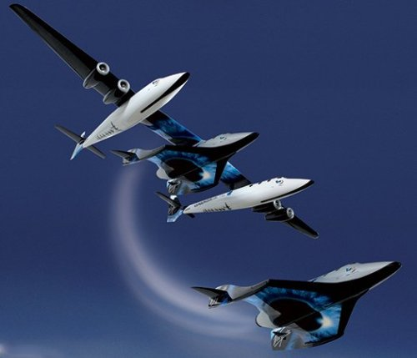
Manned Spaceship
Manned spaceship - a spaceship designed to fly people in space.

Slide 3
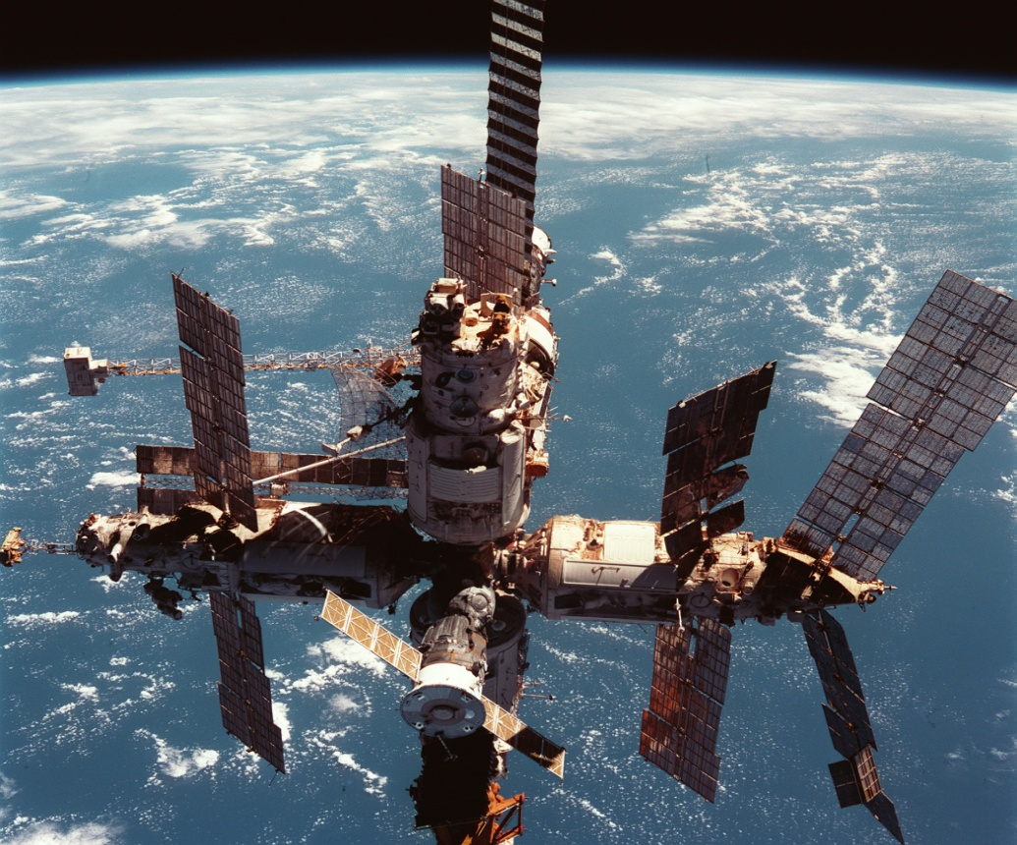
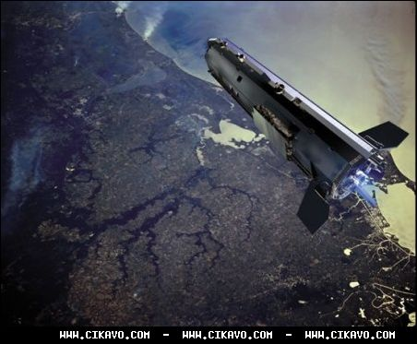
Types of spaceships
Manned spaceships to fly into orbit called the ships satellite and fly to other celestial bodies - interplanetary spaceships .

Slide 4
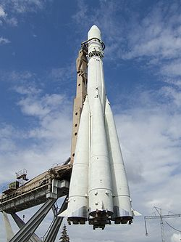
Spaceships of the first generation
Spaceships of the first generation are selected for the short flight around the Earth.
It was:
East
Sunrise
Mercury
Gemini
Shuguang

Slide 5
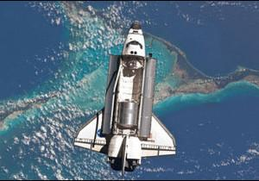
Spaceships of the second generation
Spaceships of the second generation are selected for long autonomous flight.
It was:
Union
Apollo
Shenzhou

Slide 6
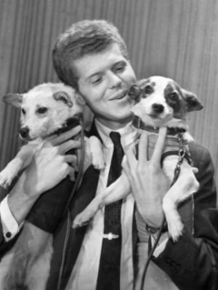
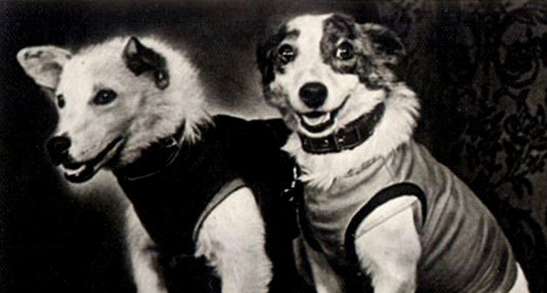
animals in space flight
20 August 1960 for the first time in the world animals, having been in space , returned to Earth.

Slide 7
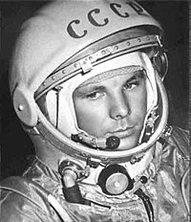
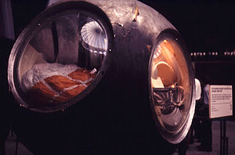
Yuri Gagarin - the world's first cosmonaut
Spaceship "Vostok"
Yuri Gagarin in space suit

Slide 8

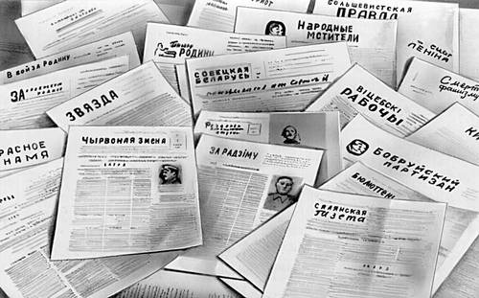
News today

Slide 9
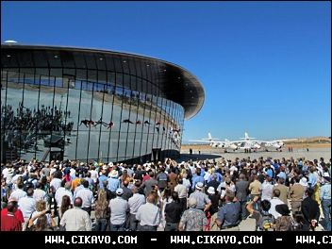
The company Virgin Galactic has opened the world's first commercial spaceport

Slide 10
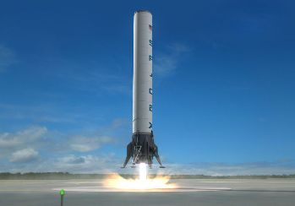
The company SpaceX made multiple space system

Slide 11
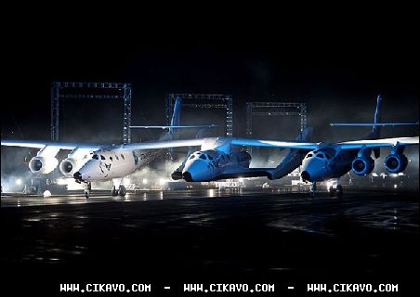
The company Virgin Galactic and British billionaire Richard Branson presented first private spacecraft “SpaceShipTwo”.

Slide 12
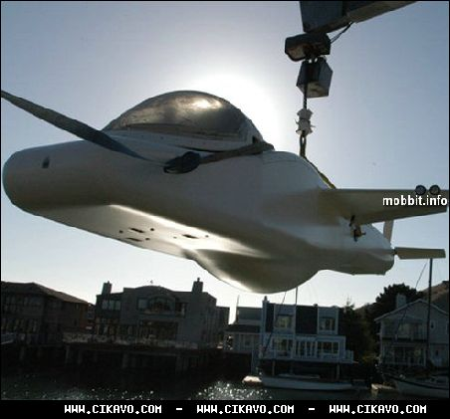
Deep Flight Challenger - submarine, aircraft and spacecraft in one

Slide 13


