Slide 1
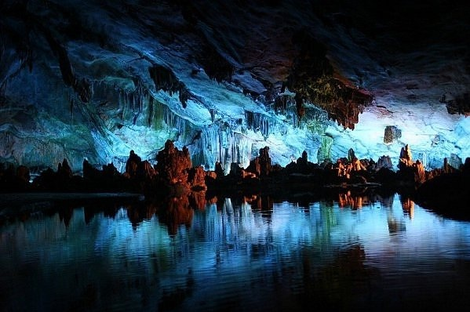
The Waitomo Caves
The Caves are located at the eponymous village in the North Island of New Zealand. They were formed about 30 million years ago.

Slide 2
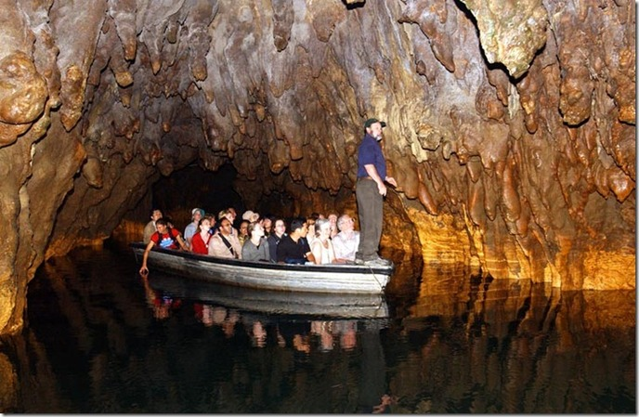
The Caves consist of three levels.
On the upper level you can see the catacombs.

Slide 3
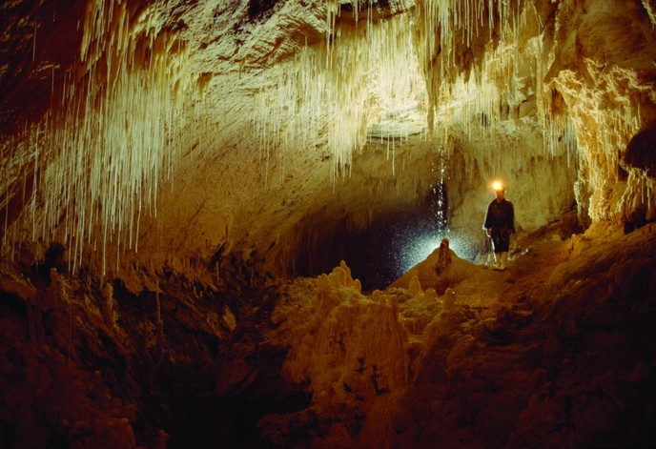
Your tour proceeds along a low narrow passage to the Tomo, a deep limestone shaft. The deepest layer is called the Cathedral.

Slide 4

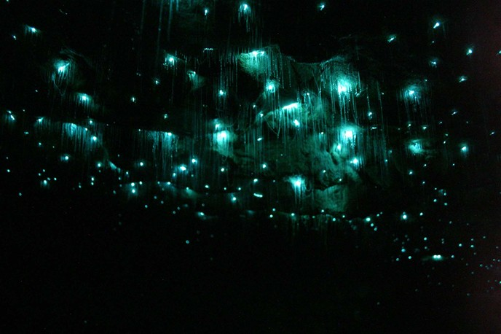
The acoustics in this particular cavern are world-renowned. Acclaimed New Zealand Diva, Dame Kiri Te Kanawa, has sung here and was delighted with the purity of the sound.

Slide 5
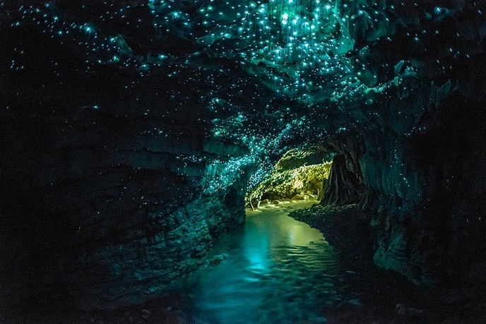
The highlight of your tour is an unrivalled boat trip through the spectacular Glowworm Grotto.

Slide 6
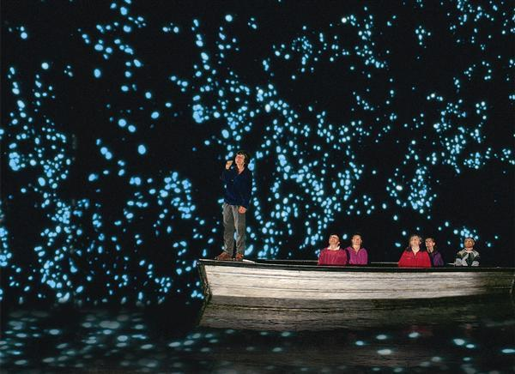
As you enter this galaxy of tiny living lights, you'll immediately experience a serene ambience and be fascinated and intrigued by tiny glowworms that light your way.

